Slide 1

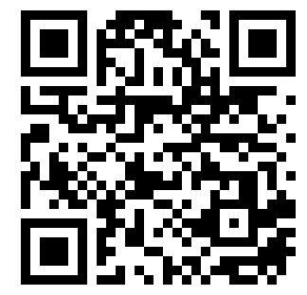
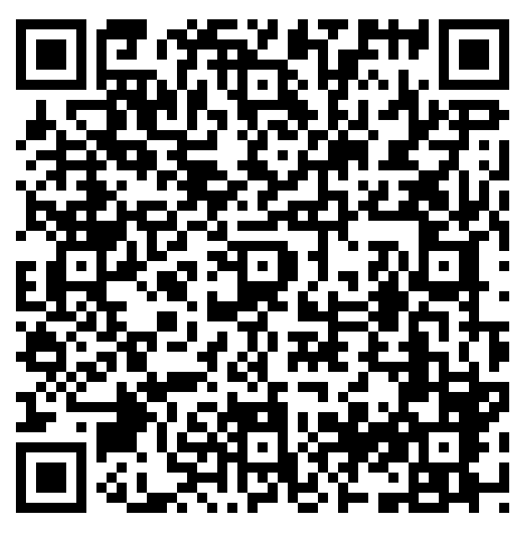
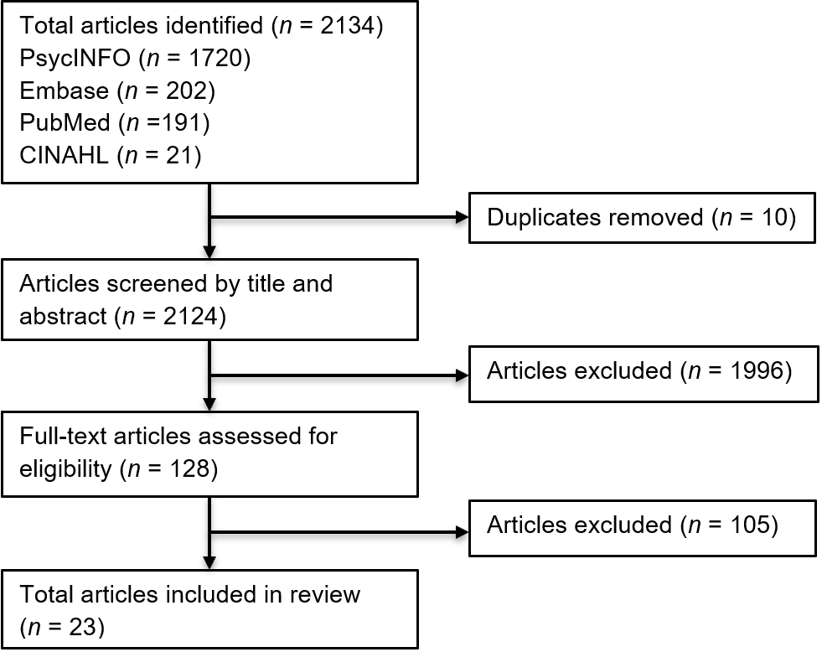
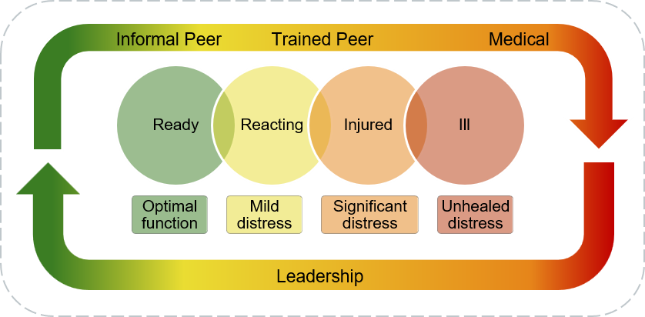
Expanding Psychological Health Support Capacity in Large-Scale Combat Operations:
The Role of Non-Specialty Personnel
Maj Felicia N. Katzovitz, PhD, RN-BC & MAJ Julia G. Catanese, PhD, RN, CNOR, CHSE
Daniel K. Inouye Graduate School of Nursing, Uniformed Services University of the Health Sciences (USUHS)
CONNECT
PUBLICATION
BACKGROUND
METHODS
STUDY CHARACTERISTICS & RESULTS
Large-scale combat operations (LSCO) could challenge military mental healthcare delivery
Contested, austere environments may disrupt:
  Resource availability
  Network connectivity and communication
  Evacuation timelines
  Access to specialty mental healthcare
Operational constraints may require scalable psychological support approaches
Scoping review using:
  Arksey & O’Malley 5-stage framework
  PRISMA-ScR guidelines
  Covidence review tool
Articles (n = 23) published 2000 – 2024
  Countries: US, UK, Israel, Syria, Norway, Australia, Palestine, & Sweden
  Settings: Military, disaster services, training, civilian medical, police, & public health
Interventions organized into flexible tiers & mapped on the stages of Stress Continuum Model (i.e., Ready, Reacting, Injured, & Ill)
    Leadership: All (Ready – Ill) zones
      Psychological First Aid
      Battle Buddies
    Informal Peer: Ready – Reacting zones
      Wingman-Connect
      Buddy-to-Buddy
    Trained Peer: Reacting zones
      Trauma Risk Management (TRiM)
      iCOVER, ReSTART, & YaHaLOM
    Medical: Injured – Ill zones
      Psychological First Aid
      Immediate Stabilization Procedure®
KEY TAKEAWAYS
- Review (n = 23) identified interventions
delivered by non-specialty personnel
- Interventions clustered into dynamic tiers
mapped on the Stress Continuum Model
- Role-based tiers offer scalable psychological
support for austere environments during LSCO
PURPOSE
Chart, collate, & summarize interventions by personnel without mental health specialty
SEARCH & SELECTION STRATEGY DIAGRAM
CONCEPTUAL MODEL
DISCUSSION & CONCLUSIONS
Distributed psychological support may supplement traditional mental healthcare when resources are limited during LSCO
Pre-deployment training & medical planning may benefit from integrating role-based psychological support approaches
The opinions and assertions expressed herein are those of the authors and do not reflect the official policy or position of the Uniformed Services University of the Health Sciences or the Department of War. Neither the authors nor their family members
have a financial interest in any commercial product, service, or organization providing financial support for this research. This work was supported by the Emergency Nurses Association Foundation and Sigma Theta Tau (2025 ENAF/Sigma Research Grant).
Notes:
References
Adler, A. B., Bliese, P. D., McGurk, D., Hoge, C. W., & Castro, C. A. (2009). Battlemind debriefing and Battlemind training as early interventions with soldiers returning from Iraq: Randomization by platoon. Journal of Consulting and Clinical Psychology, 77(5), 928–940. https://doi.org/10.1037/a0016877
View
(Open in a new window)PubMed (Open in a new window)Web of Science ®(Open in a new window)Google Scholar
Adler, A. B., & Gutierrez, I. A. (2022a). Preparing soldiers to manage acute stress in combat: Acceptability, knowledge, and attitudes. Psychiatry (Washington, D.C.), 85(1), 30–37. https://doi.org/10.1080/00332747.2021.2021598
View
(Open in a new window)Google Scholar
Adler, A. B., & Gutierrez, I. A. (2022b). Acute stress reaction in combat: Emerging evidence and peer-based interventions. Current Psychiatry Reports, 24(4), 277–284. https://doi.org/10.1007/s11920-022-01335-2
View
(Open in a new window)PubMed (Open in a new window)Web of Science ®(Open in a new window)Google Scholar
Adler, A. B., Gutierrez, I. A., McCuaig, H., Nordstrand, A. E., Simms, A., & Willmund, G. D. (2024). Peer-based intervention for acute stress reaction: Adaptations by five militaries. BMJ Mil Health, 170(5), 425–429. https://doi.org/10.1136/military-2022-002344
View
(Open in a new window)PubMed(Open in a new window)Google Scholar
Adler, A. B., Start, A. R., Milham, L., Allard, Y. S., Riddle, D., Townsend, L., & Svetlitzky, V. (2020). Rapid response to acute stress reaction: Pilot test of iCOVER training for military units. Psychological Trauma, 12(4), 431–435. https://doi.org/10.1037/tra0000487
View
(Open in a new window)PubMed (Open in a new window)Web of Science ®(Open in a new window)Google Scholar
Albott, C. S., Wozniak, J. R., McGlinch, B. P., Wall, M. H., Gold, B. S., & Vinogradov, S. (2020). Battle buddies: Rapid deployment of a psychological resilience intervention for health care workers during the COVID-19 pandemic. Anesthesia and Analgesia, 131(1), 43–54. https://doi.org/10.1213/ANE.0000000000004912
View
(Open in a new window)PubMed (Open in a new window)Web of Science ®(Open in a new window)Google Scholar
Arksey, H., & O’Malley, L. (2005). Scoping studies: Towards a methodological framework. International Journal of Social Research Methodology: Theory & Practice, 8(1), 19–32. https://doi.org/10.1080/1364557032000119616
View
(Open in a new window)Google Scholar
Aycock, C. A., Dunkle, A. N., & Kalpinski, R. J. (2024). The embedded U.S. Air Force behavioral health provider. In A. M. Thrasher, L. C. James, & W. O’Donohue (Eds.), Embedded behavioral health in the military: A guide for behavioral health officers and leaders (pp. 57–69). Springer. https://doi.org/10.1007/978-3-031-68094-6
View
(Open in a new window)Google Scholar
Beatty, S., Moore-Felton, M. S., Zaporozhets, O., & Quinn, G. (2024). Effectiveness of immediate stabilization procedure (ISP®) associated with wartime events. International Journal for the Advancement of Counselling, 46(1), 40–59. https://doi.org/10.1007/s10447-023-09531-2
View
(Open in a new window)Google Scholar
Britt, T. W., Wright, K. M., & Moore, D. (2012). Leadership as a predictor of stigma and practical barriers toward receiving mental health treatment: A multilevel approach. Psychological Services, 9(1), 26–37. https://doi.org/10.1037/a0026412
View
(Open in a new window)PubMed (Open in a new window)Web of Science ®(Open in a new window)Google Scholar
Castellano, C. (2021). Applications of peer support in disasters: Connecting in times of disaster. International Review of Psychiatry, 33(8), 677–681. https://doi.org/10.1080/09540261.2021.2011160
View
(Open in a new window)PubMed (Open in a new window)Web of Science ®(Open in a new window)Google Scholar
Chandra, A., Kim, J., Pieters, H. C., Tang, J., McCreary, M., Schreiber, M., & Wells, K. (2014). Implementing psychological first-aid training for Medical Reserve Corps volunteers. Disaster Medicine and Public Health Preparedness, 8(1), 95–100. https://doi.org/10.1017/dmp.2013.112
View
(Open in a new window)PubMed (Open in a new window)Web of Science ®(Open in a new window)Google Scholar
Cooper, D. C., Campbell, M. S., Baisley, M., Hein, C. L., & Hoyt, T. (2024). Combat and operational stress programs and interventions: A scoping review using a tiered prevention framework. Military Psychology, 36(3), 253–265. https://doi.org/10.1080/08995605.2021.1968289
View
(Open in a new window)PubMed (Open in a new window)Web of Science ®(Open in a new window)Google Scholar
Covidence. (2025). Veritas Health Innovation. www.covidence.org(open in a new window)
(Open in a new window)Google Scholar
Deveney, R. A. (2024). A brief history of embedded behavioral health in the United States military. In A. M. Thrasher, L. C. James, & W. O’Donohue (Eds.), Embedded behavioral health in the military: A guide for behavioral health officers and leaders (pp. 3–13). Springer. https://doi.org/10.1007/978-3-031-68094-6
View
(Open in a new window)Google Scholar
Dilday, J., Webster, S., Holcomb, J., Barnard, E., & Hodgetts, T. (2024). ‘Golden day’ is a myth: Rethinking medical timelines and risk in large-scale combat operations. BMJ Military Health, e002835–undefined. https://doi.org/10.1136/military-2024-002835
View
(Open in a new window)Web of Science ®(Open in a new window)Google Scholar
Everly, G. S., Jr., Barnett, D. J., Sperry, N. L., & Links, J. M. (2010). The use of psychological first aid (PFA) training among nurses to enhance population resiliency. International Journal of Emergency Mental Health, 12(1), 21–31.
(Open in a new window)PubMed(Open in a new window)Google Scholar
Everly, G. S., Jr., Lee McCabe, O., Semon, N. L., Thompson, C. B., & Links, J. M. (2014). The development of a model of psychological first aid for non-mental health trained public health personnel: The Johns Hopkins RAPID-PFA. Journal of Public Health Management and Practice, 20(Suppl 5), S24–29. https://doi.org/10.1097/phh.0000000000000065
View
(Open in a new window)PubMed(Open in a new window)Google Scholar
Fallon, P., Jaegers, L. A., Zhang, Y., Dugan, A. G., Cherniack, M., & El Ghaziri, M. (2023). Peer support programs to reduce organizational stress and trauma for public safety workers: A scoping review. Workplace Health & Safety, 71(11), 523–535. https://doi.org/10.1177/21650799231194623
View
(Open in a new window)PubMed (Open in a new window)Web of Science ®(Open in a new window)Google Scholar
Galloway, K. L., & Martinez, R. N. (2025). How did COVID-19 change the delivery of embedded mental health services for U.S. Air Force airmen? A qualitative look. Military Medicine, 190(1–2), e409–e415. https://doi.org/10.1093/milmed/usae379
View
(Open in a new window)Google Scholar
Greden, J. F., Valenstein, M., Spinner, J., Blow, A., Gorman, L. A., Dalack, G. W., Marcus, S., & Kees, M. (2010). Buddy-to-Buddy, a citizen soldier peer support program to counteract stigma, PTSD, depression, and suicide. Annals of the New York Academy of Sciences, 1208(1), 90–97. https://doi.org/10.1111/j.1749-6632.2010.05719.x
View
(Open in a new window)PubMed (Open in a new window)Web of Science ®(Open in a new window)Google Scholar
Greenberg, N., Langston, V., Everitt, B., Iversen, A., Fear, N. T., Jones, N., & Wessely, S. (2010). A cluster randomized controlled trial to determine the efficacy of trauma risk management (TRiM) in a military population. Journal of Traumatic Stress, 23(4), 430–436. https://doi.org/10.1002/jts.20538
View
(Open in a new window)PubMed (Open in a new window)Web of Science ®(Open in a new window)Google Scholar
Hamlett, T. M., & Reed, R. N. (2024). The embedded U.S. Navy behavioral health officer. In A. M. Thrasher, L. C. James, & W. O’Donohue (Eds.), Embedded behavioral health in the military: A guide for behavioral health officers and leaders (pp. 39–55). Springer. https://doi.org/10.1007/978-3-031-68094-6
View
(Open in a new window)Google Scholar
Hermosilla, S., Forthal, S., Sadowska, K., Magill, E. B., Watson, P., & Pike, K. M. (2023). We need to build the evidence: A systematic review of psychological first aid on mental health and well-being. Journal of Traumatic Stress, 36(1), 5–16. https://doi.org/10.1002/jts.22888
View
(Open in a new window)PubMed (Open in a new window)Web of Science ®(Open in a new window)Google Scholar
Hooper, J. J., Saulsman, L., Hall, T., & Waters, F. (2021). Addressing the psychological impact of COVID-19 on healthcare workers: Learning from a systematic review of early interventions for frontline responders. BMJ Open, 11(5), e044134. https://doi.org/10.1136/bmjopen-2020-044134
View
(Open in a new window)PubMed (Open in a new window)Web of Science ®(Open in a new window)Google Scholar
Howard, J. T., Kotwal, R. S., Stern, C. A., Janak, J. C., Mazuchowski, E. L., Butler, F. K., Stockinger, Z. T., Holcomb, B. R., Bono, R. C., & Smith, D. J. (2019). Use of combat casualty care data to assess the US military trauma system during the Afghanistan and Iraq conflicts, 2001-2017. JAMA Surgery, 154(7), 600–608. https://doi.org/10.1001/jamasurg.2019.0151
View
(Open in a new window)PubMed (Open in a new window)Web of Science ®(Open in a new window)Google Scholar
Hoyt, T. (2025). Preparing mental health support for multi-domain, large-scale combat operations: Current progress and future directions. Military Medicine, 190(Supplement_2), 50–56. https://doi.org/10.1093/milmed/usaf083
View
(Open in a new window)Google Scholar
Jones, N., Burdett, H., Green, K., & Greenberg, N. (2017). Trauma risk management (TRiM): Promoting help-seeking for mental health problems among combat-exposed U.K. military personnel. Psychiatry, 80(3), 236–251. https://doi.org/10.1080/00332747.2017.1286894
View
(Open in a new window)PubMed (Open in a new window)Web of Science ®(Open in a new window)Google Scholar
Jones, N. S. C., & Majied, K. (2009). Disaster mental health: A critical incident stress management program (CISM) to mitigate compassion fatigue. Journal of Emergency Management, 7(4), 17–23. https://doi.org/10.5055/jem.2009.0026
View
(Open in a new window)Google Scholar
Keyser, E. A., Weir, L. F., Valdez, M. M., Aden, J. K., & Matos, R. I. (2021). Extending peer support across the military health system to decrease clinician burnout. Military Medicine, 186(Supplement_1), 153–159. https://doi.org/10.1093/milmed/usaa225
View
(Open in a new window)Google Scholar
Khedr, M. A., Al-Ahmed, N. A., Mattar, F. K., Alshammari, M., & Ali, E. A. (2024). The feasibility of a psychological first aid intervention as a supportive tactic for feelings of psychological distress and mental health recovery outcomes among earthquake survivors in northern Syria. International Journal of Nursing Practice (John Wiley & Sons, Inc.), 30(5), 1–14. https://doi.org/10.1111/ijn.13261
View
(Open in a new window)Web of Science ®(Open in a new window)Google Scholar
Knezevic, A., Olcoń, K., Smith, L., Allan, J., & Pai, P. (2023). Wellness warriors: A qualitative exploration of healthcare staff learning to support their colleagues in the aftermath of the Australian bushfires. International Journal of Qualitative Studies on Health and Well-Being, 18(1), 2167298. https://doi.org/10.1080/17482631.2023.2167298
View
(Open in a new window)PubMed (Open in a new window)Web of Science ®(Open in a new window)Google Scholar
Larsson, G., Michel, P.-O., & Lundin, T. (2000). Systematic assessment of mental health following various types of posttrauma support. Military Psychology, 12(2), 121–135. https://doi.org/10.1207/S15327876MP1202_3
View
(Open in a new window)Web of Science ®(Open in a new window)Google Scholar
Maglione, M. A., Chen, C., Bialas, A., Motala, A., Chang, J., Akinniranye, G., & Hempel, S. (2022b). Stress control for military, law enforcement, and first responders: A systematic review. Rand Health Quarterly, 9(3), 20.
(Open in a new window)PubMed(Open in a new window)Google Scholar
Maglione, M. A., Chen, C., Bialas, A., Motala, A., Chang, J., Akinniranye, O., & Hempel, S. (2022a). Combat and operational stress control interventions and PTSD: A systematic review and meta-analysis. Military Medicine, 187(7–8), e846–e855. https://doi.org/10.1093/milmed/usab310
View
(Open in a new window)PubMed (Open in a new window)Web of Science ®(Open in a new window)Google Scholar
Math, S. B., Nirmala, M. C., Moirangthem, S., & Kumar, N. C. (2015). Disaster management: Mental health perspective. Indian Journal of Psychological Medicine, 37(3), 261–271. https://doi.org/10.4103/0253-7176.162915
View
(Open in a new window)PubMed (Open in a new window)Web of Science ®(Open in a new window)Google Scholar
Nash, W. P., Westphal, R. J., Watson, P. J., & Litz, B. T. (2010). Combat and operational stress first aid: Caregiver training manual. U.S. Navy, Bureau of Medicine and Surgery.
(Open in a new window)Google Scholar
Nordstrand, A. E., Barger, S. D., Tvedt, M. A., Gjerstad, C. L., Engen, H. G., & Adler, A. B. (2024). A novel intervention for acute stress reaction: Exploring the feasibility of ReSTART among Norwegian soldiers. European Journal of Psychotraumatology, 15(1), 2400011. https://doi.org/10.1080/20008066.2024.2400011
View
(Open in a new window)PubMed (Open in a new window)Web of Science ®(Open in a new window)Google Scholar
North, C. S., & Pfefferbaum, B. (2013). Mental health response to community disasters: A systematic review. JAMA, 310(5), 507–518. https://doi.org/10.1001/jama.2013.107799
View
(Open in a new window)PubMed (Open in a new window)Web of Science ®(Open in a new window)Google Scholar
Owen, R. D., & Schimmels, J. (2020). Leadership after a crisis: The application of psychological first aid. The Journal of Nursing Administration, 50(10), 505–507. https://doi.org/10.1097/NNA.0000000000000925
View
(Open in a new window)PubMed (Open in a new window)Web of Science ®(Open in a new window)Google Scholar
Paxton Willing, M. M., Nevers, J., Nofziger, D., Rogers, T., & Riggs, D. S. (2024). Lessons learned from efforts to prevent behavioral health problems and promote mental well-being in the US military. Mental Health & Prevention, 34, 200330. https://doi.org/10.1016/j.mhp.2024.200330
View
(Open in a new window)Google Scholar
Peng, M., Xiao, T., Carter, B., & Shearer, J. (2024). Evaluation of system-based psychological first aid training on the mental health proficiency of emergency medical first responders to natural disasters in China: A cluster randomised controlled trial. BMJ Open, 14(5), e078750. https://doi.org/10.1136/bmjopen-2023-078750
View
(Open in a new window)PubMed (Open in a new window)Web of Science ®(Open in a new window)Google Scholar
Peters, M. D., Godfrey, C. M., Khalil, H., McInerney, P., Parker, D., & Soares, C. B. (2015). Guidance for conducting systematic scoping reviews. International Journal of Evidence-Based Healthcare, 13(3), 141–146. https://doi.org/10.1097/xeb.0000000000000050
View
(Open in a new window)PubMed (Open in a new window)Web of Science ®(Open in a new window)Google Scholar
Pfeiffer, P. N., Blow, A. J., Miller, E., Forman, J., Dalack, G. W., & Valenstein, M. (2012). Peers and peer-based interventions in supporting reintegration and mental health among National Guard soldiers: A qualitative study. Military Medicine, 177(12), 1471–1476. https://doi.org/10.7205/milmed-d-12-00115
View
(Open in a new window)PubMed (Open in a new window)Web of Science ®(Open in a new window)Google Scholar
Ram, V., Delaney, E., Roesch, S., Gerardi, R., Tellez, G., Webb-Murphy, J., & Ong, A. (2024). A call to validate the stress continuum model. Military Medicine, 189(3–4), e502–e508. https://doi.org/10.1093/milmed/usad266
View
(Open in a new window)Web of Science ®(Open in a new window)Google Scholar
Remondelli, M. H., McDonough, M. M., Remick, K. N., Elster, E. A., Potter, B. K., & Holt, D. B. (2024). Refocusing the military health system to support role 4 definitive care in future large-scale combat operations. The Journal of Trauma and Acute Care Surgery, 97(2S Suppl 1), S145–S153. https://doi.org/10.1097/TA.0000000000004379
View
(Open in a new window)PubMed(Open in a new window)Google Scholar
Said, N. B., Molassiotis, A., & Chiang, V. C. L. (2022). Psychological first aid training in disaster preparedness for nurses working with emergencies and traumas. International Nursing Review, 69(4), 548–558. https://doi.org/10.1111/inr.12749
View
(Open in a new window)PubMed (Open in a new window)Web of Science ®(Open in a new window)Google Scholar
Schafer, A., Snider, L., & van Ommeren, M. (2010). Psychological first aid pilot: Haiti emergency response. Intervention, 8(3), 245–254. https://doi.org/10.1097/WTF.0b013e32834134cb
View
(Open in a new window)Web of Science ®(Open in a new window)Google Scholar
Smith-Osborne, A., Maleku, A., & Morgan, S. (2017). Impact of applied suicide intervention skills training on resilience and suicide risk in Army Reserve units. Traumatology (Tallahassee, Fla.), 23(1), 49–55. https://doi.org/10.1037/trm0000092
View
(Open in a new window)Google Scholar
Svetlitzky, V., Farchi, M., Yehuda, A. B., & Adler, A. B. (2020). Witnessing acute stress reaction in team members: The moderating effect of peer-based training. The Journal of Nervous and Mental Disease, 208(10), 803–809. https://doi.org/10.1097/NMD.0000000000001218
View
(Open in a new window)PubMed (Open in a new window)Web of Science ®(Open in a new window)Google Scholar
Svetlitzky, V., Farchi, M., Yehuda, A. B., Start, A. R., Levi, O., & Adler, A. B. (2020). Yahalom training in the military: Assessing knowledge, confidence, and stigma. Psychological Services, 17(2), 151–159. https://doi.org/10.1037/ser0000360
View
(Open in a new window)PubMed (Open in a new window)Web of Science ®(Open in a new window)Google Scholar
Thomas, B. (2022). Preparing for the future of combat casualty care: Opportunities to refine the military health system’s alignment with the national defense strategy. Rand Health Quarterly, 9(3), 18.
(Open in a new window)PubMed(Open in a new window)Google Scholar
Thrasher, A. M., James, L. C., & O’Donohue, W. (2024). Embedded behavioral health in the military: A guide for behavioral health officers and leaders (pp. 15–37). Springer. https://doi.org/10.1007/978-3-031-68094-6
View
(Open in a new window)Google Scholar
Tricco, A. C., Lillie, E., Zarin, W., O’Brien, K. K., Colquhoun, H., Levac, D., Moher, D., Peters, M. D., Horsley, T., Weeks, L., & Hempel, S. (2018). PRISMA extension for scoping reviews (PRISMA-ScR): Checklist and explanation. Annals of Internal Medicine, 169(7), 467–473. https://doi.org/10.7326/M18-0850
View
(Open in a new window)PubMed (Open in a new window)Web of Science ®(Open in a new window)Google Scholar
Villaruz Fisak, J. F., Turner, B. S., Shepard, K., & Convoy, S. P. (2020). Buddy care, a peer-to-peer intervention: A pilot quality improvement project to decrease occupational stress among an overseas military population. Military Medicine, 185(9–10), e1428–e1434. https://doi.org/10.1093/milmed/usaa171
View
(Open in a new window)PubMed (Open in a new window)Web of Science ®(Open in a new window)Google Scholar
Watson, L., & Andrews, L. (2018). The effect of a trauma risk management (TRiM) program on stigma and barriers to help-seeking in the police. International Journal of Stress Management, 25(4), 348–356. https://doi.org/10.1037/str0000071
View
(Open in a new window)Web of Science ®(Open in a new window)Google Scholar
Wyman, P. A., Pickering, T. A., Pisani, A. R., Cero, I., Yates, B., Schmeelk-Cone, K., Brown, C. H., Gibbons, R. D., Simonson, J., & Pflanz, S. E. (2022). Wingman-connect program increases social integration for Air Force personnel at elevated suicide risk: Social network analysis of a cluster RCT. Social Science & Medicine, 296, 1–9. https://doi.org/10.1016/j.socscimed.2022.114737
View
(Open in a new window)Web of Science ®(Open in a new window)Google Scholar

