Slide 1
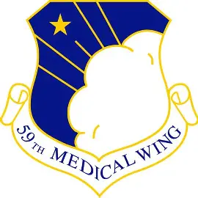
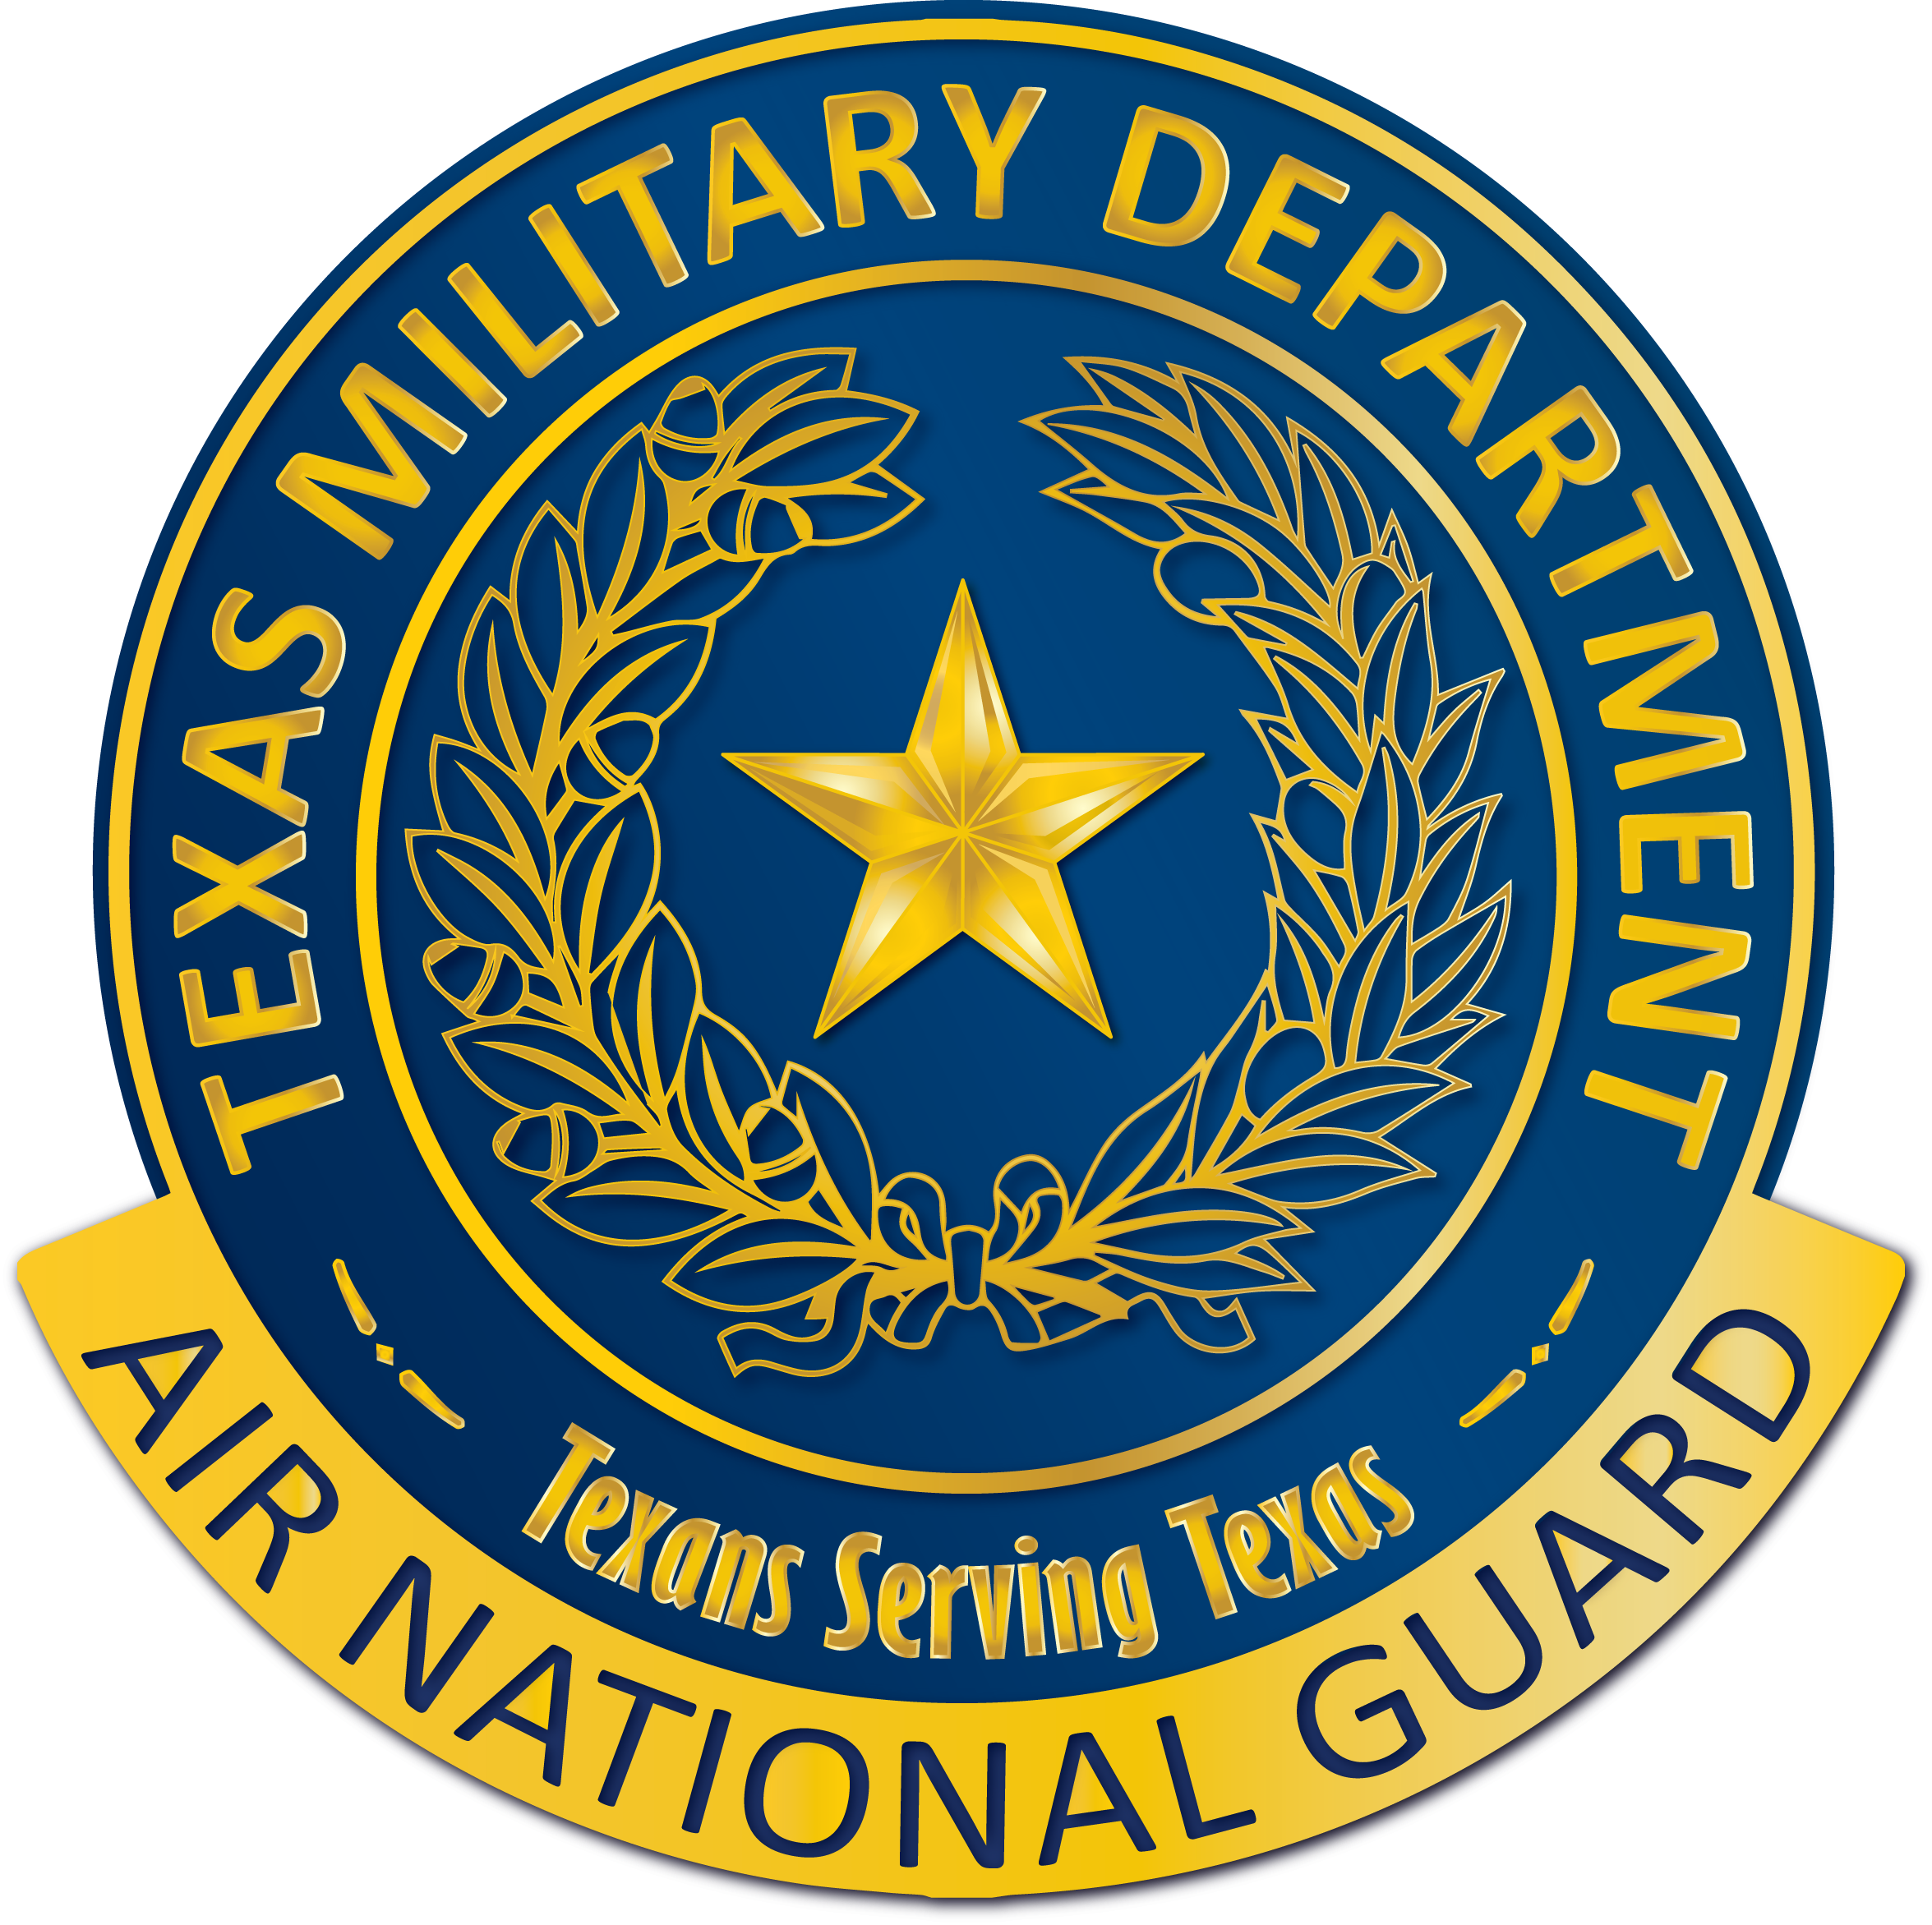
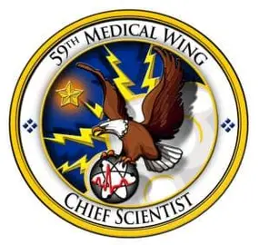
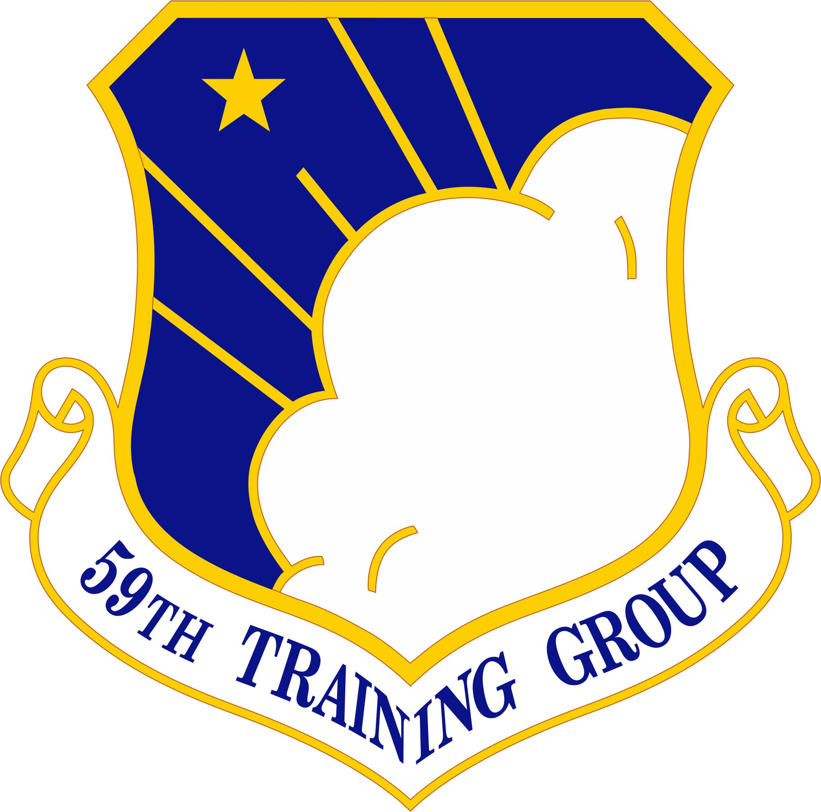
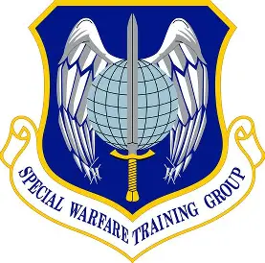
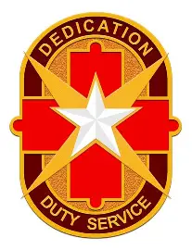
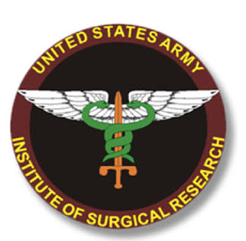
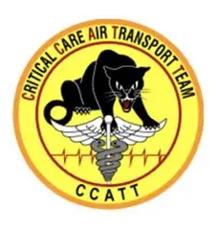



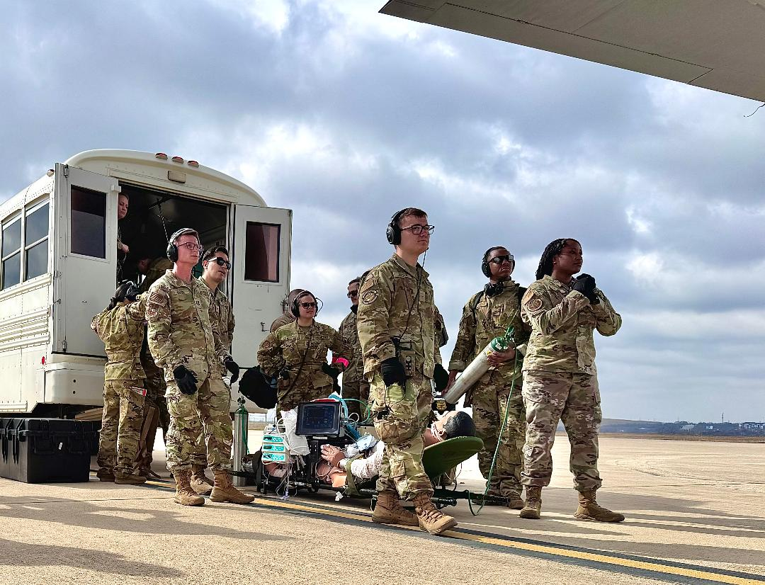
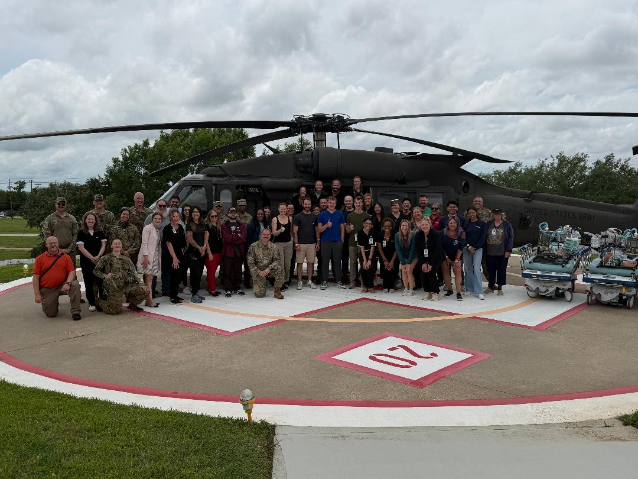
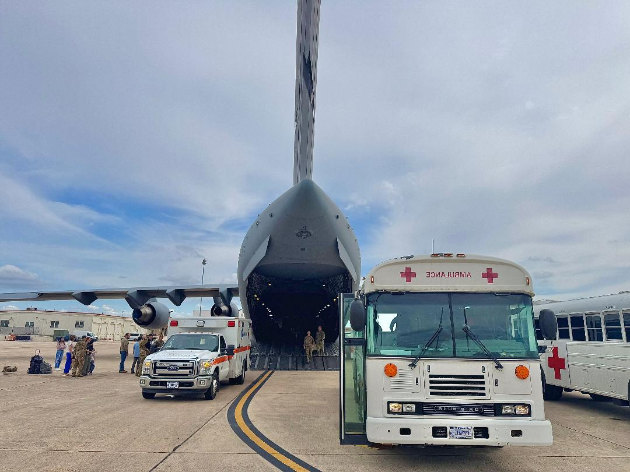
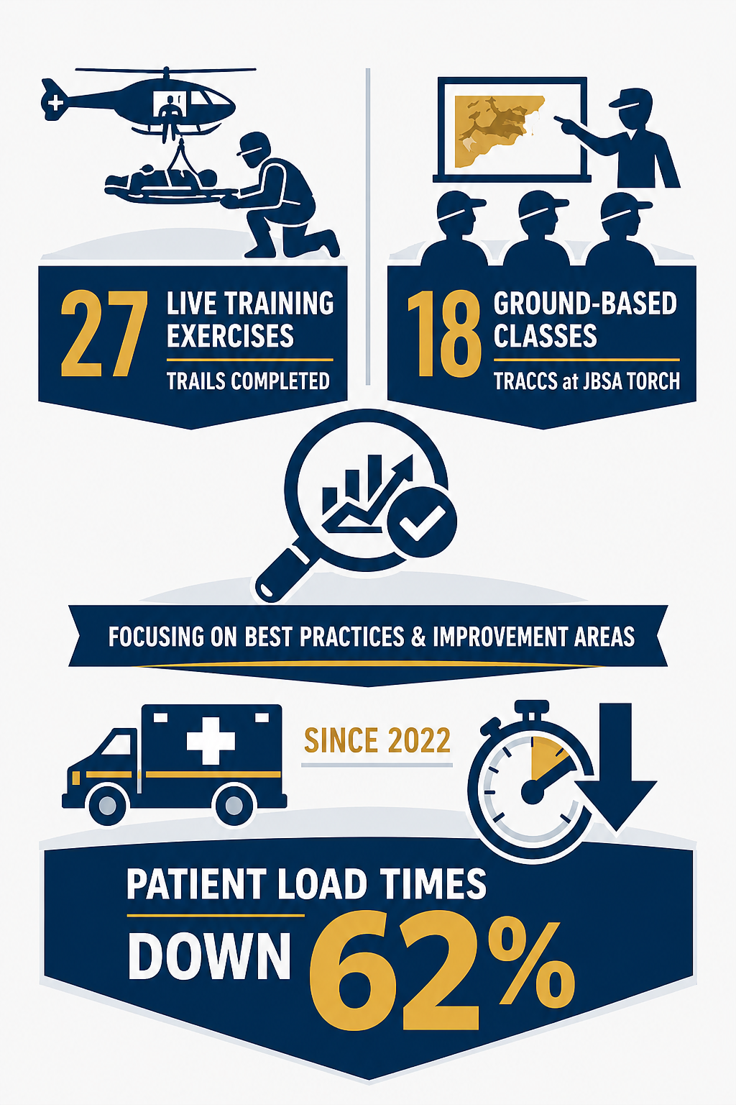
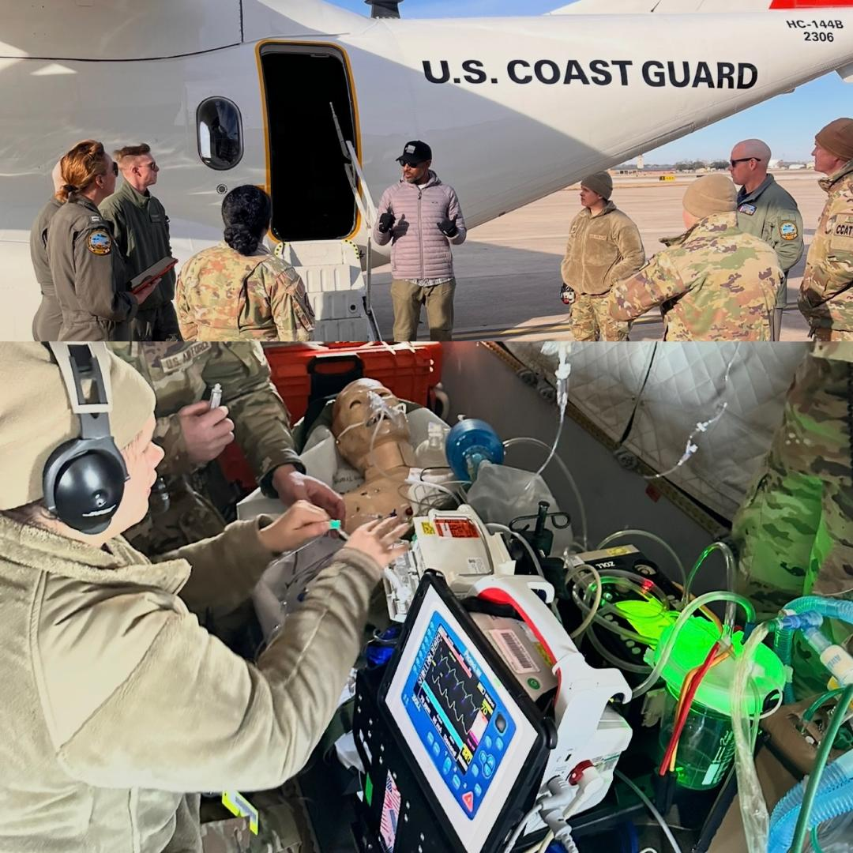
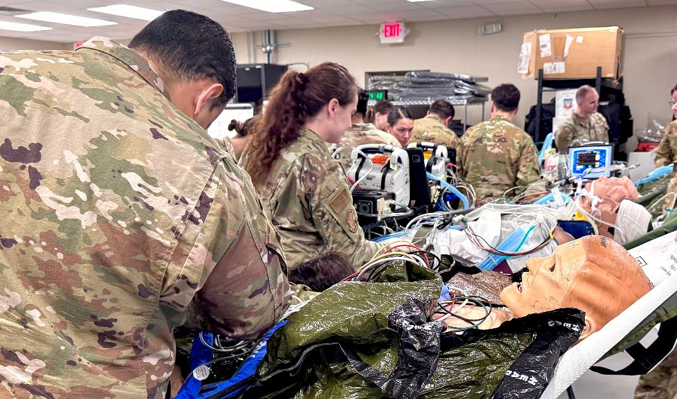
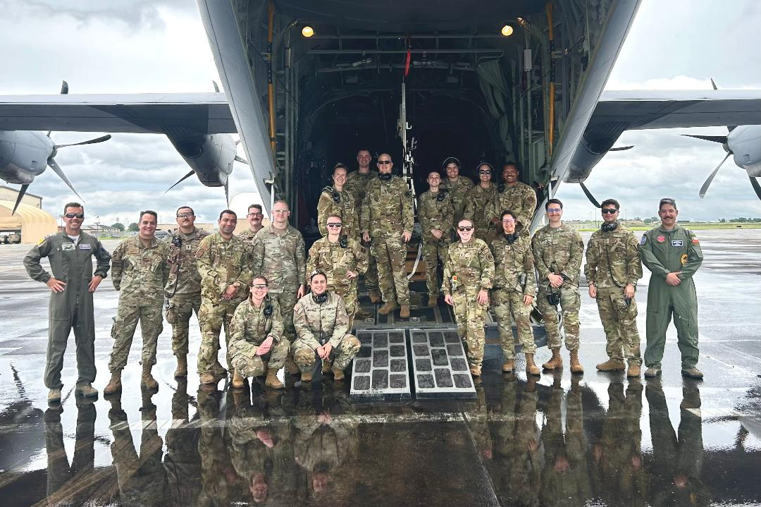
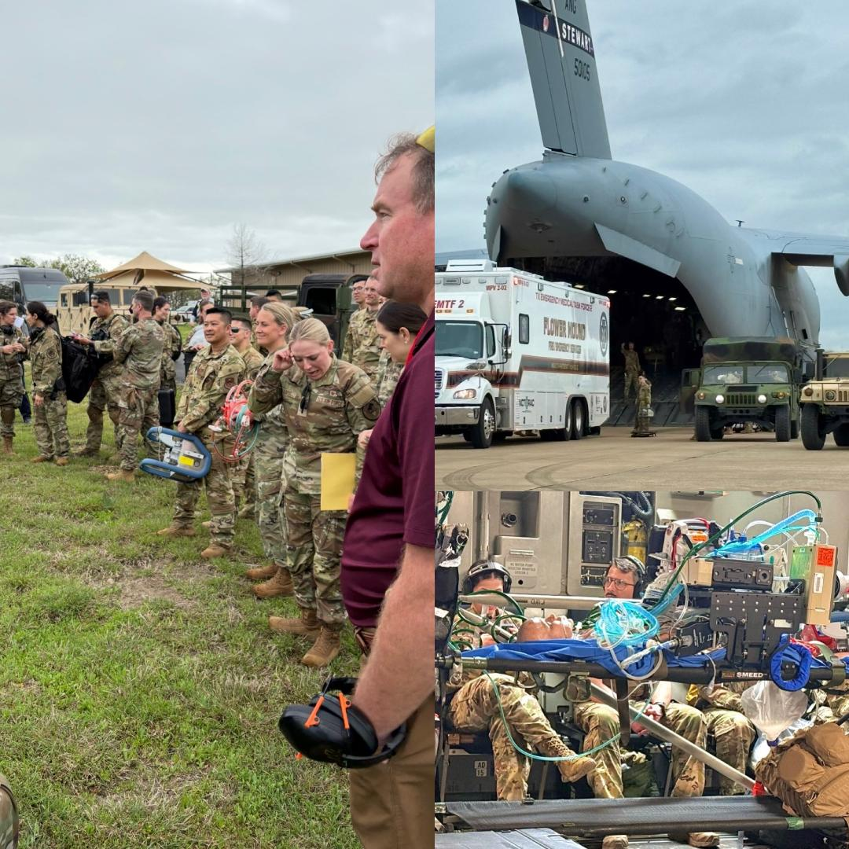
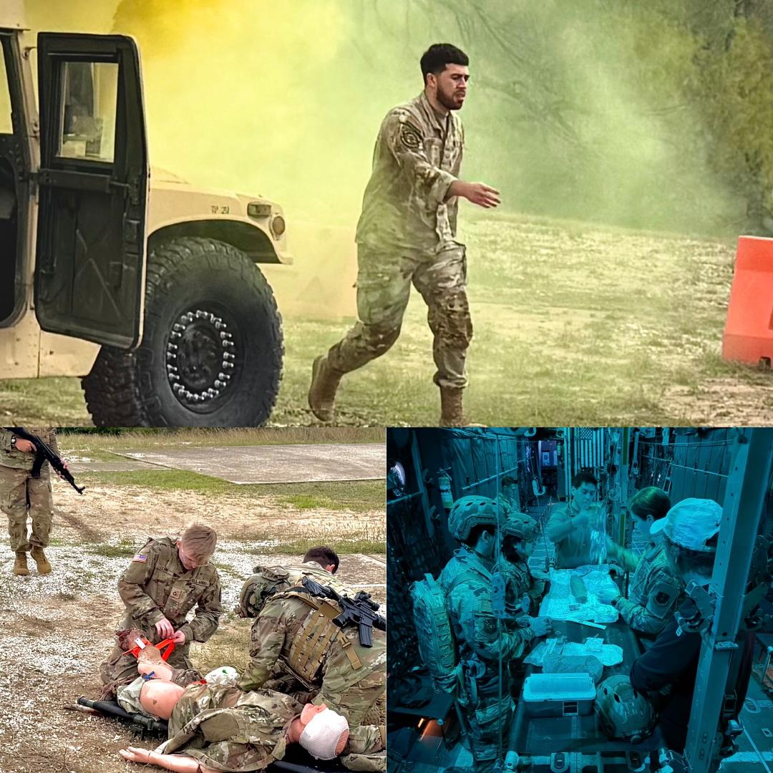
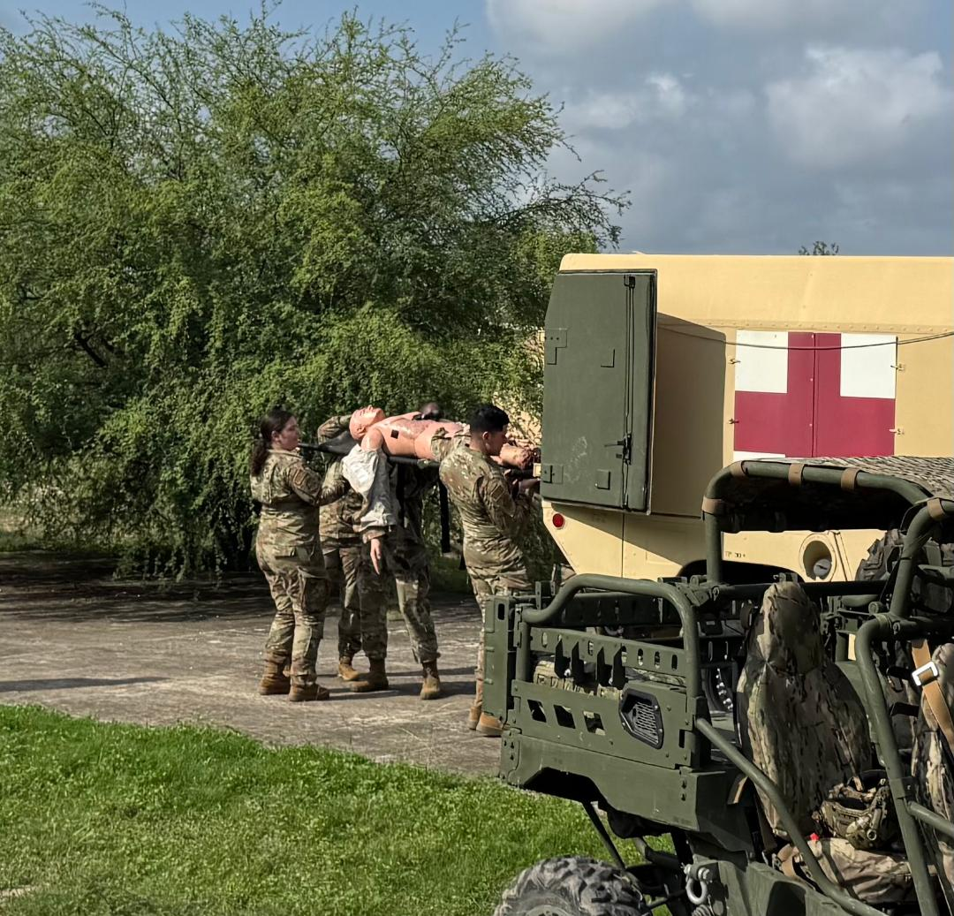
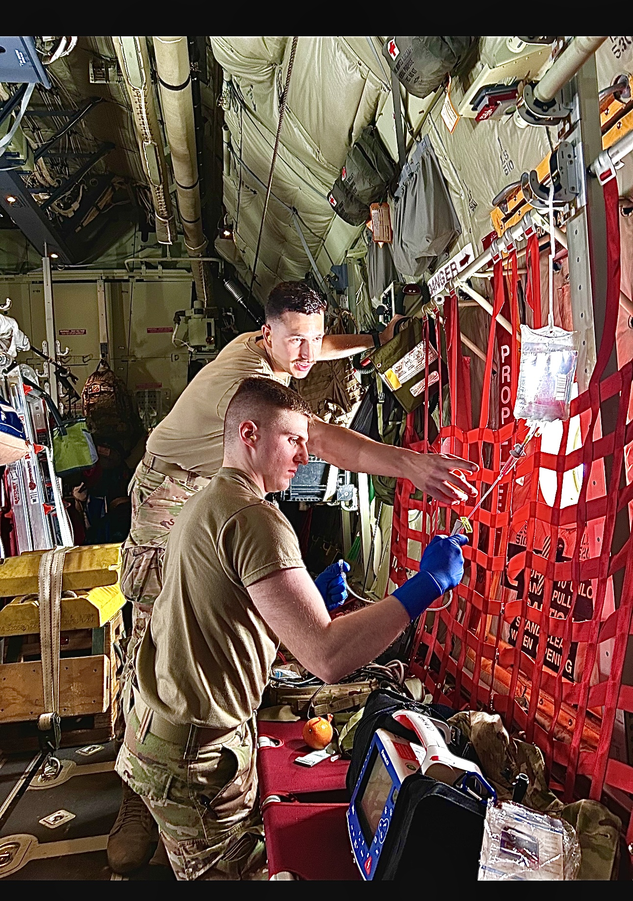
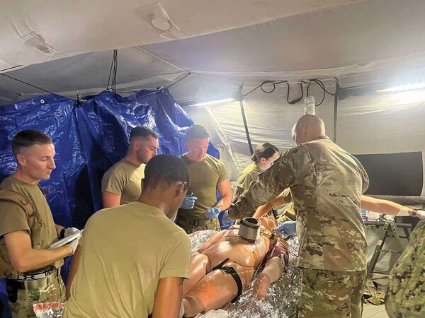
Validated Assessment Program for Operational Readiness (VAPOR): Addressing Current and Future Sustainment and Intraoperative Challenges of Medical Forces
MSGT (Ret) W. Douglas Gissendanner^{1,2,3}; LtCol (Ret) Wayne Hill⁴; Jason Moats^{5,6}; LTC (Ret) Carrie W. Hoppes PhD^{1,2,3}; Vincent B. Ho MD^{2,3}; Tony T. Yuan PhD^{2,3}
¹ 4D Bio3 Center for Biotechnology, Uniformed Services University, Bethesda, MD; ²The Geneva Foundation, Tacoma, WA; ³Department of Radiology and Bioengineering, Uniformed Services University, Bethesda, MD ; ⁴Aventias Group, Seguin, TX; ⁵USA Center for Rural Public Health Preparedness, College Station, TX; ⁶Department of Health Policy and Management, Texas A&M University School of Public Health, College Station, TX
INTRODUCTION
Military medical forces operate across a continuum of care spanning point-of-injury to definitive treatment. Sustaining clinical readiness in expeditionary environments remains a persistent challenge as personnel trained in stateside hospitals must transition to austere, high-tempo settings with complex casualty patterns and disrupted evacuation pathways. Large Scale Combat Operations (LSCOs) exacerbate these challenges due to threats to air superiority, communications, and logistics. Persistent gaps in sustainment training, interoperability, and patient movement validation across military and civilian partners underscore the need for scalable, adaptable frameworks
RESULTS
TRAILS has completed 27 live training exercises; TRACCS has completed 18 ground-based classes at JBSA TORCH, focusing on identifying best practices and improvement areas. Since 2022, patient load times during these exercises have decreased by 62%.
IMPACT
Participants span disciplines and services to include Air Force, Army, Coast Guard, Navy and Marines across active duty, reserve, and National Guard components alongside civilian and academic partners.
CAPABILITY DESCRIPTION
Established at Lackland Air Force Base, the Validated Assessment Program for Operational Readiness (VAPOR) is an expeditionary sustainment training ecosystem developed through collaboration between the 59th Medical Wing, USUHS 4DBio3, Texas Air National Guard, Texas A&M Health, and partner institutions. VAPOR provides an integrated framework for clinical readiness across the patient movement continuum from point-of-injury through aeromedical evacuation to definitive care.
APPROACH
VAPOR delivers high-frequency, low-dose experiential training across all roles of care through integrated components: TRAILS (aeromedical evacuation sustainment for CCATT and En Route Patient Staging Squadrons), TRACCS (point-of-injury and forward stabilization in expeditionary environments), and GARMED (Ground and Air Ready Medic). Exercises incorporate realistic conditions including field tents, evacuation vehicles, aircraft fuselage trainers, replicating casualty management across all Roles of Care.
STATUS OF CAPABILITY
VAPOR operates out of JBSA Lackland through joint DoW and academic partnerships, integrating military, civilian, and federal personnel to reinforce interoperability and support assessment of novel medical biotechnologies.
Conflict of Interest: The authors do not have a financial interest in any commercial product, service, or organization providing financial support for this research.
Disclaimer: The views expressed herein are those of the author(s) and do not necessarily reflect the official policy or position of the Defense Health Agency, the Uniformed Services University Health Services, the Department of War, nor any agencies under the U.S. Government.

