Slide 1

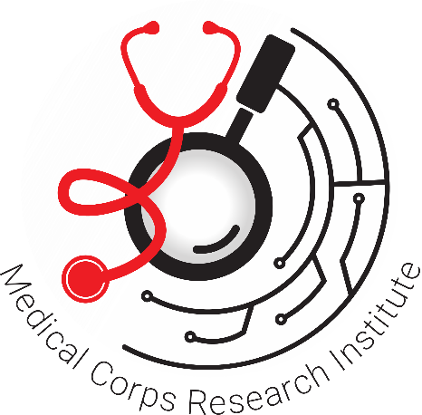
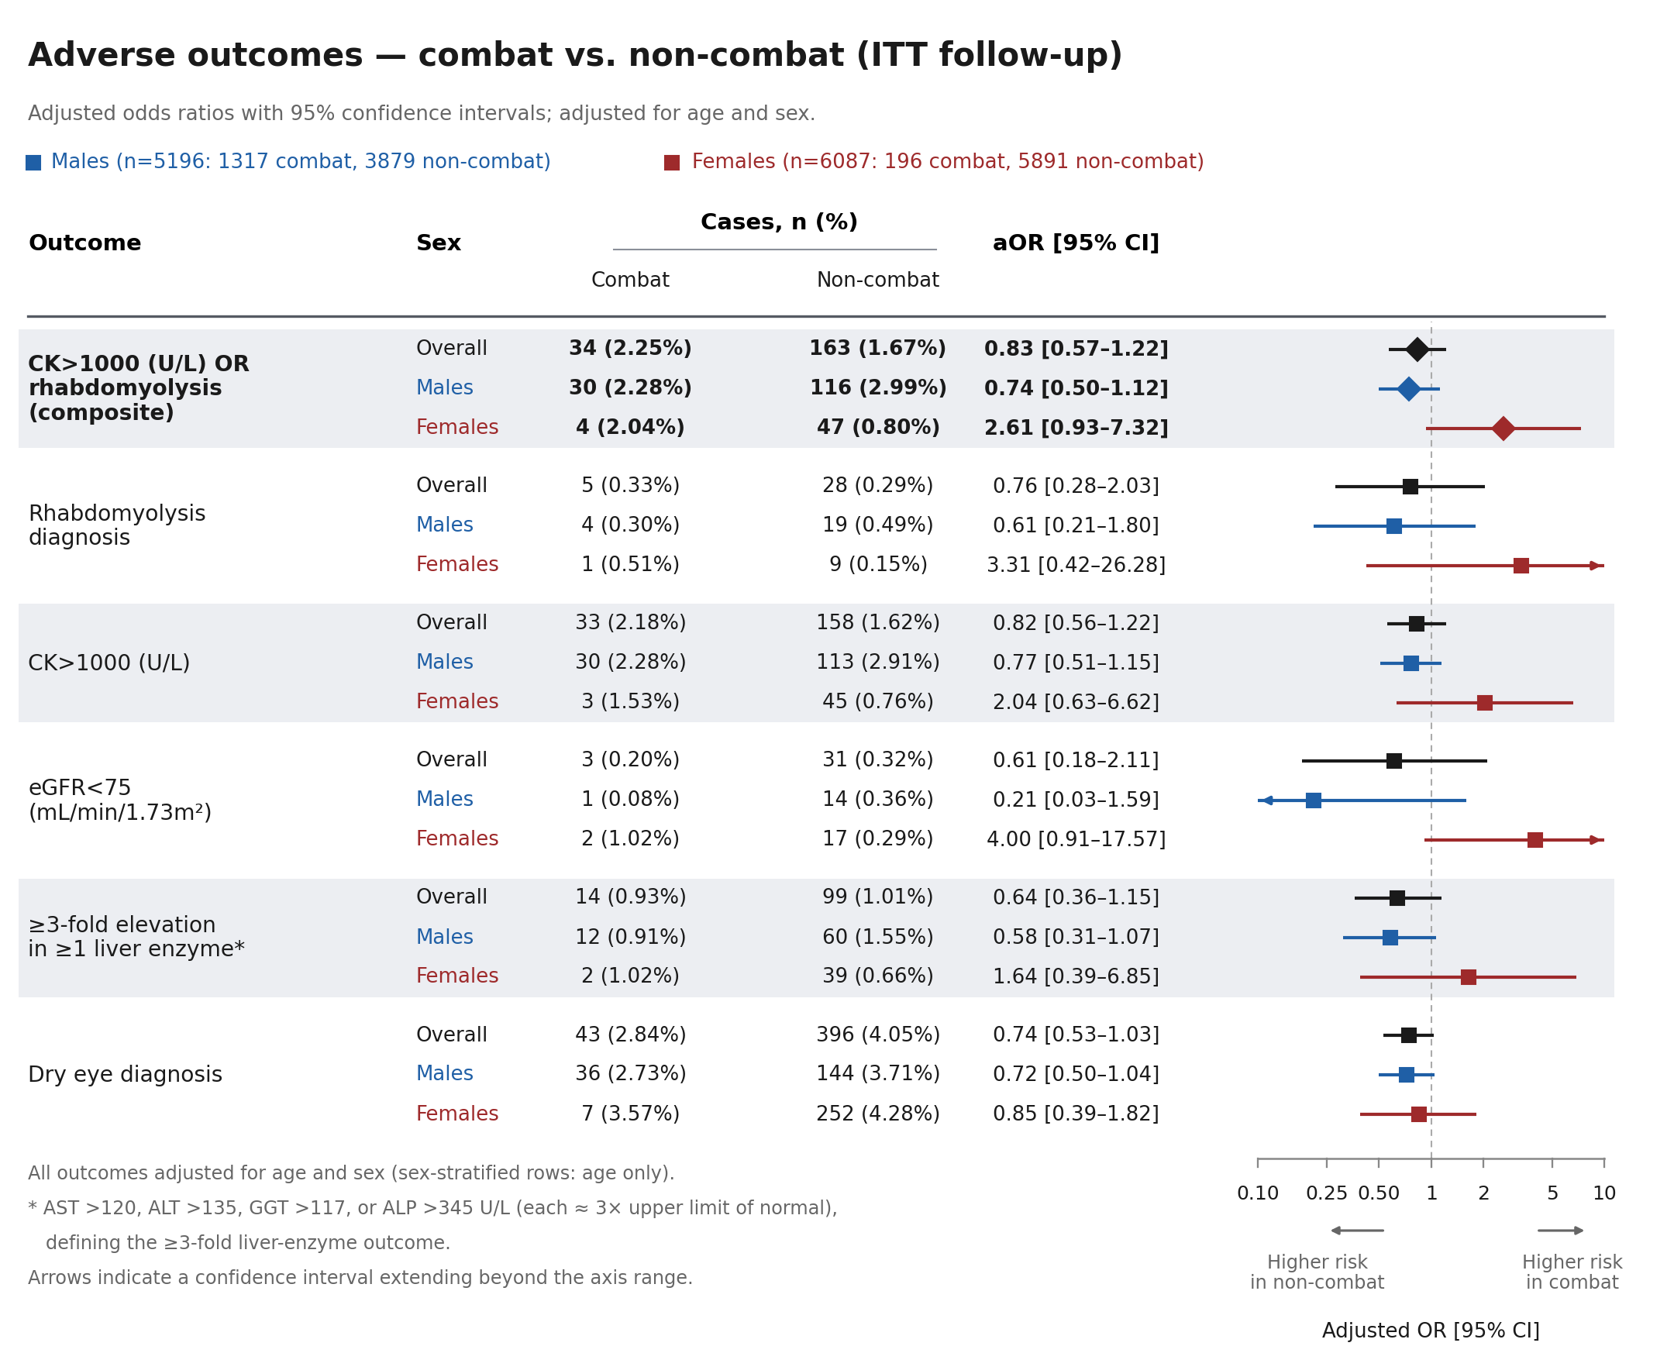
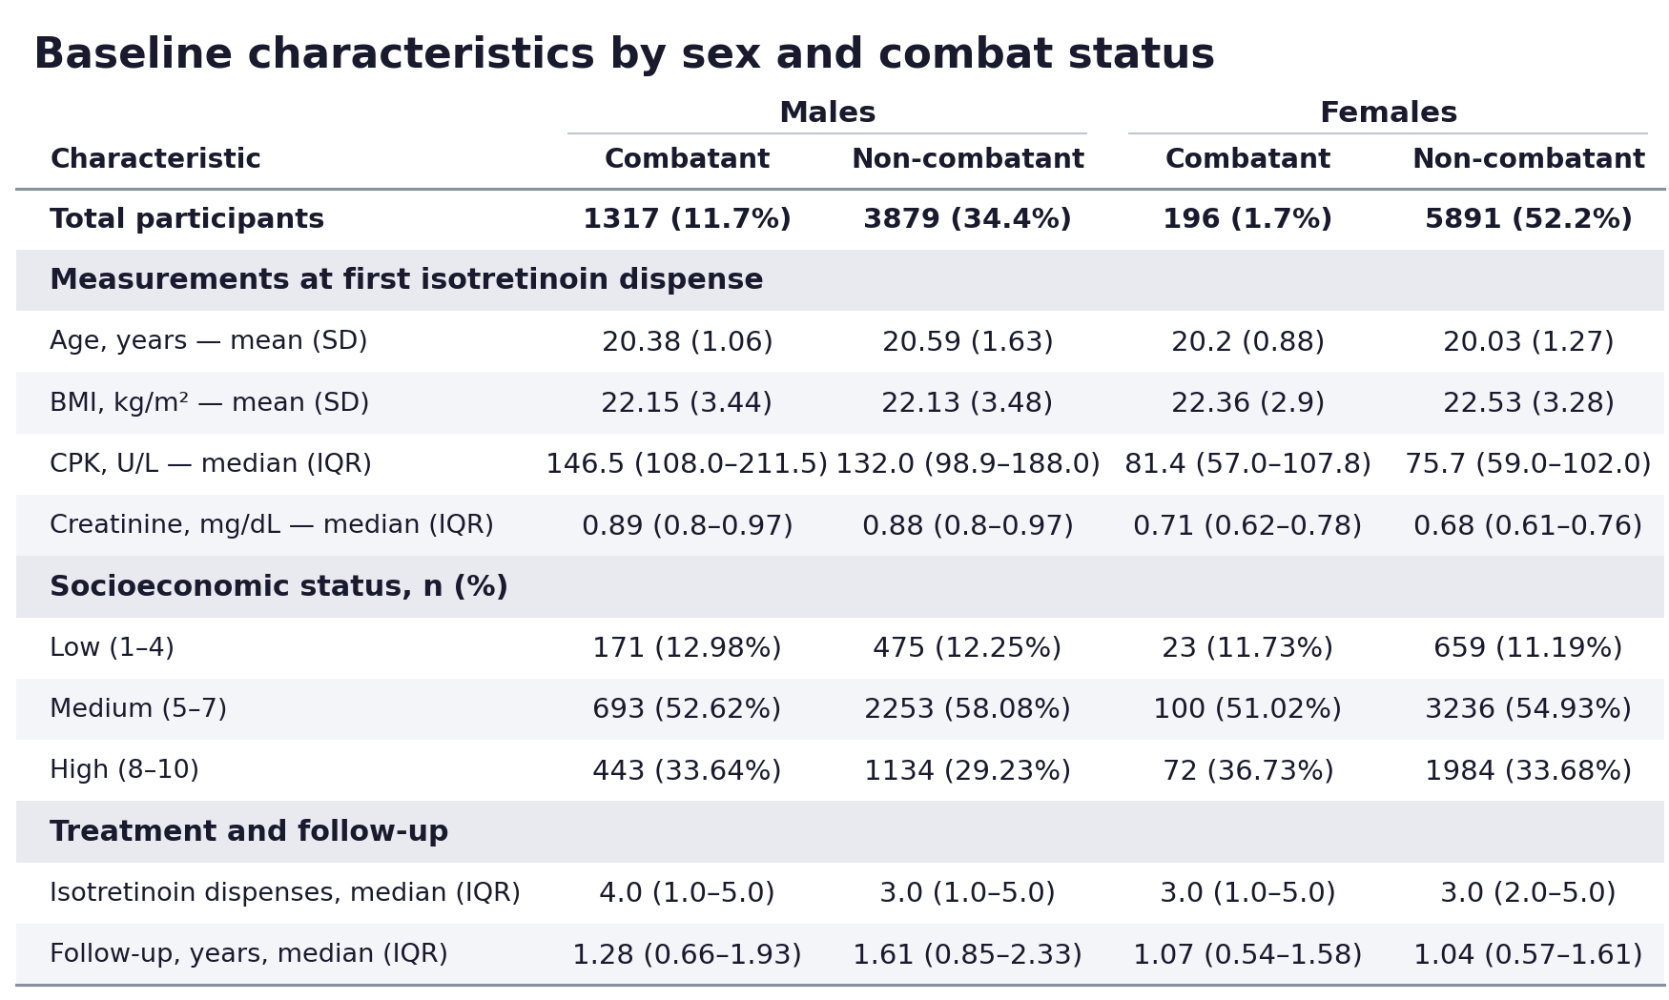
Safety of Oral Isotretinoin in Combat Soldiers:
A Nationwide Retrospective Study of 11,283 Soldiers
Michal Leibovitch, MD, MPH^{1,2}, Shahar Ronen, MD^{1,2,3}, Lirom Motola, MD^{1,2}, Omer Itzkovitch¹, Dana Stackievicz², Doron Yaya-Stupp, MD, PhD^{1,4},
Meir Schechter, MD, PhD^{1,4}, Yuval Hilerowicz, MD^{1,2, 5}
1. Medical Data Research Institute, Israel Defense Forces Medical Corps, Ramat Gan, Israel
2. Department of Military Medical Research, Faculty of Medicine, The Hebrew University of Jerusalem, Jerusalem, Israel
Medical Classification and Occupational Health Branch, Israel Defense Forces Medical Corps, Ramat Gan, Israel
Dina Recanati School of Medicine, Reichman University, Herzliya, Israel
Dermatology Department, Medical Services Center, Israel Defense Forces Medical Corps, Ramat Gan, Israel
Figure 1
Introduction
Oral isotretinoin, the most effective treatment for severe acne^{1,2}, may raise creatine kinase (CK) levels, raising concern for rhabdomyolysis and AKI, particularly with intense physical activity^{3,4,5}. Many militaries restrict combat service during isotretinoin treatment, forcing soldiers to choose between optimal care and combat service despite limited evidence of clinically significant risk⁶.
Results
Among 11,283 soldiers (mean age 20.3 ± 1.4 years, 46.1% male), 1,513 (13.4%) served in combat roles (Table 1). All adverse events were uncommon and showed no significant between-group differences (Figure 1). eGFR <60 mL/min/1.73 m2 and AKI occurred only among non-combat individuals (0.12% and 0.03%). Results were consistent in as-treated and sex-stratified analyses.
Table 1
Aim
To evaluate isotretinoin safety in a large IDF cohort and examine the policy restricting combat service during isotretinoin treatment.
Methods
Retrospective cohort study of IDF soldiers (2007-2024) with combat-eligible profiles and pharmacy-documented isotretinoin dispensation, stratified into combat vs. non-combat groups. Outcomes were ascertained from EMRs under intention-to-treat follow-up until discharge from service or up to 2.8 years. Multivariable Logistic regression was adjusted for sex and age at first dispensation.
Conclusion
Oral isotretinoin was rarely associated with significant muscle, renal, or hepatic toxicity, including among soldiers serving in combat roles.
The IDF Medical Corps updated its policy in 2025 to allow combat service during isotretinoin treatment under defined conditions.
Disclaimer: This study was conducted by the listed researchers. Statements and opinions published in this abstract are solely those of the individual abstract authors and not the Israel Defense Forces (IDF). This study did not receive external funding or support. All authors had access to the data utilized in this study.
References
1. Eichenfield DZ et al. JAMA, 2021.
2. Reynolds RV et al. J Am Acad Dermatol, 2024.
3. Marson JW et al. Int J Dermatol, 2020.
4. Landau M et al. Acta Derm Venereol, 2001.
5. Kaymak Y. Int J Dermatol, 2008.
6. Chroni E et al. Drug Saf, 2010.
Abbreviations
CK, Creatine Kinase
AKI, Acute Kidney Injury
EMRs, electronic medical records
eGFR, estimated glomerular filtration rate

