Slide 1


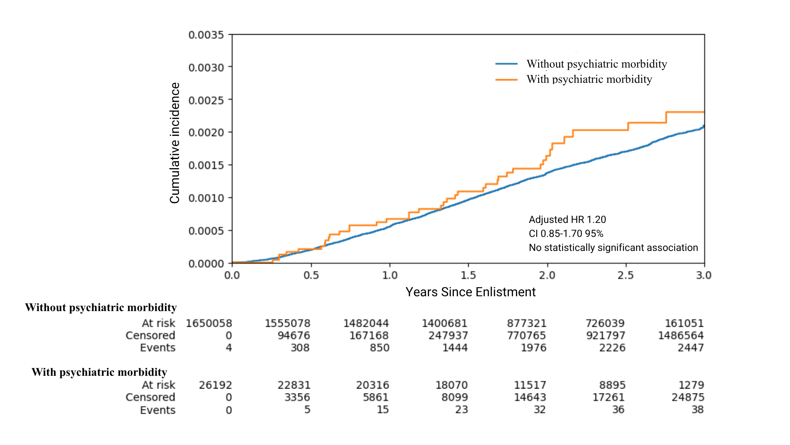
Pre-Enlistment Psychiatric Morbidity and Risk of Incident IBD: A Nationwide Cohort of 1.67 Million Military Conscripts
Omer Elazar Avital MD MHA^{1,2}, Shay Shraga MD^{1,2} , Maya Lehavi MD^{1,2}, Yael Hod BSc ¹, Meir Schechter MD PhD^{1,2,3}, Cole D. Bendor MD ^{1,2,3}, Aya Bardugo MD MSc^{1,2,3}
¹ Medical Data Research Institute, Israel Defense Forces Medical Corps, Ramat Gan, Israel
² Faculty of Medicine, Hebrew University of Jerusalem, Jerusalem, Israel
³ Dina Recanati School of Medicine, Reichman University, Herzliya, Israel
Introduction
Psychiatric disorders are associated with a broad range of gastrointestinal conditions through the gut-brain axis.
Previous research has primarily examined psychiatric morbidity following the diagnosis of inflammatory bowel disease (IBD).
Data on whether pre-existing psychiatric conditions increase the risk of incident IBD remain limited, particularly in young adults.
Results
The cohort included 1,676,250 conscripts, of whom 26,192 (1.6%) had psychiatric morbidity at enlistment. During follow-up, 2,485 incident IBD cases were identified.
IBD occurred in 38 of 26,192 participants with psychiatric morbidity (0.145%) and in 2,447 of 1,650,058 participants without psychiatric morbidity (0.148%).
Psychiatric morbidity was not significantly associated with incident IBD in the unadjusted model (HR 1.18; 95% CI 0.83-1.67) or in the multivariable-adjusted model (adjusted HR 1.20; 95% CI 0.85-1.70). Similar findings were observed in sex-stratified analyses.
Figure 1: Cumulative Incidence of IBD by Pre-Enlistment Psychiatric Morbidity
Aim
To evaluate whether pre-enlistment psychiatric morbidity is associated with incident inflammatory bowel disease during military service.
Methods
We conducted a retrospective cohort study of Israeli Defense Forces (IDF) conscripts enlisted between 1997 and 2024.
Exposure was psychiatric morbidity at enlistment, identified through standardized DSM-based diagnostic assessments and corresponding medical impairment codes.
Individuals with severe psychiatric disorders incompatible with military service were excluded.
Participants were followed from enlistment until incident Crohn’s disease or ulcerative colitis, completion of active service, or 3 years of follow-up, whichever occurred first.
Associations were assessed using Cox proportional hazards models adjusted for sex, enlistment year, socioeconomic status, and cognitive performance score.
Table 1: Selected baseline characteristics of the study participants
Characteristic | Without pre-enlistment psychiatric morbidity | With pre-enlistment psychiatric morbidity
Incident IBD during service, n (%) | 2,447 (0.148%) | 38 (0.145%)
Female sex, n (%) | 698,930 (42%) | 8,326 (32%)
Born in Israel; n (%) | 1,391,944 (84%) | 21,364 (82%)
SES 1-4 decile; n (%) | 235,043 (14%) | 3,514 (13%)
SES 5-7 decile; n (%) | 951,642 (58%) | 14,460 (55%)
SES 8-10 decile; n (%) | 450,188 (27%) | 8,069 (31%)
Low cognitive performance (10-30); n (%) | 270,952 (16%) | 5,431 (21%)
Intermediate cognitive performance (40-70); n (%) | 1,132,790 (69%) | 17,090 (65%)
High cognitive performance (80-90); n (%) | 246,227 (15%) | 3,671 (14%)
Cumulative incidence of IBD was similar among conscripts with and without pre-enlistment psychiatric morbidity during up to 3 years of follow-up.
Conclusion
In this nationwide cohort of more than 1.6 million young military conscripts, no statistically significant association was observed between pre-enlistment psychiatric morbidity and incident IBD during early adulthood.
Although IBD has been associated with subsequent psychiatric morbidity, our findings do not support pre-enlistment psychiatric morbidity as a risk marker for later IBD in this population.
Disclaimer: This study was conducted by the listed researchers. Statements and opinions published in this poster are solely those of the individual poster authors and not the Israel Defense Forces (IDF). This study did not receive external funding or support. All authors had access to the data utilized in this study.
Data are presented as n (%).
Percentages may not sum to 100% because of rounding or missing data.
References
Piovani D, Armuzzi A, Bonovas S. Inflamm Bowel Dis. 2024;30:573–584.
Bisgaard TH, Allin KH, Elmahdi R, Jess T. Gen Hosp Psychiatry. 2023;83:109–116.
Frolkis AD, Vallerand IA, Shaheen AA, et al. Gut. 2019;68:1606–1612.
Ananthakrishnan AN, Khalili H, Pan A, et al. Clin Gastroenterol Hepatol. 2013;11:57–62.
Melinder C, Hiyoshi A, Fall K, et al. BMJ Open. 2017;7:e014315
Bisgaard TH, Poulsen G, Allin KH, et al. eClinicalMedicine. 2023;59:101986.
Barberio B, Zamani M, Black CJ, et al. Lancet Gastroenterol Hepatol. 2021;6:359–370.
Fairbrass KM, Lovatt J, Barberio B, et al. Gut. 2022;71:1773–1780.
Abbreviations
IBD, inflammatory bowel disease
IDF, Israel Defense Forces
DSM, Diagnostic and Statistical Manual of Mental Disorders
HR, hazard ratio
CI, confidence interval
SES, socioeconomic status

