Slide 1








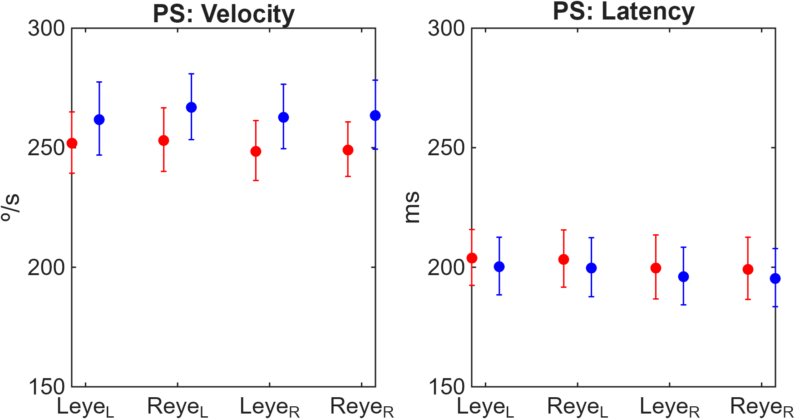

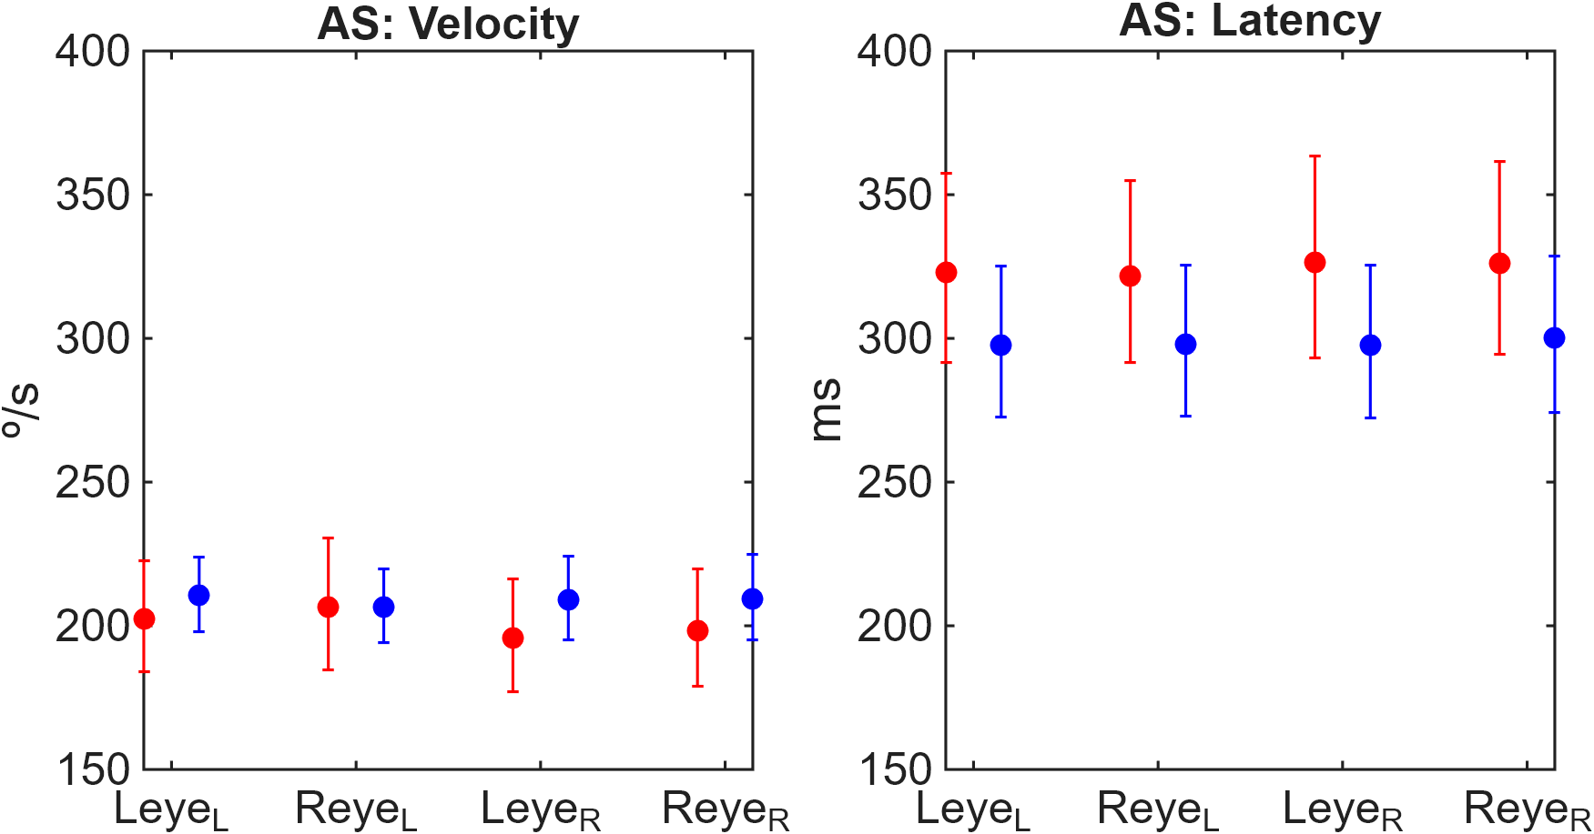

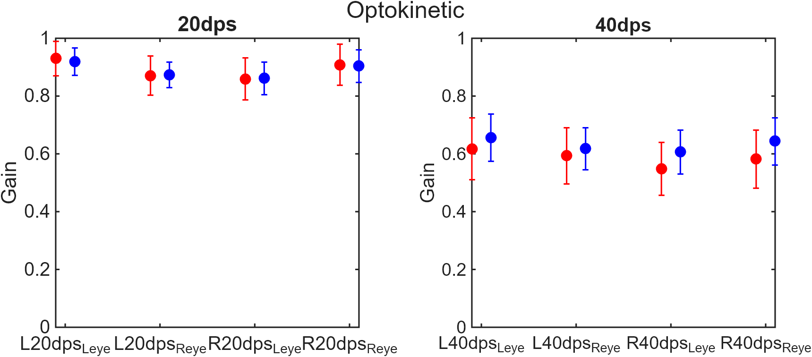
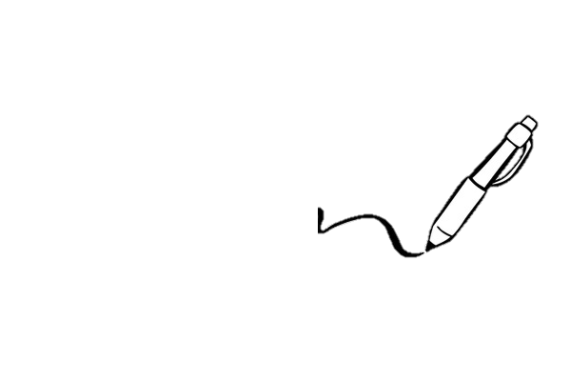
A mTBI-Predict Consortium Study On The Stability Of Vestibular And Ocular‑Motor Outcomes To Support Biomarker Development In mTBI.
Daniel J. Smullen*¹, David Jiménez-Grande*¹, Sophie P. Prosser¹, Jacob H. Tennant¹, Asha Strom¹, Samuel R.C. Weaver¹, Hannah S. Lyons¹, Yousef F. Hyder^{1,4}, Mia Mann^{1,3}, Andrew Palmer¹, Ryan S. Ottridge¹, Hamid Dehghani¹, Alice J. Sitch^{1,3}, Karen J. Mullinger^{1,2}, Lisa J. Hill^{1,3}, Alexandra J. Sinclair^{1,3}, James L. Mitchell^{1,3,4,5}, on behalf of the mTBI-Predict consortium, Samuel J.E. Lucas¹, and Raymond F. Reynolds¹.
Affiliations: ¹ University of Birmingham, Birmingham, UK; ² University of Nottingham, Nottingham, UK; ³ National Institute for Health and Care Research (NIHR) Birmingham Biomedical Research Centre, UK; ⁴ Queen Elizabeth Hospital, UK; ⁵ Defence Medical Rehabilitation Centre, Stanford Hall, UK
Email: d.smullen@bham.ac.uk
1) Background
3) Results
Mild traumatic brain injury (mTBI) is one of the most common neurological conditions, suffered by around 50 million people each year (1).
Vestibular and ocular-motor dysfunction are common following mTBI, making these systems promising candidates for objective biomarker development.
However, measures intended for longitudinal monitoring must first demonstrate adequate test-retest stability.
Therefore, establishing the stability of vestibular and ocular-motor outcomes is a critical step towards developing objective biomarkers of mTBI recovery.
Objective:
To identify ocular-motor and vestibular outcomes with sufficient short-term stability to support future longitudinal biomarker development following mTBI.
Table 1. Ranking of ocular-motor and vestibular outcomes according to short-term test-retest stability*.
1A
mTBI
Controls
Outcome | CVI (%) | RCV (%) | Category
PS Latency | 8.1-9.1 | 25-29 | 🟢 Excellent
AS Velocity | 6.3-9.6 | 19-30 | 🟢 Excellent
AS Latency | 7.9-10.5 | 24-34 | 🟢 Excellent-Good
OKN Gain (20 dps) | 10-13 | 29-35 | 🟡 Good
Smooth Pursuit (0.1-0.3 Hz) | 9-14 | 26-39 | 🟡 Good
Smooth Pursuit (0.4-0.5 Hz) | 15-19 | 42-53 | 🟠 Fair
vHIT Gain (60 ms) | 15-29 | 43-82 | 🔴 Poor
vHIT Gain (80 ms) | 16-27 | 45-74 | 🔴 Poor
OKN Gain (40 dps) | 21-28 | 57-78 | 🔴 Poor
2) Methods
Participants:
15 adults with acute (~21 days) mTBI (18–65y, median = 25y, male = 7)
18 healthy controls (18–65y, median = 29y, male = 9).
Each participant completed four testing sessions across a 12-day period.
Equipment:
Micromedical Visual-Eyes™ 525 system software.
Top-mounted eye-tracking goggles (model BG4.0USB) which tracks both eyes.
An LED TV screen running at 60 Hz, 130cm away from participant.
EyeSeeCam video Head Impulse Test (vHIT) goggles, with the camera and inertial sensors were placed over the left eye, 150cm away from wall.
Testing Protocol:
Spontaneous Nystagmus → Smooth Pursuit → Pro-saccades → Anti-saccades → Optokinetic Nystagmus → Vestibulo-Ocular Reflex (assessed using vHIT)
Statistical Analysis:
Variability was quantified using four complementary metrics:
The coefficient of group variation (CVG) – between-subject variation
The coefficient of intra‑individual variation (CVI) – within-subject variation
The reference change value (RCV) – change required to reflect ‘real’ change
The index of individuality (II) – ratio between CVG and CVI
1B
(*) Lower CVI values indicate greater test-retest stability and greater suitability for longitudinal biomarker monitoring.
Stability categories were assigned pragmatically based on intra-individual variation (CVI):
Excellent < 10%
Good 10-15%
Fair 15-20%
Poor > 20%
4) Discussion
Saccadic outcomes demonstrated consistently lower within-subject variability than vestibular measures across repeated testing sessions.
Low variability is an essential characteristic of candidate biomarkers because it improves the ability to detect genuine recovery-related change over time.
The poor stability observed for vHIT outcomes may reflect greater methodological sensitivity and highlights the need for further standardisation before incorporation into biomarker models.
Limitations: Small sample size limits the precision and generalizability of stability estimates. Fatigue may have influenced ocular-motor performance across sessions such as saccades (8), optokinetic, nystagmus (8) and smooth pursuit (9). Multiple testers conducted vHIT testing, potentially contributing to increased variability (7). The mTBI cohort was heterogeneous and may have included differing injury mechanisms and recovery trajectories (10).
mTBI
Controls
1C
mTBI
Controls
6) Funding and conflicts
5) Conclusions
UK mTBI-Predict consortium contract from the Ministry of Defence (MOD) and Department of War (DoW). NIHR BRC Birmingham. Approved by MOD Research Ethics Committee (REC-2217MODREC23). The views and conclusions contained herein are those of the authors and should not be interpreted as necessarily representing the official policies or endorsements, either expressed or implied, of the U.S. Government. The material has been reviewed by the Defense Health Agency. There is no objection to its presentation and/or publication. The opinions or assertions contained herein are the private views of the authors and are not to be construed as official or as reflecting the views of the DoW.
Pro-saccade latency, anti-saccade velocity, anti-saccade latency, and OKN gain (20 dps) demonstrated the strongest short-term test-retest stability.
These outcomes represent the most promising candidates for future longitudinal mTBI biomarker validation.
Further work is required to determine whether these highly stable measures are sensitive to recovery-related change
7) References
1. Hon, K. L., Leung, A. K. C., & Torres, A. R. (2019). Concussion: A Global Perspective. Seminars in Pediatric Neurology, 30, 117–127. https://doi.org/10.1016/j.spen.2019.03.017
2. Swain, S. K., & Dubey, D. (2023). Vestibulo-ocular Reflex – A Narrative Review. Matrix Science Medica, 7(4), 90. https://doi.org/10.4103/mtsm.mtsm_24_22
3. Connell, C. J. W., Thompson, B., Kuhn, G., Claffey, M. P., Duncan, S., & Gant, N. (2016). Fatigue related impairments in oculomotor control are prevented by caffeine. Scientific Reports, 6(1), 26614. https://doi.org/10.1038/srep26614
4. Millar, J. L., Schubert, M. C., & Gimmon, Y. (2020, February 13). Inter-Rater Differences of Vor Gains Using Video Head Impulse Test: A Reliability Study. 2020 Combined Sections Meeting (CSM). https://apta.confex.com/apta/csm2020/meetingapp.cgi/Paper/24148
5. Bafna-Rührer, T., Bækgaard, P., & Hansen, J. P. (2022). Smooth-pursuit performance during Eye-typing from Memory indicates Mental Fatigue. Journal of Eye Movement Research, 15(4), 10.16910/jemr.15.4.2. https://doi.org/10.16910/jemr.15.4.2
6. Belding, J. N., Khokhar, B., Englert, R. M., Fitzmaurice, S., & Thomsen, C. J. (2021). The Persistence of Blast- Versus Impact-Induced Concussion Symptomology Following Deployment. The Journal of Head Trauma Rehabilitation, 36(6), E397–E405. https://doi.org/10.1097/HTR.0000000000000715
Figure 1. Test-retest stability of ocular-motor and vestibular outcomes across four sessions. (A, Saccades; B, Smooth Pursuit; C, OKN).

