Slide 1
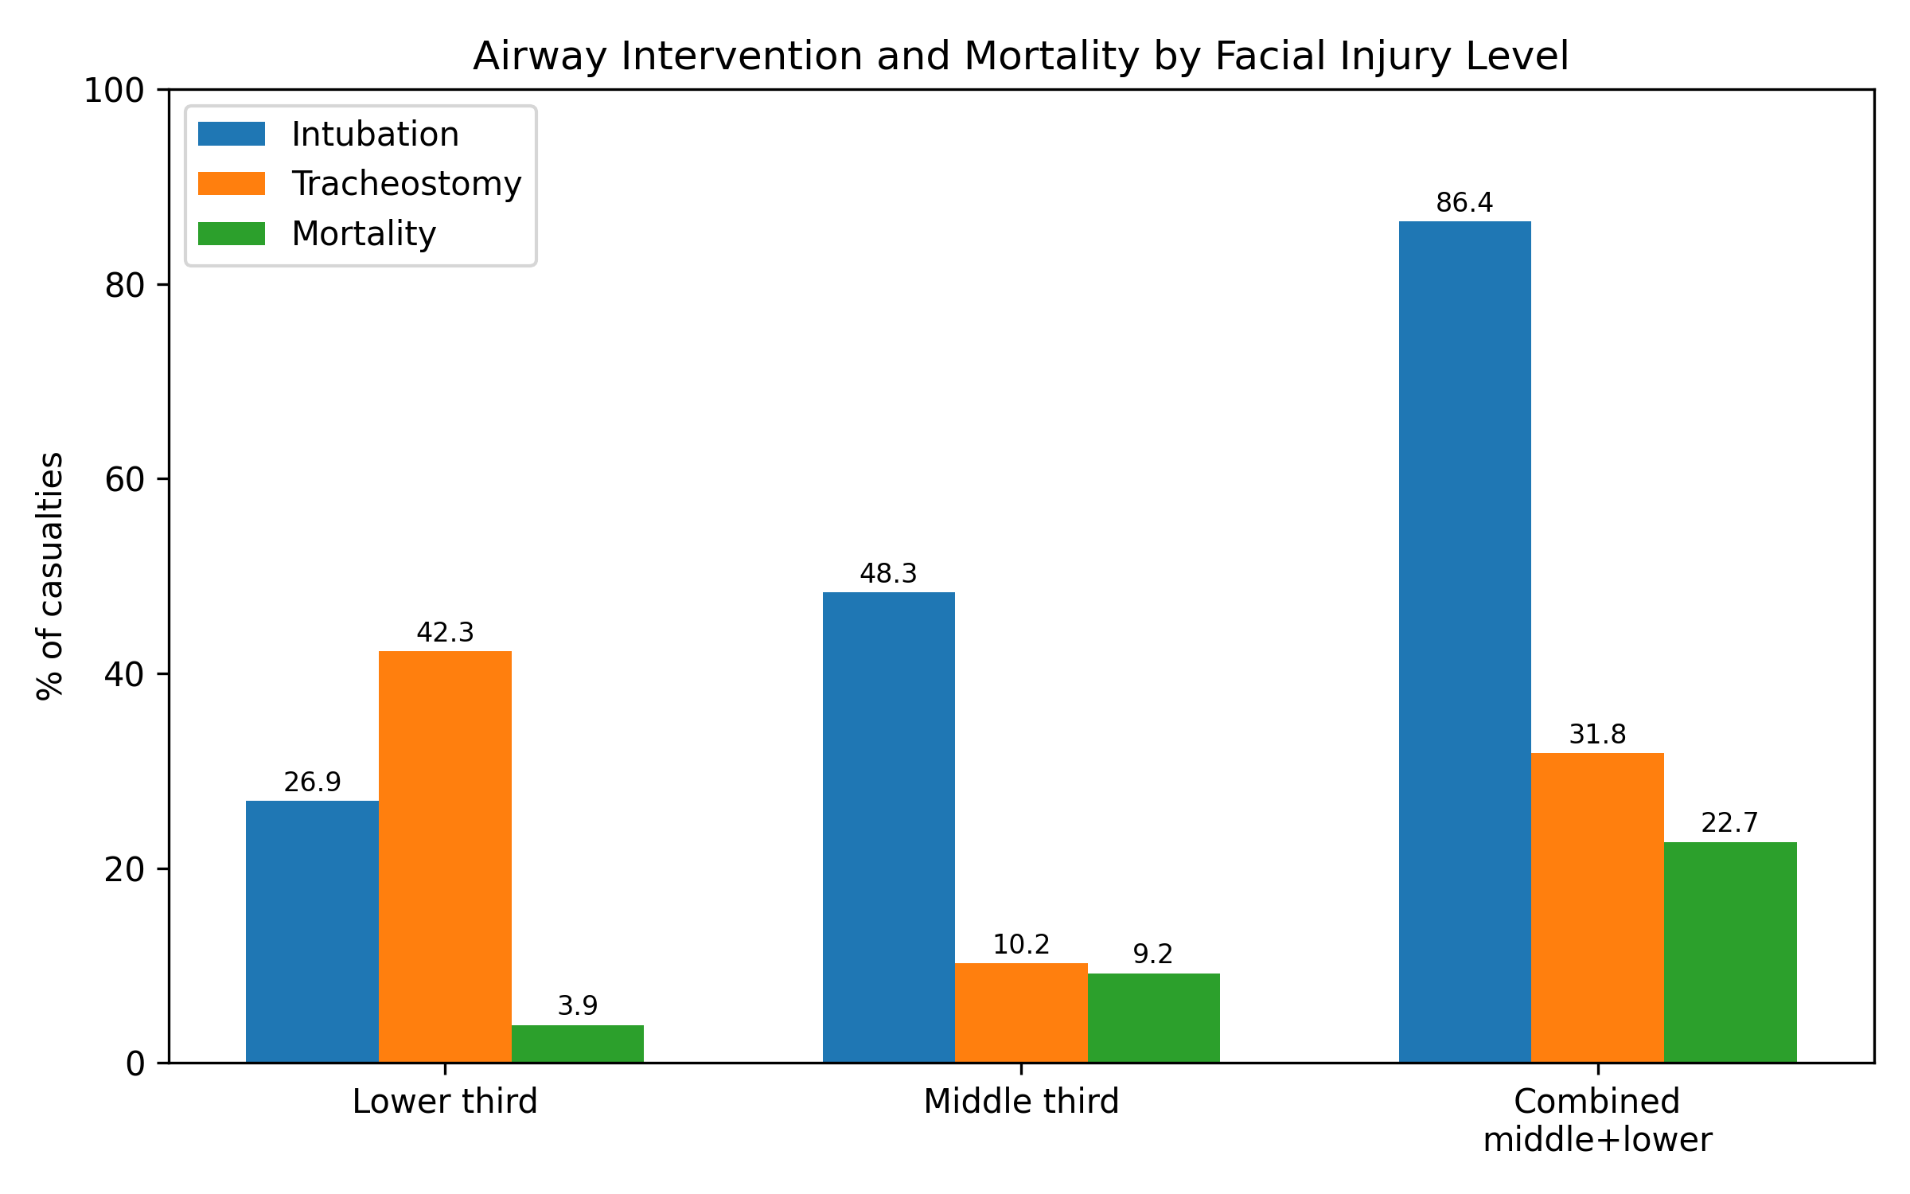
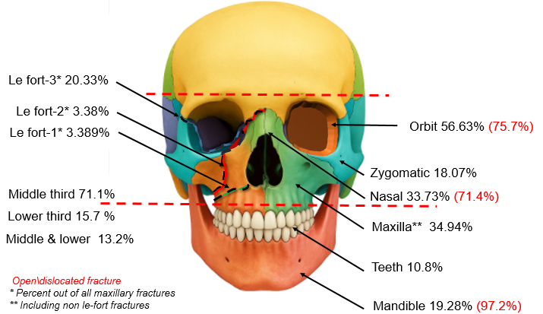
Maxillofacial Fractures in the Swords of Iron War: Patterns, Surgical Management, and Outcomes
Amir Abu-Rabia MD MHA^{1, 2, †}, Dmitry Kotovich MD^{1, 3, 4}, Nir Tsur MD⁵, Adi Givon BSc⁶, Yael Arbel DMD MHA^{1, 7}, Shachar Shapira MD MHA^{6, 8, †} , Mor Rittblat MD MPH^{1, 3, 4, †}
1 Israeli Defense Forces, Medical Corps, Tel Hashomer, Ramat Gan, Israel, 2 Department of Plastic and Reconstructive Surgery, Burn and hand units, Soroka University Medical Center, Faculty of Health Sciences, Ben Gurion University of the Negev, Beer Sheva, Israel, 3 Department of Plastic and Reconstructive Surgery, Hadassah Hebrew University Medical Center, Jerusalem, Israel ,4 Department of Military Medicine and "Tzameret," Faculty of Medicine, The Hebrew University of Jerusalem, Jerusalem, Israel, 5 Department of Otolaryngology-Head and Neck Surgery, Rabin Medical Center, Petah Tikva, Israel, 6 Gertner Institute of Epidemiology and Health Policy Research, Sheba Medical Center, Ramat Gan, Israel, 7 Department of Periodontology, Sheba Medical Center, Tel Hashomer, Israel, 8 Arrow Program for Medical Research Education, Sheba Medical Center, Ramat Gan, Israel
introduction
Maxillofacial fractures (MFF) are common in blast-related combat injuries despite body armor. Their anatomical complexity often requires multidisciplinary management.
We characterized injury patterns, acute management, and short-term outcomes during the Swords of Iron War.
Results
The cohort was predominantly male (98.8%) median age -23 years.
Primary mechanism- explosive injuries (82.0%).
Fractures were most frequent in the middle third (71.1%), followed by isolated lower third (15.7%) and combined middle-and-lower third injuries (13.2%).
At the patient level, orbital involvement was present in 94 of 166 casualties (56.6%), and isolated orbital fractures were the most common isolated injury pattern (n=26, 15.7%).
Airway intervention rates increased with injury extent: intubation occurred in 26.9%, 48.3%, and 86.4% of lower, middle, and combined injuries, respectively (p < 0.001). Tracheostomy was required in 42.3%, 10.2%, and 31.8% of these groups (p = 0.001). Overall, 68.7% underwent operative management, and mortality reached 10.2%, peaking at 22.7% in combined-level injuries.
Methods
Retrospective cohort of 166 IDF casualties (Oct 2023–Dec 2024).
Data from the Israeli National Trauma Registry and hospital records.
Outcomes: fracture distribution, airway management, surgery, ICU admission, hospital course and mortality.
Fracture data were documented using the Abbreviated Injury Scale (AIS) scores , and included facial level involvement (middle third, lower third, involvement of specific facial subunits (orbit, nasal, zygoma, maxilla, mandible, and dentoalveolar/teeth.
Conclusion
Combat-related MFF were chiefly midfacial, with orbital fractures predominating and contributing substantially to operative workload.
Combined lower and middle thirds injuries required the most airway support and had the greatest mortality,
The study underscores the need for early airway control, timely operative care, and strong rehabilitation capacity.
Figure 1
Anatomical Distribution and Frequency of Maxillofacial Fractures by Subunit of Entire Cohort
Figure 2
Airway interventions and mortality by facial fracture type
Disclaimer This study was performed as part of the Israel Defense Forces Trauma and Combat Medicine Branch effort to improve the quality of combat casualty care and received no external funding or support.

