Slide 1




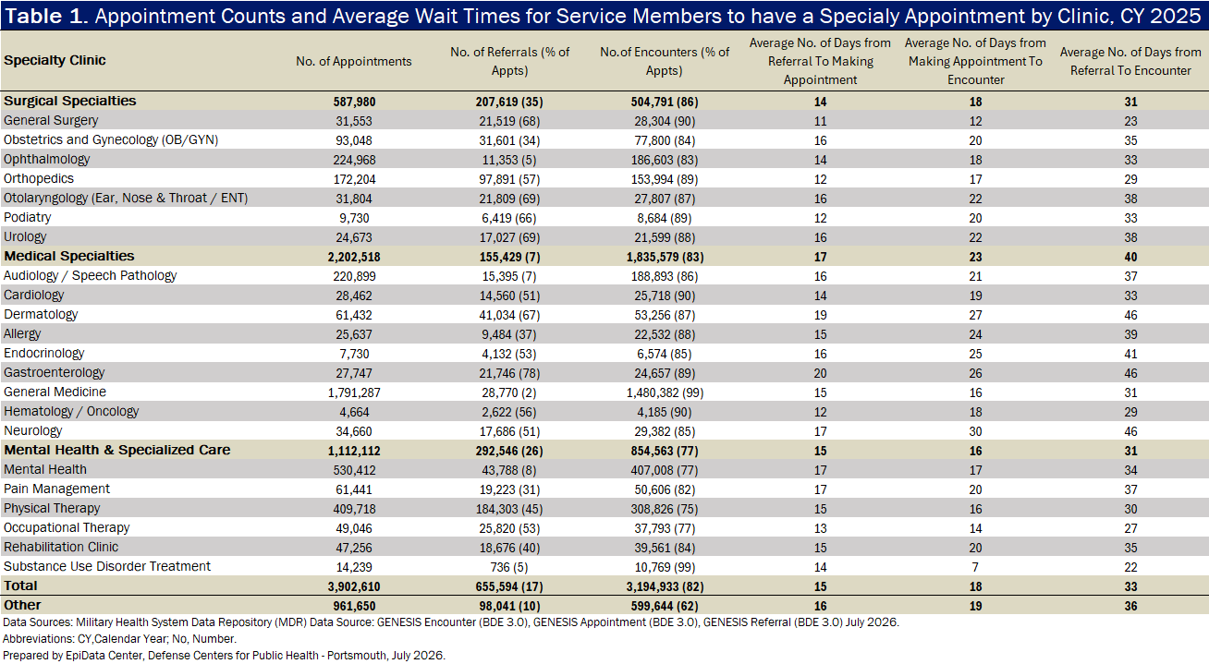
Performance Analysis of Access-to-Care for Force Readiness
Stephen P. Rossi, MPH; Sarah C. Kelsey, MPH
Defense Centers for Public Health–Portsmouth, Portsmouth, Virginia
Background
Only 46% of parent military treatment facilities are shown to be compliant with the 28-day standard, indicating a major access to care issue that may jeopardize warfighter medical readiness.
Discussion
The Military Health System (MHS) provides a 28-day standard for service members to access specialty care.¹ To initiate this process, a service member must first be evaluated by their Primary Care Manager to obtain an authorized referral, which remains valid for up to 365 days.² While the 28-day standard clock for the initial appointment starts at the time of referral reception,¹ operational reporting often tracks the number of days starting only after an appointment is successfully booked. This difference in measurement creates a significant systemic gap. To evaluate this gap, we define "referral time" as the specific chronological window between referral reception and the booking of the appointment. By focusing metrics only on the time between booking and attendance, military treatment facilities (MTFs) are left with an operational blind spot that obscures the true patient wait time. Quantifying this unmeasured referral time is critical to aligning clinical metrics with the actual patient experience. Exposing these delays is the first step toward identifying workflow inefficiencies, ensuring compliance with the 28-day standard for specialty care, and safeguarding warfighter medical readiness.
This analysis measures the time elapsed between specialty care referral reception and attending the appointment, evaluates its contribution to overall access-to-care delays in the MHS, and assesses systemic data gaps in referral tracking.
While current reporting metrics suggest most MTFs are taking 28 days or less to get patients to see a specialist after booking, this does not reflect the expectation from the actual patient experience. From the patient’s perspective, they may expect an appointment within 28 days from the moment their primary care manager issues a referral, as per the standard. However, as this analysis demonstrates, the latency from the referral time delays the initial appointment, meaning service members are not receiving care within their expected timeframe. This disconnect introduces risks to force readiness; when access to definitive specialty care is delayed, clinical recovery stalls, extending the time active-duty service members spend on waiting for an appointment and compromising unit mission capability.
To resolve this operational blind spot, the MHS may focus on referral data quality. In this analysis, only 17% of appointment records could be successfully matched to an active referral in the data. Improving data integration to make it easier to track referral time within electronic health records is critical to eliminating this 83% data deficit. Providing leadership with accurate, comprehensive metrics will inform targeted administrative interventions to streamline patient booking. Ultimately, closing this measurement gap will ensure service members receive the care they expect in a timely manner, directly enhancing both patient satisfaction and warfighter readiness.
Future analyses could investigate the gap in referral matching. More complete matching may better guide and facilitate actions by stakeholders, ultimately improving referral timeliness.
Figure 1. Number of Parent MTFs Meeting the 28-day Wait Time Standard
When tracking begins at appointment booked: 63/63
averaged 28 days or less
When tracking begins at referral reception:
29/63
averaged 28 days or less
Methods
Population
The population consisted of active-duty service members with their initial specialty clinic appointment during calendar year 2025.
Analysis
MHS data were queried to match patient appointment records with corresponding referral and clinical encounter records. Specialty clinic appointments were identified using nurse location encounter codes. Time intervals (in days) were calculated for three phases: referral time latency (referral reception to appointment creation), scheduling latency (appointment creation to attendance), and total access time (referral reception to attendance).
Verification
To ensure only initial specialty appointments were analyzed, records were verified by directly linking the appointment to an active referral and keeping the first appointment after receiving a referral.
If a direct link was not present, historical data were reviewed to confirm if it was an appointment that should have had a referral linked or if it was a recurring appointment. Records without a referral were investigated for a reason in MHS GENESIS PowerChart and Joint Longitudinal Viewer.
Limitations
Appointment and referral records may lack the data points needed to link every appointment to its corresponding referral. The actual number of initial appointments with linked referral data may be underestimated.
Data may be incomplete due to new records or record edits that appear within 6 months of the initial encounter. However, 95% of direct care encounters are assumed to be available 3 months after the encounter.
MHS Data Repository may contain data errors due to improper or insufficient clinical coding, data entry inaccuracies, or electronic processing glitches. Accurate reporting of medical encounters depends on correct International Classification of Diseases coding practices.
Direct care visit encounters may include teleconsultation, administrative actions, or group care. Therefore, the results of this analysis may be overestimated or underestimated.
MHS GENESIS data are included in this analysis. The reliability and understanding of MHS GENESIS data, its capture, content, and structure, are still being investigated. The impacts on the accuracy of results for facilities that transitioned to MHS GENESIS are unclear.
Results
Citations
Figure 1 shows whether select parent MTFs (consisting of medical centers and hospitals) and their clinic networks met the 28-day standard for the specialty clinics listed in Table 1.
The average number of days reported in Table 1 consist of appointment records with a matching referral date and encounter date. The appointment, referral, and encounter counts are for all initial appointments.
When including the referral time, most specialty clinics surpassed an average wait time of 28 days, apart from general surgery (23-day average), occupational therapy (27-day average) and substance use disorder treatment (22-day average).
¹Defense Health Agency. (2025, May 5). TRICARE access to care standards. TRICARE. https://www.tricare.mil/GettingCare/TRICARE-Access-to-care-Standards
²TRICARE Communications. Q&A: Getting and using referrals with TRICARE. TRICARE Newsroom. February 23, 2023. Accessed June 29, 2026. https://newsroom.tricare.mil/News/TRICARE-News/Article/3306629/qa-getting-and-using-referrals-with-Tricare
UNCLASSIFIED: Approved for public release; distribution unlimited. Disclaimer: The views expressed in this presentation are those of the author(s) and do not necessarily reflect the official policy of the Department of War or the U.S. Government.
The mention of any non-federal entity and/or its products is for informational purposes only, and is not to be construed or interpreted, in any manner, as federal endorsement of that non-federal entity or its products.

