Slide 1


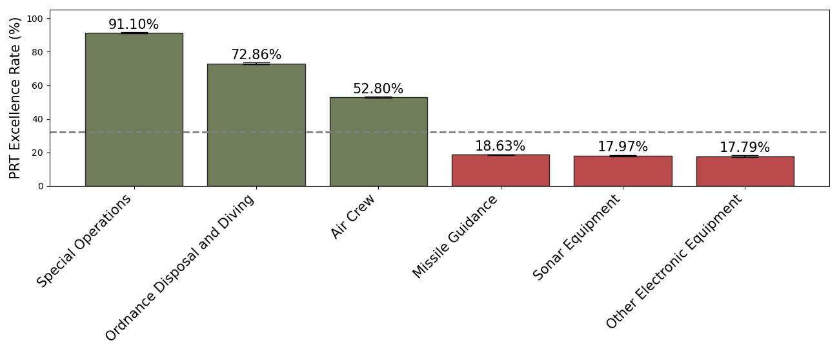
U.S. NAVY EXCEPTIONAL FITNESS RATES BY OCCUPATION
Meg I. Robinson, MS^{1,2}; Justin T. Stamets, MS^{1,2}; James K. Romine, PhD^{1,2}; Amber L. Dougherty, MPH^{1,2}; Ryan W. Smith, PhD¹; Andrew J. MacGregor, PhD¹
¹Naval Health Research Center, San Diego, CA; ²Leidos, Inc., San Diego, CA
BACKGROUND
RESULTS
RESULTS
The U.S. Navy requires routine Physical Readiness Tests (PRTs) to maintain operational readiness
While PRT scores range from “Failure” to “Outstanding,” consistent high performance, defined as achieving a score of “Outstanding” or “Excellent,” is indicative of exceptional physical fitness
No studies have leveraged data from the PRT to examine occupation and physical fitness, which could potentially inform targeted interventions as well as provide possible PRT policy considerations
A total of 363,326 individuals and 2,286,880 PRTs were included in the analysis (average 6 ± 3 PRTs per person)
On average, individuals scored Excellent or Outstanding on 32.2% of their PRTs
Highest PRT Excellence rate occupations were special operations, ordnance disposal and diving, air crew
Lowest PRT Excellence rate occupations were missile guidance, sonar equipment, and other electronic equipment.
Table 2. Distributions of Occupations, With Corresponding PRT Excellence Rates
Occupation | Individuals n, % | PRT Excellence Rate (SD)
Total | 363,326 (100) | 32.2% (±0.1%)
Special Operations | 4,251 (1.2) | 91.1% (±0.2%)
Ordnance Disposal and Diving | 3,117 (0.9) | 72.9% (±0.3%)
Air Crew | 5,925 (1.6) | 52.8% (±0.3%)
Utilities | 2,405 (0.7) | 45.7% (±0.4%)
Construction | 5,140 (1.4) | 44.0% (±0.3%)
Medical Care | 36,972 (10.2) | 43.9% (±0.4%)
Automotive | 2,102 (0.6) | 41.2% (±0.4%)
Musicians | 748 (0.2) | 37.0% (±0.6%)
Intelligence | 4,114 (1.1) | 35.6% (±0.3%)
Religious, Morale and Welfare | 1,062 (0.3) | 35.3% (±0.6%)
Law Enforcement | 14,404 (4.0) | 34.6% (±0.2%)
Clerical/Personnel | 5,052 (1.4) | 33.4% (±0.3%)
Forward Area Equipment Support | 2,364 (0.7) | 32.5% (±0.4%)
Personnel | 2,099 (0.6) | 32.3% (±0.4%)
Signal Intelligence/Electronic Warfare | 14,604 (4.0) | 32.0% (±0.2%)
Weather | 1,461 (0.4) | 31.7% (±0.5%)
Information and Education | 1,683 (0.5) | 29.4% (±0.4%)
Other Functional Support | 16,093 (4.4) | 29.3% (±0.1%)
Administration | 7,825 (2.2) | 28.8% (±0.2%)
Artillery/Gunnery, Rockets and Missiles | 6,686 (1.8) | 27.7% (±0.2%)
Armament and Munitions | 12,778 (3.5) | 27.6% (±0.2%)
Material Receipt, Storage and Issue | 2,853 (0.8) | 27.4% (±0.4%)
Aircraft and Aircraft Related | 44,376 (12.2) | 27.4% (±0.1%)
Radar and Air Traffic Control | 12,964 (3.6) | 27.1% (±0.2%)
Seamanship | 13,579 (3.7) | 26.7% (±0.2%)
ADP Computers | 17,298 (4.8) | 26.5% (±0.1%)
Metalworking | 901 (0.2) | 23.9% (±0.6%)
Wire Communications | 3,034 (0.8) | 23.9% (±0.3%)
Radio/Radar | 23,962 (6.6) | 23.4% (±0.1%)
Other Craftworkers | 7,650 (2.1) | 22.9% (±0.2%)
Not Occupationally Qualified | 1,614 (0.4) | 22.8% (±0.7%)
Food Service | 11,031 (3.0) | 22.6% (±0.2%)
Power Generating Equipment | 11,638 (3.2) | 21.2% (±0.2%)
Shipboard Propulsion | 34,747 (9.6) | 21.1% (±0.1%)
Missile Guidance, Control and Checkout | 14,382 (4.0) | 18.6% (±0.1%)
Sonar Equipment | 7,388 (2.0) | 18.0% (±0.2%)
Other Electronic Equipment | 5,024 (1.4) | 17.8% (±0.2%)
OBJECTIVES
 |  | Highest PRT Excellence Rate |  |  | Lowest PRT Excellence Rate
Variable | Overall (n=363,326) | Special Operations (n=4,251) | Ordnance Disposal and Diving (n=3,117) | Air Crew (n=5,925) | Missile Guidance (n=14,382) | Sonar Equipment (n=7,388) | Other Electronic Equipment (n=5,042)
PRT Excellence rate, adjusted mean (SD) | 32.2% (±0.06%) | 91.1% (±0.2%) | 72.9% (±0.3%) | 52.8% (±0.3%) | 18.6% (±0.1%) | 18.0% (±0.2%) | 17.8% (±0.2%)
Sex
% Male | 80.8 | 100.0 | 99.2 | 92.3 | 89.1 | 88.2 | 93.6
% Female | 19.2 | 0.0 | 0.8 | 7.7 | 10.9 | 11.8 | 6.4
Age, years
% Age <30 | 78.6 | 66.9 | 63.3 | 73.0 | 77.6 | 77.0 | 91.7
% Age 30+ | 21.4 | 33.1 | 36.7 | 27.0 | 22.4 | 23.0 | 8.3
Avg Age (SD) | 24.9 (±6.4) | 28.0 (±6.9) | 28.2 (±7.0) | 26.0 (±6.5) | 25.1 (±6.2) | 25.1 (±6.3) | 23.0 (±4.7)
PRTs
Avg # Tests (SD) | 6 (±3) | 6 (±2) | 7 (±2) | 7 (±3) | 7 (±3) | 6 (±3) | 7 (±3)
Range (min, max) | 2 to 11 | 2 to 11 | 2 to 11 | 2 to 11 | 2 to 11 | 2 to 11 | 2 to 11
Describe the overall PRT Excellence rate among U.S. Navy personnel
Analyze the occupations with the lowest and highest PRT Excellence rate
METHODS
Study Population
This was a retrospective analysis of 2014–2019 data from the Physical Readiness Information Management System
Active duty Navy personnel with ≥2 valid PRTs were included
Occupational Groups
Navy occupations were grouped by occupational code into 37 categories, as defined by the Defense Manpower Data Center
PRT Excellence Rate
PRT Excellence rate was defined as the number of PRTs scored Excellent or Outstanding divided by the total number of non-waived PRTs during the study period
Statistical Analysis
A generalized linear model assessed the relationship between Navy occupations and PRT Excellence rate, controlling for age and sex
Adjusted probabilities were calculated to examine the effect of occupations on PRT performance, with 95% confidence intervals (CIs) reported
Table 1. Demographics of Occupations With the Highest and Lowest PRT Excellence Rates
CONCLUSIONS
These results reveal physically demanding occupations have the highest PRT Excellence rate
Occupations with the lowest PRT Excellence rate may face barriers to fitness, such as limited access to facilities and long or irregular work hours
Targeted interventions among those with the lowest PRT Excellence rate, as well as possible policy considerations could boost Navy force readiness
Figure 1. Highest and Lowest PRT Excellence Rate by Occupation. The occupations with the highest PRT Excellence rate (green) and lowest PRT Excellence rate (red) are listed. The adjusted average rate is plotted with 95% CIs included. Horizontal dashed gray line at cohort average (PRT Excellence rate 32.2%).
Disclaimer: I am a military service member or employee of the U.S. Government. This work was prepared as part of my official duties. Title 17, U.S.C. §105 provides that copyright protection under this title is not available for any work of the U.S. Government. Title 17, U.S.C. §101 defines a U.S. Government work as work prepared by a military service member or employee of the U.S. Government as part of that person’s official duties. This work was supported by U.S. Navy Bureau of Medicine and Surgery under work unit no. 60808. The views expressed in this work are those of the authors and do not necessarily reflect the official policy or position of the Department of the Navy, Department of Defense, nor the U.S. Government. The study protocol was approved by the Naval Health Research Center Institutional Review Board in compliance with all applicable federal regulations governing the protection of human subjects. Research data were derived from approved Naval Health Research Center Institutional Review Board protocol number NHRC.2003.0025.

