Slide 1


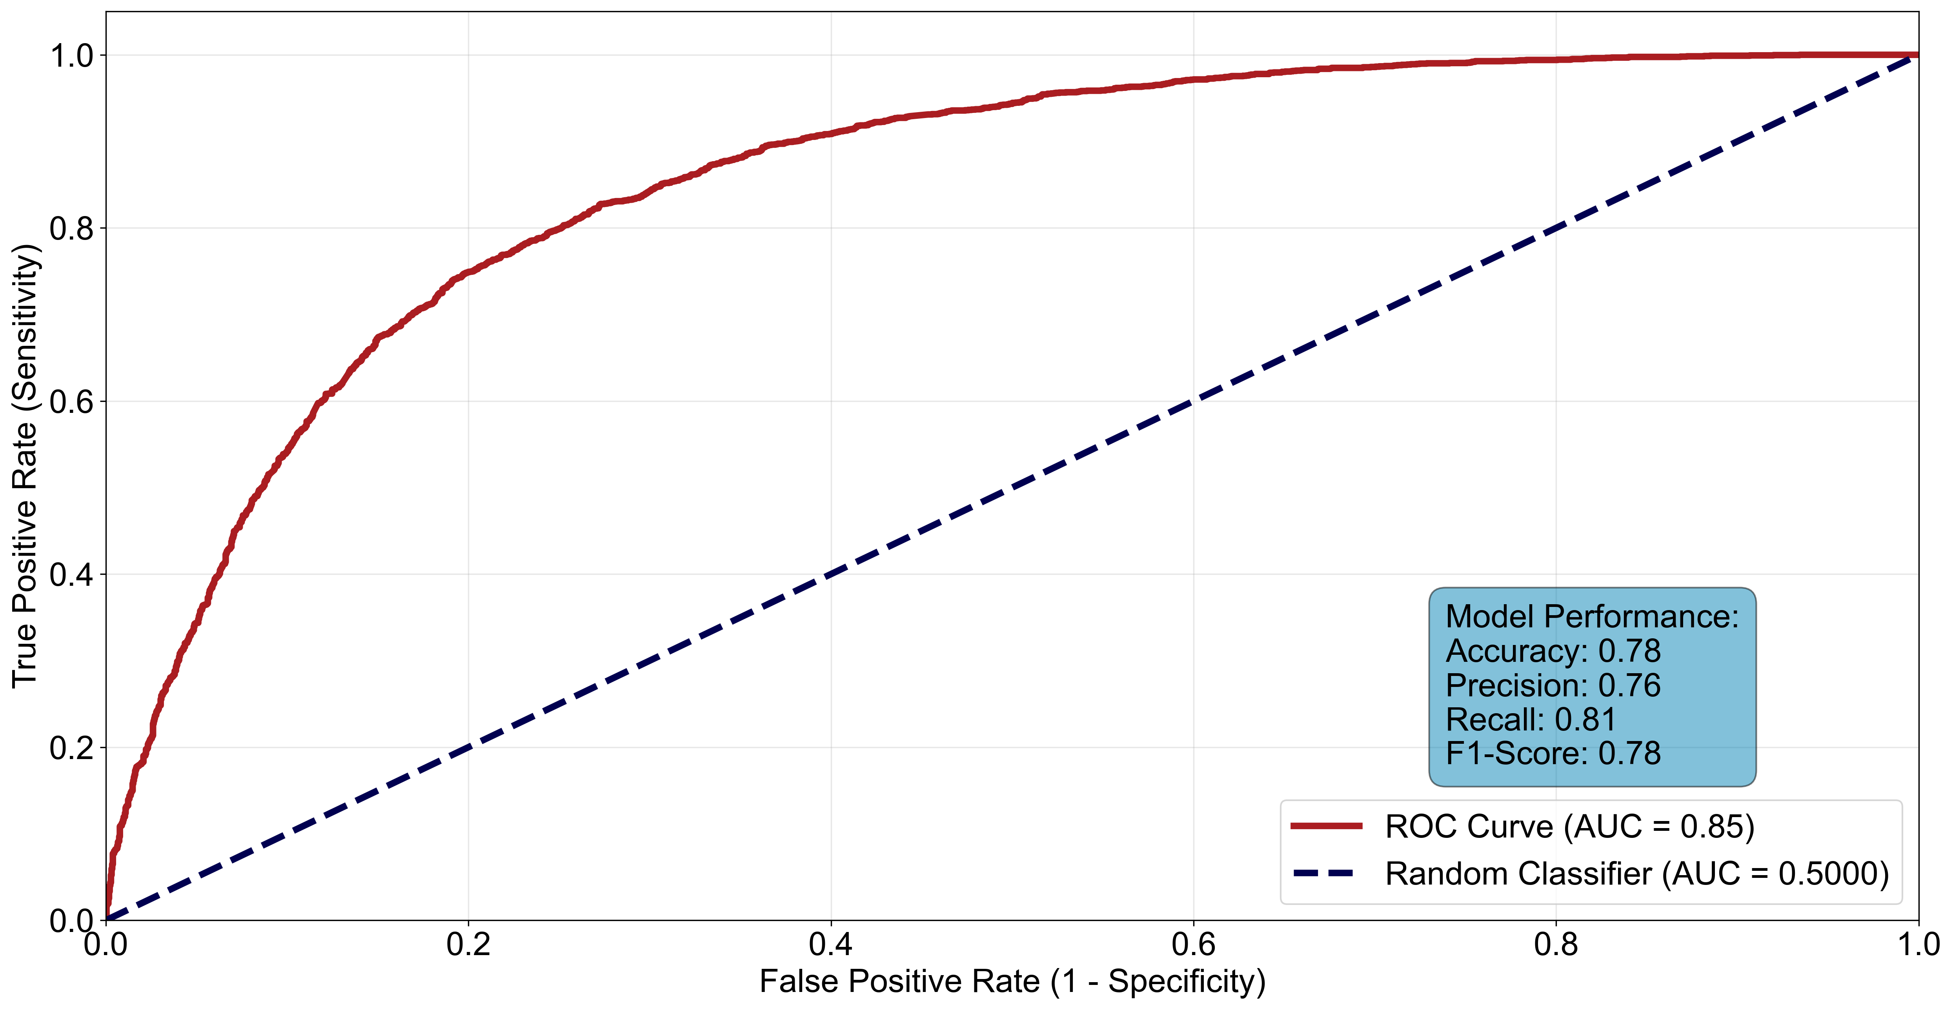
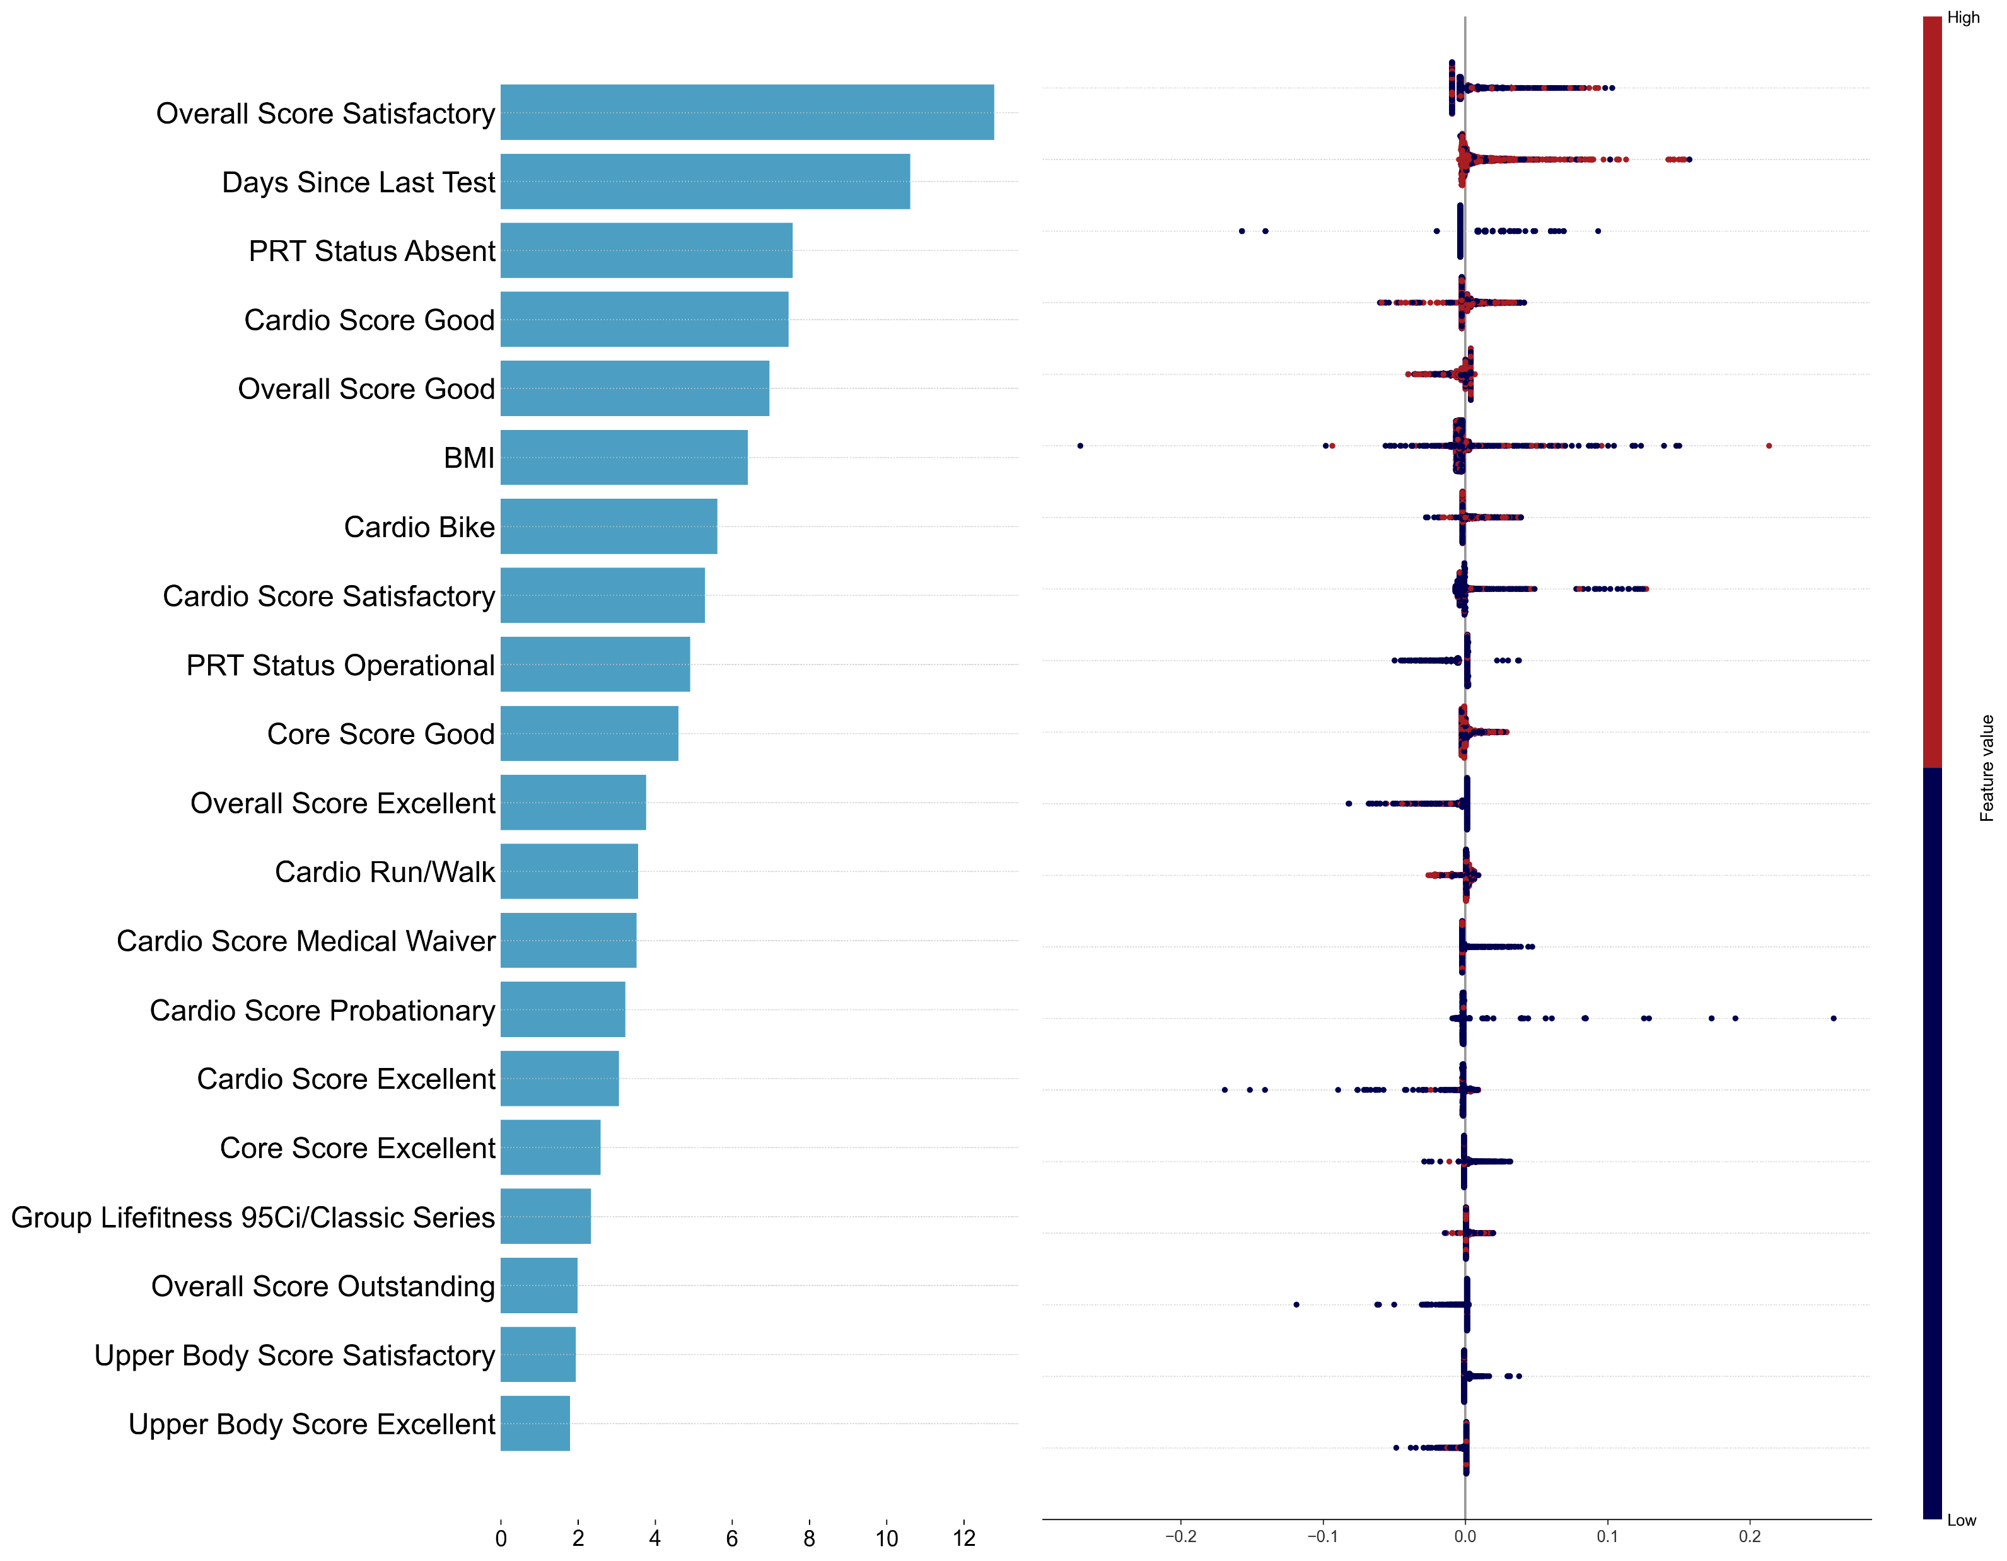
SEQUENTIAL MACHINE LEARNING MODEL PREDICTS CARDIOVASCULAR PHYSICAL READINESS TEST FAILURE
Meg I. Robinson, MS^{1,2}; Justin T. Stamets, MS^{1,2}; Ryan W. Smith, PhD¹; Andrew J. MacGregor, PhD¹
¹Naval Health Research Center, San Diego, CA; ²Leidos, Inc., San Diego, CA
BACKGROUND
RESULTS
RESULTS
U.S. Navy personnel regularly undergo Physical Readiness Tests (PRTs) to assess cardiovascular (cardio) fitness and overall physical readiness
Failure on the cardio PRT affects operational effectiveness, potentially resulting in discharge
The use of advanced sequential machine learning techniques to analyze longitudinal PRT data, predict cardio PRT failure, and identify key features remain underexplored
Figure 1. ROC-AUC Curves for Cardiovascular PRT Failure Prediction (GRU)
Table 1. Study Population Characteristics by Cardio Failure Group
 | Cardio PRT Failure (n=28,431) | Cardio PRT Non-Failure (n=28,431)
Demographics¹
Age (years), Mean ± SD | 24.3 ± 6.1 | 24.2 ± 5.8
BMI, Mean ± SD | 28.8 ± 4.1 | 25.7 ± 3.4
Sex, % Male | 22,716 (79.9) | 22,716 (79.9)
PRT History
Total Tests in Study Period, Mean ± SD | 3.7 ± 2.5 | 3.4 ± 2.3
≥1 Cardio Fail, n (%) | 28,431 (100) | 0 (0)
≥1 Upper Body Fail, n (%) | 367 (1.3) | 109 (0.4)
≥1 Core Fail, n (%) | 512 (1.8) | 166 (0.6)
Waiver History²
≥1 Medical Waiver, n (%) | 1,386 (4.9) | 870 (3.1)
≥1 Operational Waiver, n (%) | 6,451 (22.7) | 5,083 (17.9)
≥1 Absent Waiver, n (%) | 2,339 (8.2) | 2,314 (8.1)
≥1 Validated Waiver, n (%) | 542 (1.9) | 1,859 (6.5)
OBJECTIVES
Evaluate the performance of sequential machine learning models in predicting cardio PRT failure
Identify and report the most significant features contributing to the prediction of cardio PRT failure
1 Demographics at the time of the most recent physical readiness test within the study period
2 Medical waivers include pregnancy; operational waivers include DEP/OP, TAD, leave; absent waivers include unauthorized
SD: Standard Deviation, BMI: Body Mass Index, PRT: Physical Readiness Test
Figure 2. Top 20 SHAP-Based Feature Importance and Value Distributions for Cardiovascular PRT Failure Prediction
Table 2. Study Population Characteristics by Cardio Failure Group
“Pass”
“Fail”
High
Domain | Percent of signal | # Features
Overall score | 21.9% | 9
Cardio score | 20.4% | 8
Waiver status | 11.8% | 4
Core score | 11.1% | 9
Days since last test | 8.8% | 1
Cardio modality | 8.4% | 6
Upper body score | 8.3% | 9
BMI | 5.3% | 1
Cardio machine | 4.0% | 17
METHODS
Study Population
This was a retrospective analysis of 2014–2019 data from the Physical Readiness Information Management System
Active-duty Navy personnel with ≥2 valid PRTs were included
Matched Cohort Design
The analytical cohort included individuals who failed at least one cardio PRT that was not their first recorded test
These individuals were matched on sex, age at PRT within 3 months, unit, and number of tests to create an equal-sized comparison cohort
Sequential Machine Learning Model
A recurrent neural network, gated recurrent unit (GRU), was trained on all available sequences of PRT data for everyone in the cohorts
Output
Model performance was evaluated with AUC and F1 scores.
SHapley Additive exPlanations (SHAP) analysis was conducted to assess feature importance, with features analyzed both individually and across grouped domains (e.g., core, cardio, waiver)
64 features from the PRIMS dataset
Feature value
CONCLUSIONS
Sequential machine learning model demonstrated strong performance predicting cardiovascular PRT failure (AUC: 0.85)
Prior performance (overall & cardio) and waivers were most important predictors of cardio PRT failure
Using just the PRIMS dataset with 64 features, this is a simple and efficient model that is easy to maintain
These results can inform targeted interventions for individuals at-risk of PRT failure and potentially influence command directed enrollment in the Fitness Enhancement Program
Low
Percent of predictive signal
SHAP value
Disclaimer: I am a military service member or employee of the U.S. Government. This work was prepared as part of my official duties. Title 17, U.S.C. §105 provides that copyright protection under this title is not available for any work of the U.S. Government. Title 17, U.S.C. §101 defines a U.S. Government work as work prepared by a military service member or employee of the U.S. Government as part of that person’s official duties. This work was supported by U.S. Navy Bureau of Medicine and Surgery under work unit no. 60808. The views expressed in this work are those of the authors and do not necessarily reflect the official policy or position of the Department of the Navy, Department of Defense, nor the U.S. Government. The study protocol was approved by the Naval Health Research Center Institutional Review Board in compliance with all applicable federal regulations governing the protection of human subjects. Research data were derived from approved Naval Health Research Center Institutional Review Board protocol number NHRC.2003.0025.

