Slide 1

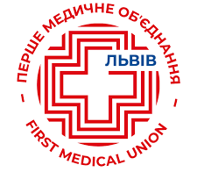


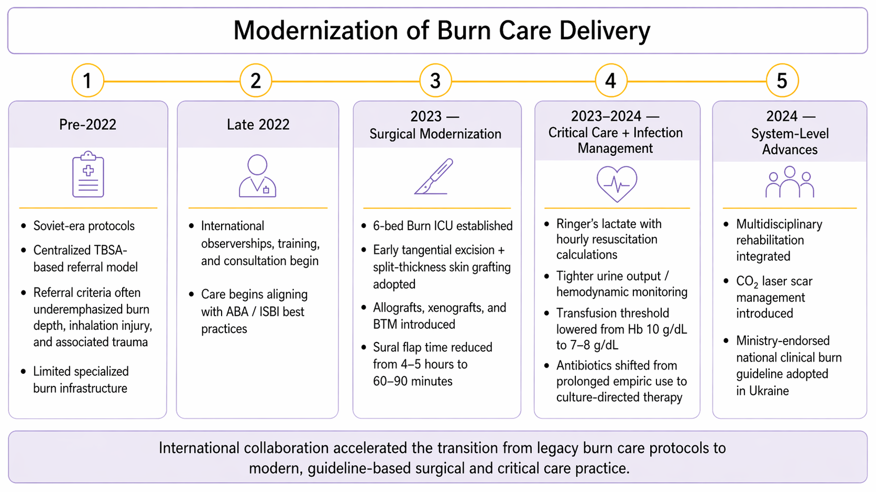
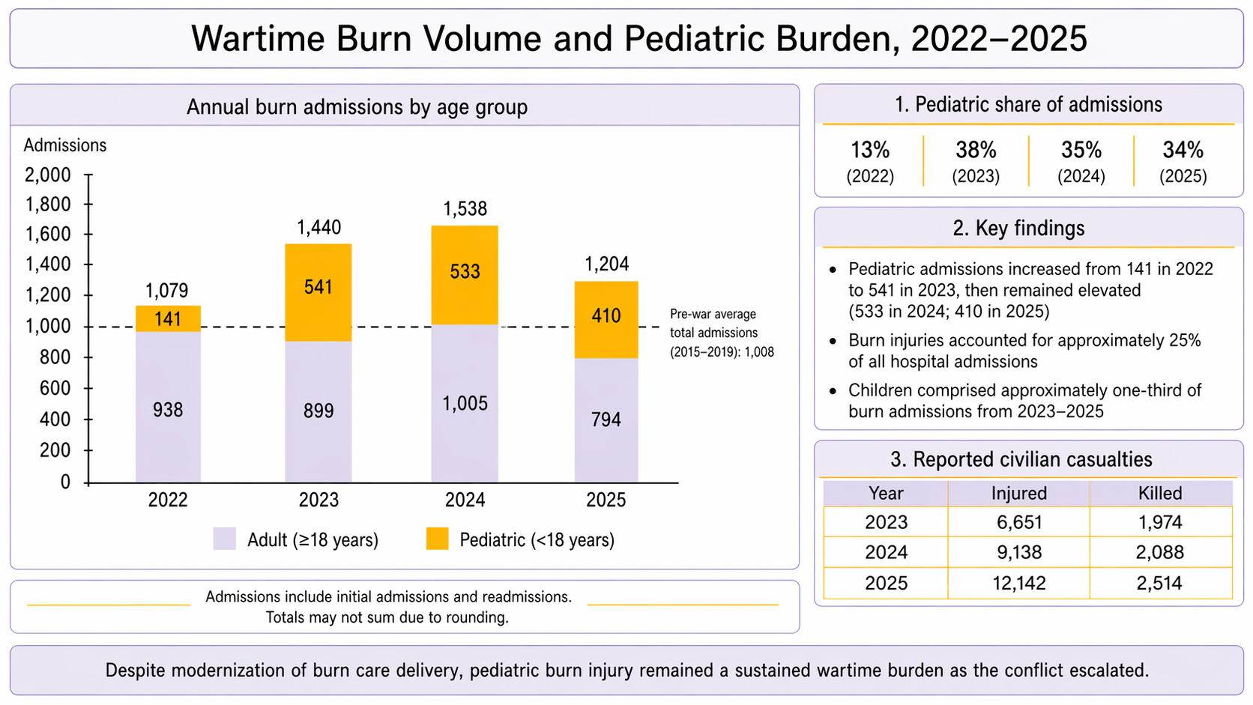
From Soviet-Era Protocols to Modern Burn Care: A Single-Center Experience with International Surgical Collaboration in Ukraine
Anastasiya Ivanko MS¹, Halyna Saian MD², Mariana Svirchuk MBA², Ivan Ryk MD², Vitaliy Kolodiy MD², M. Victoria P. Miles EMT-P, MD^{1,3},
Jonathan E. Schoen, MPH, MD, FACS, FABA^{1,3}, Jeffrey E. Carter, MD, FACS, FABA^{1,3}
Louisiana State University Health Sciences Center, School of Medicine, New Orleans; 2. First Medical Union Lviv Burn Center, Lviv Ukraine; 3.University Medical Center, New Orleans, Burn Center
INTRODUCTION
RESULTS
DISCUSSION
Russia’s full-scale invasion of Ukraine has produced a sustained and escalating burden of civilian trauma, including complex burn injuries.
Prior to 2022, burn care in Ukraine was largely guided by Soviet-era protocols, with limited incorporation of contemporary evidence-based burn practices.
Wartime demands exposed the need for rapid expansion of burn care capacity, standardized protocols, & multidisciplinary treatment pathways.
Beginning in late 2022, international surgical collaboration supported modernization of burn care at the First Medical Union Lviv Burn Center.
These efforts occurred alongside a growing & sustained pediatric burn burden, which had not been well characterized due to the absence of a unified national burn or trauma registry.
International collaboration led to the implementation of contemporary burn care practices: early STSG, dermal substitutes, refined resuscitation, culture-directed antimicrobial therapy, & multidisciplinary rehabilitation.
Referral practices evolved beyond TBSA-based criteria to better incorporate burn depth, inhalation injury, & associated trauma.
The 2024 Ministry-endorsed national guideline marks a shift from local practice change toward national standardization of burn care in Ukraine.
The sustained pediatric burden underscores that wartime burn injury extends beyond acute survival.
Children require longitudinal care pathways addressing growth-related contractures, scar management, functional recovery, psychosocial trauma, & staged reconstruction.
Conflict-affected burn systems must therefore be designed for continuity of care, not only crisis response.
METHODS
A retrospective descriptive review was conducted using de-identified hospital records from the First Medical Union Lviv Burn Center.
Burn admissions from January 2022–December 2025 were stratified by age group: pediatric <18 years and adult ≥18 years. Annual admission volumes were compared with pre-war annual averages from 2015–2019.
In parallel, clinical and system-level burn care adaptations implemented during the war were described, including changes supported by international collaboration, in-person observerships, training, and consultation.
Civilian casualty data were reviewed descriptively to contextualize admission trends during ongoing conflict escalation.
Because no national burn registry existed during the study period, analyses were limited to aggregate annual admission volumes and age-group stratification.
CONCLUSIONS
International collaboration enabled rapid modernization of burn care delivery in Ukraine, but retrospective admission trends demonstrated that pediatric burn injuries remained a sustained and substantial burden as the war escalated.
Modern burn systems in conflict settings must therefore address not only acute surgical care, but also long-term pediatric rehabilitation, reconstruction, & outcomes tracking.
ACKNOWLEDGMENTS
We thank our colleagues at the First Medical Union Lviv Burn Center for their leadership, resilience, and commitment to patient care under wartime austere conditions, without which this work would not have been possible.
This work was supported by the Spirit of Charity Foundation.
REFERENCES
WHO. Standards and Recommendations for Burns Care in Mass Casualty Incidents. WHO; 2024.
ABA. Guidelines for Burn Patient Referral. ABA; 2022.
ISBI Practice Guidelines Committee; Steering Subcommittee; Advisory Subcommittee. ISBI practice guidelines for burn care. Burns. 2016;42(5):953-1021. doi:10.1016/j.burns.2016.05.013.
Ministry of Health of Ukraine. Opiky: klinichna nastanova, zasnovana na dokazakh [Burns: Evidence-Based Clinical Guideline]. Ministry of Health of Ukraine; 2023.
Ma Y, Stewart G, Chipp E, Bache S. World burn care and the multidisciplinary team. Burns. 2025;51(4):107453. doi:10.1016/j.burns.2025.107453.
Ucak M, Celikkaya ME. Surgical evaluation of flame burn injuries in Syrian civilians. J Burn Care Res. 2019;40(6):864-869. doi:10.1093/jbcr/irz086.

