Slide 1





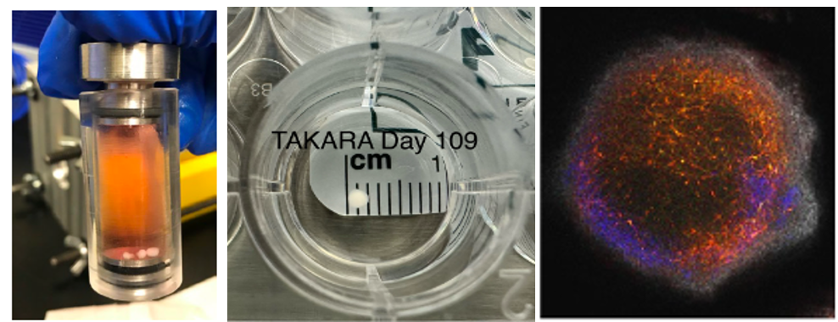
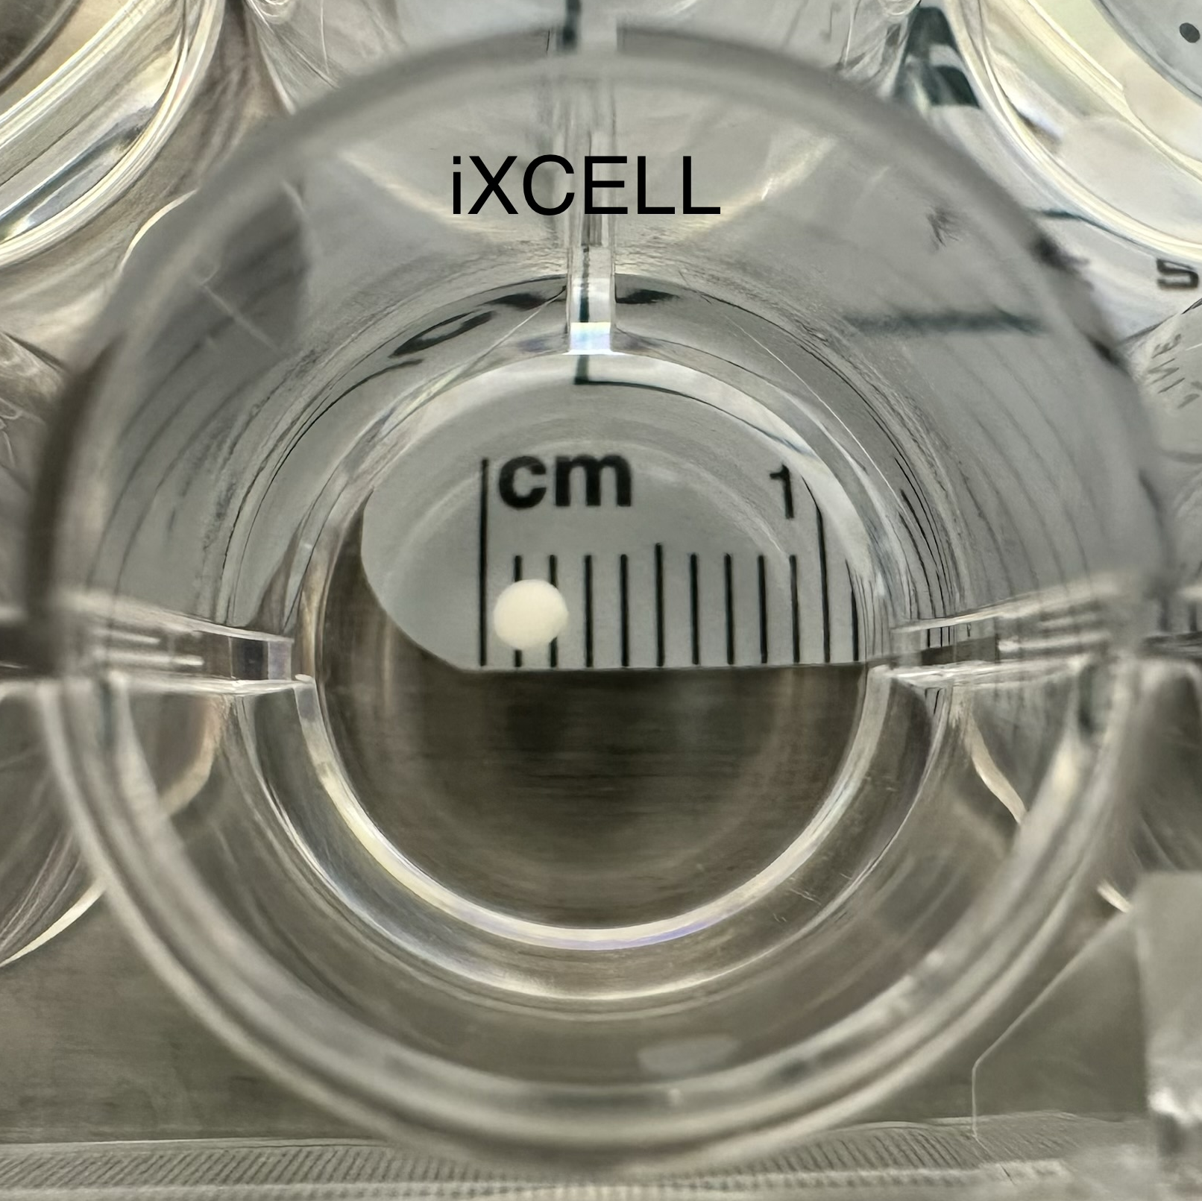
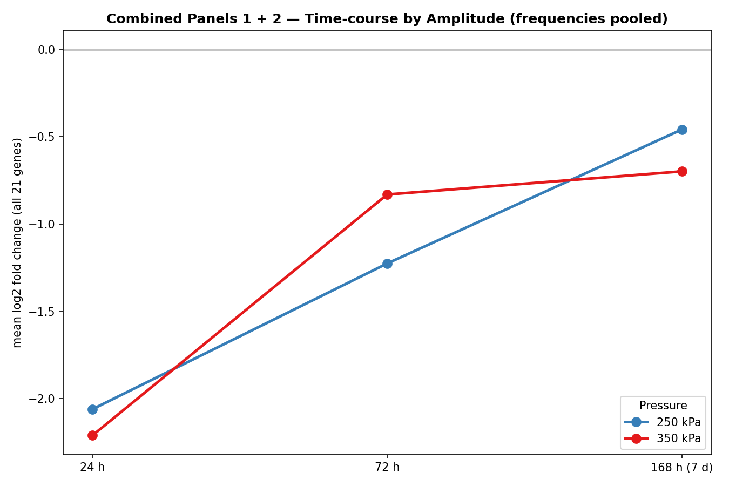
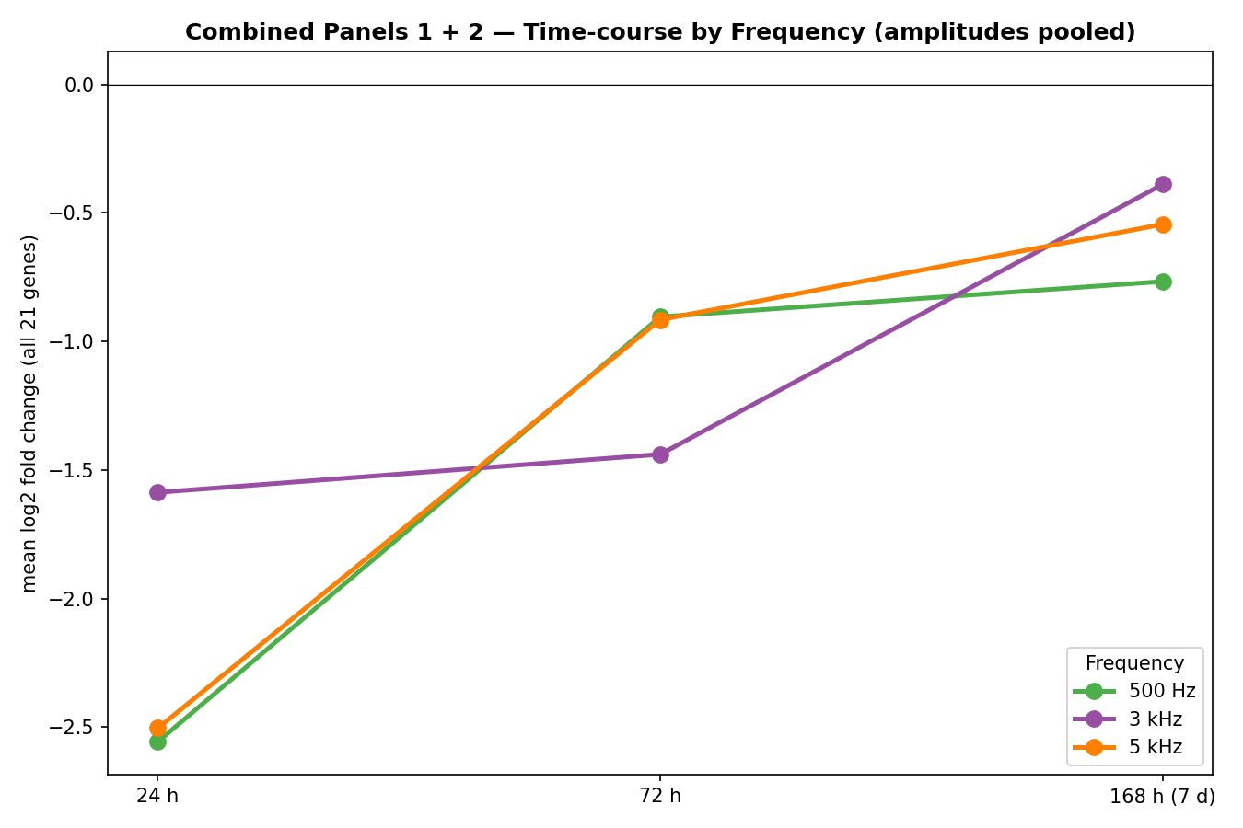
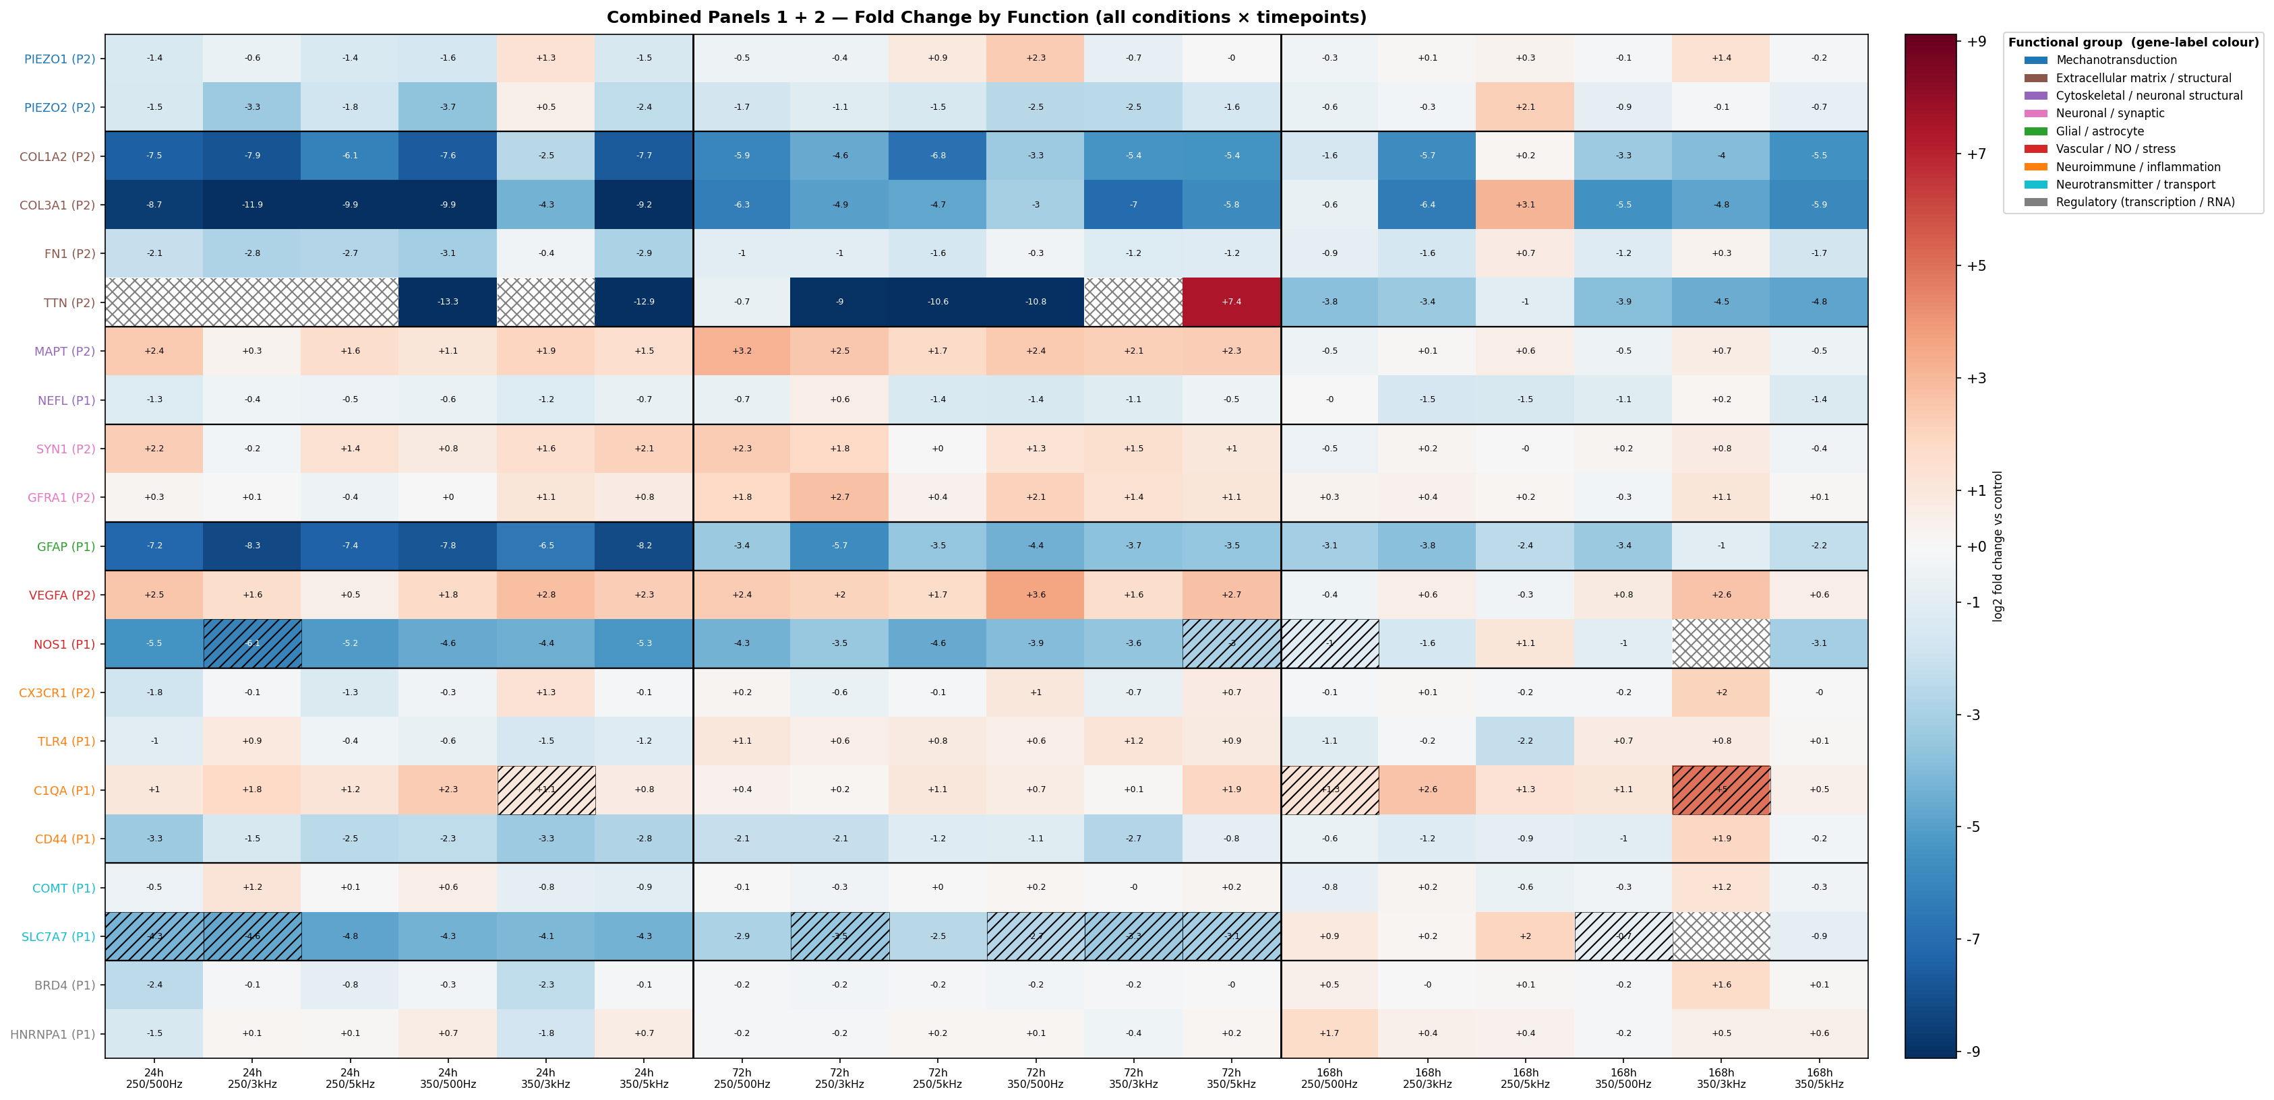
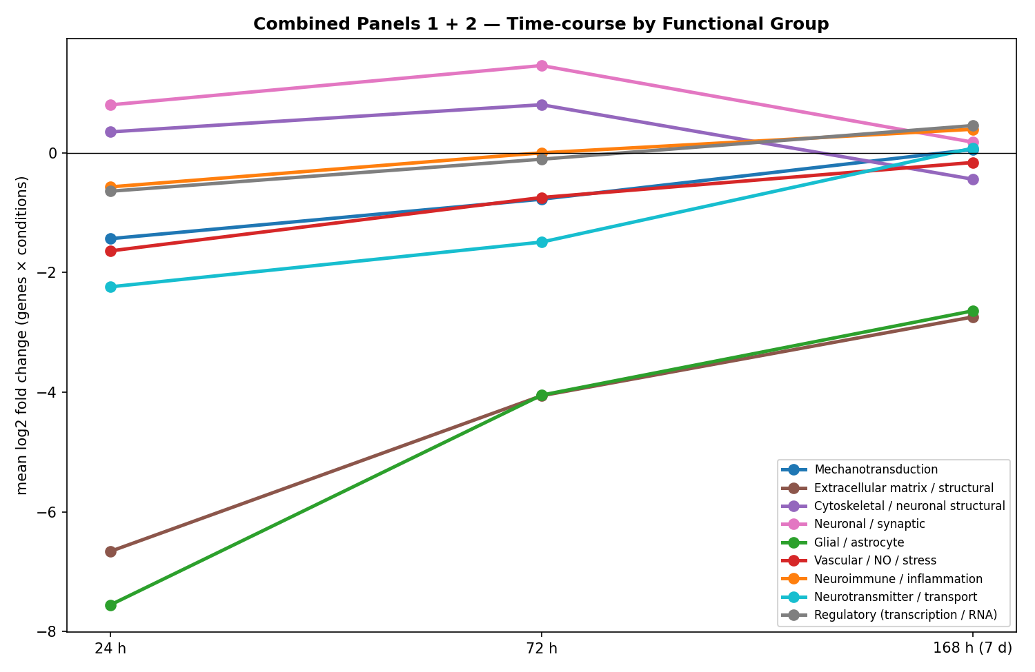
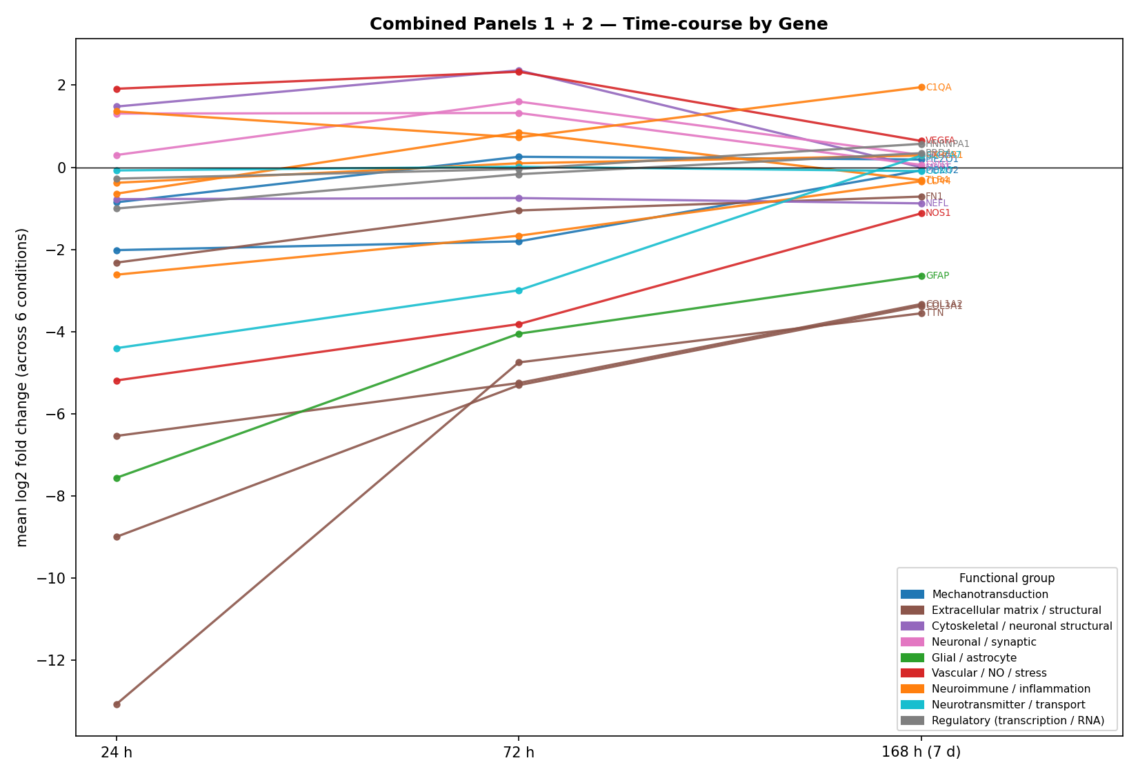
Evaluation of Cellular Mechanical Synapse Gene Expression Changes using Human Cerebral Organoids in a Blast Model.
Christi L. Salgado BS^{1,2}, Ann M. DiGeorge Foushee BS^{1,2}, Cassandra M. Rodriguez BS^{3,4}, Zane Lybrand PhD⁵, Carrie W. Hoppes PT, PhD^{1,2}, Col Adam M. Willis, MD, PhD⁶, Tony T. Yuan PhD, MS^{2,7}
¹ The Geneva Foundation, Tacoma, WA, ²4DBio³ Center for Biotechnology, Uniformed Services University, Bethesda, MD, ³ 59th Medical Wing Science & Technology, JBSA-Lackland, TX, ⁴ Emerge Solutions Group, North Bethesda, MD, ⁵Department of Biology, Texas Woman’s University, Denton, TX, and ⁶Department of Neurology, Uniformed Services University, Bethesda, MD. ⁷Department of Radiology & Bioengineering, Uniformed Services University, Bethesda, MD.
BACKGROUND
Blast-associated traumatic brain injuries (bTBIs) are prevalent among military populations, arising from both operational and occupational exposures. Characterizing and treating the short- and long- term consequences of blast exposures are challenging due to the wide range of injuries, inconsistent symptom reporting and highly variable exposure patterns. Active-duty service members are at heightened risk of TBI, primarily from blast injuries. To address this problem, we examine how specific mechanical pressure components contribute to brain injury, employing human cerebral organoids, generated from induced human pluripotent stem cells (iPSC)¹, to elucidate the cellular mechanisms that drive the resulting pathophysiology.
RESULTS
a)
b)
c)
Fold Change of Selected Functional Genes
Figure 1:
a) High-frequency pressure exposure chamber
b) Human iPSC-based cerebral organoids
Table 1: Targeted Genes and Functions.
Figure 2: Longitudinal Expression by Amplitude (Frequencies pooled).
Figure 3: Longitudinal Expression by Frequency (Amplitudes pooled).
Functional group | Gene | Panel | Role
Mechano-transduction | PIEZO1 | P2 | Mechanically-activated ion channel
Mechano-transduction | PIEZO2 | P2 | Mechanically-activated ion channel
Extracellular matrix / structural | COL1A2 | P2 | Collagen I (ECM)
Extracellular matrix / structural | COL3A1 | P2 | Collagen III (ECM)
Extracellular matrix / structural | FN1 | P2 | Fibronectin (ECM/adhesion)
Extracellular matrix / structural | TTN | P2 | Titin (elastic cytoskeleton)
Cytoskeletal / neuronal structural | MAPT | P2 | Tau (microtubule stabilization)
Cytoskeletal / neuronal structural | NEFL | P1 | Neurofilament light (axonal cytoskeleton)
Neuronal / synaptic | SYN1 | P2 | Synapsin I (synaptic vesicles)
Neuronal / synaptic | GFRA1 | P2 | GDNF-family receptor (neurotrophic)
Glial / astrocyte | GFAP | P1 | Astrocyte identity/reactivity
Vascular / NO / stress | VEGFA | P2 | Vascular endothelial growth factor (hypoxia/stress)
Vascular / NO / stress | NOS1 | P1 | Neuronal nitric-oxide synthase
Neuroimmune / inflammation | CX3CR1 | P2 | Fractalkine receptor (microglial)
Neuroimmune / inflammation | TLR4 | P1 | Toll-like receptor 4 (innate immune)
Neuroimmune / inflammation | C1QA | P1 | Complement C1q (near noise floor)
Neuroimmune / inflammation | CD44 | P1 | Adhesion / neuroinflammation
Neurotransmitter / transport | COMT | P1 | Catecholamine metabolism
Neurotransmitter / transport | SLC7A7 | P1 | Amino-acid transporter
Regulatory (transcription / RNA) | BRD4 | P1 | Chromatin/transcription regulator
Regulatory (transcription / RNA) | HNRNPA1 | P1 | RNA processing
OBJECTIVE
To analyze the role of targeted genes in TBI mechanisms, neuroinflammation and structural integrity.
To establish organoids as a model platform for studying bTBIs by independently or as a complement to animal models.
METHODS
Organoid Generation: Cerebral organoids were generated from various human induced pluripotent stem cells (iPSCs) as previously published¹ using a dual SMAD inhibition protocol and matured for >100 days (Fig 1b).
Blast Exposures: Matured organoids were subjected to high frequency pressure amplitudes of 250 or 350 kPa and frequencies of 500Hz, 3000Hz, and 5000Hz in a novel blast chamber (Fig 1a). Corresponding matched controls were included in the analysis.
qRT-PCR: RNA was extracted from both exposed organoids and unexposed controls at 24, 72 and 168 hours, RNA was processed to obtain cDNA for qPCR analysis. A panel of cellular mechanical and synaptic markers was used to assess differences in gene expression between control and blast-exposed samples over time. Fold change relative to time-matched controls was calculated using the 2^(−ΔΔCt) method, with each gene normalized to the housekeeping genes (18S/GAPDH/GUSB).
Statistics: Benjamini–Hochberg FDR was used across all 21 genes within each timepoint. Two-way ANOVA (Pressure × Frequency), Dunnett vs control, and 250-vs-350 kPa amplitude t-test, all on ΔCt.
Figure 4: Longitudinal Expression by Functional Group
Figure 5: Longitudinal Expression by Selected Genes
Figure 6: Time Course of Gene Expression at 24-, 72-, and 168-hours Post-Exposure. Longitudinal gene expression post blast expressed in fold change across all conditions. GFAP and NOS1 suppression yielded the most robust effects observed. Frequency and amplitude dependent effects could be visualized at 168-hours timepoint.
CONCLUSIONS
The acute (24-hour) response is a coordinated suppression of structural/identity and matrix genes-consistent with an early stress-and-remodeling reaction to mechanical loading. Concurrent downregulation of collagens, fibronectin, and GFAP indicates that mechanical energy perturbs cytoskeletal-ECM coupling, transiently halting matrix deposition and biosynthesis of load-bearing structural proteins. (Fig 4, 5).
GFAP suppression, a well-known blood biomarker for TBI², exhibits the single most robust signal, which points to an astrocyte-state shift rather than overt gliosis. Since astrogliosis typically raises GFAP, this strong, sustained decrease with only partial recovery by 168-hours suggests a downshift in astrocytic identity or a protective state change. The incomplete recovery implies a lasting, low-grade glial alteration rather than a fully reversible event. (Fig 6)
Mechano-sensors PIEZO1 and PIEZO2, the most direct sensors of applied stimulus, show the expected mechano-transduction with desensitization signature: acute transcriptional suppression followed by recover to baseline by 72-168-hours consistent with receptor adaptation/desensitization. (Fig 6)
The frequency-dependent modulation of COMT suggests acoustic frequency may tune neuromodulatory/catecholamine clearance capacity, notably linking a specific physical exposure parameter to a defined neurochemical pathway. (Fig 6)
A neuroinflammatory response (TLR4, C1QA, CX3CR1) emerging at 72-hours points to a slow neuroimmune component following the acute structural response. This mild, late drift of innate-immune/microglial genes is consistent with secondary rather than primary activation, warranting follow-up given its low magnitude. (Fig 6)
Disclaimer: The opinions and assertions expressed herein are those of the author(s) and do not necessarily reflect the official policy or position of Defense Health Agency, Uniformed Services University, or the Department of War.
COI: The authors do not have a financial interest in any commercial product, service, or organization providing financial support for this research.
Funding: We gratefully acknowledge USUHS Intramural New Faculty Award and DARPA BTO Seedling Award for financial support.
References
Silvosa, M. J., Mercado, N. R., Merlock, N., Vidhate, S., Mejia-Alvarez, R., Yuan, T. T., ... & Lybrand, Z. R. (2022). Understanding primary blast injury: high frequency pressure acutely disrupts neuronal network dynamics in cerebral organoids. Journal of neurotrauma, 39(21-22), 1575-1590.
Zhang Z, Zoltewicz JS, Mondello S, Newsome KJ, Yang, Z FC (2014) Human Traumatic Brain Injury Induces Autoantibody Response against Glial Fibrillary Acidic Protein and Its Breakdown Products. PLOS One, journal.pone.0092698.

