Slide 1
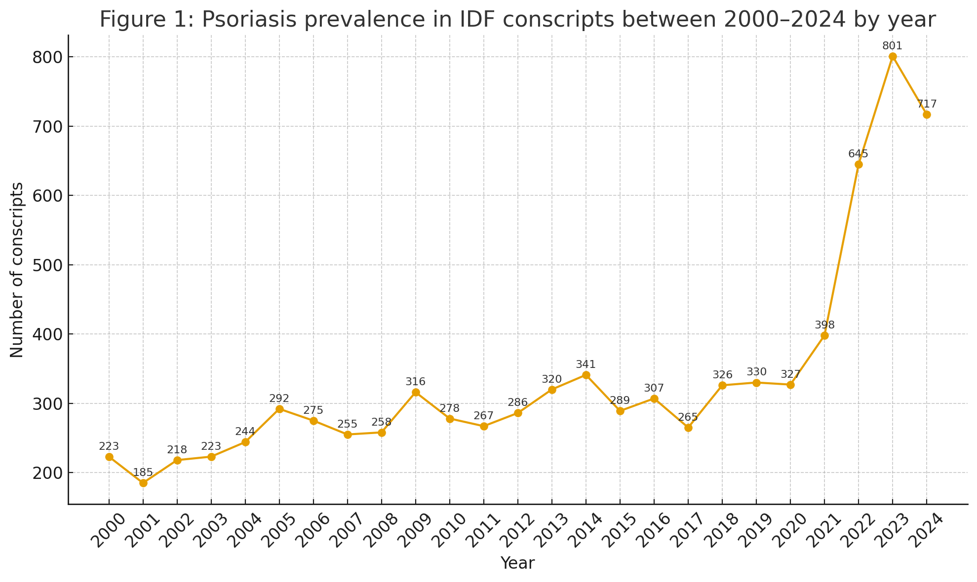
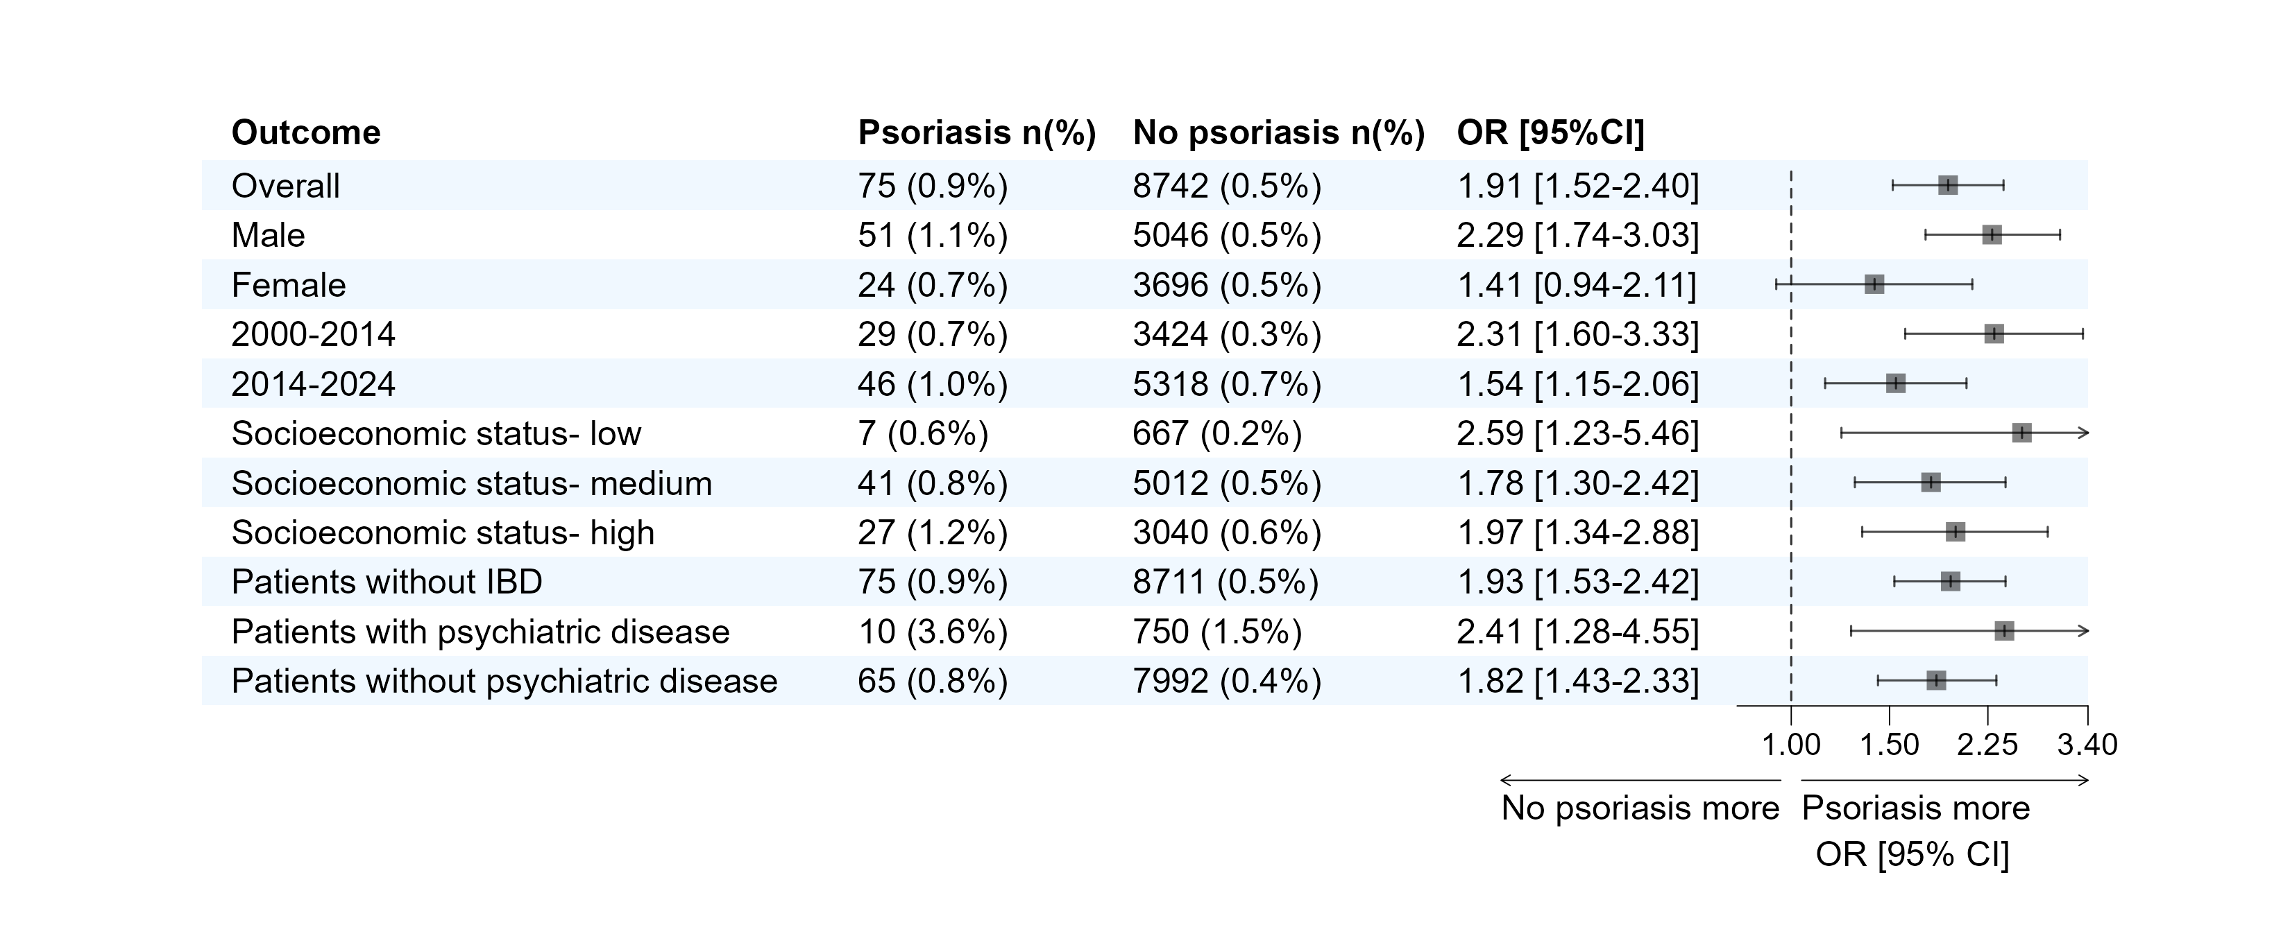
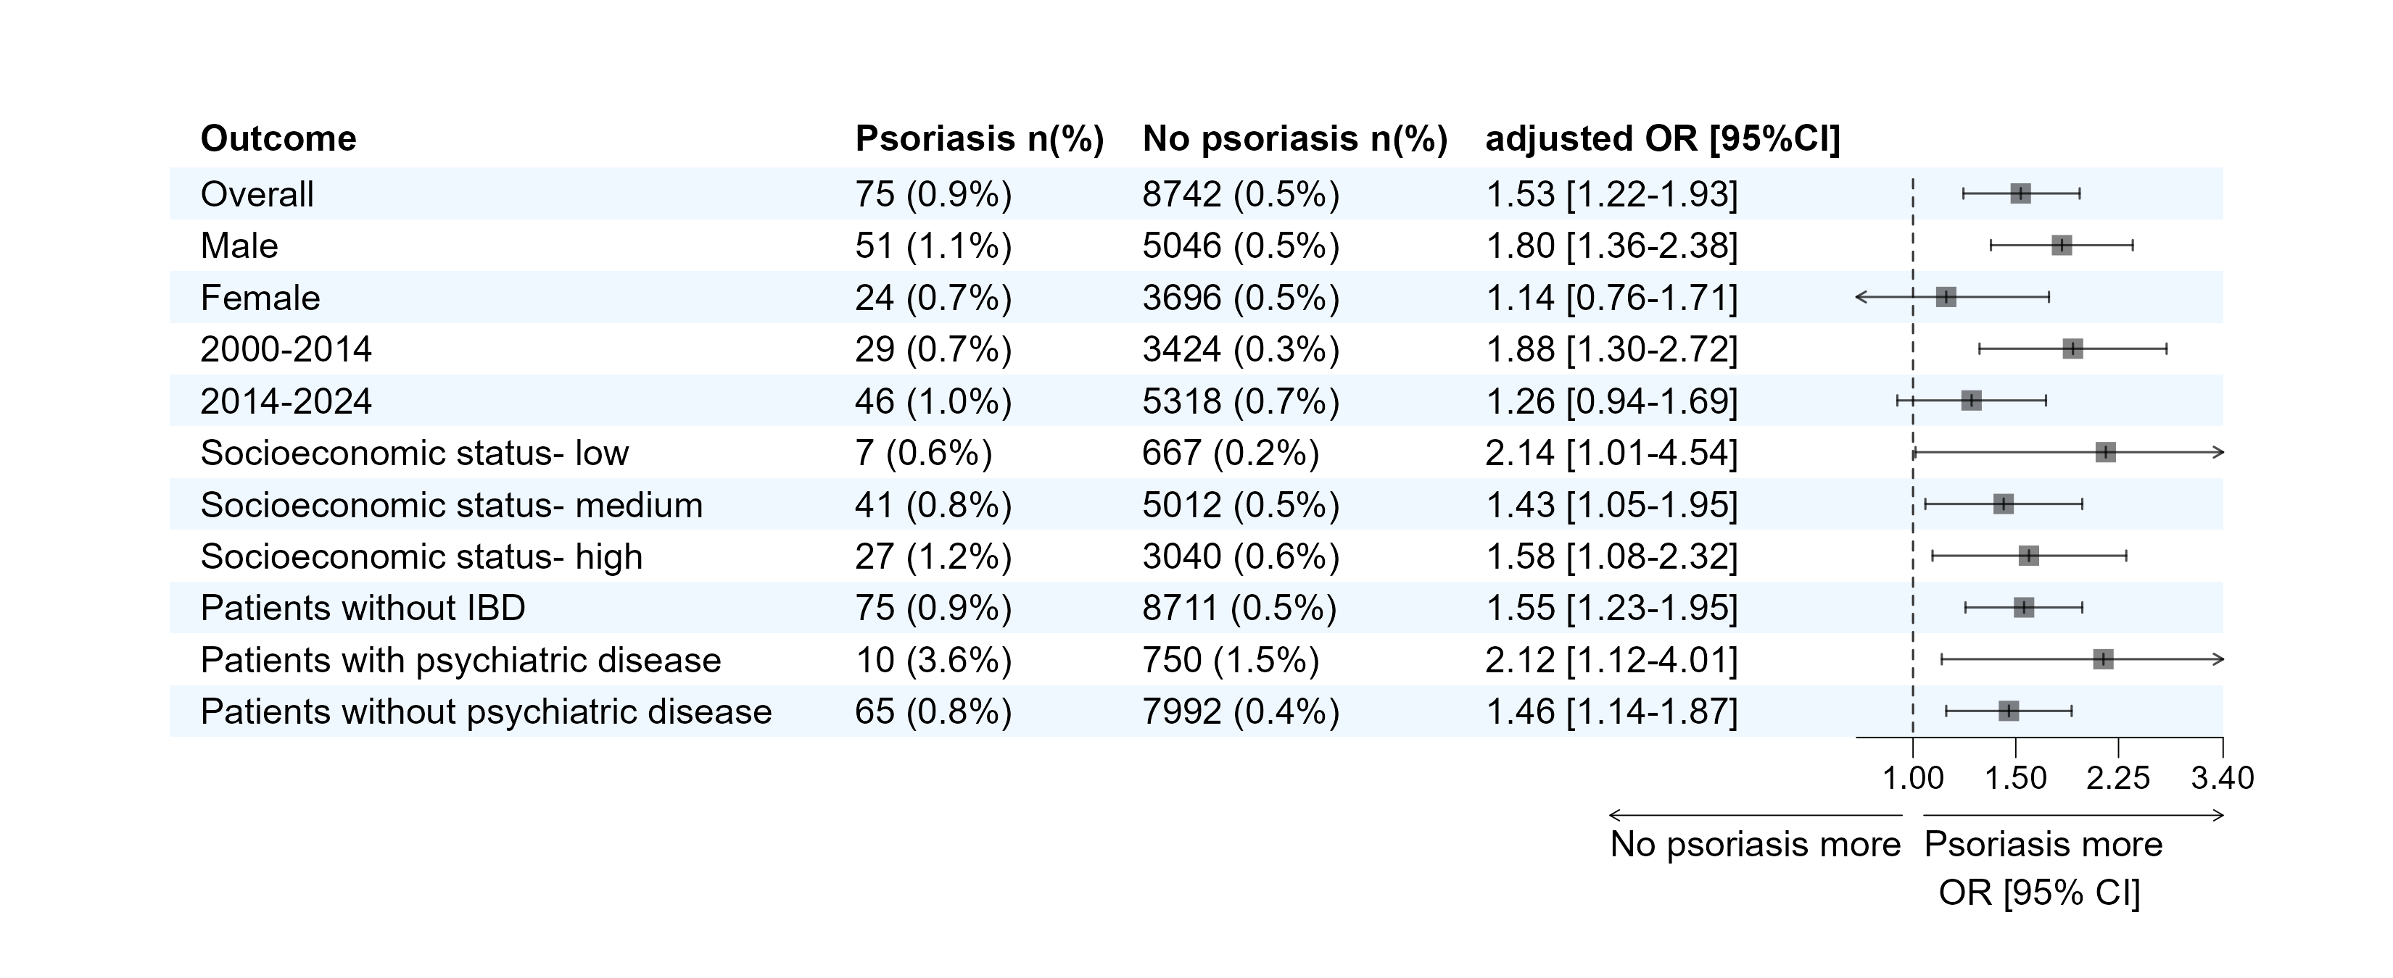
Skin, Stress and Gut: Investigating Psoriasis Comorbidities in IDF Cohort
Authors
Lirom Motola^{1,2}, MD; Shahar Ronen^{1,2,3}, MD; Michal Leibovitch¹, MD, MPH; Aya Bardugo¹, MD; Meir Schechter¹, MD, PhD; Doron Stupp¹ MD, PhD; Hadar Sharvit¹, BSc; Yael Hod¹, BSc; Yuval Hillerowicz^{1,2,4} MD.
1. Medical Data Research Institute, Israel Defense Forces Medical Corps, Tel Hashomer, Ramat Gan, Israel.
2. Department of Military Medical Research, Faculty of Medicine, The Hebrew University of Jerusalem, Jerusalem, Israel.
3. Medical Classification and Occupational Health Branch, Israel Defense Forces Medical Corps, Ramat Gan, Israel.
4. Dermatology Department, Medical Services Center, Israel Defense Forces Medical Corps, Ramat Gan, Israel
Background
Psoriasis is a chronic systemic skin condition, characterized by increased epidermal proliferation and erythematous squamous lesions¹.
There are consistent links between psoriasis, mental illness and irritable bowel syndrome (IBS)^{2,3}.
However, the direct relationship between psoriasis and IBS has received relatively little attention in the literature, and existing studies provide insufficient evidence to establish a clear connection.
This study aimed to evaluate the associations of psoriasis and IBS among adolescents with psoriasis within a large military cohort.
Methods
We performed a retrospective cross-sectional study.
Were included Israeli military conscripts aged 16–19, who underwent standardized pre-conscription medical evaluations between 2000 and 2024.
Diagnoses of psoriasis, mental disorders associated with IBS (including depression, anxiety, schizophrenia, bipolar disorders, somatization, and sleep disorders), and IBS were identified via coded medical assessments.
Univariate and multivariate Logistic regression models were used to assess the association between the presence of psoriasis and IBS.
They were adjusted to sociodemographic variables (as described in Table 1) and psychiatric disorders associated with IBS.
In a sensitivity analysis, patients without IBD were excluded to verify the results.
Table 1. Baseline Socio-Demographic Characteristics of IDF Conscripts With and Without Psoriasis Between 2000-2024
Results
The study cohort included 8,427 (0.45%) patients with psoriasis, and 1,870,411 without psoriasis (Table 1).
The prevalence of psoriasis was 0.31% in 2000 and 0.67% in 2024 (Figure 1).
Among individuals with psoriasis, 75 (0.89%) were diagnosed with IBS compared to 8,742 (0.47%) in the control group.
To further assess the strength of this association, univariate and multivariate logistic regression analyses were performed (Figure 2). Individuals with psoriasis had higher odds to be diagnosed also with IBS (OR 1.91, 95% CI 1.51–2.40). These results remained consistent after adjustment for sociodemographic variables and mental comorbidity (adjusted OR 1.53, 95% CI 1.22-1.93).
Variable | Psoriasis (n = 8,427) | Conscripts without psoriasis (n = 1,870,411)
Age at last medical appointment, mean | 17.55 | 17.38
Gender – female, n (%) | 3,650 (43.3) | 792,885 (42.4)
Socioeconomic status, n (%)
Low | 1,177 (14.0) | 289,347 (15.6)
Medium | 4,894 (58.3) | 1,058,932 (57.0)
High | 2,320 (27.6) | 510,432 (27.5)
Country/continent of origin, n (%)
Israel | 7,294 (86.6) | 1,611,456 (86.2)
USSR | 781 (9.3) | 152,221 (8.1)
West | 308 (3.7) | 73,423 (3.9)
Ethiopia | 23 (0.3) | 26,643 (1.4)
Asia | 14 (0.2) | 3,927 (0.2)
Africa | 4 (0.0) | 706 (0.0)
Residential area type, n (%)
Urban | 7,539 (89.8) | 1,660,040 (89.2)
Rural | 853 (10.2) | 199,129 (10.7)
Psychotechnical Test Score, n (%)
Low | 1,504 (17.8) | 401,429 (21.5)
Medium | 4,187 (49.7) | 928,593 (49.6)
High | 2,736 (32.5) | 540,347 (28.9)
Ethnicity – non-Jewish, n (%) | 754 (9.0) | 131,301 (7.0)
Figure 1. Psoriasis prevalence in IDF Conscripts Between 2000-2024 by Year
Figure 2. Association Between Psoriasis and IBS, With and without Adjustments for Sociodemographic and Psychiatric Factors
Conclusions
In this large nationwide cohort of adolescents, those with psoriasis had higher odds of having IBS. The findings highlight the importance of assessing IBS as part of the comorbidities associated with psoriasis.
References
Griffiths, C. E. M., Armstrong, A. W., Gudjonsson, J. E., & Barker, J. N. (2021). Psoriasis. The Lancet, 397(10281), 1301–1315.
Lukmanji, A., Benczik, M., & Drucker, A. M. (2020). Risk of depression in patients with psoriasis: A systematic review and meta-analysis. JAMA Dermatology, 156(9), 1043–1051.
Gulbahar, Ü., Kaya İslamoğlu, Z. G., Aytekin, S., Arslan, İ., & Akdoğan, R. A. (2020). Psoriasis and irritable bowel syndrome: Is there an association? Annals of Medical Research, 27(3), 828–831.

