Slide 1
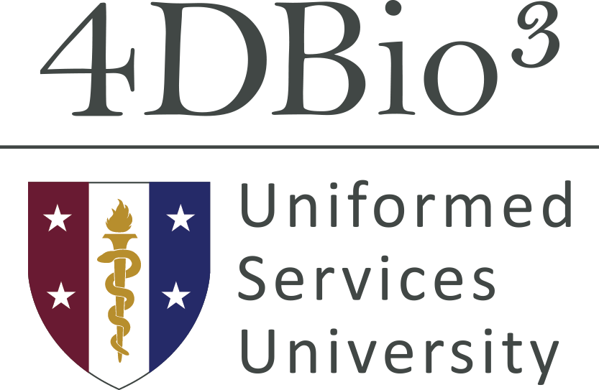
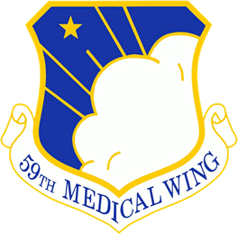
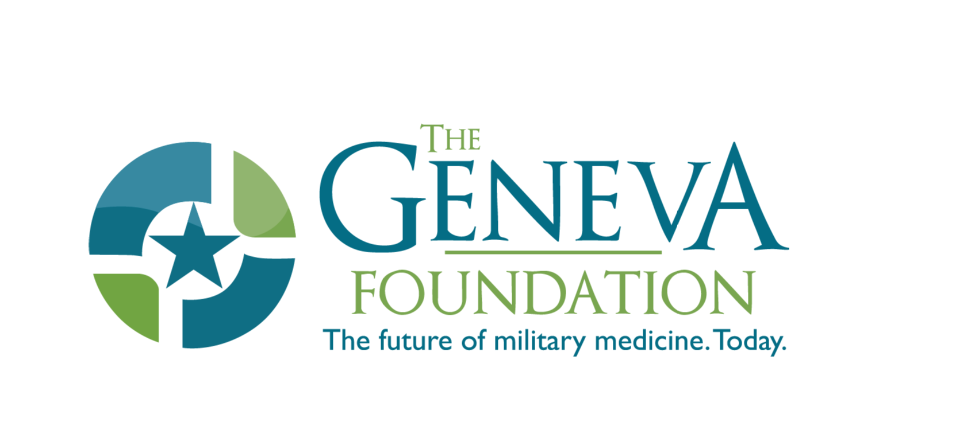


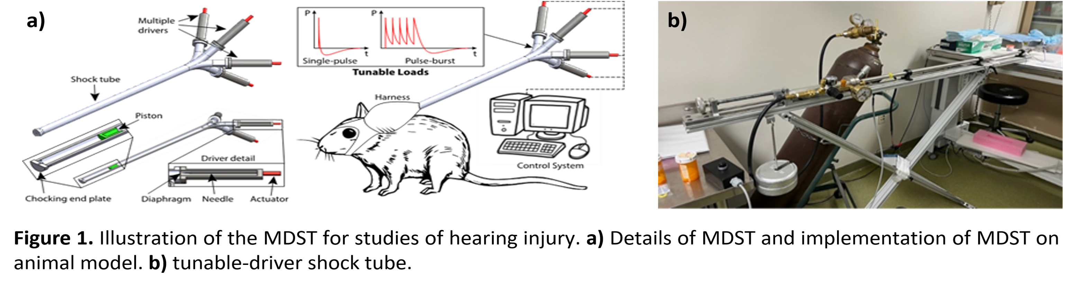
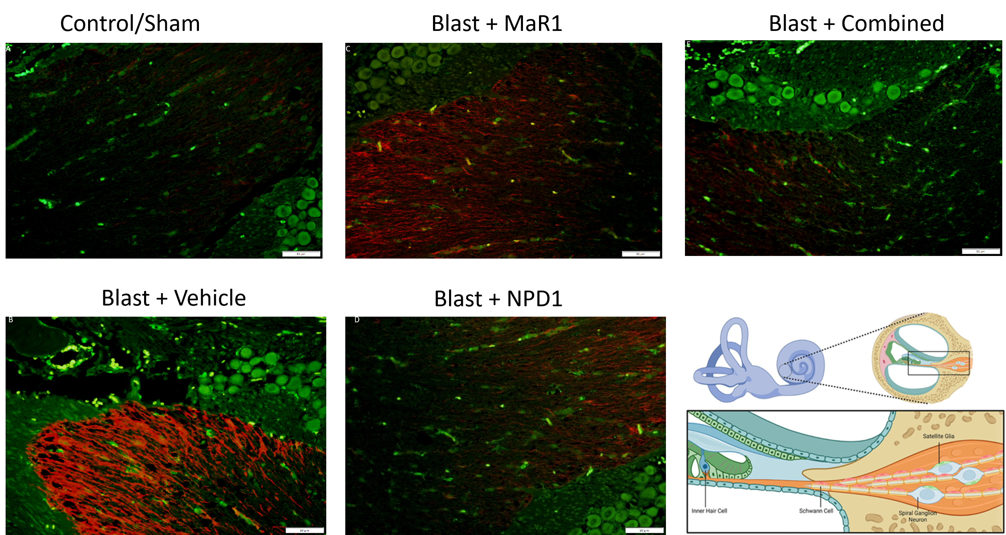
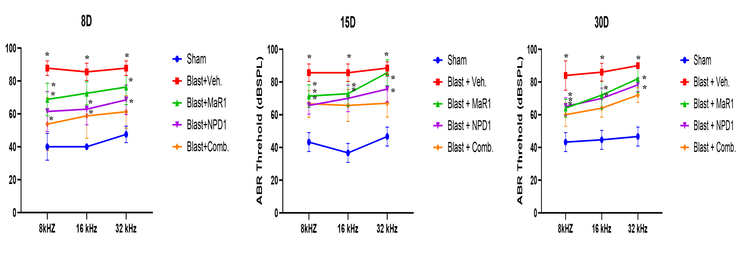
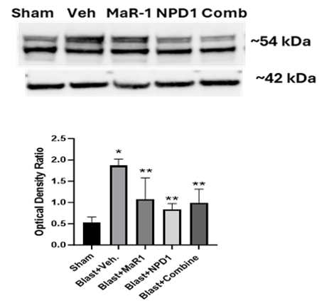
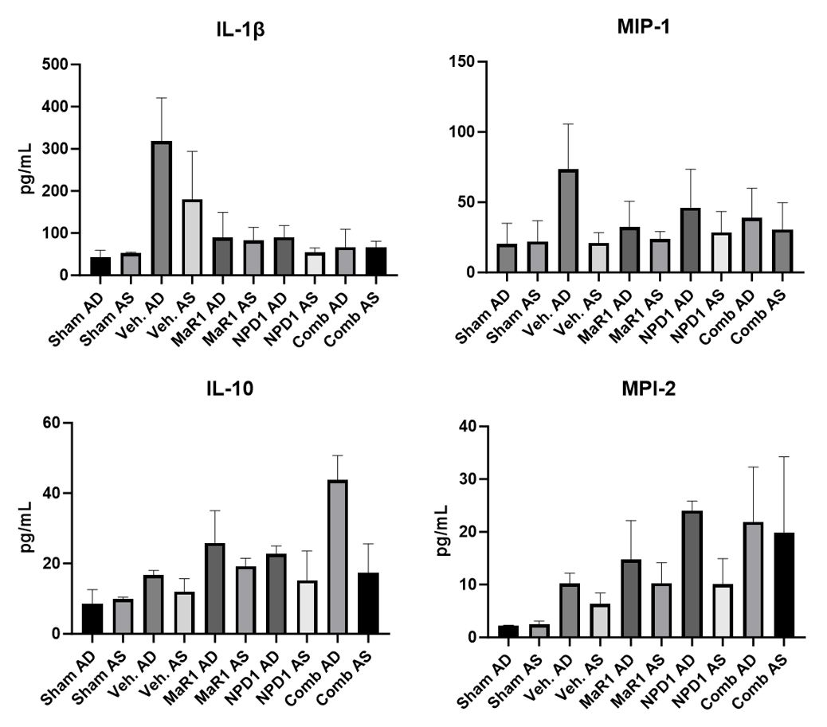
Beyond Anti-Inflammatories: Novel Strategies to Mitigate Blast-Induced Auditory Injury
José D. Ríos, PhD^{1,2}, Cassandra M. Rodriguez^{2,3}, Christi L. Salgado^{1,4}, Tushar Kailu, MS^{4,5}, Ricardo Mejia-Alvarez, PhD⁵, Charles N. Serhan PhD, DSc⁶, Tony T. Yuan, PhD, MS^{4,7}, LTC Isaac D. Erbele, MD^{8,9}
¹The Geneva Foundation, Tacoma, WA , ²59th Medical Wing Science & Technology, JBSA-Lackland, TX, ³Emerge Solutions Group, North Bethesda, MD, ⁴4DBio³ Center for Biotechnology, Uniformed Services University, Bethesda, MD, ⁵Department of Engineering, Michigan State University, ⁶Center for Experimental Therapeutics and Reperfusion Injury, Department of Anesthesiology, Perioperative and Pain Medicine, Brigham and Women's Hospital, Harvard Medical School, Boston, MA, ⁷Department of Radiology & Bioengineering, Uniformed Services University, Bethesda, MD, ⁸Department of Surgery, Uniformed Services University, Bethesda, MD , ⁹Brooke Army Medical Center, Fort Sam Houston, TX,
BACKGROUND
Blast-induced traumatic brain injuries (bTBIs) with auditory disfunction are a key concern for military personnel. Blast overpressure can induce a neuroinflammatory response that can progress to a sensorineural hearing loss and tinnitus^{1,2}. Although current therapeutic approaches, such as glucocorticoids and antioxidants, have been shown to reduce inflammatory mediators in blast-induced TBI^{3,4}, these approaches do not target the pro-resolution pathways associated with expeditious termination of inflammation exerted by the specialized pro-resolvin lipid mediators (SPMs) like Maresin-1 (MaR-1) and neuroprotectin D1 (NPD1) after blast exposure. By promoting inflammation termination following blast exposure, SPMs represent a promising therapeutic strategy to preserve hearing and mitigate lasting auditory injuries.
RESULTS
a)
b)
c)
SPMs Attenuates Blast Overpressure Induced Reactive Microglial Cells and Glial Cells Activation in the Cochlea
a)
c)
e)
SPMs Improves Hearing Thresholds at 8, 15, and 30 Days after Blast Exposure
OBJECTIVE
The objective of this study is to analyze the effectiveness of SPMs in delivering auditory protection following blast-induced trauma in a rodent model.
b)
d)
METHODS
Animals and Blast Wave Exposure: Adult male Long-Evans rats were anesthetized and subjected to high-pressure shock waves generated by the multi-driver shock tube (MDST) (Fig 1) to a single blast overpressures level of ~17 Psi. After blast exposure, rats were treated daily up to seven days with either 1.0 µg/kg MaR1, 0.1 µg/kg NPD1, combined (MaR1+NPD1), or vehicle (saline), delivered intravenously. Hearing thresholds were assessed with auditory brainstem responses (ABR) at frequencies of 8, 16, and 32kHz during the baseline, right after blast and at 8, 15, and 30 days after blast injury.
At the conclusion of the study (30D), animals were euthanized and the cochleae were harvested and subjected to immunohistochemistry, Western Blots (WBs), and bead‐based immunoassay (Luminex) analyses for glial fibrillary acidic protein (GFAP), ionized calcium-binding adaptor 1 (Iba1), and pro-inflammatory cytokines and chemokines (MilliPlex® rat cytokine/chemokine (IL-1β, IL-10, MIP-1, and MIP-2) panel) expression, respectively. Tissues were evaluated for relative levels of positive signals compared to the unexposed controls. The ABR threshold measurement, WBs, and Luminex data were expressed as the mean ± SEM and plotted in GraphPad Prism (GraphPad Software Inc., Version 9.0).
Figure 2. ABRs from animals subjected to single (~17 Psi) blast exposure followed by treated with either vehicle MaR-1, NPD1, or MaR-1+NPD1 (Combined). Increased hearing thresholds on the exposed ears was detected in vehicle blast-exposed animals after compared to sham or control. MAR-1 significantly reduced hearing thresholds levels at 8 kHz. However, NPD1, and combined SPMs significantly reduced hearing thresholds levels at all frequencies tested. Two-way ANOVA to check the significance (*) of drug treatment’s effects (P < 0.05). N=4-7 animals per group.
Figure 3. Immunolocalization of GFAP and Iba-1 in the cochlea after blast exposure. An increase in GFAP- and Iba-1- immunostaining was detected across the cochleae nerve fibers (CNF) and the spiral ganglion neurons (SGN) in the cochleae at 30 days post-blast of b) vehicle blast-exposed rats compared to a) controls. c) MaR-1, d) NPD1, or e) MaR-1+NPD1 (Combined) treatment reduced GFAP- and Iba-1 immunostaining of CNF and SGN from blast-exposed rats. SPMs mitigated upregulation of glial and microglial reactivity in the cochlea 30 days after blast injury. GFAP (red), Iba-1 (green), 200X magnification (bars = 100 µm).
SPMs Reduces GFAP Protein Levels and Modulate Cytokines and Chemokines Expression in the Cochlea after Blast Exposure
a)
c)
MIP-2
Figure 4. a) Representative immunoblots of GFAP protein expression from cochleae at 30 days post-blast. b) Optical density analysis. GFAP levels were significantly increased in cochleae of blast exposed and vehicle treated animals compared to shams. SPMs significantly decreased blast-induced GFAP protein expression in the cochleae. Β-Actin was used as loading control. c) Measurement of IL-1β, IL-10, MIP-1, and MIP-2 analytes in the cochleae at 30 days post-blast. Increased IL-1β levels in cochleae homogenates of blast exposed animals were reduced by SPMs treatments. IL-10, MIP-1, and MIP-2 levels were increased in SPMs treatment of blast exposed animals suggesting SPMs modulate microglial activation. *= significant from sham, **= significant from blast + Vehicle.
b)
Disclaimer: The opinions and assertions expressed herein are those of the author(s) and do not necessarily reflect the official policy or position of Defense Health Agency, Uniformed Services University, or the Department of War.
COI: The authors do not have a financial interest in any commercial product, service, or organization providing financial support for this research.
CONCLUSIONS
MDST induced auditory injury is characterized by a shift in hearing threshold levels and increased expression of proinflammatory mediators following blast exposure.
The SPMs, MaR-1 and NPD1 exhibited mitigation of the blast-induced hearing threshold shifts and reduced the expression of proinflammatory mediators after blast exposure.
Therapeutic approaches targeting resolution of inflammation with SPMs may advance effective strategies for hearing restoration to reduce cochlear and auditory nerve injury associated to blast exposures.
References
Kubli LR, Brungart D, Northern J. Effect of Blast Injury on Auditory Localization in Military Service Members. Ear Hear. 2018 May/Jun; 39(3):457-469.
Cho SI, Gao SS, Xia A, Wang R, Salles FT, Raphael PD, Abaya H, Wachtel J, Baek J, Jacobs D, Rasband MN, Oghalai JS, “Mechanisms of hearing loss after blast injury to the ear” PLoS One. 2013; 8(7): e67618
Ewert DL, Lu J, Li W, Du X, Floyd R, Kopke R. Antioxidant treatment reduces blast-induced cochlear damage and hearing loss. Hear Res 2012; 285:29–39.
Kalinec GM, Lomberk G, Urrutia RA, Kalinec F. Resolution of Cochlear Inflammation: Novel Target for Preventing or Ameliorating Drug-, Noise- and Age-related Hearing Loss. Front Cell Neurosci. 2017; 11: 192
Serhan CN. Pro-resolving lipid mediators are leads for resolution physiology. Nature. 2014; 510:92–101
Statement: Research was conducted in compliance with the Animal Welfare Act, the implementing Animal Welfare Regulations, and the principles of the Guide for Care and Use of Laboratory Animals, National Research Council. The facility’s Institutional Animal Care and Use Committee approved all research conducted in this study. The facility where this research was conducted is fully accredited by AAALAC. The authors do not have a financial interest in any commercial product, services, or organization providing financial support for this research. IACUC approved FHW20230035AR.
Acknowledgements
The work was supported by the Congressionally Directed Medical Research Program under Hearing Research Program Grant Number W81XWH-22-2-0047

Slide 2
MIP-2

