Slide 1


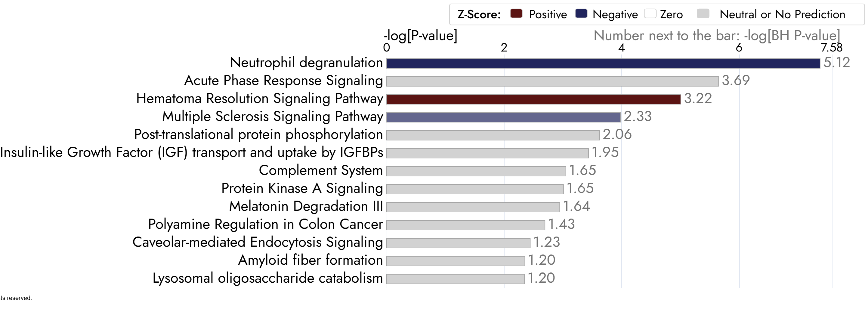
Prospective Identification of Stress Fracture Risk via Serum Proteomic Profiling upon Entry to Training at the US Military Academy
Emily A Ricker^{1,2,3,4}, Christopher K Kargl⁵, Thomas P Conrads⁶, Ming Zhou⁶, Nicholas W Bateman⁴, Sarah J de la Motte⁷, Kenneth L Cameron^{2,8}
¹Center for Advanced Research for Military Optimization, Readiness, and Rehabilitation, ²Department of Physical Medicine and Rehabilitation, ³Department of Military and Emergency Medicine, F. Edward Hébert School of Medicine, Uniformed Services University, Bethesda, MD; ⁴Henry M. Jackson Foundation for the Advancement of Military Medicine, Inc., Bethesda, MD; ⁵Neuromuscular Research Laboratory/Warrior Human Performance Center, Department of Sports Medicine and Nutrition, University of Pittsburgh, Pittsburgh, PA; ⁶Women’s Health Integrated research Center, Women’s Service Line, Inova Health System, Falls Church, VA; ⁷MissionReady Prevention Systems, LLC, Carbondale, CO; ⁸John A. Feagin Sports Medicine Fellowship, Keller Army Hospital, United States Military Academy, West Point, NY
MASS SPECTROMETRY
507 proteins identified
10-FOLD CROSS- VALIDATION
92 candidate proteins prioritized
ITERATIVE LOGISTIC REGRESSION
30 proteins significantly associated with LE SFx
INTRODUCTION
RESULTS
Stress Fracture (SFx) incidence rates in the military average 5.69 per 1,000 person-years¹
SFx rates in entry-level military trainees are 15-23x higher than other active duty personnel²
Jump-landing biomechanics are associated with SFx risk in US Military Academy (USMA) cadets, but lack predictive sensitivity³
Proteomic signatures may precede clinical manifestations of musculoskeletal disorders, identifying novel mechanistic targets for injury prevention⁴
Figure 3. Top Enriched Biological Processes using Gene Ontology (GO) for 30 Proteins Associated with LE SFx
Figure 1. Statistical Analysis Pathway to Identify Proteins Associated with LE SFx
Table 1. Sample Characteristics
 | Control n=203 | LE SFx Cases n=103
Male | 48% (97) | 49% (50)
Female | 52% (106) | 51% (53)
Race
Caucasian | 67% (140) | 65% (67)
African American | 10% (21) | 14% (14)
Asian | 11% (23) | 10% (10)
Hispanic | 7% (15) | 8% (8)
American Indian | 1% (2) | 2% (2)
Other | 1% (2) | 2% (2)
Height (cm) | 171.4 ± 9.0 | 171.8 ± 8.9
Weight (kg) | 68.9 ± 10.7 | 68.8 ± 11.0
BMI (kg/m²) | 23.3 ± 2.3 | 23.2 ± 2.4
LESS-17 | 4 (3-6) | 5 (3-6)
LESS-22 | 5 (4-6.75) | 5 (4-7)
Categorical: % (n); Continuous: mean±SD; Ordinal: median (IQR) Note: Sex and Landing Error Scoring System (LESS) scores were not associated with LE SFx in models
PURPOSE
Figure 4. Top Enriched Molecular Pathways Using Reactome Database for 30 Proteins Associated with LE SFx
To integrate untargeted serum proteomics and jump-landing biomechanics to identify novel lower extremity stress fractures (LE SFx) biomarkers in cadets entering the US Military Academy (USMA)
METHODS
study DESIGN
Case-control study using existing data from a previously conducted cohort study and new proteomics data from serum samples obtained at entry to training and stored in the DoD Serum Repository
Participants
USMA Cadets entering their first year of training between 2015 and 2019
          Cases: sustained a medically documented LE SFx within their first year at USMA, after serum samples were obtained
          Controls: age-, race-, and sex-matched cadets without LE SFx
Variables
Jump Landing Biomechanics: Data from the Landing Error Scoring System (LESS) assessed at entry to training (17-point and 22-point scoring systems)
Proteomics: Quantitative mass spectrometry-based approach
Stress Fractures: ICD-10-CM codes (M84.3 series) from DMSS (lower extremity only)
Statistical analysis
10-fold cross-validation to identify candidate proteins
Iterative multivariate logistic regression assessing candidate proteins, LESS scores, and sex
Biological relevance of significant proteins evaluated through functional enrichment and pathway analyses using Gene Ontology (GO) Enrichment Analysis, Reactome database, and Ingenuity Pathway Analysis (IPA)
Figure 2. Directional Fold-Change Profiles of 30 Proteins Associated with LE SFx
CONCLUSIONS
No baseline clinical predictors of SFx : neither sex nor LESS scores (biomechanics) were associated with LE SFx risk.
Immune and Inflammatory processes and pathways were consistently enriched (e.g., neutrophil degranulation). This suggests an impaired innate immune response that may hinder early bone repair, allowing fractures to propagate with repetitive loading during training.
Novel Screening Potential: Untargeted serum proteomics with functional enrichment and pathway analyses may detect novel mechanisms underlying SFx risk, paving the way for objective, molecular-based screening tools.
Next steps: Replication of identified proteins in independent cohorts of military trainees in different settings
Innate immune responses may be impaired, hindering early bone repair and facilitating fracture propagation with loading.
Figure 5. Ingenuity Pathway Analysis (IPA) Showing Predicted Activation (Red) or Inhibition (Blue) of Pathways Based on 30 Proteins Associated with LE SFx
References
Waterman BR, Gun B, Bader JO, Orr JD, Belmont PJ, Jr. Epidemiology of Lower Extremity Stress Fractures in the United States Military. Mil Med. 2016;181(10):1308-13. Epub 2016/10/19. doi: 10.7205/MILMED-D-15-00571. PubMed PMID: 27753569.
Lee D, Armed Forces Health Surveillance C. Stress fractures, active component, U.S. Armed Forces, 2004-2010. MSMR. 2011;18(5):8-11. Epub 2011/07/29. PubMed PMID: 21793616
Cameron KL, Peck KY, Davi SM, Owens C, Svoboda C, DiStefano LJ, et al. Association Between Landing Error Scoring System (LESS) Items and the Incidence Rate of Lower Extremity Stress Fracture. Orthop J Sports Med. 2022;10(6):23259671221100790. Epub 20220609. doi: 10.1177/23259671221100790. PubMed PMID: 35706554; PubMed Central PMCID: PMC9189539
Kraus VB, Sun S, Reed A, et al. An osteoarthritis pathophysiological continuum revealed by molecular biomarkers. Sci Adv. 2024;10(17):eadj6814. doi:10.1126/sciadv.adj6814
Disclaimers: The opinions and assertions expressed herein are those of the authors and do not reflect the official policy or position of the Uniformed Services University or the Department of War. The contents of this publication are the sole responsibility of the authors and do not necessarily reflect the views, opinions or policies of The Henry M. Jackson Foundation for the Advancement of Military Medicine, Inc. Mention of trade names, commercial products, or organizations does not imply endorsement by the U.S. Government. Conflict of Interest: The authors have no financial interests or relationships to disclose. Funding: This work was funded in part through a grant from the Military Operational Medicine Research Program Award #W911QY-16-1-0004.
Notes:
1

