Slide 1


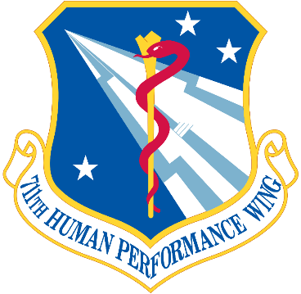

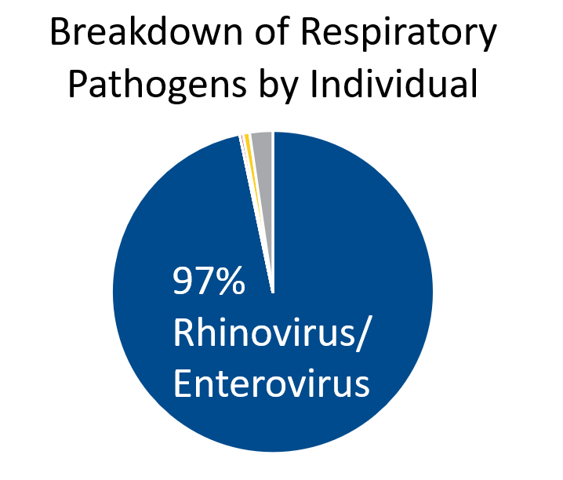
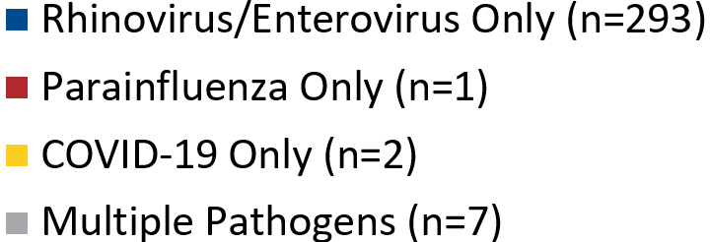
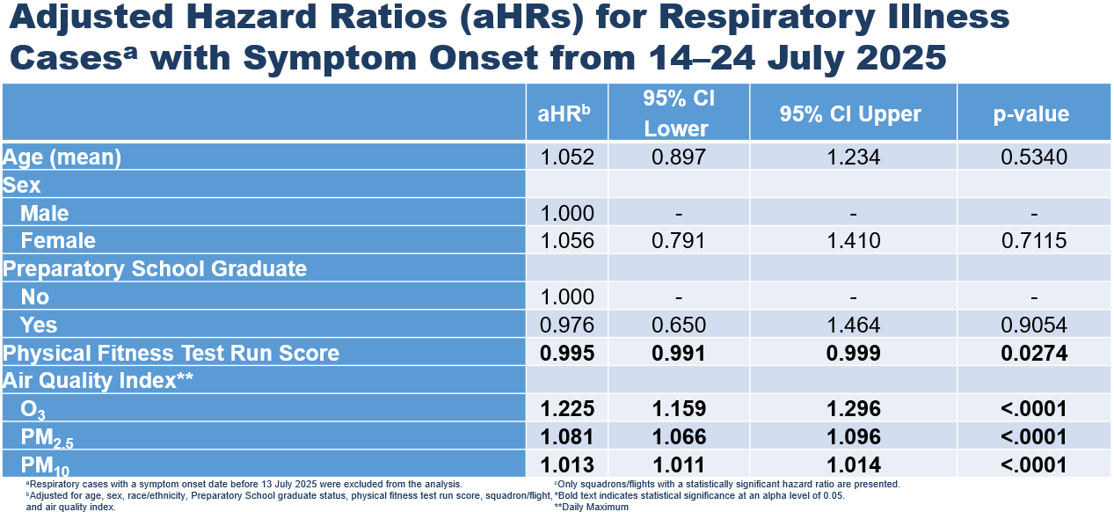
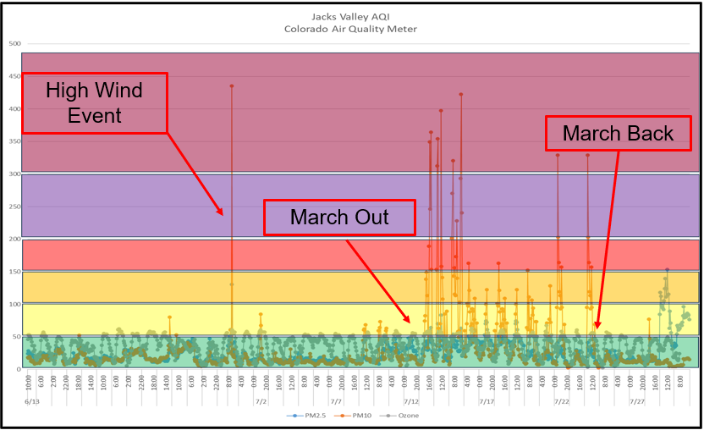
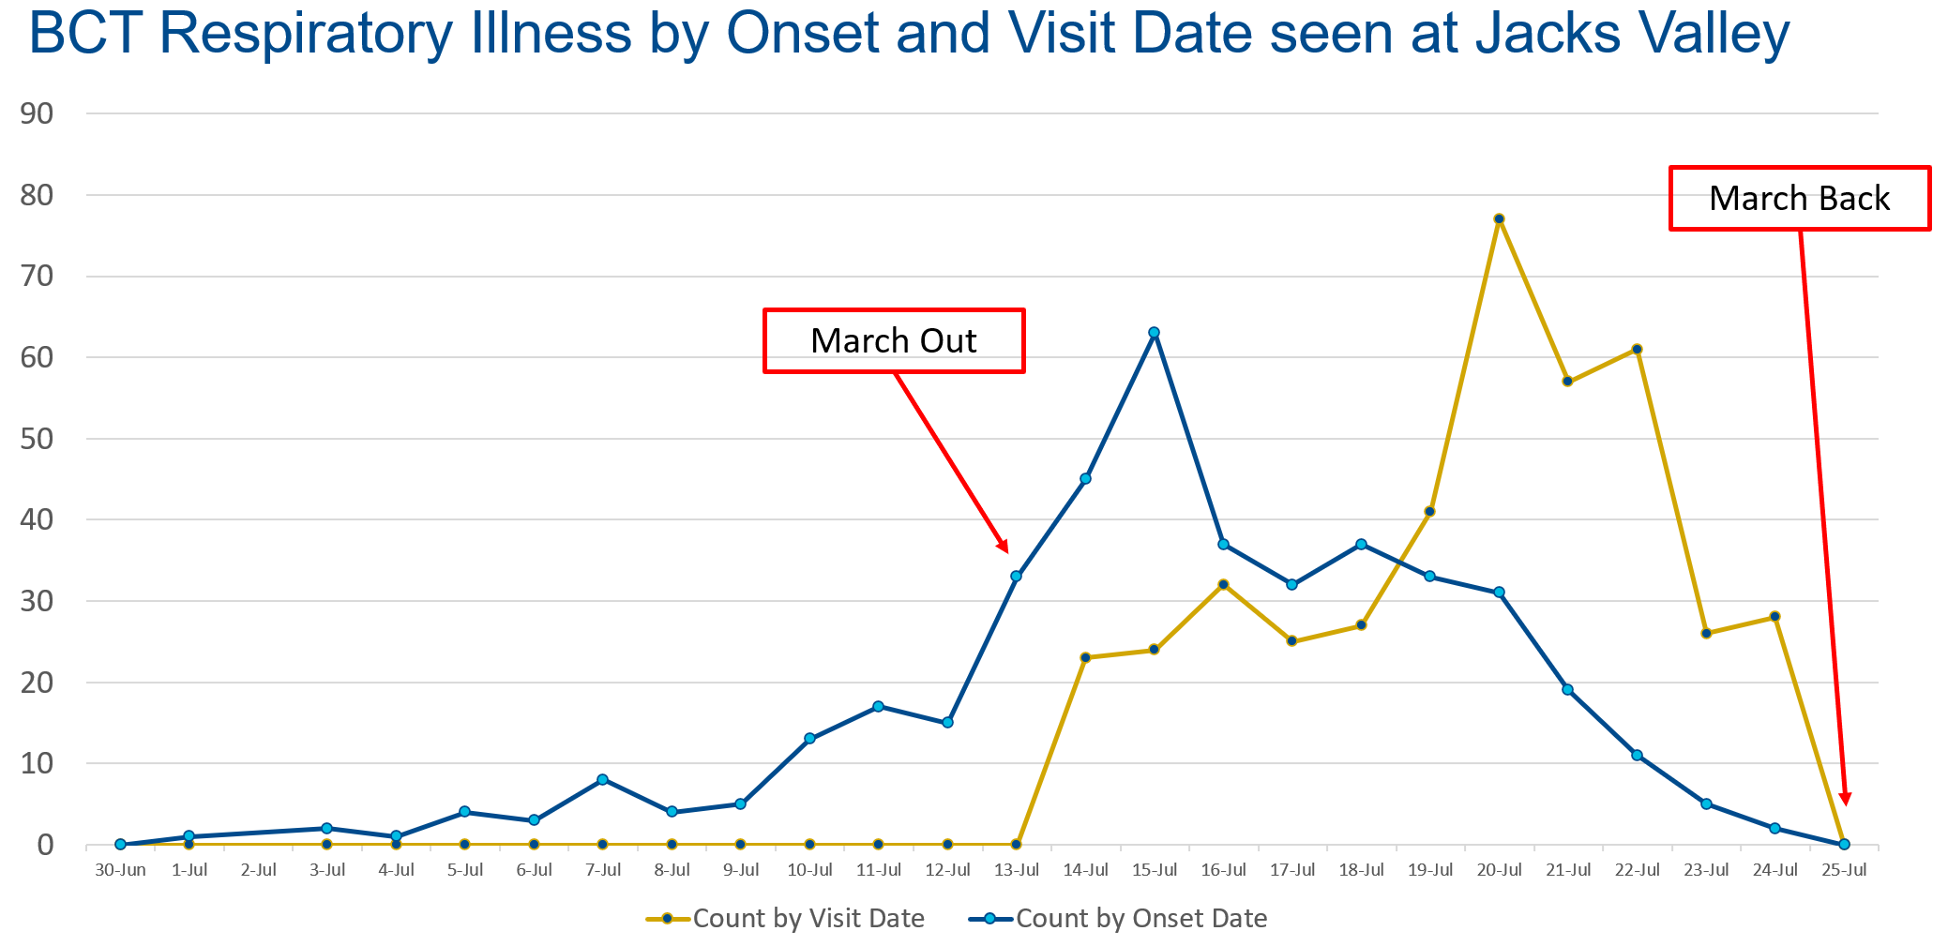
Respiratory Illness at the United States Air Force Academy Field Training Site: A Cohort Field Investigation
Lt Col Devin C. Kelly^{a,b}, Lt Col Keith T. Beam^{a,c}, Lt Col Scott M. Boydª, Maj Hanna Chang^{c}, Anthony C. Friesª, James D. Escobarª, Emily A. Adkins^{a,d}, Sarah M. Fryman-Wynkoop^{a,e}, Greg G. Wolffª, Alisa A. Simonª, William Gruner^{a,f}, Vivian Hogan^{a,f}, Angie S. Guinn^{a,d}, Lt Col Amber F. Brittª
ªUnited States Air Force School of Aerospace Medicine, Public Health Department, Wright-Patterson Air Force Base, OH, United States 45433, USA, ^{b}Department of Medicine, Uniformed Services University of the Health Sciences, 4301 Jones Bridge Road, Bethesda, MD 20814, USA; ^{c}Department of Preventive Medicine and Biostatistics, Uniformed Services University of the Health Sciences, 4301 Jones Bridge Road, Bethesda, MD 20814, USA, ^{d}VISTA Innovative Solutions, LLC, Beavercreek, OH, United States 45431, USA, ^{e}Venesco, LLC, Chantilly, VA, United States 20151, USA, ^{f}JYG Innovations LLC, Dayton, OH, United States 45414, USA
INTRODUCTION
MATERIALS AND METHODS CONTINUED
RESULTS
The Challenge: High rates of respiratory illness historically disrupt Basic Cadet Training (BCT) at the U.S. Air Force Academy (USAFA) Jacks Valley field site, threatening training efficacy and basic cadet welfare.
Historical Context: Prior USAFA investigations (2007–2009, 2024) identified a high burden of infectious respiratory illness, with rhinovirus dominant outside pandemic years.
Risk Factors: Known contributors in military training include crowded housing, stress, and sleep deprivation. At Jacks Valley, cadets sleep in high-density containers (~16 personnel per 354 sq. ft.).
Environmental Variable: Review of 20-year regional air quality data revealed elevated July ozone (O₃) and particulate matter (PM), prompting the inclusion of ambient air quality metrics in this study.
Statistical Analysis
Exposure Modeling: Air quality exposures were analyzed using one-day lag (peak AQI from the day prior to symptoms).
Time-to-Event: Person-days were calculated from 13 July to symptom onset or right-censored at 23 July.
Multivariable Modeling: Two Cox proportional hazards models (95% CI; = 0.05) controlled for confounding.
Figure 3. Respiratory Pathogens Identified at Jacks Valley, 2025
RESULTS
MATERIALS AND METHODS
Study Design & Population
Design: Prospective cohort study.
Population: Basic cadets at the USAFA Jacks Valley field training site (July 2025). Non-trainees (permanent/temporary party) were excluded.
Case Definition: Any basic cadet presenting to the aid station (14–24 July 2025) with acute respiratory illness (e.g., cough, sore throat, conjunctivitis), with or without fever (≥38.0°C). Non-ill cadets served as the comparison.
Data Collection
Pathogen Surveillance: Completed questionnaires and underwent testing for respiratory pathogens.
Environmental Monitoring:
  PM: Located at the Jacks Valley dining facility.
  O₃: Measured via existing meter at airfield.
Table 1. Select Adjusted Hazard Ratios for Respiratory Illness Cases (Model 1)
Figure 1. Air Quality Index at Jacks Valley, 2025
CONCLUSIONS
Nearly 38% of basic cadets developed respiratory illnesses driven by rhinovirus.
Respiratory illness was associated with PM, O₃, and lower physical fitness levels.
Targeted control strategies: increase living space, enhance indoor air quality, enforce strict hygiene practices, cohort symptomatic cadets, and reduce PM at the field site.
REFERENCES
Figure 2. Respiratory Illness at Jacks Valley, by Visit and Symptom Onset Date
See Handout
The views expressed are those of the authors and do not necessarily reflect the official policy or position of the Air Force, the Department of War, or the U.S. Government. DISTRIBUTION STATEMENT A: Cleared for public release. Distribution is unlimited. AFRL/PA, AFRL-2026-1275, 10-Jul-2026

