Slide 1


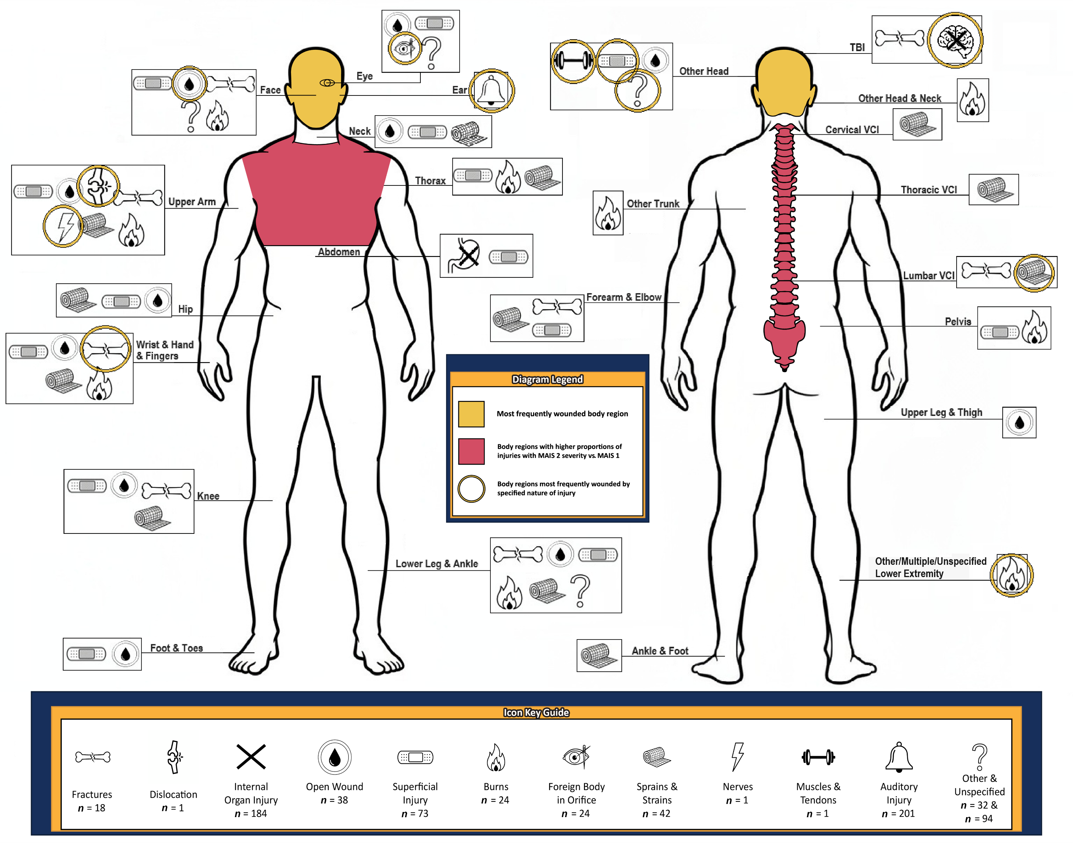
DRONE-RELATED INJURIES AMONG DEPLOYED U.S. MILITARY PERSONNEL, 2023–2024
Jessamyn E. Boltz, MPH^{1,2}; Amber L. Dougherty, MPH^{1,2}; James D. Wallace, MD^{3,4}; Brian E. Wilson, MSN^{1,5};
James M. Zouris, MS¹; Ryan W. Smith, PhD⁶; and Andrew J. MacGregor, PhD¹
¹Epidemiology and Data Management Support Department, Naval Health Research Center, San Diego, CA; ²Leidos, Inc., San Diego, CA; ³Department of General Surgery, Navy Medical Center San Diego, San Diego, CA; ⁴Uniformed Services University of the Health Sciences, Bethesda, MD; ⁵Axiom Resource Management, Inc., San Diego, CA; ⁶Operational Readiness Directorate, Naval Health Research Center, San Diego, CA
Background
Results
Results
The proliferation of drone warfare is a significant threat to U.S. forces
In February 2026, U.S. Central Command launched Operation Epic Fury against Iran, where drone and ballistic missile attacks have dominated the battlefield
Literature on drone-related injuries is sparse and primarily drawn from non-U.S. combat engagements
Figure 1. ICD-10-CM Injury Diagnosis Matrix Nature of Injury by Body Region and Body Regions With Significant MAIS for Drone-Related Injuries Among U.S. Service Members, 2023–2024 (N = 710)
Of the N = 367 service members in this sample, the median age was 27 years (18–56), most were male (89.9%), in the Army (94.5%), junior enlisted (65.7%) with a median ISS of 1 (1–29) and were RTD (86.6%) after injury
Approximately 48.5% of service members had a traumatic brain injury (TBI), predominantly mild, and 33.8% had an auditory injury, predominantly tinnitus
Those who did not RTD were SIQ (6.8%), evacuated (5.2%), or placed on LIMDU (1.4%)
Most of the 710 injuries were minor (92.3%) and to the head (79.3%), followed by the extremities (13.5%)
The extremities had the most variety of injury types (8 of the 12 nature of injury categories were present)
Service members in the MAIS 2 (n = 24) versus MAIS 1 (n = 335) severity group had significantly higher proportions of thorax (45.8% vs. 1.5%) and spine injuries (20.8% vs. 4.2%), respectively
Objectives
Describe characteristics of U.S. service members with drone-related injuries in 2023–2024
Describe the distribution of drone-related injuries by nature and body region using the ICD-10-CM injury diagnosis matrix
Discuss differences in drone-related injury patterns by Abbreviated Injury Score (AIS) body region and Maximum Abbreviated Injury Score (MAIS)
Conclusions
Methods
Drone attacks resulted in a “top down” versus “bottom up” wounding pattern, a significant shift from previous conflicts involving improvised explosive devices
Results suggest planning for forward triage of high-volume mild TBI and auditory injuries, while retaining rapid medical evacuation and forward surgical capabilities for infrequent but severe injuries to the head and trunk body regions
Although most were RTD, the high volume of TBI and diversity of other injuries indicate treatment of drone-related injuries in future large-scale combat operations may be complicated in resource-constrained environments with prolonged holding times
Further research on wounding patterns from drone warfare is recommended, along with a reevaluation of modern body armor as drone warfare continues to evolve and increase in frequency
Study population
This descriptive retrospective cohort study included U.S. service members with drone-related injuries from distinct events while deployed between 2023 and 2024 included in the Expeditionary Medical Encounter Database (EMED)
Measures
Age, sex (male/female), service branch (Army/Air Force), military rank (junior enlisted/senior enlisted/officer or warrant officer), and patient disposition [returned to duty (RTD)/limited duty (LIMDU)/sick in quarters (SIQ)/evacuated)] were included as descriptives
ICD-10-CM and AIS codes were used for injury analyses
Injury Severity Score (ISS) and MAIS scores were calculated to measure severity of injury
The ICD-10-CM injury diagnosis matrix was used to categorize injuries by nature of injury and body region
Statistical analyses
Descriptive frequencies were reported for all variables
Fisher’s exact tests were used to assess differences between MAIS groups by AIS body region
P values were adjusted for multiple comparisons with the Holm-Bonferroni method to control for the family-wise error rate at an alpha level of .05
Created using GenAI.mil and Microsoft Paint Application
Table 1. Distribution of U.S. Service Members With Drone-Related Injuries, by MAIS Group, 2023–2024
Variable | Total* (N = 365) | Patient Group, n (%)
 |  | MAIS 1 (n = 335) | MAIS 2 (n = 24) | MAIS 3+ (n = 6)
Median ISS (range) | 1 (1–29) | 1 (1–3) | 5 (4–6) | 17.5 (9–29)
AIS body region of injury†
Head | 310 (84.9) | 286 (85.4) | 20 (83.3) | 4 (66.7)
Face‡ | 139 (38.1) | 128 (38.2) | 7 (29.1) | 4 (66.7)
Neck | 3 (0.8) | 3 (0.9) | 0 | 0
Thorax | 16 (4.4) | 5 (1.5)§ | 11 (45.8)§ | 0
Abdomen | 2 (0.5) | 0 | 0 | 2 (33.3)
Spine | 20 (5.4) | 14 (4.2)§ | 5 (20.8)§ | 1 (16.7)
Upper extremity | 25 (6.8) | 23 (6.8) | 1 (4.2) | 1 (16.7)
Lower extremity | 37 (10.1) | 31 (9.2) | 4 (16.7) | 2 (33.3)
External | 9 (2.5) | 8 (2.4) | 0 | 1 (16.7)
AIS, Abbreviated Injury Scale; ISS, Injury Severity Score; MAIS, Maximum Abbreviated Injury Scale *Two service members with an AIS severity score of 9 (unspecified) were excluded from analysis †Percentages are calculated based on the number of service members with an injury in each AIS body region relative to the total number of service members in the corresponding MAIS group ‡AIS Face includes 122 patients with auditory injuries only §Statistically significant difference between minor and moderate MAIS patient groups as determined by Fisher’s exact test with Holm-Bonferroni method for multiple comparisons (p < .05)
References
Rogers JP, ed. De Gruyter Handbook of Drone Warfare. De Gruyter; 2024. doi:10.1515/9783110742039
U.S. forces launch Operation Epic Fury. U.S. Central Command. Published February 28, 2026. Accessed March 5, 2026. https://www.centcom.mil/MEDIA/PRESS-RELEASES/Press-Release-View/Article/4418396/us-forces-launch-operation-epic-fury/
Shertz M. FPV drone casualties in Ukraine: what limited data suggests—and what we still don’t know. Crisis Medicine. Published 2024. Accessed March 6, 2026. https://www.crisis-medicine.com/fpv-drone-casualties-in-ukraine/
Eskridge SL, Macera CA, Galarneau MR, Holbrook TL, Woodruff SI, MacGregor AJ, et al. Injuries from combat explosions in Iraq: injury type, location, and severity. Injury. 2012;43(10):1678-1682. doi:10.1016/j.injury.2012.05.027
Disclaimer: Some authors are military service members or employees of the U.S. Government. This work was prepared as part of their official duties. Title 17, U.S.C. §105 provides that copyright protection under this title is not available for any work of the U.S. Government. Title 17, U.S.C. §101 defines a U.S. Government work as work prepared by a military service member or employee of the U.S. Government as part of that person’s official duties. This work was supported by the U.S. Navy Bureau of Medicine and Surgery under work unit no. 60808. The views expressed in this work are those of the authors and do not necessarily reflect the official policy or position of the Department of the Navy, Department of Defense, nor the U.S. Government. The study protocol was approved by the Naval Health Research Center Institutional Review Board in compliance with all applicable federal regulations governing the protection of human subjects. Research data were derived from approved Naval Health Research Center Institutional Review Board protocol number NHRC.2003.0025.

