Slide 1



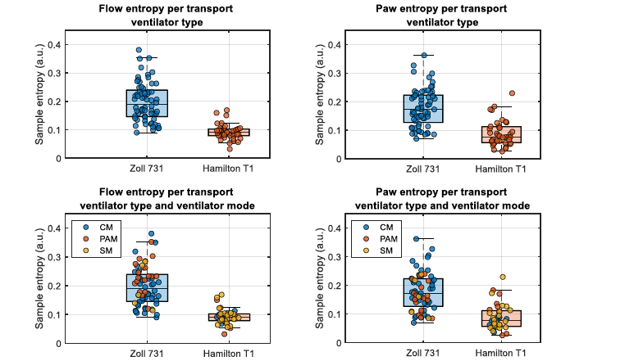
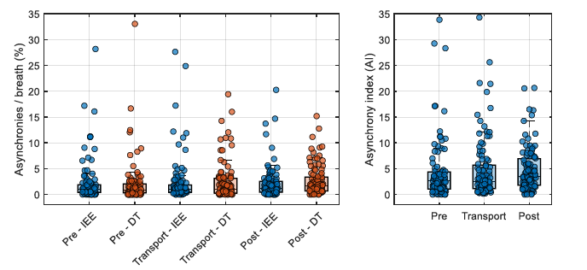
A Pragmatic Study of Asynchrony During Intrahospital Transport
Richard Branson MSc RRT¹, Dina Gomaa MSc RRT¹, Leonardo Sarlabous Uranga PhD², Veronica Pulpon PhD², Olivia Puntenney¹, Fransec Galofre PhD², Thomas Blakeman MSc RRT, Lluis Blanch MD PhD², ¹Institute for Military Medicine, University of Cincinnati College of Medicine, Cincinnati Oh USA, ²Parc Tauli University Hospital, Sabadell, Spain
INTRODUCTION
METHODS (Continued)
RESULTS
Mechanical ventilation during transport is a common event in the ICU, prehospital care and military medicine. Patient ventilator interaction is a challenge during mechanical ventilation regardless of the environment. Asynchrony describes a condition when the patient and ventilator are not in harmony and an asynchrony index (AI) > 10% is associated with mortality and prolonged mechanical ventilation. We hypothesized that during transport, patient movement, use of portable ventilators, changes in patient position and changes in sedation might alter patient ventilator interaction.
For each subject and each asynchrony, we calculated an asynchrony value per phase, corresponding with the count of (asynchrony events) / (total breaths + IEE) x 100%. AI was estimated as count of (IEE events + count of DT events) / (total breaths + IEE) x 100%. Sample entropy was computed for all pressure (P) and flow (V̇) waveforms during all three phases. To evaluate the asynchronies and entropy dynamics during patient transport, visual analyses were conducted using boxplots and overlaid scatter plots. Absolute sample entropy was assessed across three time phases were calculated to characterize temporal changes in signal complexity. Combined effects of ventilator mode and transport ventilator type were explored.
IEE remained stable across timepoints, DT and the AI significantly increased after transport. Ventilator mode had little impact during the pre- and intra-transport phases; however, post-transport, spontaneous modes were associated with higher AI. Regarding device comparison, Hamilton T1 showed a higher rate of IEE than Zoll 731 (p=0.02) during transport suggesting mode-device interactions influence asynchrony burden. Entropy analysis revealed an increase in respiratory signal complexity during transport, which largely normalized post-transport for V̇ but remained partially elevated for P. Spontaneous modes consistently exhibited higher entropy than controlled modes, particularly during transport. Notably, the Zoll 731 ventilator was associated with significantly higher entropy values than T1 for both flow and Paw (p<0.0001).
METHODS
IRB approval was obtained from the UCMC IRB and AFRL. Mechanically ventilated patients scheduled for in hospital transport were eligible for inclusion. Informed consent was obtained from the next of kin. Prior to transport a portable monitor (NM-3, Philips, PA) was connected using a variable orifice pneumotachograph. Airway pressure, flow and volume were continuously recorded and saved for analysis. Two ventilators were used: Hamilton T1 (Hamilton Medical Reno, NV) and Zoll 731 (Zoll Chelmsford, MA). Waveforms were recorded before, during and after transport. Respiratory therapists chose ventilator settings for transport. Doses of sedatives were recorded during all three phases. Asynchronies were determined using automated analysis (BetterCare, Spain) with the reviewers blinded to the type of ventilator. AI was determined. Asynchronies and entropy values were evaluated across three phases and stratified by ventilator mode as well as by ventilator (Zoll 731 or Hamilton T1). Waveforms were analyzed to determine ineffective respiratory efforts (IEE) and double triggering (DT).
RESULTS
Patient–ventilator asynchronies across pre-transport, transport, and post-transport phases.
CONCLUSIONS
These findings suggest that entropy metrics reflect ventilator-induced variability, which is modulated by both device architecture and ventilation mode.
Comparison of absolute entropy values between Zoll 731 and Hamilton T1 ventilators during transport phase (upper plots), and stratified by ventilator mode (lower plots). Controlled Modes (CM), Partially Assisted Modes (PAM), and Spontaneous Modes (SM).
This work is solely the authors and does not reflect the official position of the U.S. Air Force, Department of Defense, or U.S. Government.
Funding provided by the US Air Force: Task Order # FA8650-21-2-6285

