Slide 1
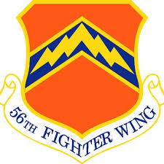

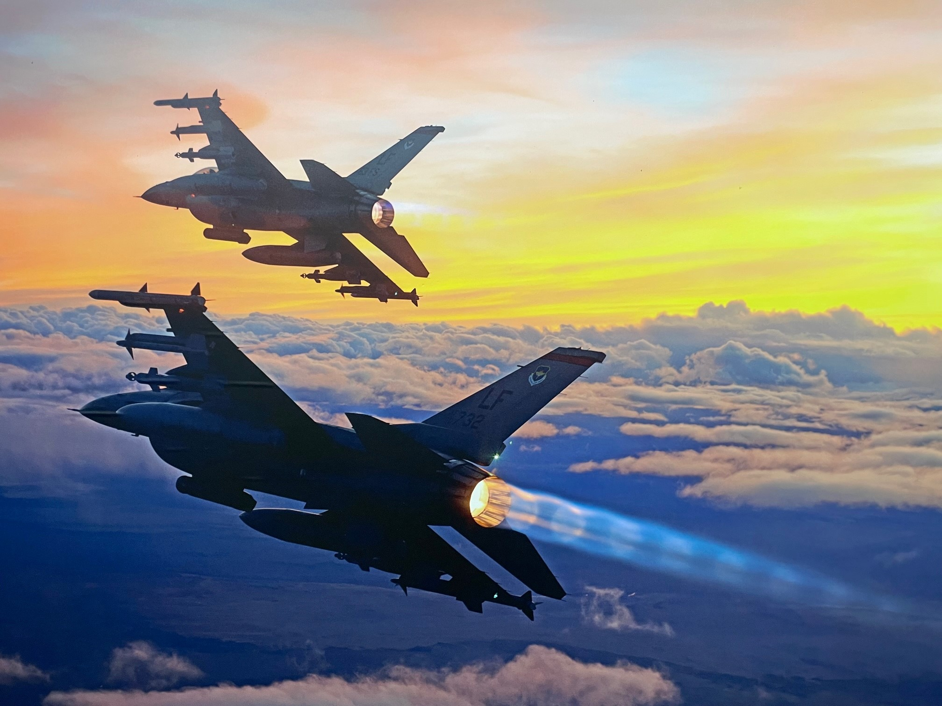

Modernizing the Learning Environment for
Complex Performance Demands
John Byron Gassaway, PsyD, CMPC
United States Air Force, Luke AFB, Glendale AZ
ABSTRACT
Success in student fighter pilot training is predicated on the ability to detect, recognize, and respond to visual stimuli quickly and efficiently, as well as simultaneously executing proper flight tasks. Combat aviation is a complex task that requires the operator to process and respond to a large number of sensory inputs (visual/aural/physiological) while simultaneously executing appropriate motor outputs. Instructing within this complex problem set requires student feedback to ascertain their comprehension and application of concepts, facts, and procedures. A similar problem set exists within the medical field.
Purpose: To assess the efficacy of active learning principles to maximize student engagement in fighter aviation curriculum.
Methods: Instructor pilots were provided lessons on active learning principles and application to their syllabus deliverables. These instructors were then observed executing their lessons with students to determine the level of student engagement.
Results: Instructor pilots taught to deliver curriculum through active learning methodology were superior in student engagement and better able to ascertain student knowledge, application, and comprehension.
Conclusion: It appears from our study that training instructor pilots in active learning core principles results in greater student engagement and optimized assessment of complex information comprehension, retention, and application for fighter aviation.
METHODS
Six instructor pilots were observed while providing lessons to Basic-Course (B-Course), Airframe Transitional Training (TX), and Instructor Pilot Upgrade (IPUG) students. Instructors were rated on their ability to include active learning core principles, integrate active engagement techniques, draw students into discussions, diversify their teaching medium within a lesson, and assess students’ in-the-moment knowledge to adjust content delivery. Instructor pilots were categorized as those who had been trained in active learning core principles and techniques (AL) and instructor pilots who received Training As Usual (TAU).
An observer known to the participants attended academic lessons and used a scoring rubric to determine the aforementioned active learning core principles applied during lessons. Rubrics were shared with one or two other instructor pilots who were subject matter experts in active learning for aviation. These SMEs helped develop and instruct active learning curriculum for instructor pilots. Lessons ranged from 1 to 5 hours (median being 3hrs) and covered diverse fighter aviation topics: systems, weapons, tactics, etc. Percentages were calculated to ameliorate the time variability in lesson delivery. Complexity of topic variability between comparison groups was not evaluated in this study; however, some of the lessons were identical in objectives and content between groups.
RESULTS
Our analysis revealed considerable differences between AL and TAU instructors. Active learning integration demonstrated a 3-fold increase in the percentage of time students were talking in lessons. Students asked ~6-times as many questions in the active learning group. AL instructors utilized 2+ times the amount of active learning techniques. Students answered 265 questions and provided 77 accurate metrics for the active learning lessons while the TAU students answered only 14 questions and provided just 5 accurate metrics. Core learning principles present in the execution of lessons were more than doubled for the active learning group compared to the TAU. Finally, the active learning group varied the delivery of information almost twice as much as the TAU group.
300
200
100
INTRODUCTION
Similar to the medical field, aviation requires pilots to assimilate complex knowledge and develop sophisticated skills rapidly (Hubbard, 2023). Avionic and tactical information is complex, and human/machine interfaces require nuanced motor skills development and application. Traditional instructional methods often fall short in fostering deep understanding and swift acquisition of tactical proficiencies. Integrating active learning principles presents a compelling alternative, moving to enhance comprehension (Prince, 2004), retention (Prince, 2004), and application. Active learning has the potential to expedite the learning processes and produce more adept pilots in a shorter timeframe.
Student Questions
Training As Usual Active Learning
30
20
CONCLUSION
The results from this study support our hypothesis that active learning training enhances student pilot's engagement in instruction. The increased student inputs through active learning provide the instructor with invaluable insights to tailor the instruction in real time and recognize gaps, strengths, and application of knowledge. Running a continuous loop of (1) assessing student knowledge, comprehension, retention, and application of instructional concepts to (2) adjust for content, medium, and class exercises to (3) execute lesson delivery, allows the instructor to maximize learning opportunities and match content of the lesson to the specific needs of the students. Limitations of this study include - small subject population, observation bias, variability of curriculum complexity between groups, and lack of objective performance metrics to evaluate application of knowledge in performance.
10
% Student Time Talking
AL Techniques
Variability of Delivery
REFERENCES
  Hubbard, C. (2023, February). Modernizing 5th Gen Fighter Pilot Training. Air University: Online Journal. https://www.airuniversity.af.edu/Wild-Blue-Yonder/Article-Display/Article/3287863/modernizing-5th-gen-fighter-pilot-training/
  Prince, M. (2004). Does Active Learning work? A review of the research. Journal of Engineering Education. 93(3),
Disclaimer: The authors of this abstract are responsible for the study design, analysis of results, discussions, views, and recommendations provided. The opinions and assertions expressed herein are those of the authors and do not necessarily reflect the official policy or position of the 56th Fighter Wing, the U.S. Air Force, or the Department of War.

