Slide 1




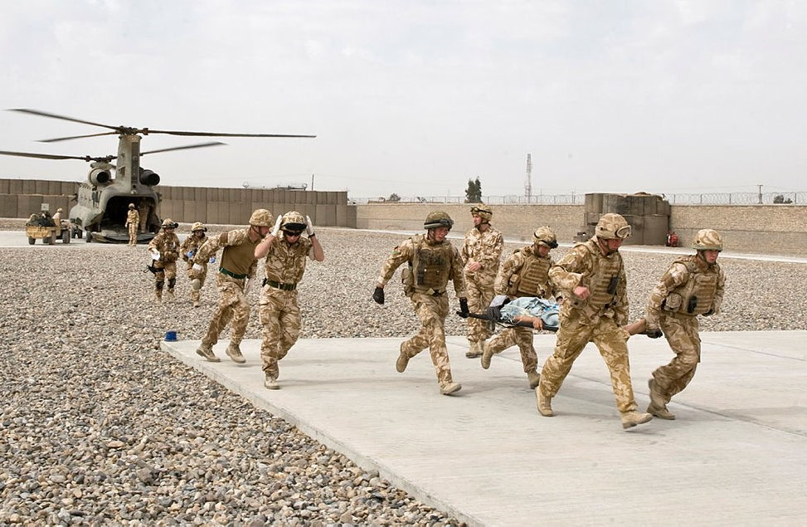
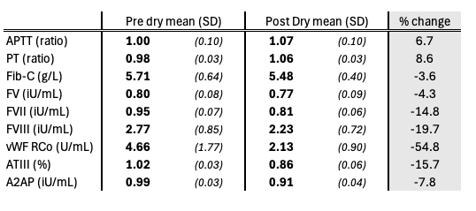
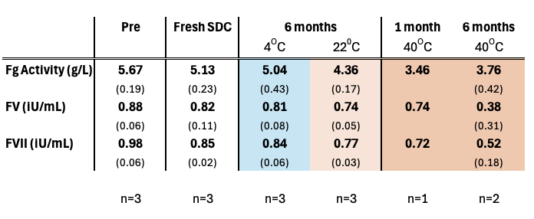
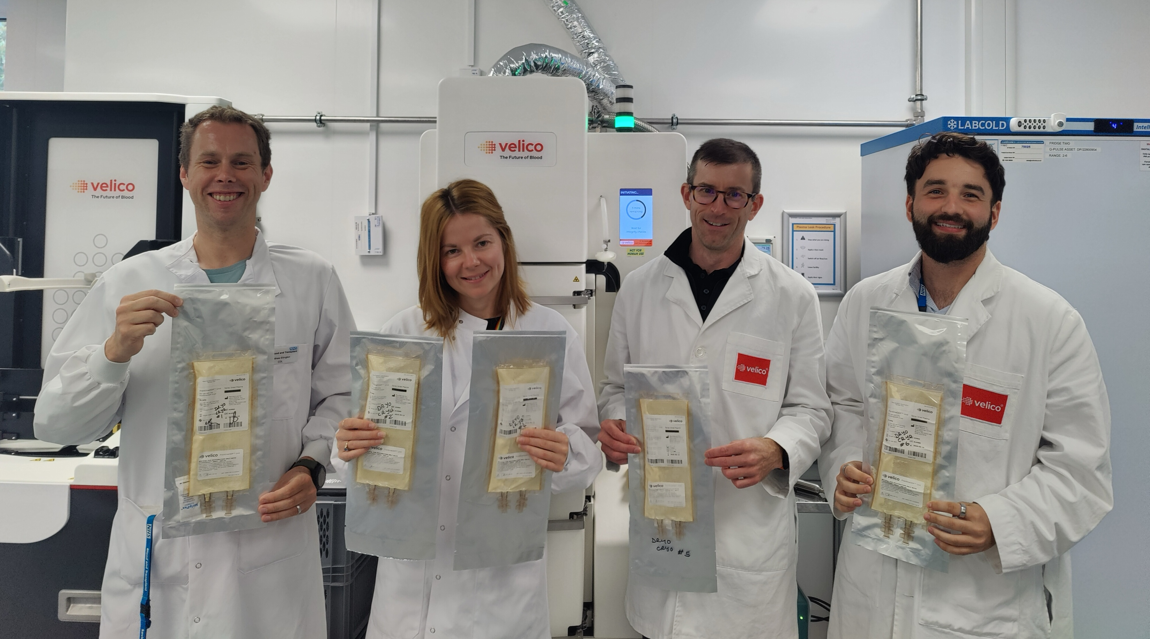
Feasibility of Using Spray Drying to Produce Dried Cryoprecipitate
M Ellington,^{1,2,3} L Bower¹, S Huish¹, T Woolley,⁴ E Barnard,² L Green,⁵ R Cardigan^{1,5}
1. NHS Blood and Transplant, Cambridge, UK. 2. Academic Department of Military Emergency Medicine, Royal Centre for Defence Medicine, Birmingham, UK 3. Department of Haematology, University of Cambridge, UK 4. Centre for Defence Medicine (Research and Clinical Innovation), Birmingham, UK. 5. NHS Blood and Transplant, UK.
Background
Haemorrhage is the leading cause of preventable death in military trauma.¹ By hospital arrival, up to 40% of haemorrhaging trauma patients have an Acute Traumatic Coagulopathy (ATC).² This proportion will likely increase with prolonged MEDEVAC timelines in future conflicts.
Results
SDC units rehydrated in a mean time of 6 minutes. Coagulation parameters were within +/- 20% pre to post drying, except vWF activity (~50 %) (table 1), mirroring percentage losses seen in Spray Dried Plasma.⁴
Table 1. Changes in coagulation factors in SDC pre to post drying. Data are mean (SD). N=10
Fibrinogen is the key mediator of ATC, and hypofibrinogenaemic trauma patients have a 4-fold higher mortality than those with normal fibrinogen.³
Cryoprecipitate is a plasma-derived blood component used for replacing fibrinogen in bleeding trauma patients. However, thawed cryoprecipitate is logistically burdensome, associated with a delay in provision, and high wastage. A dried cryoprecipitate that could be quickly rehydrated for early (including prehospital) administration could therefore provide significant benefit.
Aims
Assess the feasibility of using Velico® On Demand Plasma Spray drying technology to produce Spray Dried Cryoprecipitate (SDC).
Storage of SDC for 6 months at 4°C showed minimal decreases in key coagulation parameters, compared to fresh SDC. Greater losses were seen at 22°C (6 months) and 40°C (1 month and 6 months).
Methods
Cryoprecipitate pools of 7 single units (n=10) were manufactured to ensure sufficient volume to meet the requirements of the drying system and pre-drying sampling (275 ± 10 mL). Units were sampled, and then added to the pre-treatment container and spray dried in around 35 minutes using Frontline ODPTM (On Demand Plasma) system from Velico® Medical (MA, USA). After storage for 1 week at 4 ±2 ºC, units were subsequently rehydrated (Sterile Water for Injection, 200mL), sampled and tested for coagulation factor activity using a coagulometer (ACL Top 550, WERFEN, UK).
Storage study: 12 additional pooled SDC units were manufactured and stored at 4°C for <2 weeks (fresh)(n=3), 4°C and 22°C for 6 months (n=3 each) and 40°C for 1 month (n=1) and 6 months (n=2) in a paired study design. Units were rehydrated and sampled as above and tested for a range of coagulation parameters.
Table 2. Coagulation factors in SDC during storage. Units were stored at 4, 22 and 40 degrees for 1 and 6 months. Data are mean and (SD).
Conclusions
Production of Spray Dried Cryoprecipitate is feasible using the Frontline ODPTM system from Velico® Medical.
Spray Dried Cryoprecipitate appears to have adequate coagulation factor preservation post – reconstitution.
Spray Dried Cryoprecipitate has significant logistical benefits over conventional thawed cryoprecipitate.
Spray Dried Cryoprecipitate appears stable when stored for up to 6 months at 4^{O}C.
Further work is now warranted to develop this novel blood component.
Figure 1. Spray Dried Cryoprecipitate units manufactured using the Velico® Frontline ODPTM system.
References
Pusateri AE, Butler FK, Shackelford SA, Sperry JL, Moore EE, Cap AP, et al. The need for dried plasma – a national issue. Transfusion. 2019/04/01;59(S2)
Moore EE, Moore HB, Kornblith LZ, Neal MD, Hoffman M, Mutch NJ, et al. Trauma-induced coagulopathy. Nature reviews Disease primers. 2021;7(1):30
McQuilten ZK, Wood EM, Bailey M, Cameron PA, Cooper DJ. Fibrinogen is an independent predictor of mortality in major trauma patients: a five-year statewide cohort study. Injury. 2017;48(5):1074-81
Bower L, Huish S, Oleniacz K, Ellington M, Robbins MJ, Woolley T, Sohn J, Green L, Cardigan R. Spray dried plasma manufactured from apheresis and whole blood derived plasma. Transfusion.
Acknowledgements
We would like to thank the MoD for funding this work, and Velico Medical for technical support . Development of Velico Medical's FrontlineODP™ System is funded by Biomedical Advanced Research and Development Authority (BARDA), under Contract No. 75A50121C00059

