Slide 1



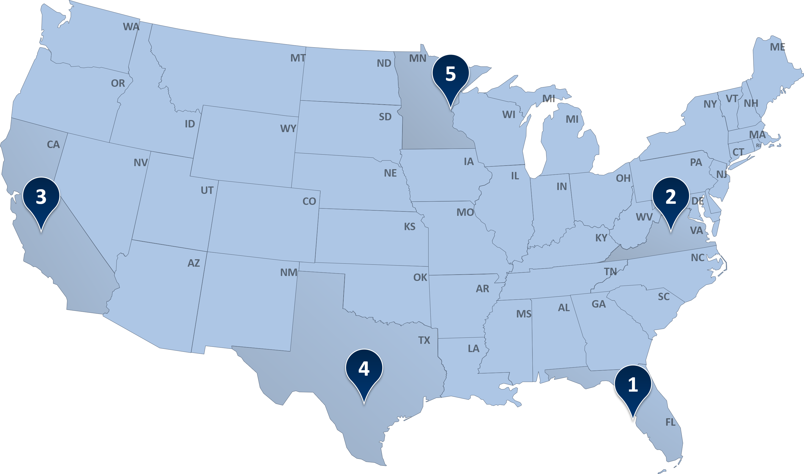

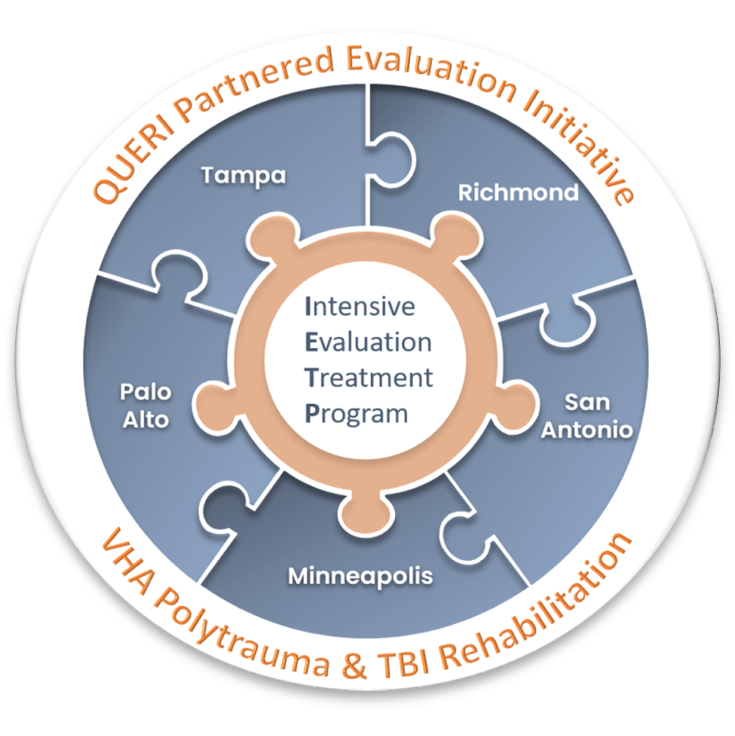
Effects of Complimentary and Integrative Health Services on Traumatic Brain Injury Rehabilitation Program Outcomes for US Military Service Members and Veterans
Jolie N. Haun, EdS, PhD¹, Justin McDaniel, PhD^{1,2} Risa Nakase-Richardson, PhD^{1,3}, Tali Schneider, PhD³, Julie McMahon-Grenz, MS, OTR/L¹⁰, Sharon Barton, MS, CRC, CVE, CBIS, CPD⁴, Roberto Sandoval, PT, PhD⁵, Karen M. Skop, PT, DPT, MS^{1,3}, Clara Dismuke-Greer, PhD⁶, Jerome Sabangan, PT, DPT⁶, Kimberly Samson, PT, DPT⁶, Daniel W. Klyce, PhD, ABPP⁴ Yvonne Friedman, MA, OTR/L¹, Leah R. Gause, PsyD⁷, Shannon R. Miles, PhD^{1,3}, Kevin Wells⁸, Mary Jo Pugh, PhD⁹
Complex history mild to moderate TBI
Integrated Inpatient Rehabilitation:
Evidence-based, interdisciplinary model delivering patient-centered assessment, coordinated care, and peer support.
Improve higher-level functioning, well-being, and brain health.
¹James A. Haley Veterans’ Hospital, Tampa, FL; ²Southern Illinois University, Carbondale, IL; ³University of South Florida, Tampa, FL; ⁴Central Virginia VA Health Care System, Richmond, VA; ⁵South Texas Veterans Health Care System, Audie L. Murphy VAMC, San Antonio, TX; ⁶VA Palo Alto Healthcare System, Menlo Park, CA; ⁷Minneapolis VA Health Care System, Minnesota; ⁸VA Eastern Colorado Health Care System, Denver, CO; ⁹VA Salt Lake City Health Care System, Salt Lake City, UT; ¹⁰Hines VA Medical Center, Hines, IL
Introduction
Intensive Evaluation and Treatment Program (IETP) Approach to Impacting Outcomes
Complementary and integrative health services may be associated with improvements in TBI-related outcomes during rehabilitation.
CIH services are increasingly integrated into multidisciplinary TBI rehabilitation for service members and veterans
KEY TAKE AWAY
Standards for CIH delivery and documentation are needed to improve validity of data sources CIH data sources.
Defining and measuring CIH exposure in complex clinical settings remains challenging
This study demonstrates a method to quantify CIH service dose in inpatient interdisciplinary TBI care
Table 2F
Sociodemographic and rehabilitation characteristics of participants in the Intensive Evaluation and Treatment Program (n = 133)
IETP complementary and integrative health (CIH) service availability by site
Methods
Variable | M | SD
Age (Years) | 41.56 | 5.53
Number of Concussions | 15.93 | 7.42
Number of Deployments | 7.39 | 3.08
Adjusted Dose: CIH | 0.51 | 0.29
Adjusted Dose: Other Services | 2.28 | 0.72
Rehabilitation Days | 41.21 | 19.58
 | n | %
Race: White | 95 | 71.43
Ethnicity: Hispanic | 11 | 8.27
Military Rank: Officer | 46 | 34.59
Special Operations | 110 | 82.71
Education: Graduate Degree | 82 | 61.65
Neurobehavioral Symptoms
CIH Services
(standardized, adjusted for length of stay)
Pain Interference
n = 133
participants
VHA inpatient TBI rehabilitaion
Participation
Posttraumatic Stress
Mixed-effects linear regression models
Changes in IETP outcomes by CIH service dose
Admission
Discharge
1
2
3
Palo Alto
4
San Antonio
5
Minneapolis
Results
Tampa
Richmond
  -Meditation
  -Biofeedback
  -Guided Imagery
  -Yoga
  -Acupuncture
  -Chiropractic
  -Meditation
  -Biofeedback
  -Clinical Hypnosis
  -Guided Imagery
  -Yoga
  -Tai Chi
  -Acupuncture
  -Chiropractic
  -Meditation
  -Massage Therapy
  -Biofeedback
  -Clinical Hypnosis
  -Guided Imagery
  -Yoga
  -Tai Chi
  -Acupuncture
  -Meditation
  -Biofeedback
  -Clinical Hypnosis
  -Guided Imagery
  -Yoga
  -Acupuncture
  -Chiropractic*
  -Meditation
  -Biofeedback
  -Clinical Hypnosis*
  -Guided Imagery
  -Yoga
  -Tai Chi
Greater CIH services received were associated with greater reductions in neurobehavioral symptoms (time × CIH: b = −9.50, p = 0.007) and pain interference (b = −4.89, p = 0.006). No significant relationships were observed for participation or posttraumatic stress outcomes
Conclusion
This use case demonstrates the feasibility, and key limitations, of operationalizing CIH services within complex rehabilitation settings, which demonstrates the need for more precise and standardized measurement approaches to advance CIH research
Acknowledgement and Disclaimers
This work was funded by the Veterans Health Administration Health Services Research and Development Partnered Evaluation Center (PEC 21-129) through the Quality Enhancement Research Initiative. This protocol is the result of work supported with resources and the use of facilities and personnel at the James A. Haley Veterans’ Hospital. Contents do not represent the views of the Department of Veterans Affairs or the US government.
Note. All IETP participants had equal opportunity for CIH integration in their care; * Available at Minneapolis VA in the Comprehensive Pain Center (chiropractic) and within Psychology Service (hypnosis), but not immediately available/provided within IETP; offered to participants

