Slide 1

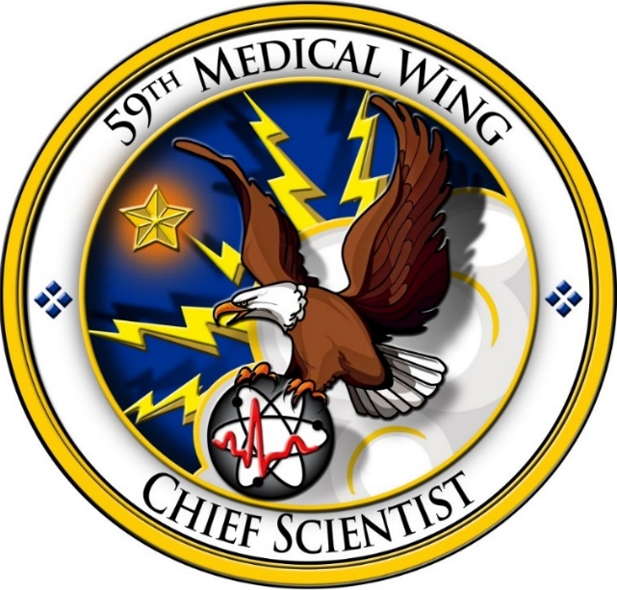
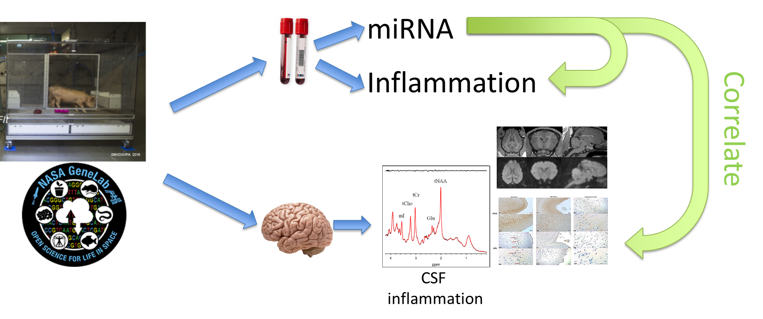
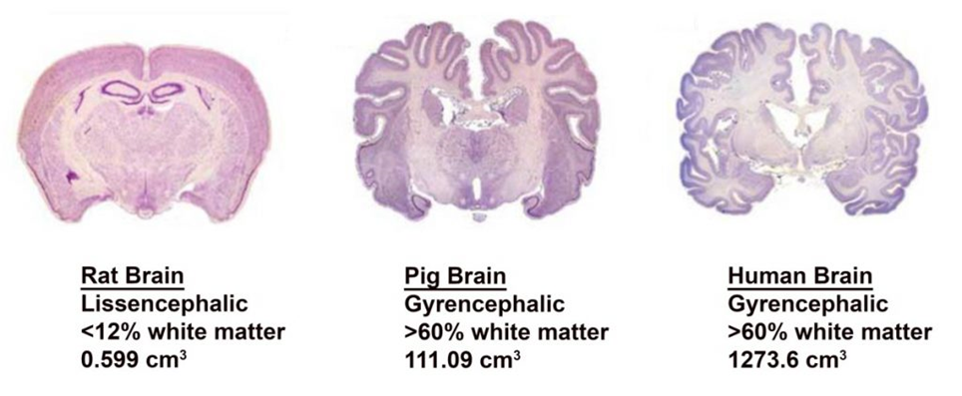
MiRNA and Mitochondrial Adaptations in Lunar Extravehicular Activity (EVA) Environments for Targeted Countermeasure Development
Holly Chapapas¹, Bianca Cerqueira¹, Meghan E. Robinson¹, Diego Galeano², Joseph W. Guarnieri³, Robert Meller⁴, JangKeun Kim⁵, Francisco Enguita⁶, Jonathan C. Schisler⁷, Lt Col Robert Smalley⁸, Paul Sherman⁸, Afshin Beheshti⁹
1) KBR, Mission Technology Solutions, San Antonio, TX, USA; 2) Department of Electronics and Mechatronics Engineering, Facultad de Ingeniería, Universidad Nacional de Asunción - FIUNA, Luque, Paraguay; 3) Blue Marble Space Institute of Science, Seattle, WA, USA; 4) Neuroscience Institute, Department of Neurobiology/ Department of Pharmacology and Toxicology, Morehouse School of Medicine, Atlanta, GA, USA; 5) Department of Physiology and Biophysics and World Quant Initiative for Quantitative Prediction, Weill Cornell Medicine, New York, NY, USA; 6) Instituto de Medicina Molecular João Lobo Antunes, Faculdade de Medicina, Universidade de Lisboa, Lisboa, Portugal; 7) McAllister Heart Institute and Department of Pharmacology, The University of North Carolina at Chapel Hill, Chapel Hill, NC, USA; 8) USAF 59MDW Science & Technology, San Antonio, TX, USA; 9) Center for Space Biomedicine, McGowan Institute for Regenerative Medicine, Department of Surgery, University of Pittsburgh School of Medicine, Pittsburgh, PA, USA
Introduction
Results
The space missions of the future, including planned lunar missions, are expected to include prolonged extravehicular activities (EVAs). Understanding the biological changes induced by the EVA environment is essential for successful missions. In addition to radiation and altered gravity that have characterized space missions on the international space station (ISS), EVA-heavy missions will also include lengthy exposures to hypobaric conditions in the space suit. The combination of exposures may exacerbate biological effects.
C)
Methods
We investigated the systemic effects mediated by predicted circulating microRNAs (miRNAs) by analyzing transcriptomic and biospecimen data from hypobaria studies in miniature swine along with rodent transcriptomic data from NASA’s Open Science Data Repository (OSDR) to identify conserved spaceflight-associated factors across environmental conditions.
Swine were exposed to repeated multi-hour exposures at 0.30 atm (~4.4 psi) and with FiO2=1.0 (100% O2). Rodents were exposed via missions to the ISS, or experiments that simulated space radiation and microgravity. Differential Expression (DE) analysis and Gene Set Enrichment (GSEA) analysis were performed to determine cross-species similarities in various spaceflight similar conditions. Overlap of significantly regulated genes (p<0.05) found 66 key driving genes. The significant DE genes were used to identify which miRNA target these genes with miRTarBase and then cross-referenced and ranked to predict miRNA targets. These targets were examined across murine and swine brain regions and selected if present is more than 3 swine brain regions and in a murine dataset. Finally, using our machine learning-powered drug repurposing model we identified FDA-approved small molecule drug candidates predicted to target these miRNAs, identifying potential countermeasures to mitigate damage from these combined environmental stressors.
A) UpSet plot illustrating overlap of significantly regulated genes (p < 0.05) across OSDR murine spaceflight datasets and minipig hypobaria samples, highlighting shared cross-species transcriptional responses. The red colored dots represent the threshold used to
determine the 66 key driving genes with coordinated up- and downregulated programs associated with metabolic and neurological functions (Figures 3E and 3F), based on their directionality in the minipig expression. B) Heatmap of conserved differentially expressed genes meeting cross-dataset stringency; among the most notable enriched pathways were GABA reuptake, inositol transport, and several core metabolic processes, highlighting disruption in neurotransmission and cellular bioenergetics. A majority of downregulated pathways were associated with tissue development, lipid metabolism, collagen organization and extracellular matrix (ECM) biology, suggesting structural remodeling or loss of tissue integrity under combined hypobaric and spaceflight stress. These results were used to identified a set of 9 predicted miRNAs that were affected by microgravity, radiation, and hypobaria, and are most likely to be affected in personnel on long-term EVA-heavy space missions. C) Refined heatmap showing miRNAs commonly enriched in 3 or more swine brain regions and present in OSDR murine datasets, highlighting high-confidence cross-species regulatory candidates. These include miR-122-5p, miR-17-5p, let-7a-5p, miR-34a-5p, miR-155-5p, miR-21-5p, miR29a-3p, miR-29b-3p, and miR-29-3p; Among these, several demonstrated particularly strong and consistent enrichment across datasets, suggesting they represent central regulatory nodes in the shared stress response.
miRNet disease pathway enrichment analysis revealed strong associations with neurological, metabolic, inflammatory, and systemic disease pathways. Indicating a systemic immune–metabolic axis being activated under combined hypobaric and spaceflight stress. Many of these miRNAs are known regulators of inflammation, mitochondrial metabolism, extracellular matrix remodeling, and vascular integrity, aligning with the gene and pathway findings.
sChemNet identified vitamin D receptor (VDR) agonists, estrogen receptor agonists, and glucocorticoid receptor agonists as candidate modulators. Heatmap illustrating the predicted mode of action of candidate drugs targeting the prioritized miRNAs. Among predicted compounds, paricalcitol (a synthetic vitamin D analog) demonstrated the strongest predicted regulatory coverage across the key miRNAs. Importantly, paricalcitol has been shown to have mitochondrial-protective effects, including reduced oxidative stress, preserved membrane potential, modulation of apoptosis, and regulation of mitochondrial dynamics. These properties align closely with the mitochondrial dysfunction signatures observed in our exposure datasets.
Depiction of the general data ingest pipeline to determine cross-conserved spaceflight-associated factors including predicting circulating miRNA utilizing the NASA GeneLab data repository and high-altitude minipig data from the Radiologic Aerospace Medical Group at the 59MDW/ST-R.
Conclusions and Future Directions
By simulating lunar EVA conditions, our model provides critical insights into physiological challenges astronauts face during moonwalks by combining hypobaria, altered gravity, and space radiation. Results demonstrated conserved gene set and mitochondrial pathways are suppressed in minipig and murine models. These results predicted 9 likely miRNA targets for further investigation and probable therapeutic targets; observed transcriptional changes may be orchestrated by a small number of stress-responsive miRNA regulators with both central nervous system and circulating immune relevance. A complete space exposure profile including hypobaria merits further investigation to validate the predicted miRNA targets through sequencing in addition to examination of paricalcitol as a therapeutic treatment to EVA conditions. This integrated approach enhances our understanding of the biological impacts of spaceflight and directly informs the development of molecular countermeasures to protect astronaut health during EVAs on future lunar missions.
Disclaimers
Acknowledgements
Slices of rat, swine, and human brain sections demonstrating the difference in comparison across species particularly the gyrencephalic content of each species.
The views expressed in this abstract are those of the authors and do not necessarily reflect the official policy or position of the Defense Health Agency, Department of Defense, nor the U.S. Government. The experiments reported herein were conducted in compliance with the Animal Welfare Act and per the principles set forth in the “Guide for Care and Use of Laboratory Animals,” Institute of Laboratory Animals Resources, National Research Council, National Academy Press, 1996.
This work is supported by funding from JPC5 - FH ID: 2015-141; D22 Tail End 711HPW: SA-21-028; 80JSC020N0001-HHCSR 2020 HERO Appendix C: Human Health Countermeasures and Space Radiation, 20-20HHCSR_2-0021.
Warrior Medics – Mission Ready – Patient Focused

