Slide 1
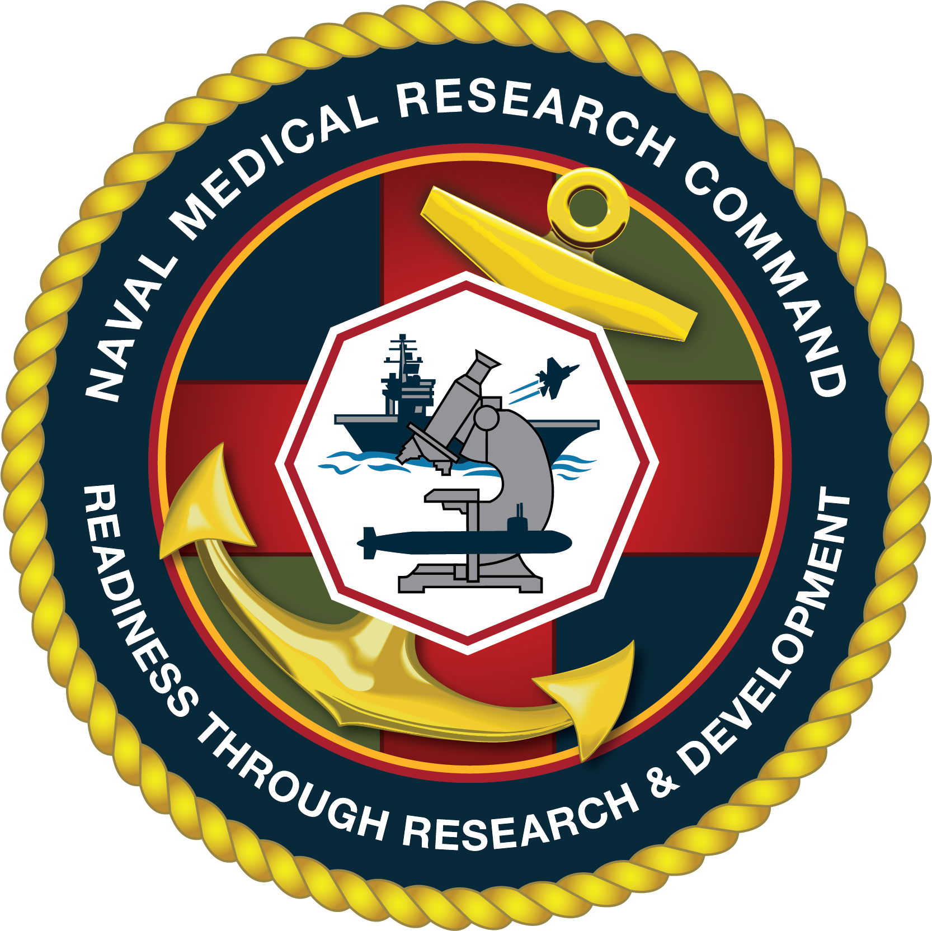

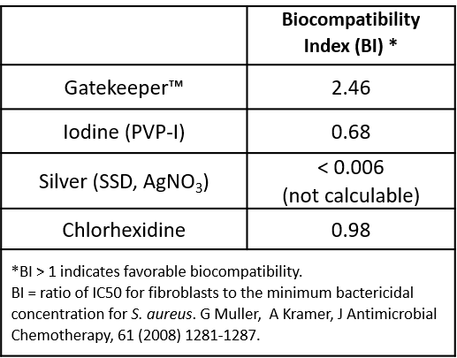
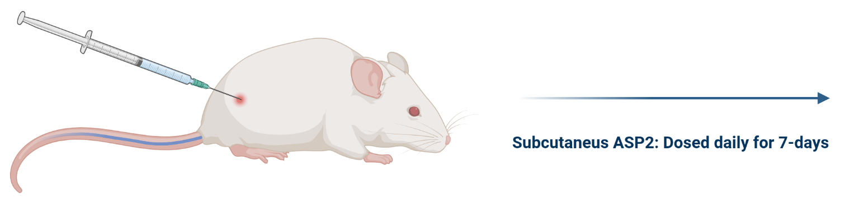
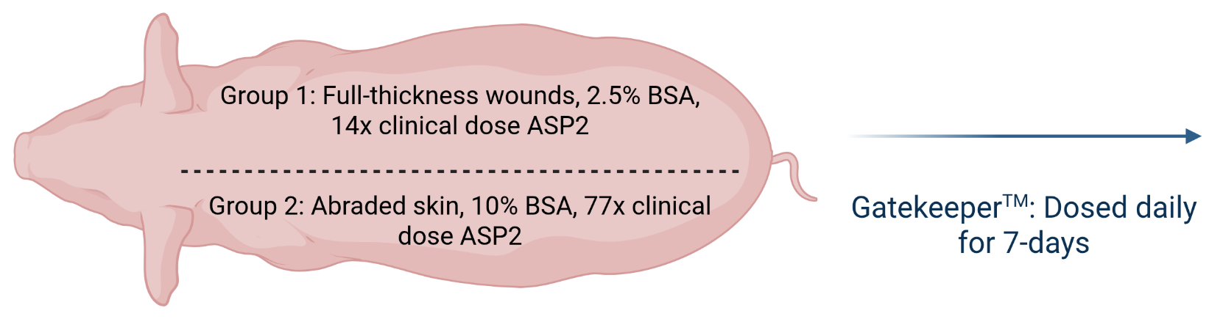

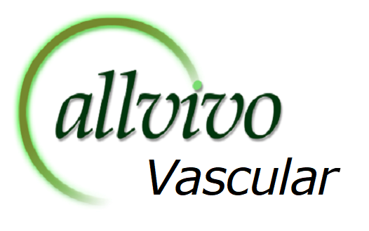
Efficacy of a Novel Antimicrobial Peptide in Eradicating Multidrug-Resistant Bacterial Infections and Biofilms in Preclinical Mouse and Porcine Models
John C. Vitucci^{1,2}, Danir Bayramov³, Ryan Cummings³, Melissa Hamilton^{1,4}, Jesse Smith^{1,2}, Katy Garcia^{1,4}, Shannon Dennis^{1,4}, Joseph Salzo^{1,2}, Jonathan Benaye^{1,2}, Gabriel Feleke^{1,4}, John A. Cleary^{1,4}, Alexandria Kesterson¹, Sara Tuck^{1,5}, Frederic Poly^{1,5}, Jennifer Neff^{3,*}, Yoann Le Breton^{1,5,*}
1. Naval Medical Research Command, Combat Wounds Infectious Division, Silver Spring, MD. 2. Henry M. Jackson for the Advancement of Military Medicine, Bethesda, MD. 3. Allvivo Vascular Inc. Lake Forest, CA. 4. General Dynamics Information Technology, Falls Church, VA. 5. Naval Medical Research Command, Military Relevant Bacterial Diseases Department, Silver Spring, MD.
Background
Results
Infectious disease complications of combat-related injuries remain a major threat to the health and readiness of Warfighters.^{1,2} Injured military members requiring prolonged combat casualty care (PCCC) are at greater risk of developing biofilms and infections with multi-drug resistance organisms (MDROs).³ The steady increase in MDROs in the US military healthcare system highlights the importance of discovering and developing alternative antimicrobial treatments. The management of these infections may be complex, requiring prolonged hospital stays and use of combinations of multiple antibiotics. Current antimicrobial treatment options are limited and during prolonged antibiotic therapy, soldiers are potentially exposed to multi-organ toxic effects.^{4,5} These toxic effects, as well as treatment failure are common, leading to increased morbidity and mortality.⁵
Antimicrobial peptides (AMPs) are promising agents for the treatment of MDRO infections.^{6,7} AMPs have demonstrated efficacy against biofilms and planktonic bacteria through various mechanisms that include disrupting the lipopolysaccharide layer of Gram-negative bacteria, permeabilization of the cell membrane, inhibition of protein activity, and inhibition of adhesion to surfaces.^{6,7} Bacteria in biofilms exhibit tolerance to antibiotics and increased resistance, where the structure of the biofilm, metabolic state of bacteria within the biofilm, oxygen availability, and increased horizontal gene transfer have been identified as contributing factors.⁸⁻¹⁰ The ability to eradicate biofilms is a major advantage that AMPs possess over standard of care antibiotics. Dispersion of the biofilm by AMPs can render biofilm-associated bacteria susceptible again to antibiotics, suggesting that AMPs and antibiotics can have a synergistic effect when administered as a co-therapy.⁸⁻¹¹ Eliminating biofilms is important as they have been associated with chronic wound infections, prevent proper healing of wounds, and are a source for the generation of new drug-resistant bacteria. To combat these growing challenges, Allvivo Vascular Inc. has developed a novel AMP (ASP2) and Gatekeeper™, a chitosan sponge impregnated with ASP2.
A.
S. aureus Planktonic
C.
A. baumannii Planktonic
E.
S. aureus Biofilm
G.
A. baumannii Biofilm
Daily
Application
B.
D.
F.
H.
Single
Application
Objectives
Figure 1. Gatekeeper™ demonstrates efficacy against MDR Gram-positive and Gram-negative organisms at multiple concentrations. In vivo efficacy of Gatekeeper™ administered at various doses against a model Gram-positive and Gram-negative organisms’ planktonic and biofilm infections. The efficacy is compared against an untreated infection of the model pathogens (Gram-pos. methicillin-resistant Staphylococcus aureus, strain: JE2 [figures A, B, E, and F] and Gram-neg. Acinetobacter baumannii strain: AB5075 [figures C, D, G, and H]). For daily treatments, figures A, C, E, and G, sponges were removed and replaced on Days 1 and 2 post-infection, while the single treatment groups are figures B, D, F, and H. Bars represent CFU/gram of tissue recovered from the wound bed on day 1, 2 or 3 post-infection. Planktonic Infections: A. Efficacy of Gk™ against S. aureus. B. Single application efficacy of Gk™ against S. aureus. C. Efficacy of Gk™ against A. baumannii. D. Single application efficacy of Gk™ against A. baumannii. Biofilm: E. Efficacy of Gk™ against S. aureus. F. Single application efficacy of Gk™ against S. aureus. G. Efficacy of Gk™ against A. baumannii. H. Single application efficacy of Gk™ against A. baumannii.
1. Outline difficult-to-treat skin and soft tissue infections (SSTIs) caused by MDR bacteria and therapeutics that are being studied within Combat Wound Infections Division, in collaboration with Allvivo Vascular Inc.
2. Discuss the impact of the studies presented on the optimization of GatekeeperTM as a safe and effective therapeutic against gram-positive and gram-negative organisms.
3. Demonstrate CWID’s preclinical pipeline for novel therapeutics, the challenges faced implementing new therapeutics within the pipeline, and navigating the design of in vivo models based on a body of in vitro/ex vivo/in vivo work.
A.
B.
Conclusions and Future Directions
Conclusions:
  Figure 1:
    Against Gram-positives, sponges loaded with 0.5 to 2.0 mg/cm² ASP2 all demonstrated a reduction of ≥ 2.5 log CFU when compared to controls over 3 days.
    Against Gram-negatives, sponges loaded with 0.5 to 2.0 mg/cm² ASP2 all demonstrated a reduction of ≥ 2.5 log CFU when compared to controls over 3 days.
  Figure 2:
    Multiple Gatekeeper™ formulations can reduce MRSA bioburden over the immediate onset and subsequent infection timeline.
  Figure 3:
    Gatekeeper™ has a favorable Biocompatibility Index relative to commonly used antiseptics and passed biocompatibility studies for both skin irritation (rabbit) and sensitization (guinea pig).
Future Directions:
    CWID and WRAIR ET: MIC testing using strategic bacterial panels for the SPAK pathogens
    CWID: Porcine wound healing studies and efficacy with GatekeeperTM V2
    Allvivo: GMP production with CMO and GLP wound-healing studies
    Allvivo: Prepare FDA regulatory filing
Methods
The antimicrobial efficacy of Gatekeeper™ was evaluated in vivo utilizing the Combat Wound Infections Division (CWID) murine full-thickness dorsal wound model. Full-thickness cutaneous wounds were created using 6mm biopsy punches on the dorsum of anesthetized mice. The wounds were then inoculated with S. aureus JE2 or A. baumannii. Pre-wetted Gatekeeper™ were used to cover the wounds and fixed in place with Tegaderm™ bandages.
A series of in vivo studies examined Gatekeeper’s™ efficacy against gram-positive and -negative bacterial infections during single and repeated applications. Additional in vivo studies tested different iterations Gatekeeper™ for efficacy and usability in the wound bed. Pilot large animal studies were conducted in Yorkshire cross pigs, using a full-thickness dorsal wound model. These studies examined the efficacy of Gatekeeper’™ against methicillin resistant S. aures JE2. Statistical analysis was completed using GraphPad Prism. CFU data was analyzed using one way ANOVA that compared treatment groups to the untreated group and an asterisk denotes statistical significance at p ≤ 0.05 (or *: p ≤ 0.05; **: p ≤ 0.01; ***: p ≤ 0.001; and ****: p ≤ 0.0001).
To evaluate safety, Gatekeeper™ was tested according to ISO 10993-23 for irritation in rabbits and ISO 10993-10 for sensitization in guinea pigs. The tolerability and toxicokinetics (TK) of ASP2 were studied in rats (N=10) with daily subcutaneous administration for 7 days. Tolerability and TK were also studied in minipigs following daily application of the Gatekeeper™ dressing on either full thickness wounds over 2.5% body surface area (BSA) (N=2) or abraded skin over 10% BSA (N=2) for 7 days.
Figure 2. Pilot study of Gatekeeper ™ formulations in a dorsal full-thickness porcine model. In vivo efficacy of multiple Gk™ formulations administered against a planktonic infection of a model Gram-positive organism (methicillin-resistant S. aureus, strain: JE2) A. Efficacy (CFU/g) of multiple versions of Gk™ against S. aureus on Day 1 post-infection. B. Efficacy (CFU/g) of a single application of Gk™ against S. aureus on Day 3 post-infection.
A.
B.
NOAEL = 100 mg/kg
(20x equivalent of the clinical dose)
C.
Well tolerated (no toxicological effects)
Partners/Collaborators
Minimal systemic absorption
Corresponding Author Contact Information:
Jennifer Neff – jneff@allvivo.com
Danir Bayramov - bayramov@allvivo.com
Ryan Cummings - rcummings@allvivo.com
Acknowledgements: This work was performed with the aid of Department of Defense (DoD) funding. We’d like to acknowledge the entire NMRC CWID technical and administrative staff.
References:
Murray, C.K., et al., Infections in combat casualties during Operations Iraqi and Enduring Freedom. J Trauma, 2009. 66(4 Suppl): p. S138-44.
Hospenthal, D.R., et al., Guidelines for the prevention of infections associated with combat-related injuries: 2011 update: endorsed by the Infectious Diseases Society of America and the Surgical Infection Society. J Trauma, 2011. 71(2 Suppl 2): p. S210-34.
Keen, E.F., 3rd, et al., Incidence and bacteriology of burn infections at a military burn center. Burns, 2010. 36(4): p. 461-8.
Safdar, N. and D.G. Maki, The commonality of risk factors for nosocomial colonization and infection with antimicrobial-resistant Staphylococcus aureus, enterococcus, gram-negative bacilli, Clostridium difficile, and Candida. Ann Intern Med, 2002. 136(11): p. 834-44.
Davis, K.A., et al., Multidrug-resistant Acinetobacter extremity infections in soldiers. Emerg Infect Dis, 2005. 11(8): p. 1218-24.
Reffuveille, F., de la Fuente-Núñez, C., Mansour, S., and Hancock, R. E. W. (2014) A Broad-Spectrum Antibiofilm Peptide Enhances Antibiotic Action against Bacterial Biofilms.
Lewies, A., Du Plessis, L. H., and Wentzel, J. F. (2019) Antimicrobial Peptides: the Achilles’ Heel of Antibiotic Resistance? Probiotics and Antimicrobial Proteins 11, 370-381
Omar, A., Wright, J. B., Schultz, G., Burrell, R., and Nadworny, P. (2017) Microbial Biofilms and Chronic Wounds. Microorganisms 5, 9
Rabin, N., Zheng, Y., Opoku-Temeng, C., Du, Y., Bonsu, E., and Sintim, H. O. (2015) Biofilm formation mechanisms and targets for developing antibiofilm agents. Future Medicinal Chemistry 7, 493-512
Høiby, N., Bjarnsholt, T., Givskov, M., Molin, S., and Ciofu, O. (2010) Antibiotic resistance of bacterial biofilms. International Journal of Antimicrobial Agents 35, 322-332
Flemming, H.-C., and Wingender, J. (2010) The biofilm matrix. Nature Reviews Microbiology 8, 623-633
Figure 3. Summary of safety studies of ASP2 and Gatekeeper™. These demonstrated high safety margins and favorable biocompatibility in pre-clinical evaluations. A. Biocompatibility index of ASP2 in comparison to other commercial antimicrobials and biocompatibility of Gatekeeper™ in accordance with ISO 10993. B. Subcutaneous (SC) ASP2 dose range finding toxicology study in rats with daily dosing over 7 days. C. Gatekeeper™ dermal toxicology study in miniature swine with daily treatment of full thickness wounds and abraded skin over 7 days.
Disclaimer: The views expressed in this article are those of the author and do not necessarily reflect the official policy or position of the Department of the Navy, Department of Defense, nor the U.S. Government.
Source of support: The work presented here was supported by MI250155 and NIH grant R44AI136195 .
Human subject research protections: The study protocol was approved by the Naval Medical Research Command Institutional Review Board in compliance with all applicable. Federal regulations governing the protection of human subjects. The study protocol was reviewed and approved by the WRAIR/NMRC, Altrasciences, and Sinclair Research’s Institutional Animal Care and Use Committees in compliance with all applicable federal regulations governing the protection of animals and research.
Copyright statement: Some authors are military service members and employees of the U.S. Government. This work was prepared as part of their official duties. Title 17 U.S.C. §105 provides that “Copyright protection under this title is not available for any work of the United States Government”. Title 17 U.S.C. §101 defines a U.S. Government work as a work prepared by a military service member or employee of the U.S. Government as part of that person’s official duties.

