Slide 1


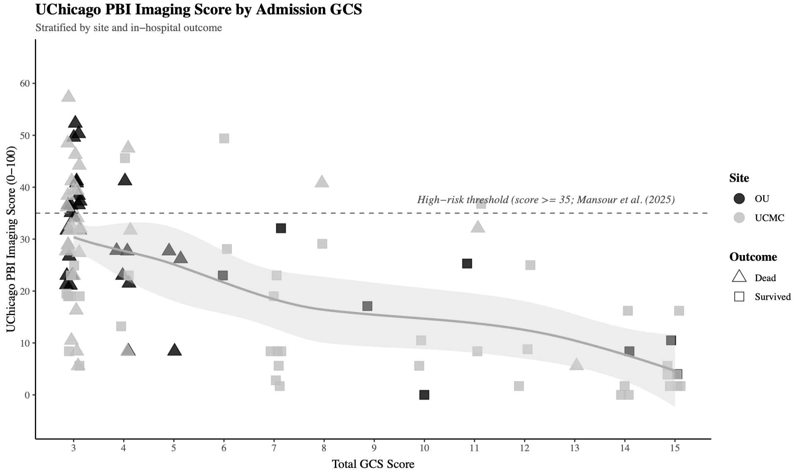
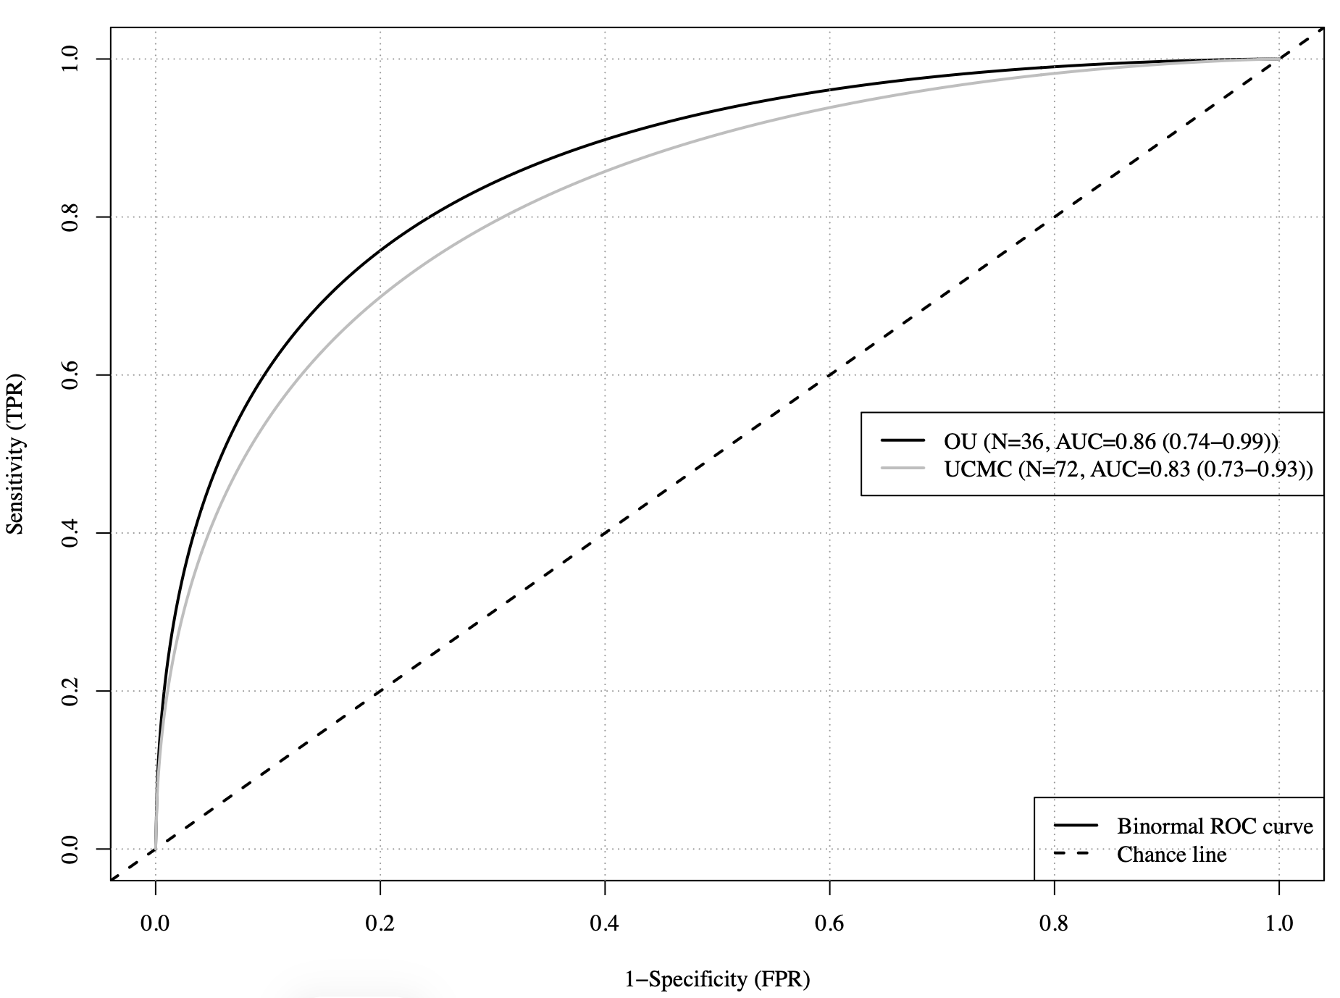
Validation of the UChicago Penetrating Brain Injury Imaging Score Across Two Independent Cohorts
Ronald Alvarado-Dyer, MD¹; Elena Badillo-Goicoechea ²; Elaine Lo ²; Farima Fakhri ²; Tracey Fan ²; William Roth ²; Elizabeth Carroll ²; Deborah Huang ²; Paramita Das ³; Susan Rowell ³; Timothy Placket ³; Christos Lazaridis ²; Fernando Goldenberg ²; Ali Mansour²
¹ Department of Neurology, Neurosciences Intensive Care Unit, OU Health University of Oklahoma Medical Center, Oklahoma City, OK.
² Department of Neurology, Division of Neurocritical Care, University of Chicago Medical Center, Chicago, IL
³ Department of Neurological Surgery, University of Chicago Medical Center, Chicago, IL
Introduction
Results
Mortality was 77.8% in the OUHSC cohort and 46.9% in the UCMC cohort.
The UChicago PBI Imaging Score demonstrated good discrimination for mortality in both cohorts, with an AUC of 0.86 (95% CI 0.74-0.99) at OUHSC and 0.83 (95% CI 0.73-0.93) at UCMC.
In the OUHSC cohort, median admission GCS was 3 (IQR 3-5), pupillary reactivity was absent in 61.1%, and median UChicago PBI Imaging Score was 28 (IQR 21.4-37).
In the UCMC cohort, median admission GCS was 4 (IQR 3-10), pupillary reactivity was absent in 35.9%, and median UChicago PBI Imaging Score was 25 (IQR 14.4-39).
The UChicago Penetrating Brain Injury (PBI) Imaging Score was developed as a head computed tomography-based tool to stratify mortality risk after PBI.
We aimed to evaluate its performance in 2 independent cohorts: a separate cohort from the University of Chicago Medical Center (UCMC), distinct from the original score-development cohort, and an external cohort from the University of Oklahoma Health Sciences Campus (OUHSC).
Conclusion
Methods
The UChicago PBI Imaging Score demonstrated good discrimination for in-hospital mortality in 2 independent cohorts, supporting its reproducibility across institutions.
Despite similar median imaging scores, mortality differed substantially between cohorts, highlighting the importance of clinical and center-level context when interpreting imaging-based prognostic models.
More broadly, these findings reinforce the need for PBI-specific imaging classification systems that capture radiographic features unique to PBI and may ultimately improve prognostication and guide more tailored management.
We retrospectively analyzed 108 patients with PBI from the 2 cohorts: OUHSC (n=36) and UCMC (n=72).
Variables collected included admission Glasgow Coma Scale (GCS), pupillary reactivity, and imaging features scored using the UChicago PBI imaging score.
The primary outcome was in-hospital mortality.
Predictive performance was assessed using the area under the curve (AUC) analysis.

