Slide 1
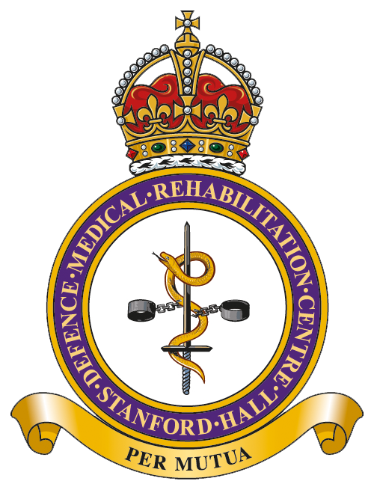
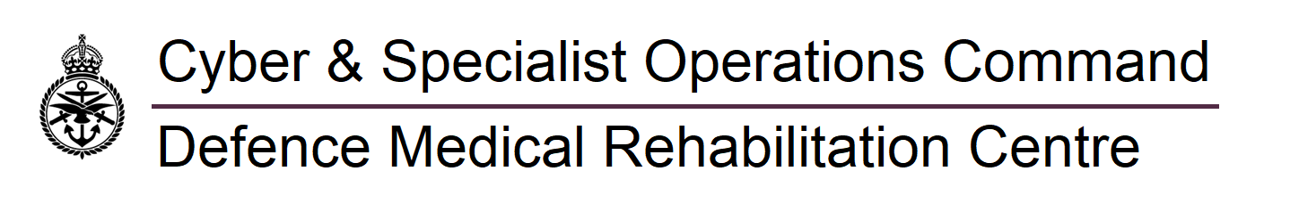
Universal Repositioning Manoeuvre (URM)
for BPPV Treatment in TBI Patients
Ms Toni White, DMRC Stanford Hall
Introduction
Traumatic Brain Injury (TBI) patients frequently present with multiple canal Benign Paroxysmal Positional Vertigo (BPPV).
Traditional treatment involves separate canalith repositioning manoeuvres (e.g., Epley, BBQ Roll) for each affected semicircular canal.
Barreto et al. (2023) proposed a Universal Repositioning Manoeuvre (URM) that treats all three semicircular canals on one side in a single session, potentially improving treatment efficiency.
Based on the longest durations in standard manoeuvres (Epley), each position was held for 30 seconds.
Power et al. (2020) reports 79% resolution after one treatment and 91% after two treatments with traditional manoeuvres. The URM was evaluated against these predictions.
Method
Retrospective study of 167 TBI patients from March to December 2025.
Data source: Medical notes, vestibular assessments, and patient-reported symptom resolution, clinician feedback questionnaire.
468 physiotherapy contacts recorded.
URM applied to unilateral and bilateral BPPV cases involving single or multiple canals.
Anterior canal BPPV treated with Yacovino manoeuvre due to diagnostic limitations.
Table 2. Showing how many treatments required to resolve BPPV using the URM, in 1x canal or 2x unilateral canals.
URM used to treat: | 1x canal | 2x canals (unilateral)
Total | 31 | 22
Needed 1x Rx | 25 | 9
Needed 2x Rx | 6 | 10
Needed 3x Rx | 0 | 3
Needed 4th Rx | 0 | 1
Needed original canal manoeuvre | 0 | 0
Discussion
URM effectively treats multiple canal BPPV in fewer sessions, improving service efficiency.
Challenges in distinguishing bilateral involvement without eye movement recording devices may affect treatment precision.
URM preferred for unilateral multiple canal BPPV; anterior canal treated separately.
Repeating URM up to 4 times justified by continued patient improvement.
Table 9. Shows summary of treatment sessions saved per canals involved.
 | Number of patients | Number of sides involved | Number of canals involved | URM 100% resolution Vs predicted treatment sessions for original manoeuvres to gain 79% resolution | URM 100% resolution Vs predicted maximum treatment sessions for original manoeuvres to gain 91% resolution
 | 15 | 1 | 1 | -4 | 11
 | 10 | 1 | 2 | 0 | 20
 | 4 | 2 | 2 | 1 | 9
 | 12 | 2 | 3 | 6 | 42
 | 13 | 2 | 4 | 7 | 59
Total | 54 | - | - | 10 | 141
Aim
Evaluate clinical effectiveness, ease of use, and staff satisfaction with URM in routine physiotherapy practice over 10 months.
Objectives
Assess treatment outcomes and service utilisation.
Compare URM efficiency against traditional manoeuvres.
Analyse patient symptom resolution and treatment session reduction. Successful treatment was defined by a nil finding’s reassessment post treatment.
Evaluate clinicians feedback on their confidence, satisfaction, and likelihood to use URM in their future practice.
Conclusions
URM is a clinically effective, efficient, and user-friendly treatment for BPPV in TBI patients.
It reduces the number of treatment sessions required, potentially easing service demand.
Further research with objective eye movement recording could enhance diagnostic accuracy and treatment targeting.
References
1. Barreto RG et al. (2023) Universal Repositioning Manoeuvre: A new treatment for single canal and multi-canal benign paroxysmal positional vertigo by 3-dimensional model analysis. J Int Adv Otol 19(3):242-247
2. Kaski D, Bronstein AM. (2014) Epleys and beyond: an update on treating positional vertigo. Pract Neurol 14:210-221
3. Power L et al. (2020) Characteristics of assessment and treatment in benign paroxysmal positional vertigo (BPPV). J Vestib Res 30:55-62
Results
URM achieved 100% symptom resolution across all groups of presentations.
Significant reduction in treatment sessions compared to predicted numbers for traditional manoeuvres.
Clinicians found the URM effective and user-friendly, supporting clinical reasoning with high satisfaction, though some seek stronger evidence for consistent use.
Acknowledgements
Thank you to all the members of DMRC TBI team who have contributed to delivery and data collection: Emily Morton, Louise Berridge, Lt Charles Fryatt (Physiotherapists)

