Slide 1
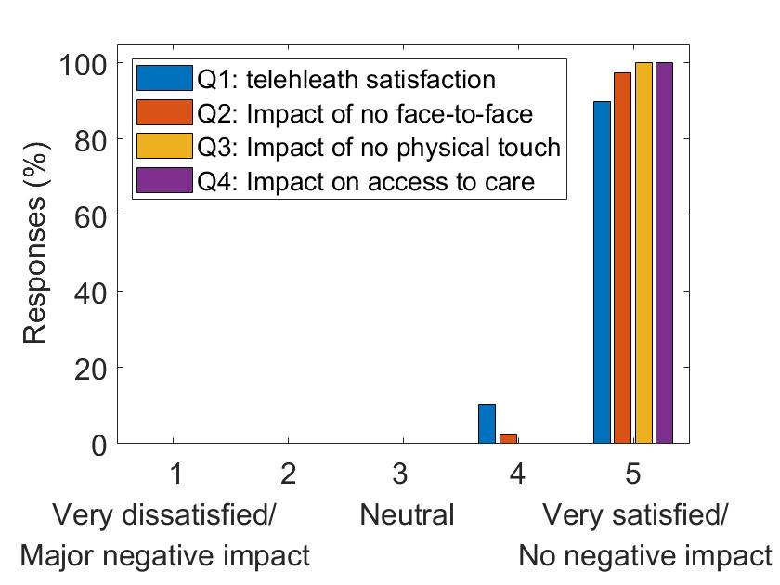
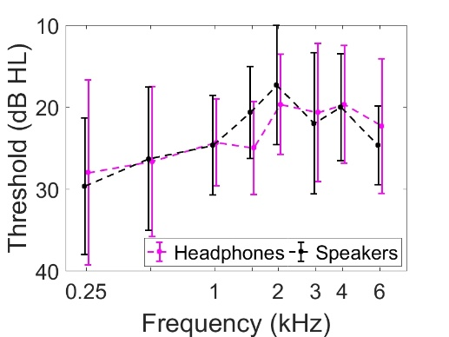
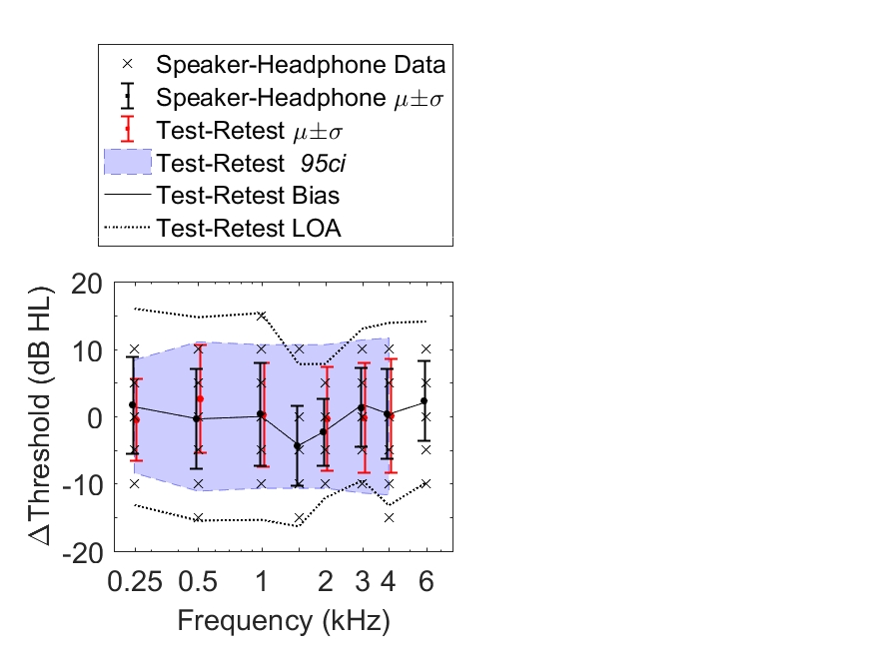
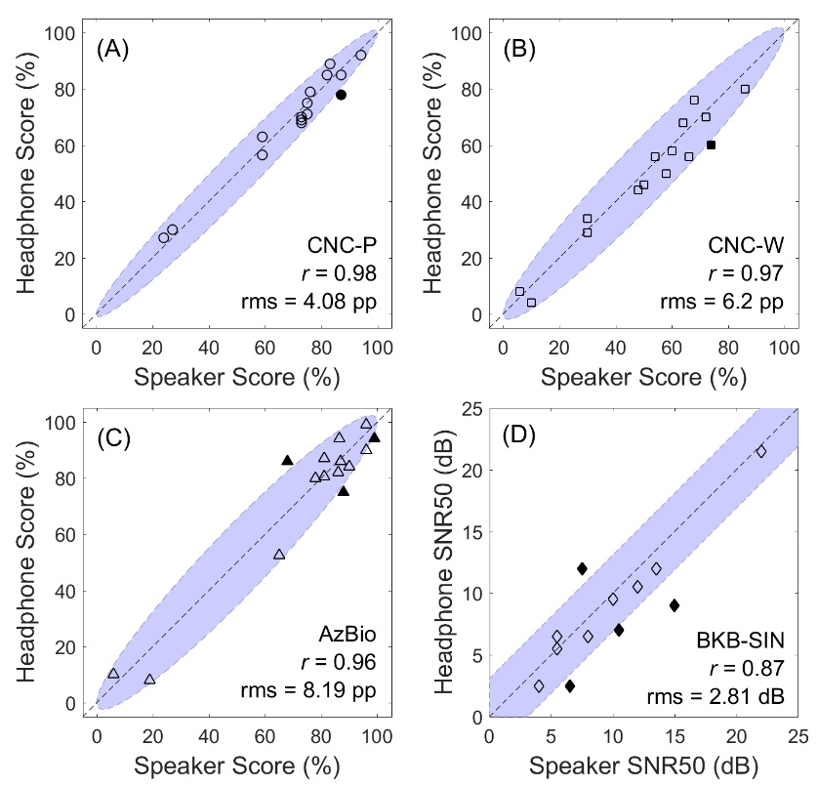
Cochlear implant telemedicine to overcome geographic barriers and increase access to care
Joshua Bernstein PhD¹, Elicia Pillion AuD¹, Sandeep Phatak PhD¹, LTC Anthony Tolisano MD²
¹Audiology & Speech Pathology Center, ²Department of Otolaryngology—Head and Neck Surgery
INTRODUCTION
FIGURE 1: Standard and telehealth systems produce similar CI “sound-field” audiograms
FIGURE 3: Field study shows high patient satisfaction
Cochlear implants (CIs) are a spectacularly successful neural-prosthetic treatment for severe to profound hearing loss.
Most active-duty service members who receive a CI are able to remain on active duty.
Geographical restrictions are a major barrier to access to CI due to limited number of MTFs that support care.
CI recipients require extensive travel and mission disruption, or civilian network care costing the government >$35k per patient.
This study developed a prototype telemedicine approach, allowing patients to complete nearly all their follow-up care without traveling to the CI center.
Two studies evaluated validity (comparison to standard of care measures) and efficacy (field trial evaluation).
(a) Group-mean audiograms are indistinguishable for the two systems
(b) Loudpeaker-headphone differences are within expected test-retest reliability limits: 95% confidence interval (95ci) and limit of agreement (LOA)
Subjects completed a survey following each telehealth visit. 39 responses from 13 subjects show high patient satisfaction with telehealth.
RESULTS
FIGURE 2: Standard and telehealth systems produce similar speech-testing results
Mean absolute differences between telehealth-system and sound-field audiograms were 5 dB. 96% of 500–4000 Hz telehealth-system thresholds within the sound-field 95ci.
CNC word and sentence identification in quiet showed high interclass correlations (ICC=0.96–0.98) and 80-93% of telehealth-system scores within the sound-field 95ci. Sentences in noise scores showed larger deviations.
13 CI patients located across the U.S. and overseas completed 39 post-op telehealth programming and assessment visits.
Telehealth-survey responses indicated high patient satisfaction, improved convenience and access to care, and only minor challenges.
METHODS
Telehealth headphones-based speech scores are within or close to the 95% confidence interval. (a) consonant-nucleus-consonant (CNC) phonemes, (b) CNC words, (c) sentences in quiet, (d) sentences in noise
Calibration. Headphones placed over the CI sound processor. Virtual audio techniques, using acoustic manikin and “cochlear implant in a box”, to determine headphones filter needed to produce the same electrical response as loudspeaker testing
Study 1: Validation. Compare telehealth system headphones-based speech perception and pure-tone thresholds to standard-of-care loudspeaker sound-field testing (N=15)
Study 2: Field study. Complete CI audiological follow-up appointments from the patient’s home, with patients completing questionnaires to rate their experience (N=13)
CONCLUSIONS
All elements of a post-CI visit replicated in the telehealth system
The headphone-based system for at-home follow-up appointments is accurate, feasible, and satisfactory to patients.
By reducing geographical barriers and increasing access to care, the telehealth approach has the potential to
  increase return-to-duty for hearing-impaired service
  limit mission impact by maintaining continuity of care regardless of geographical requirements
  recapture patients from the civilian network, saving the government 10s of thousands of dollars per surgery.
 | Standard practice | Telemedicine
Audiogram | Sound field | Headphones
Speech tests | Sound field | Headphones
Programming | Company software USB connection In-person | Company software USB connection Remote control
Sound quality check | Live voice | Pre-recorded sounds, headphones
Questionnaires | Pencil & paper | Online
Red Font = Different from standard practice

