Slide 1


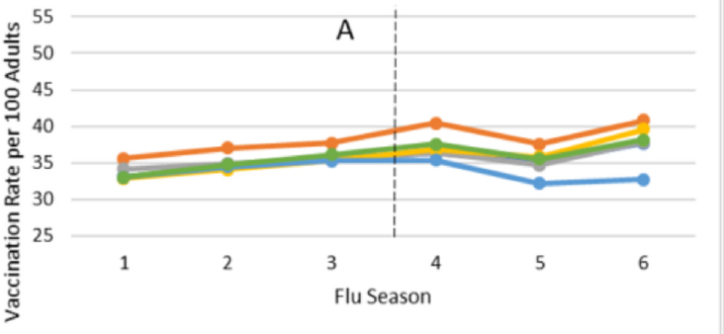
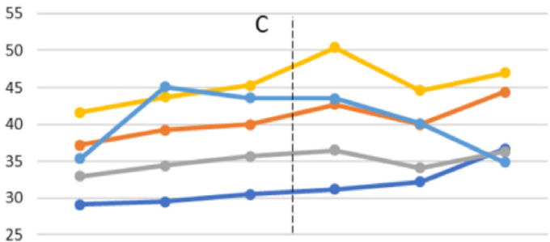
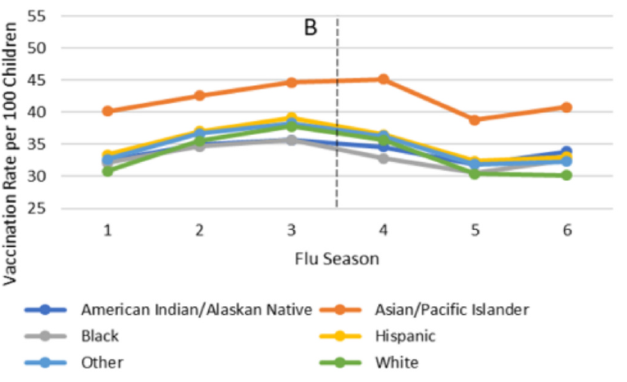
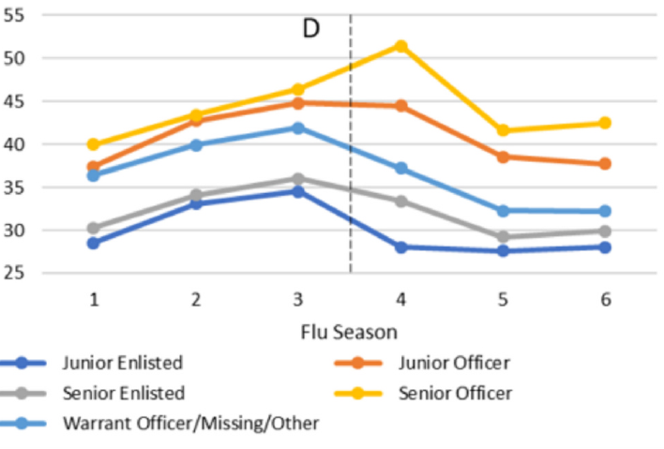
Trends in Influenza Vaccination Uptake in a Universally Insured Population in the United States, 2017 - 2023
Christopher Reeves, DVM^{1,}, Sarah Selica T. Miura, MPH^{1,2}, Ashley R. Chappell, MPH^{1,2}, Amanda Banaag, MPH^{1,2}, Christian L. Coles, PhD, MPH^{1,2}, Tracey Pérez Koehlmoos, PhD, MHA¹
¹ Uniformed Services University of the Health Sciences, 4301 Jones Bridge Road, Bethesda, MD 20814, USA
² The Henry M. Jackson Foundation for the Advancement of Military Medicine, Inc, 6720 Rockledge Dr., Bethesda, MD 20817, USA
INTRODUCTION
RESULTS
DISCUSSION
Annual United States vaccination rates against influenza remain below the Healthy People 2030 target of 70%
Various patient demographic factors are associated with differences in vaccine uptake to include race, socioeconomic status, and insurance status
The Military Health System (MHS) offers comprehensive healthcare coverage to active-duty services members (ADSM), retirees, and their dependents through TRICARE, which covers both direct and patient care reducing the barriers to accessing health services
While annual influenza are required for all ADSM without a medical or religious exemption, there is no influenza vaccination requirement for military dependents or retirees
We hypothesized that universal access to care would mitigate vaccine uptake discrepancies among the various demographic groups
We identified a total of 6.006 million ADSM, dependents, and retirees between July 2017 and March 2023. Roughly a quarter were children <18 years and the remaining three quarters were adults >18 years.
We observed a significant increase in vaccination rate from 33% to 36.5% in vaccination rate
In Children, we observed a general increase in rate between seasons 1 to 3, followed by a decrease from season 4 to 6. In adults, we observed an increase from season 1 to 4, a sharp decline in season 5, then increase for season 6.
General increase in vaccination rate, well below general population and the Healthy People 2030 goal
Support previously published trends that show higher vaccination rates among Asian/Pacific Islanders and those in higher SES
Highlights the inaccuracies of electronic health records. ADSM’s are reported at 46% but medical readiness databases know the rate to be 92%
Some selected observed trends:
  Only age that decreased vaccination rate was 5-17
  Shift towards private care setting (21.4% → 35.5%)
  Highest vaccination odds with Asian/Pacific Islander
  Vaccination rates increased as sponsor rank increased (SES)
  Reported vaccination rate of ADSM was 46%
  Air Force / Space Force had the highest vaccination rate
  Direct Care Clinics and pharmacy dropped from 70.2% to 56.4%
  Private Sector Retail Pharmacy increased from 21.4% to 35.5%
Limitations include transition from legacy military health systems to MHS Genesis in 2019 resulting in known accuracy problems, prolonged access to care, and usability. An additional limitation was the inability to track vaccination status if receiving care from health departments, vaccination drives, or community healthcare clinics.
Table 2. Selected Descriptive Statistics Between Vaccination Season 1 Versus Season 6
Table 2. Factors associated with Influenza Vaccination Coverage among MHS Beneficiaries, Jul 2022 – Mar 2023
METHODS
Demographic | Vx Season 1 | Vx Season 6 | % Change
Total | 33.0 | 36.5 | 3.5ª
Age
1 - 4 | 35.1 | 37.1 | 2ª
5 - 17 | 30.9 | 29.8 | -1.1ª
18 - 24 | 27.2 | 33.8 | 6.6ª
25 - 29 | 31.8 | 40.2 | 8.7ª
30 - 34 | 34.6 | 41.4 | 6.8ª
35 - 39 | 36.3 | 42.2 | 5.9ª
40 - 44 | 35.9 | 38.4 | 2.5ª
45 - 49 | 34.6 | 35.1 | 0.5
50 - 54 | 34.3 | 35.3 | 1.0ª
55 - 64 | 38.9 | 40.4 | 1.5ª
Active Duty | 34.2 | 46.0 | 11.8ª
Service
Army | 37.2 | 35.0 | -2.2ª
Air Force / Space Force | 23.1 | 37.9 | 14.8ª
Navy | 37.5 | 37.1 | -0.4ª
Marine Corps | 33.7 | 34.9 | 1.2ª
Care Setting
Direct Care | 70.2 | 56.4 | -13.8
Priv. Pharm | 21.4 | 35.5 | 14.1
Demographic | UnVx | Vx | Adjusted OR
Racial Identitiy
White | 63.4 | 36.6 | ref
Black | 63.1 | 36.9 | 1.07ª
Hispanic | 61.7 | 38.3 | 1.1ª
Asian/Pacific Islander | 59.2 | 40.8 | 1.18ª
American Indian / Alaskan Native | 62.7 | 37.3 | 1.01ª
Rank
Junior Enlisted | 64.4 | 35.6 | 0.56ª
Senior Enlisted | 65.4 | 34.6 | 0.62ª
Junior Officer | 57.3 | 42.7 | 0.8ª
Senior Officer | 65.7 | 34.3 | ref
Service
Army | 65 | 35 | ref
Air Force / Space Force | 62.1 | 37.9 | 1.09ª
Navy | 62.9 | 37.1 | 1.01ª
Marine Corps | 65.1 | 34.9 | 0.98ª
We used the MHS Data Repository (MDR) to conduct a cross-sectional study of ADSM, dependents, and retirees with TRICARE Prime/Plus coverage between the ages of 1 - 64 in the U.S. Army, Air Force, Space Force, Navy, and Marine Corps between July 2017 and March 2023
Individuals in the National Guard or Reserves were excluded due to inconsistent access to the MHS, and those over 65 were excluded due to Medicare being the primary payer
The study period encompassed six different influenza seasons starting with influenza season 1 from July 2017 – March 2018 and ending with season 6 from July 2022 – March 2023.
Patient demographics such are age, biological sex, race/ethnicity, beneficiary status, sponsor rank (which was used as a surrogate for socioeconomic status (SES), and sponsor branch of service were extracted
Vaccination status was identified using current procedural terminology (CPT) codes and vaccine administered (CVX) codes.
Missing race/ethnicity was imputed using reweighted estimating equations (RWEE) method. Descriptive analytics included chi-squared and multivariable logistic regressions. Significance was set at α< 0.05 and performed using SAS, version 9.4
CONCLUSIONS
Our study successfully displays the trends in influenza vaccination among various demographics within a universal healthcare model
We highlight the continued need for accurate linkages between vaccination and their monitoring system like Electronic Health Records
We provide information to inform public health officials in their targeted outreach campaigns to improve influenza vaccination across the population
ªStatistically significant, p<0.05 / ref = reference group
Note:Each variable in the table was adjusted by all other variables in the table.
DISCLAIMER
REFERENCES
The contents of this publication are the sole responsibility of the authors and do not necessarily reflect the views, assertions, opinions or policies of the Uniformed Services University of the Health Sciences (USUHS), the Henry M. Jackson Foundation for the Advancement of Military Medicine, Inc. (HJF), the Department of War (DoW), or the Departments of the Army, Navy, or Air Force. Mention of trade names, commercial products, or organizations does not imply endorsement by the U.S. Government. The authors declare no conflict of interest.
Centers for Disease Control and Prevention 2023-2024 Influenza season summary: influenza severity assessment, burden and burden prevented. Updated. https://www.cdc.gov/flu/whats-new/flu-summary-addendum-2023-2024.html; November 22, 2024. [Accessed 11 July 2025]
Centers for Disease Control and Prevention. Vaccination Trends. Updated January 24, 2025. Accessed February 06, 2025, https://www.cdc.gov/respiratory-viruses /data/vaccination-trends.html; 2025
Healthy People 2030. Increase the Proportion of People Who Get the Flu Vaccine Every Year. https://odphp.health.gov/healthypeople/objectives-and-data/browse- objectives/vaccination/increase-proportion
Lu PJ, Hung MC, Srivastav A, et al. Surveillance of vaccination coverage among adult populations -United States, 2018. MMWR Surveill Summ. 2021;70(3):1–26. Published 2021 May 14, 10.15585/mmwr.ss7003a1
Koehlmoos TP, Korona-Bailey J, Janvrin ML, Madsen C. Racial disparities in the military health system: a framework synthesis. Mil Med 2022;187(9–10): e1114–21. https://doi.org/10.1093/milmed/usab506.
Note Tables 1 &2: Vaccination season 1 was July 2017 – March 2018. Vaccination Season 6 was July 2022 – March 2023.
Vx = Vaccinated, UnVx = Unvaccinated, % = Percent, OR = Odds ratio
Priv. Pharm = Private sector retail pharmacy

