Slide 1


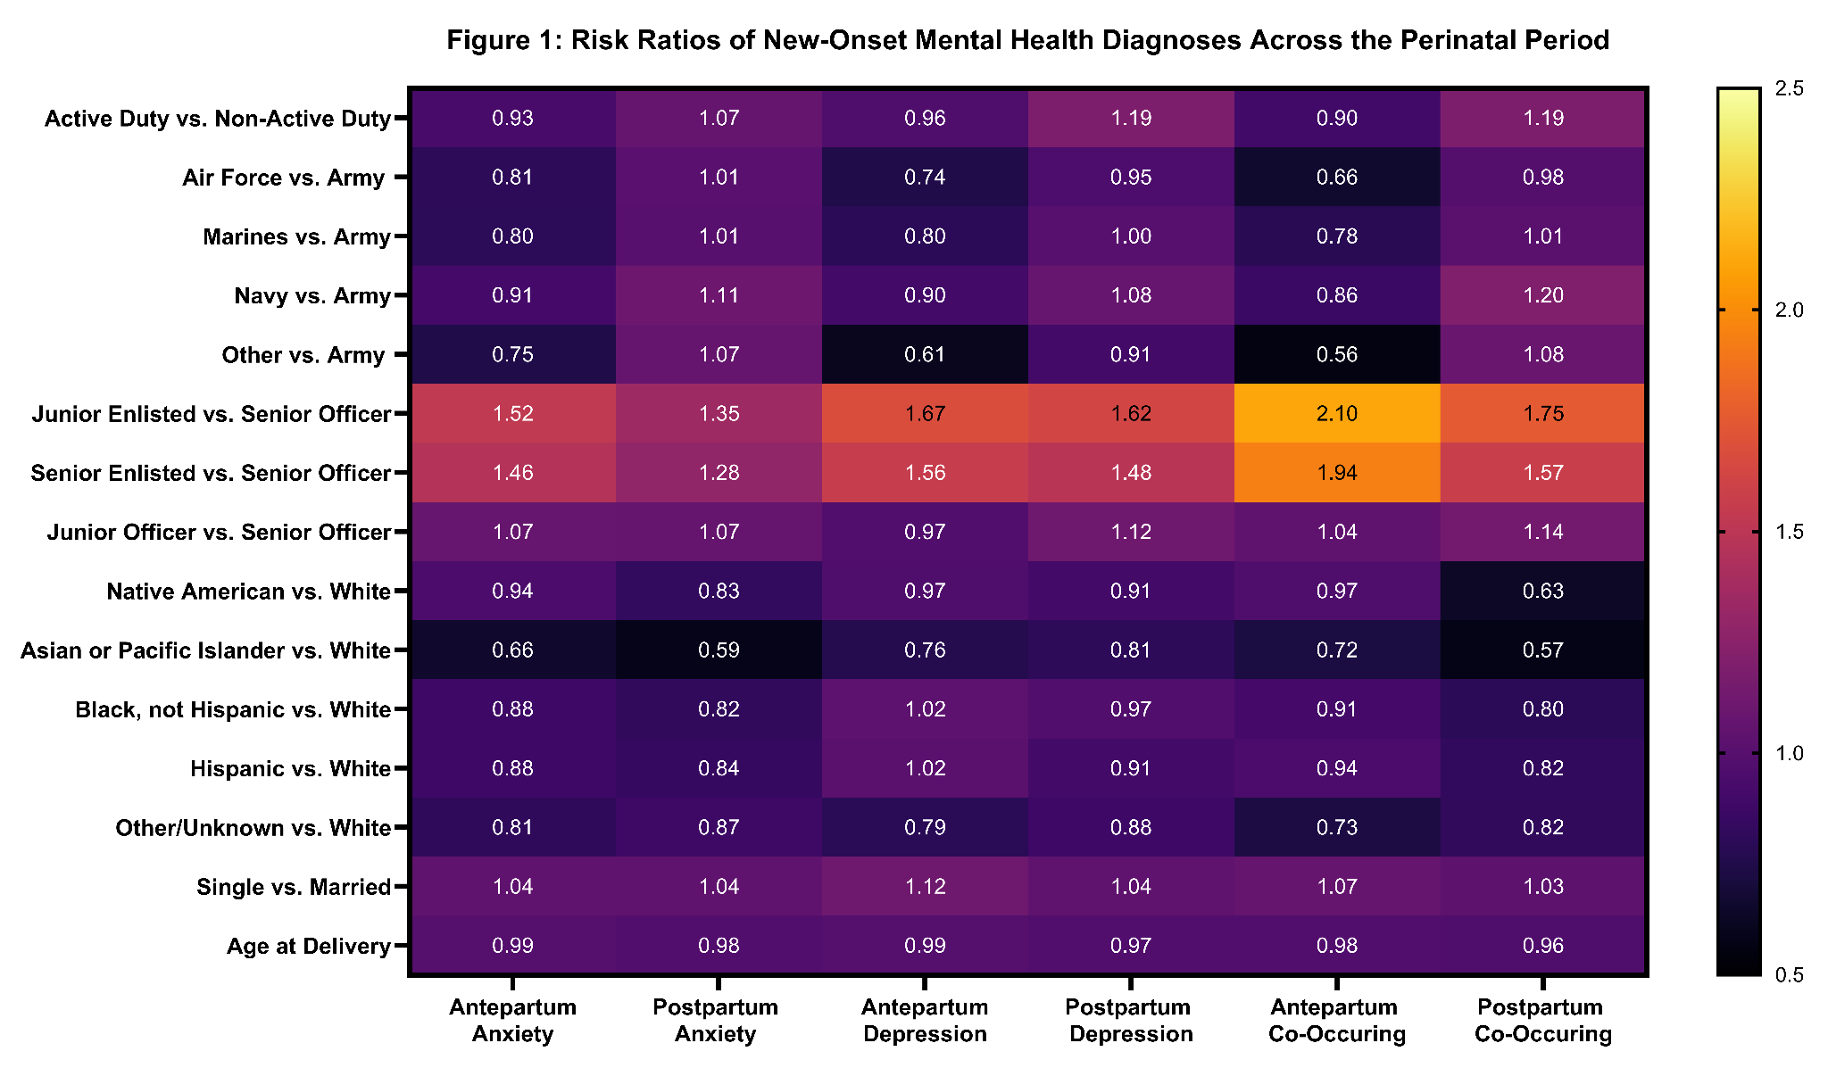
At Home and in Service: Maternal Mental Health Diagnoses in the MHS, 2018-2022
Jasmin R. Martinez, MPH^{1,3}, Elizabeth H. Lee, DrPH¹, Ian S. Sorensen, MPH^{1,3}, Zella Berill, MS^{1,3}, Dakota Davis, BS^{1,3}, Binny Chokshi, MD¹, Lucia M. Reyes, PhD³, Jill Brown, MD, MPH²
¹Department of Pediatrics, Uniformed Services University, Bethesda, MD, ²Department of Gynecologic Surgery and Obstetrics, Uniformed Services University, Bethesda, MD,
³The Henry M. Jackson Foundation for the Advancement of Military Medicine, Inc., Bethesda, MD
INTRODUCTION
RESULTS
Military-connected women are at an increased risk for maternal mental health diagnoses compared to their civilian counterparts
No study has examined maternal mental health incidence and its risk factors across the MHS
Table 1. Demographic Characteristics of Mothers at the Start of Pregnancy
 |  | Mothers (n=254,241)
 |  | Pregnancies (n=302,850)
 |  | n | %
Active Duty | Yes | 66,605 | 22.0
 | No | 236,245 | 78.0
Branch of Service of Sponsor | Air Force | 73,449 | 24.3
 | Army | 116,308 | 38.4
 | Marine Corps | 34,771 | 11.5
 | Navy | 68,662 | 22.7
 | Other | 9,660 | 3.2
Rank of Sponsor | Junior Enlisted | 91,106 | 30.1
 | Junior Officer | 48,341 | 16.0
 | Senior Enlisted | 145,474 | 48.0
 | Senior Officer | 17,929 | 5.9
Race & Ethnicity | Asian or Pacific Islander | 8,122 | 2.7
 | Black, Not Hispanic | 23,240 | 7.7
 | Hispanic | 16,723 | 5.5
 | Native American | 1,810 | 0.6
 | Other/Unknown | 197,386 | 65.2
 | White, Not Hispanic | 55,569 | 18.4
Marital Status | Married | 280,378 | 92.6
 | Unmarried | 22,472 | 7.4
 |  | Mean | IQR
Age at delivery (in years) |  | 29.4 | 5.1
Table 2. Incidence of Mental Health Diagnoses Across the Perinatal Period
 |  | Mothers (n=254,241)
 |  | Pregnancies (n=302,850)
Diagnosis |  | Antepartum | Postpartum
Anxiety
No prior diagnosis |  | 260,252 | 236,445
Incident cases, n (%) |  | 23,807 (9.1%) | 21,680 (9.2%)
Depression
No prior diagnosis |  | 273,091 | 254,065
Incident cases, n (%) |  | 19,026 (7.0%) | 27,591 (10.9%)
Both, Anxiety and Depression
No prior diagnosis |  | 227,688 | 196,900
Incident cases, n (%) |  | 7,071 (3.1%) | 7,646 (3.9%)
254,241 mothers with 302,850 pregnancies ending in a live birth (multiple gestations were counted as a single pregnancy).
Across the perinatal period, depression increased from AP to PP by 43.5%, while anxiety remained stable.
Duty Status: AD mothers had a lower risk of all outcomes in AP but a higher risk for all outcomes during PP.
Service Branch: In AP, all branches had a lower risk of all outcomes, compared to the Army. In PP, across all outcomes, Navy mothers had an increased risk.
Rank: Enlisted mothers showed increased risk across all outcomes and both periods.
Race & Ethnicity: Minoritized mothers showed decreased risk, compared to White mothers, across all outcomes in PP.
OBJECTIVE
Analyze sociodemographic factors associated with the risk of a new maternal mental health diagnosis among women with a linked live birth receiving care in the MHS.
METHODS
Data Source: MHS Data Repository
Population: Active Duty and Non-Active Duty mothers with TRICARE pregnancies resulting in a live birth, CY2018-22
Outcome: ICD-10 codes identified maternal mental health surrounding pregnancy. Anxiety, depression, and co-occurring anxiety and depression were identified across three windows: pre-pregnancy (1 year prior to start of pregnancy), antepartum (AP: start of pregnancy to delivery), and postpartum (PP: up to 1 year post-delivery)
Covariates: Maternal demographics at conception (duty status, Service branch, sponsor rank, race & ethnicity, marital status, age at delivery)
Analysis: Generalized Estimating Equations (GEE) model with a binomial distribution and log link to calculate Risk Ratios (RRs). Accounted for maternal clustering and varied follow up time
Age: Each additional year of age at delivery was associated with a decreased risk across all outcomes and both periods.
***
**
***
**
***
***
***
**
***
CONCLUSIONS
***
***
***
***
***
***
***
***
***
The postpartum period may be a critical vulnerability window for AD mothers
Differences in secondary caregiver leave across service branch may elucidate higher risk of all outcomes for Navy mothers in PP.
Increased risk for all outcomes in both periods among enlisted mothers may be a proxy for lower socioeconomic status.
It is unknown whether lower risk in minoritized mothers relates to healthcare utilization rather than actual reduced risk.
Findings support time-sensitive, rank-informed, and branch-specific approaches to perinatal mental health screening and intervention.
***
***
**
***
***
***
***
***
***
***
***
***
***
***
***
***
*
**
*
**
***
***
***
***
***
***
***
***
*
***
***
***
***
***
***
***
***
***
***
***
***
***
***
***
***
***
***
Note: * = p < 0.05, ** = p < 0.01, *** = p < 0.001
The opinions and assertions expressed herein are those of the author(s) and do not reflect the official policy or position of the Uniformed Services University of the Health Sciences. The opinions and assertions expressed herein are those of the author(s) and do not reflect the official policy or position of the Henry M Jackson Foundation for the Advancement of Military Medicine, Inc.

