Slide 1


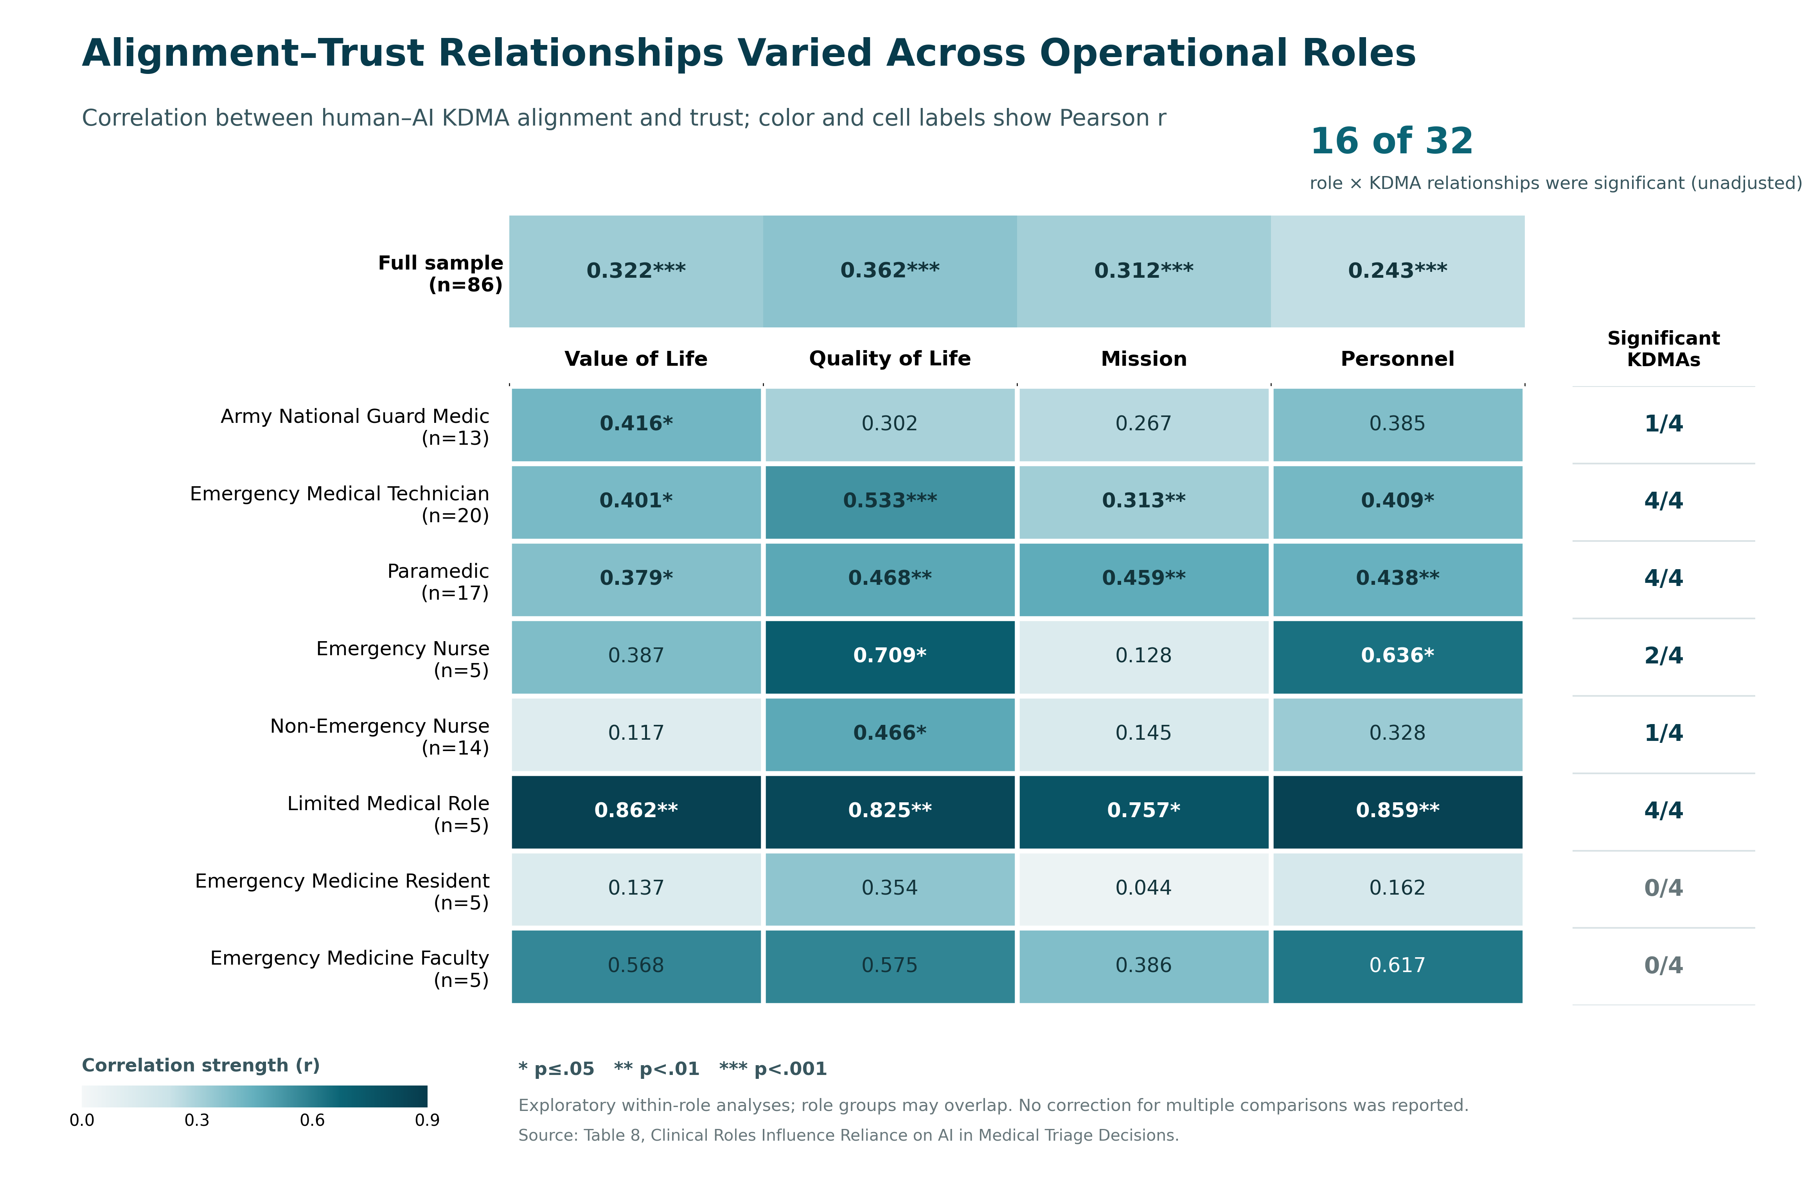
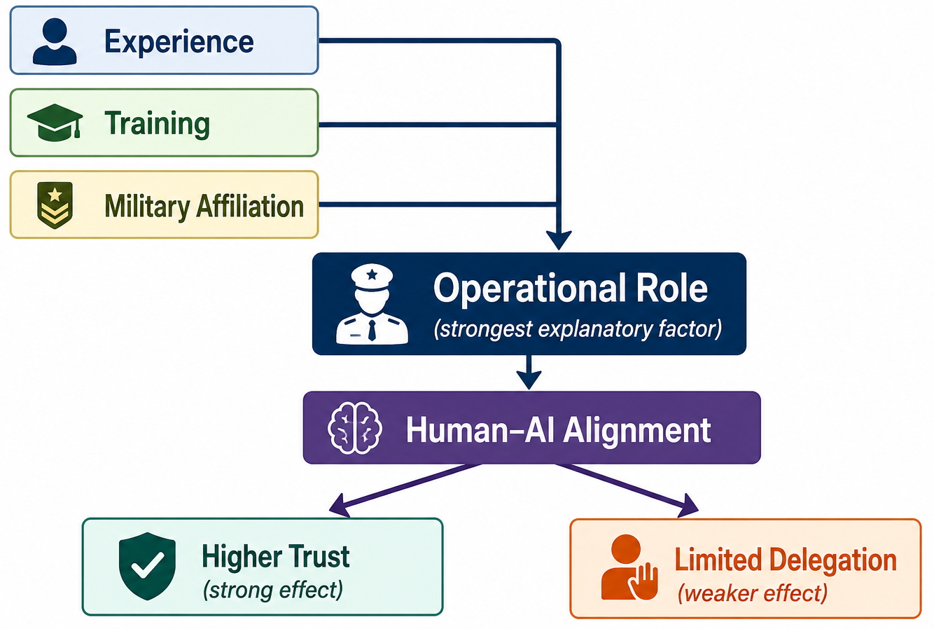
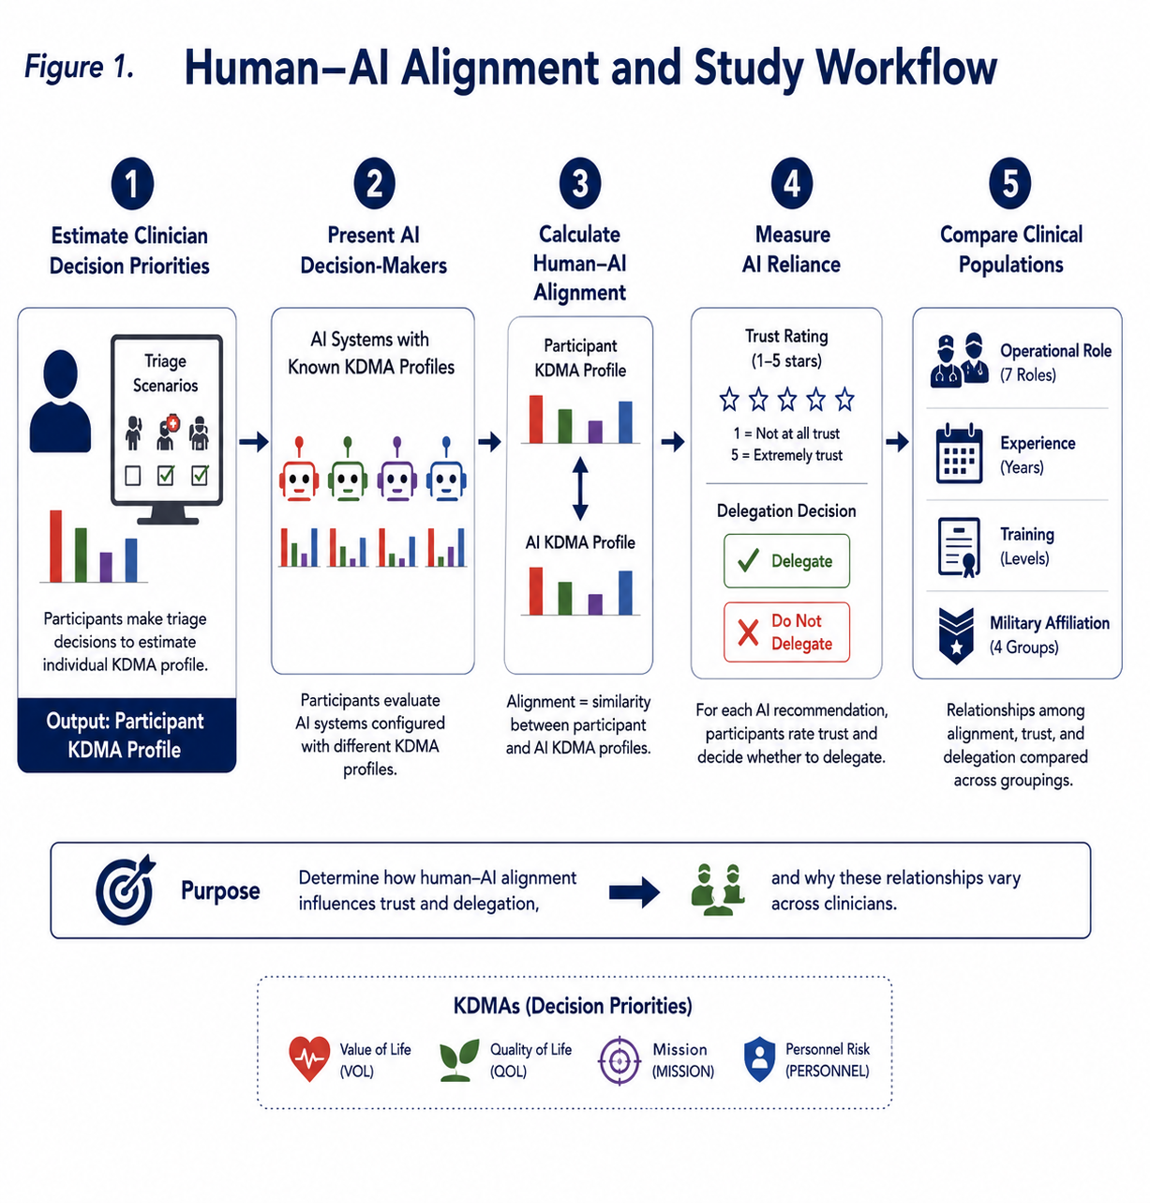
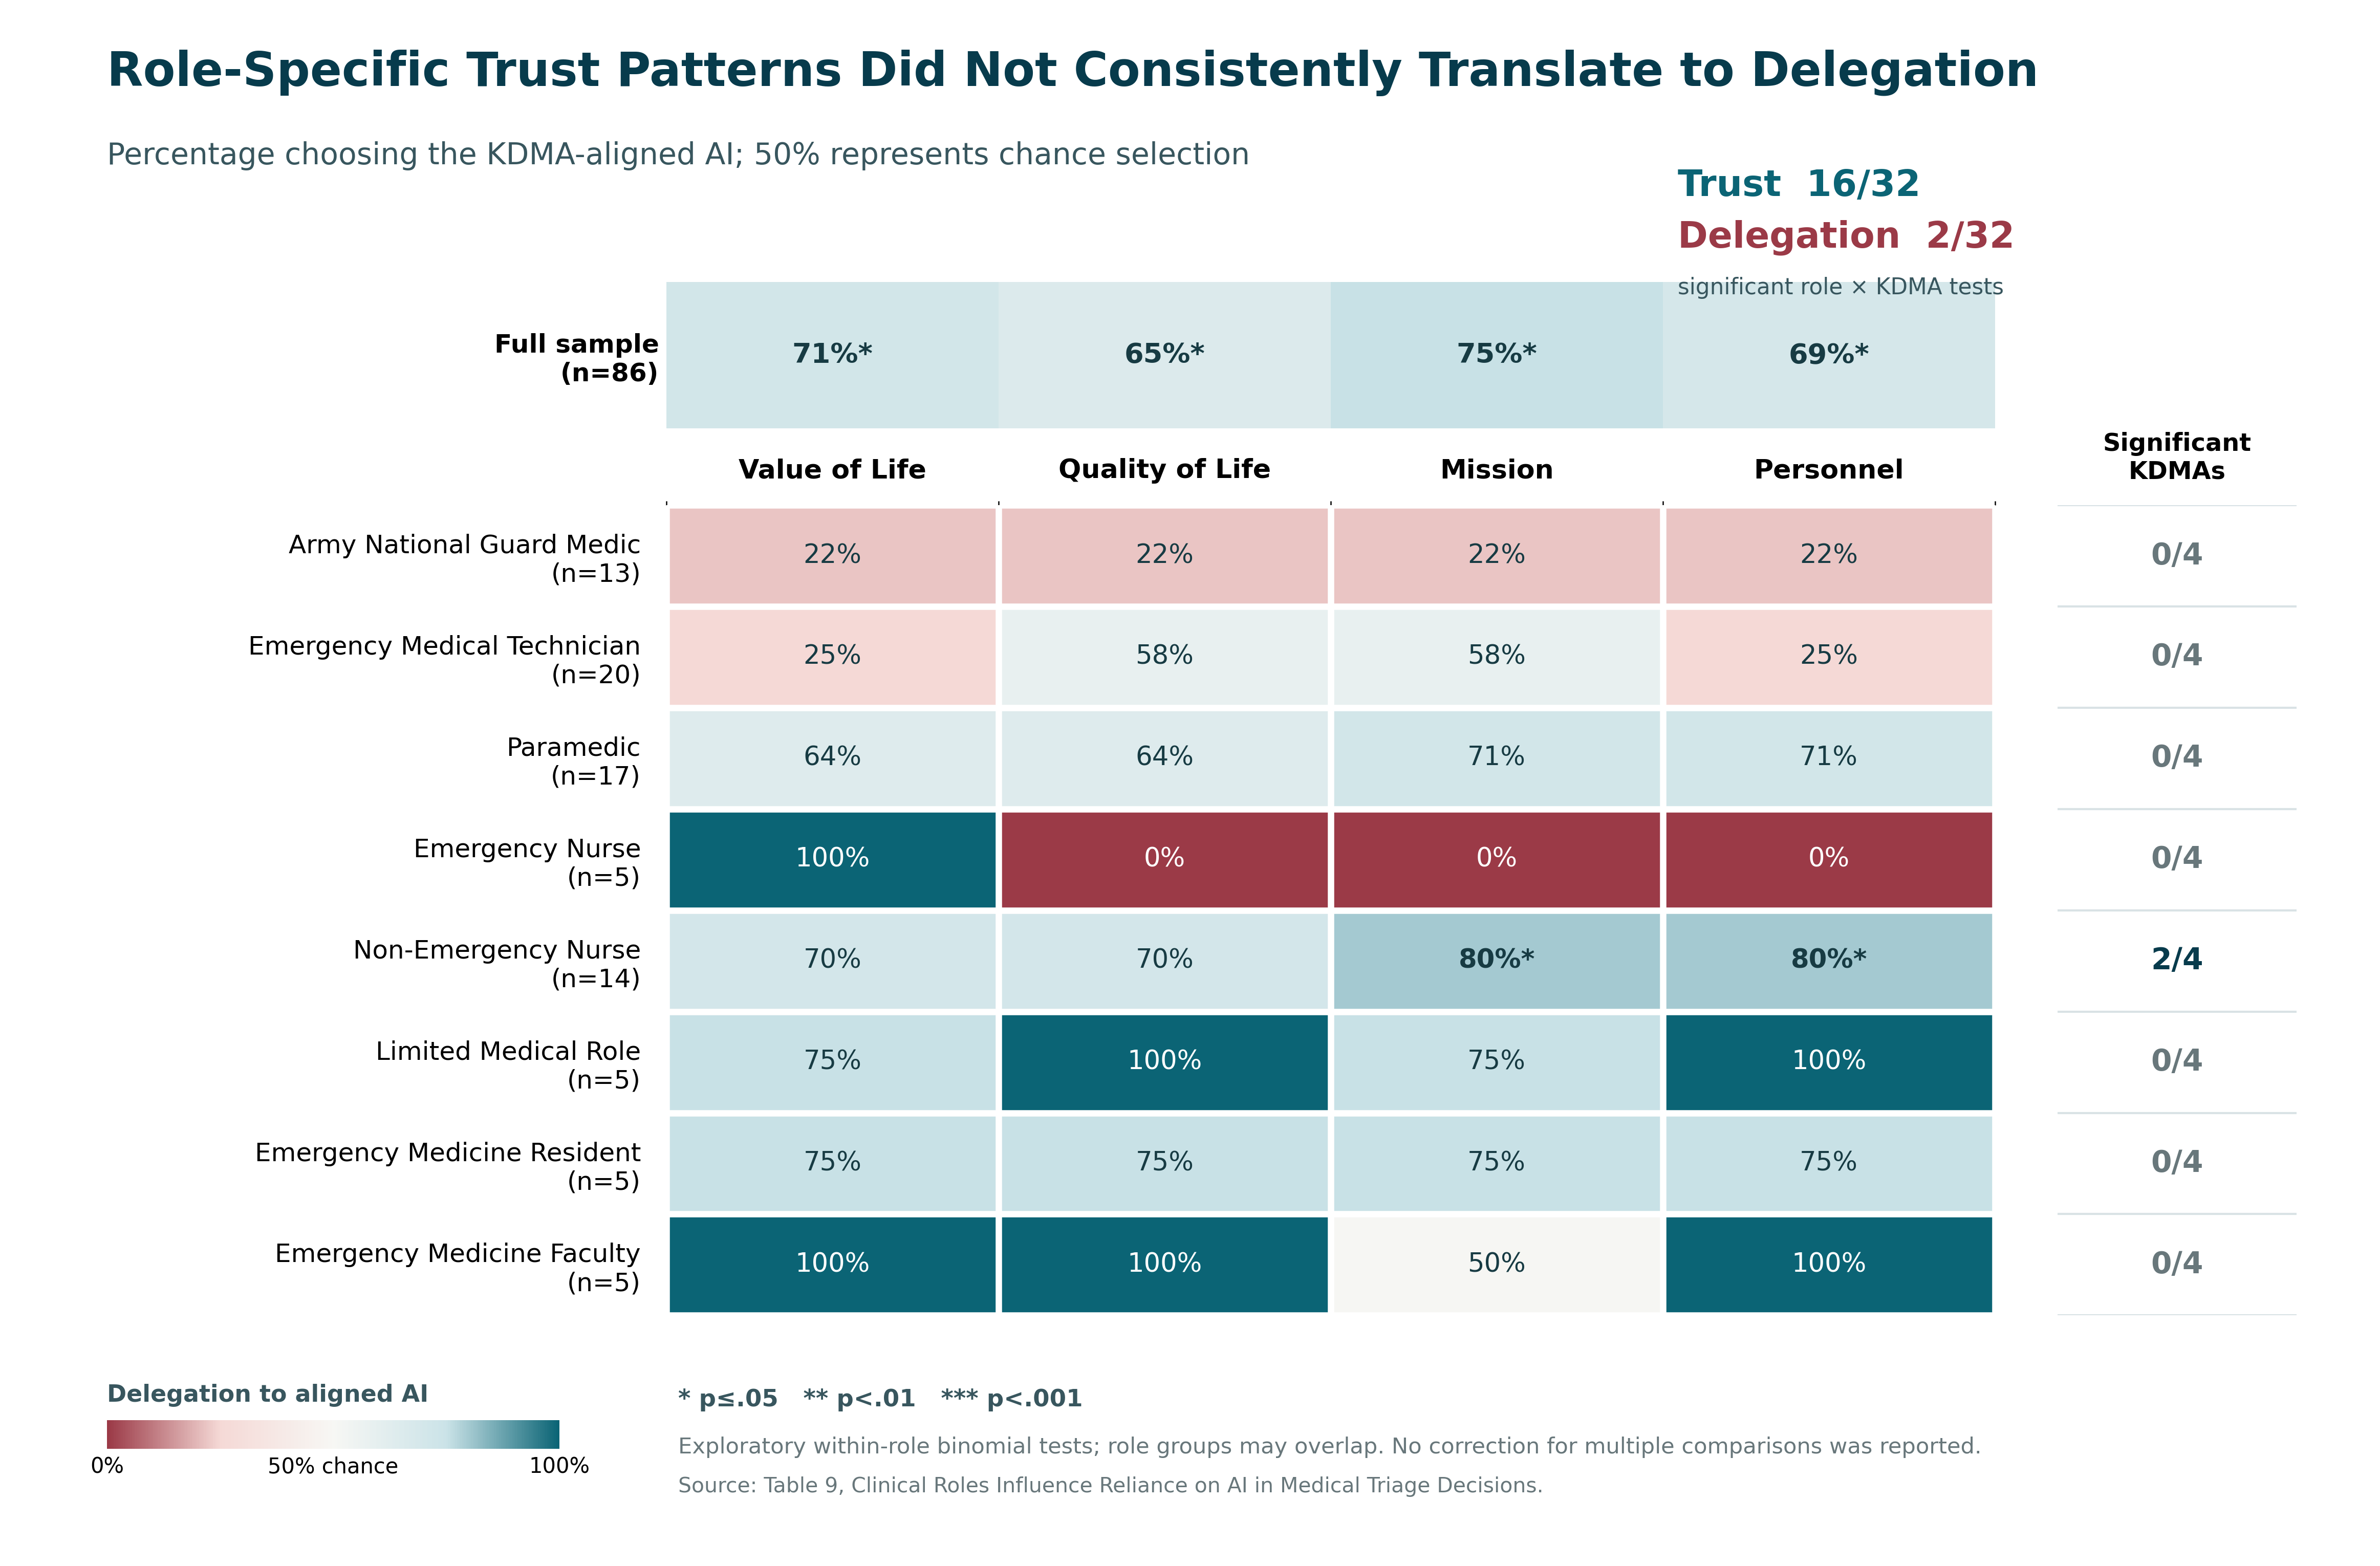
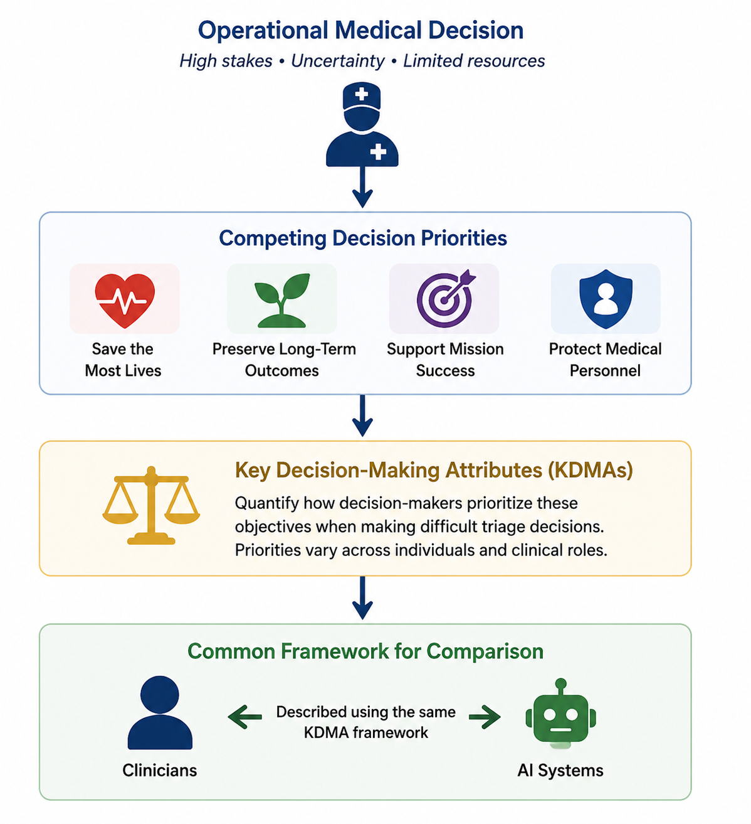
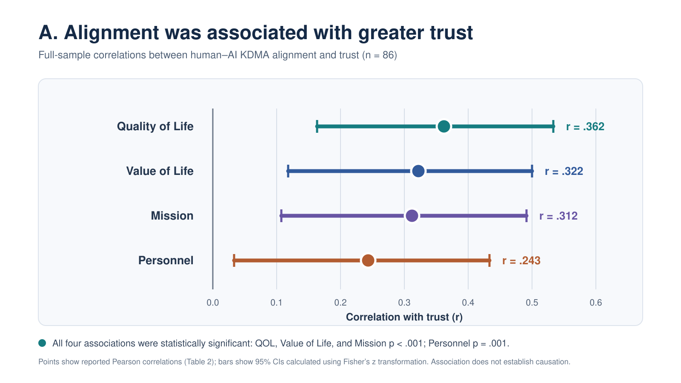
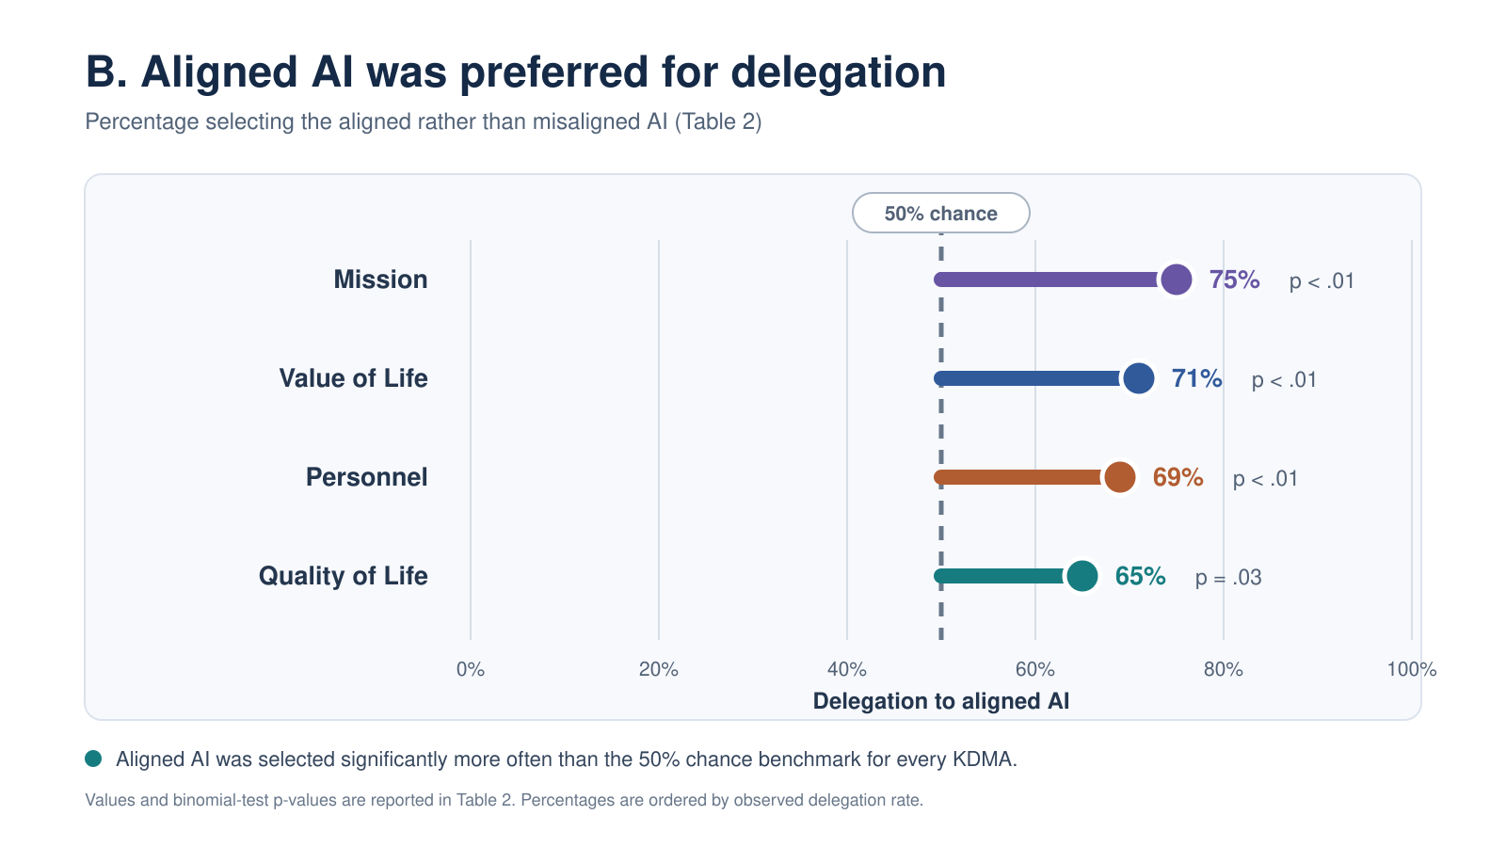
Clinical Roles Influence Trust and Reliance on AI in Medical Triage Decisions
Joseph Cohn¹, Dylan Schmorrow¹, Neil Shortland²,
¹Lyntris, ²UMass-Lowell
Operational Need
Measuring Decision Priorities
Novel Finding
Artificial intelligence (AI) decision-support systems are increasingly being introduced into military and civilian medicine to improve the speed and quality of complex medical decisions. Yet successful deployment depends not only on AI performance, but also on whether clinicians are willing to trust and rely on AI recommendations.
Previous studies have shown that alignment between human and AI decision-making influences trust. However, little is known about whether differences in clinical role influence willingness to rely on AI beyond traditional factors such as experience or training.
Key Decision-Making Attributes (KDMAs) quantify how individuals prioritize competing objectives during decision-making. KDMAs measure the decision priorities that influence why a particular decision is made.
Measuring KDMAs Participants completed a series of structured casualty-triage scenarios. Their responses were analyzed using previously developed probabilistic scoring models to estimate an individual KDMA profile—a quantitative representation of how they prioritize competing operational objectives.
KDMA profiles provide a common framework for describing both clinicians and AI decision-makers, enabling direct comparison of their decision priorities.
Alignment–trust relationships varied across roles
Research Questions
Clinician-AI Alignment and Study Workflow
Does clinical role influence AI trust?
Does it matter more than experience, affiliation or training?
Does trust lead to reliance (delegation)?
Novel Finding
Role-specific trust relationships did not consistently increase willingness to delegate to the aligned AI
Conceptual Framework
AI decision support should align with how clinicians make decisions—not just what decisions they make.
Triage decisions rarely have one "correct" answer because multiple objectives are in opposition.
Two clinicians may make different, but equally defensible, decisions because they prioritize objectives differently.
Key Decision-Making Attributes (KDMAs) provide a common framework for quantifying decision priorities in clinicians and AI.
Conclusions
Foundational Finding
Across KDMAs, higher human–AI alignment was associated with higher trust & delegation to AI.
Alignment–trust relationships varied across operational roles, revealing role-specific patterns.
Role-specific trust patterns did not consistently translate into delegation, suggesting trust and behavioral reliance are distinct outcomes.
Comparing clinician and AI KDMA profiles enables human–AI alignment to be measured.
Degree of alignment can then be related to clinician willingness to trust and rely on AI
Across all KDMAs, alignment was associated with greater trust and a significant preference to delegate to an aligned AI
Alignment associated with greater trust (n=86)
Aligned AI was preferred for delegation (n=86)
References
Cohn, J., Bixler, R., Woods, A., Lampi, J., & Shortland, N. (2025). Modeling human decision attributes to enhance AI trustworthiness. Proceedings of the 2025 Interservice/Industry Training, Simulation, and Education Conference (I/ITSEC). Orlando, FL: National Training and Simulation Association.
McVay, J., de Visser, E. J., Pippin, B., Mani, A., Hyde, J. and Kman, N. (2025). Trust in AI Aligned Decision-Makers. 2025 IEEE Conference on Artificial Intelligence (CAI). Santa Clara, CA.
Woods, A., Lampi, J., Pisanelli, S., Shortland, N., Marinier, R. Bixler, R., Cohn, J. (2025a). Enhancing Human-Artificial Intelligence Alignment: A Calibration-Based Approach. 2025 IEEE Conference on Artificial Intelligence (CAI). Santa Clara, CA.
Acknowledgments
This work was funded by DARPA contracts FA8650-23-C-7315 and W912CG-23-C-0036.
Notes:
AI should align with how clinicians make decisions—not just what decisions they make.
Trust in AI is influenced by whether clinicians perceive that an AI prioritizes competing objectives similarly to themselves. To evaluate this, both clinicians and AI must be described using a common framework that captures decision priorities.
Key Decision-Making Attributes (KDMAs) provide that framework. They quantify how decision-makers balance competing operational objectives during difficult medical triage decisions.

