Slide 1
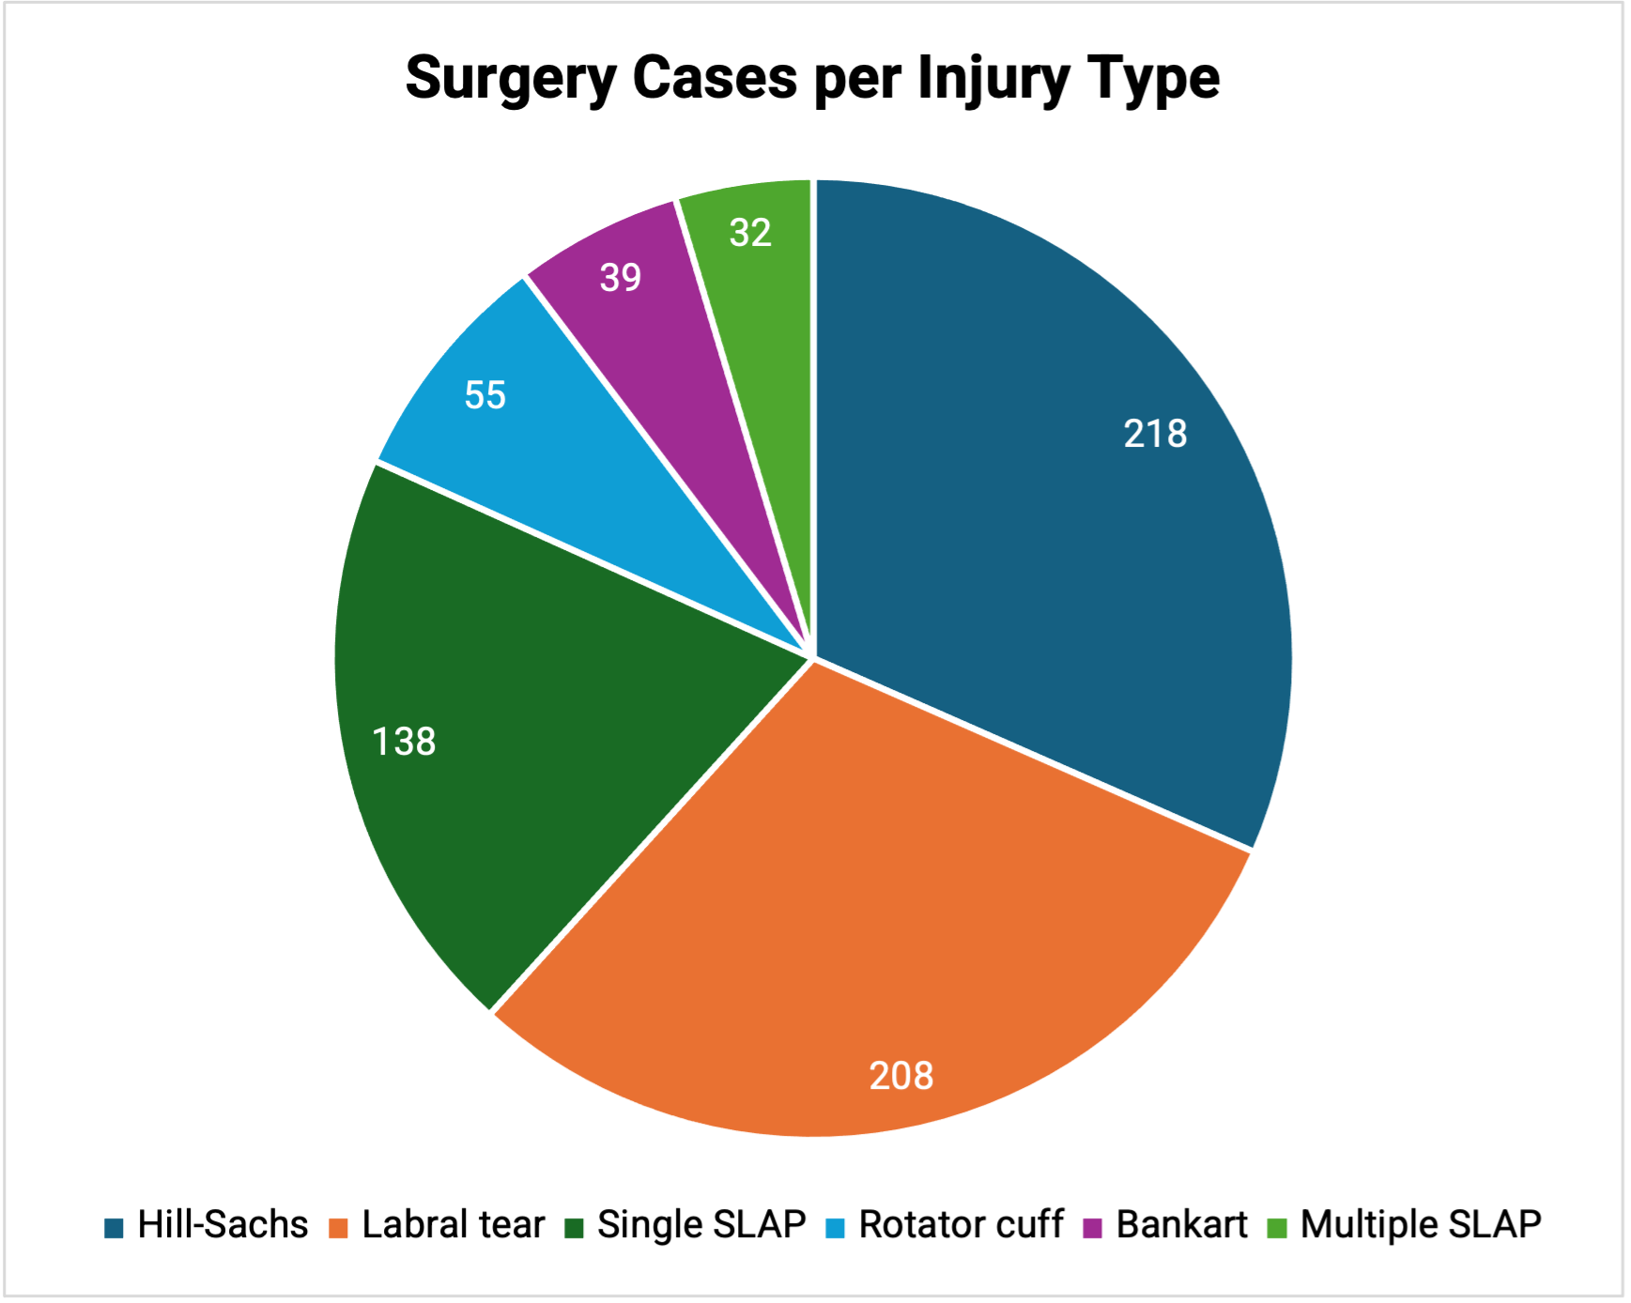
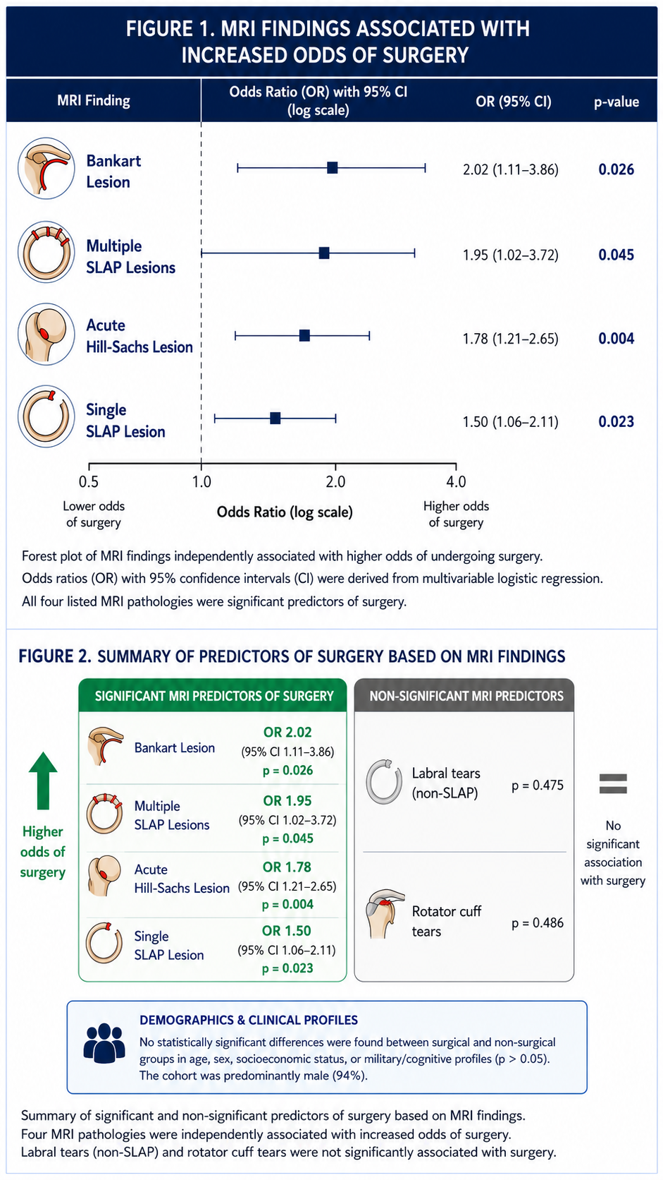
Predicting the Need for Shoulder Surgery in Military Personnel:
A Retrospective Cohort Analysis
Ma'ayan Pivko¹, Yaron Cohen MD^{2,3}, Aharon S Finestone MD MHA^{4,5}, Yael Steinfeld-Mass PT MSc⁵, Noa Ben Ami PhD⁶, Shai Herberzger MD³, Yaniv Elzam MD³, Guy Vishnevsky MD MPH MBA^{5,7}
1 Department of Military Medicine and “Tzameret”, Faculty of Medicine, Hebrew University of Jerusalem, Jerusalem, Israel 2 Medical Data Research Institute, Israeli Defense Forces Medical Corps, Ramat Gan, Israel 3 Israeli Defense Forces Medical Corps, Ramat Gan, Israel 4 Department of Orthopedics, Shamir Medical Center, Zerifin, Israel 5 Gray Faculty of Medical and Health Sciences, Tel Aviv University, Tel Aviv, Israel 6 Department of Physiotherapy, Faculty of Health Sciences, Ariel University, Ariel, Israel 7 Department of Internal Medicine H, Tel Aviv Sourasky University Medical Center, Tel Aviv, Israel
Introduction
Results
Shoulder injuries represent a massive clinical and operational burden in active military populations. While conservative management is the first line of defense, a significant subset of soldiers ultimately requires surgical intervention.
Study Objective: To characterize demographic, clinical, and MRI-based factors that predict the transition to surgical treatment, enabling early risk stratification and treatment optimization.
Demographics: Cohort was predominantly male (94%).
Non-Predictors: No statistically significant differences between groups regarding age, sex, socioeconomic status, or military/cognitive profiles (p > 0.05).
Key MRI Predictors for Surgery: Bankart Lesion OR = 2.02 (95% CI 1.11-3.86, p = 0.026), Multiple SLAP Lesions OR = 1.95 (p = 0.045), Acute Hill-Sachs Lesion OR = 1.78 (95% CI 1.21-2.65, p = 0.004), Single SLAP Lesion OR = 1.50 (p = 0.023).
Non-Significant Pathologies: Labral tears (non-SLAP) (p = 0.475) and rotator cuff tears (p = 0.486) did not significantly predict surgery.
Materials and Methods
Study Design: Retrospective cohort analysis (2014-2024).
Participants: 595 Israel Defense Force (IDF) soldiers referred for orthopedic consultation with a shoulder MRI (Mean age: 21.2 ± 3.6 years).
Cohort Stratification:
  Surgical Group: N = 345
  Conservative Group: N = 250
Data Extracted: Demographics, military cognitive scores, physical therapy usage, and specific MRI pathologies.
Statistical Analysis: Univariate logistic regression to determine Odds Ratios (OR) and 95% Confidence Intervals (CI).
Figure 2. Distribution of surgical cases by shoulder injury type, predominantly driven by Hill-Sachs (n=218) and labral tears (n=208)
Conclusions
No demographic risk factors were identified as predictors of surgical outcomes in young IDF soldiers. Surgery was mainly indicated by specific intra-articular lesions, while ongoing analyses of "return to duty" questionnaires will soon provide deeper insights into long-term recovery and success rates.
Figure 1. MRI findings associated with increased odds of surgery: forest plot of MRI findings independently associated with higher odds of undergoing surgery.
Corresponding author: Ma’ayan Pivko; Email: Maayan.pivko@mail.huji.ac.il
Abstract disclaimer: The views expressed in this abstract are those of the authors and do not necessarily reflect the official policy or position of the Israel Defense Forces (IDF). This study was performed as part of the IDF Medical Corps efforts to improve the quality of care and received no external funding or support. All authors had access to the data utilized in this study. Institutional review board approval was obtained.

