Slide 1
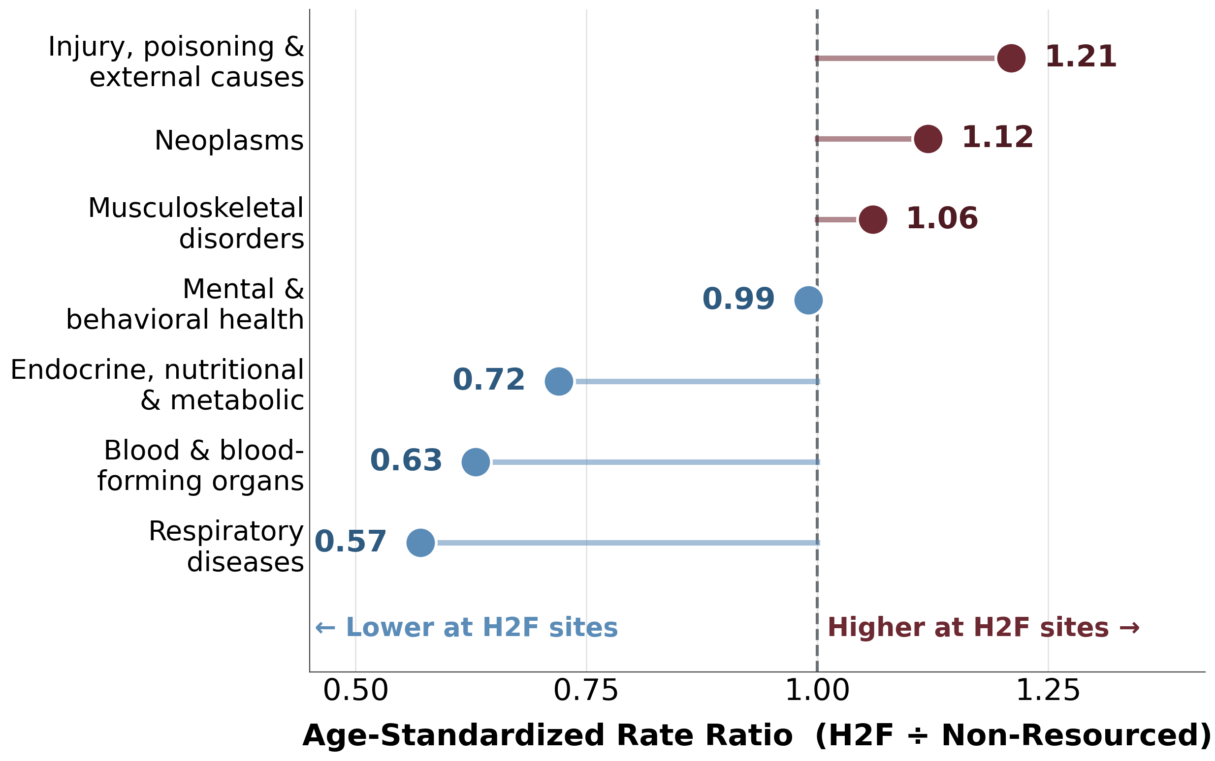
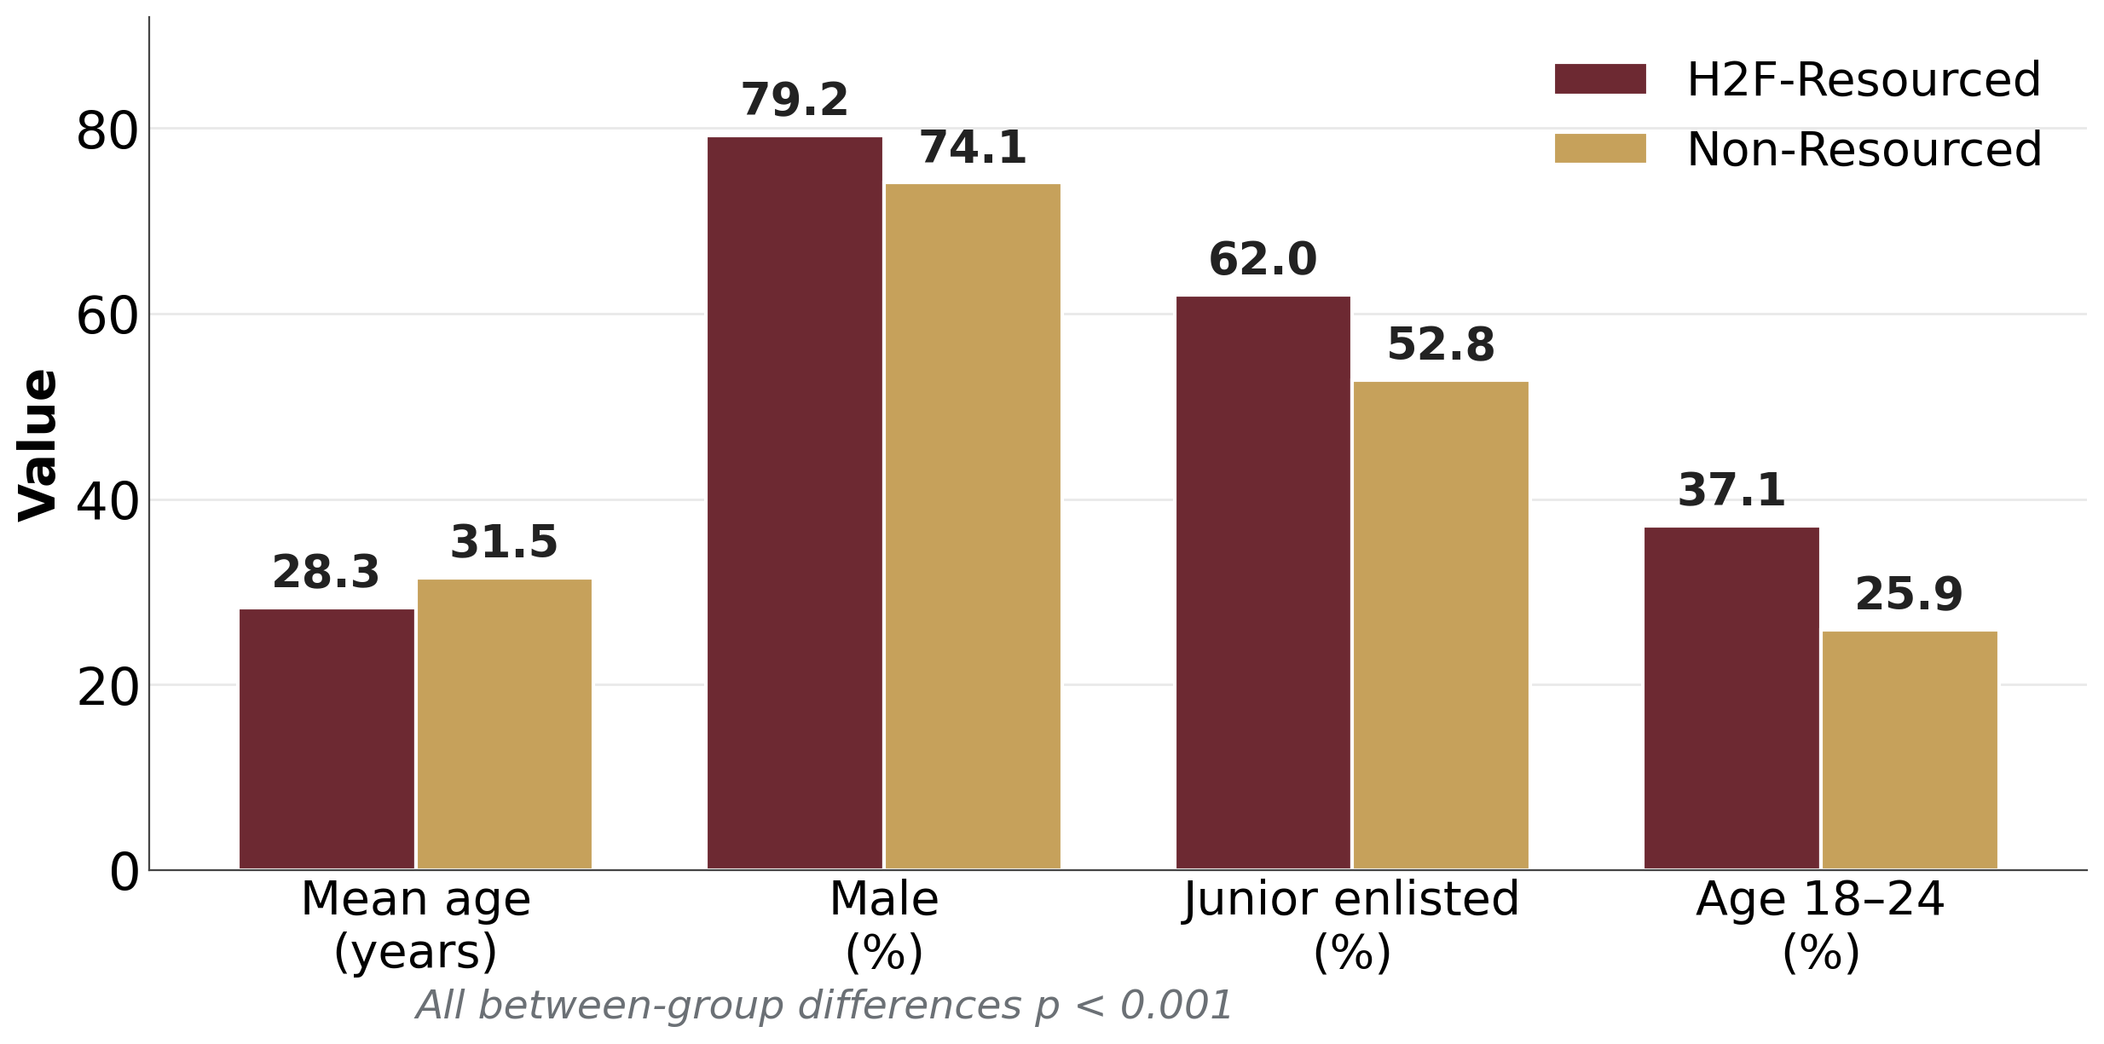
Age-Standardized Diagnostic Patterns at Holistic Health and Fitness–Resourced Versus Non-Resourced Army Installations
Abe Dummar • Melissa Richardson • Axel Wolff • Tim Murray
U.S. Army Research Institute of Environmental Medicine (USARIEM), Natick, MA
INTRODUCTION
RESULTS
CONCLUSIONS
The Holistic Health and Fitness (H2F) program embeds multidisciplinary performance and rehabilitation resources within operational Army units to improve Soldier readiness.
Differences in healthcare utilization between H2F-resourced and non-resourced populations within Military Health System (MHS) GENESIS remain incompletely described.
H2F sites were younger (mean 28.3 vs 31.5 yrs), more male (79.2% vs 74.1%), with more junior enlisted (62.0% vs 52.8%) and more aged 18–24 (37.1% vs 25.9%); all p<0.001.
Clinical complexity per encounter was similar between groups.
After age standardization, injury, poisoning & external causes showed the highest rate ratio (RR=1.21), then neoplasms (1.12) and musculoskeletal disorders (1.06).
Musculoskeletal RR rose from crude 1.01 to age-standardized 1.06 — the younger H2F population partially masked the underlying burden.
Respiratory (0.57), endocrine/metabolic (0.72), and blood-forming (0.63) disorders were lower; mental/behavioral health was near parity (0.99).
H2F-resourced and non-resourced installations demonstrated distinct diagnostic utilization patterns in FY2025 GENESIS data.
After accounting for age, H2F sites showed greater injury-related and musculoskeletal burden, while several chronic categories remained lower.
Findings provide a baseline for future analyses of care delivery, resource alignment, and readiness outcomes associated with H2F implementation.
OBJECTIVES
Table 1. Crude vs. age-standardized rate ratios (H2F ÷ non-resourced).
Describe demographic and diagnostic differences between H2F-resourced and non-resourced installations using encounter-level GENESIS data.
Quantify diagnostic utilization differences across ICD-10-CM chapters using crude and age-standardized rate ratios.
Assess how age-adjusted patterns may inform H2F resource alignment, care delivery, and readiness assessment.
ICD-10-CM Chapter | Crude | Age-Std
Injury, poisoning & external causes | — | 1.21
Neoplasms | — | 1.12
Musculoskeletal disorders | 1.01 | 1.06
Mental & behavioral health | 1.02 | 0.99
Endocrine, nutritional & metabolic | — | 0.72
Blood & blood-forming organs | — | 0.63
Respiratory diseases | — | 0.57
KEY TAKEAWAYS
Use age-standardized metrics: crude rates understate MSK burden at H2F sites (1.01 → 1.06); cross-installation policy comparisons should adjust for age.
Resources align with burden: injury & external causes show the largest excess (RR=1.21), concentrating H2F rehab assets where need is greatest.
Account for force demographics: lower chronic-disease utilization (RR 0.57–0.72) reflects a younger cohort, not reduced demand per capita.
Baseline for evaluation: mental health parity (RR=0.99) and FY25 patterns anchor future assessments of H2F care delivery and readiness outcomes.
METHODS
Retrospective cross-sectional analysis of MHS GENESIS encounter data for fiscal year 2025.
Population: active-duty Service Members receiving care at H2F-resourced vs. non-resourced Army installations.
Restricted to encounters where file month matched encounter month: 5,629,467 encounters from 511,496 unique Service Members.
  H2F-resourced: 1,649,780 encounters (29.3%) — 165,289 patients.
  Non-resourced: 3,979,687 encounters (70.7%) — 346,207 patients.
Demographics (age, sex, rank) and clinical complexity per encounter compared between groups.
Primary outcome: ICD-10-CM chapter distributions as crude and age-standardized rate ratios, using direct standardization to the non-H2F age distribution.
Rate ratios expressed as H2F ÷ non-resourced; RR > 1 indicates a higher encounter share at H2F sites.
Figure 1. Age-standardized rate ratios by ICD-10-CM chapter. Values >1.0 indicate a higher encounter rate at H2F sites.
1. MHS GENESIS encounter data, Defense Health Agency, FY2025.
2. Dept. of the Army. Holistic Health and Fitness. FM 7-22.
Supported by USARIEM. The authors thank the Defense Health Agency for MHS GENESIS data access.
Disclaimer: The views expressed are those of the authors and do not necessarily reflect the official policy or position of the U.S. Army, the Department of War, or the U.S. Government.
Figure 2. Cohort demographics: H2F-resourced vs. non-resourced installations.

