Slide 1


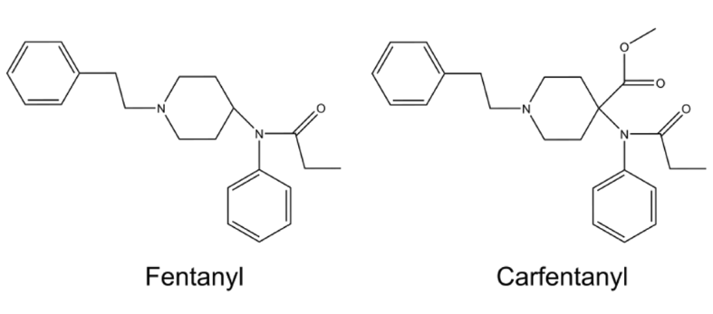
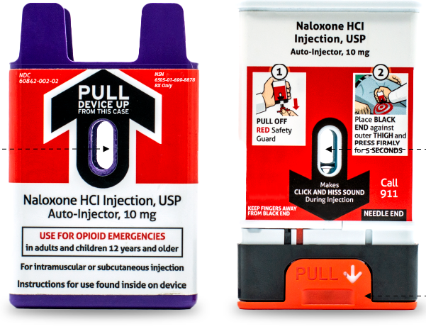
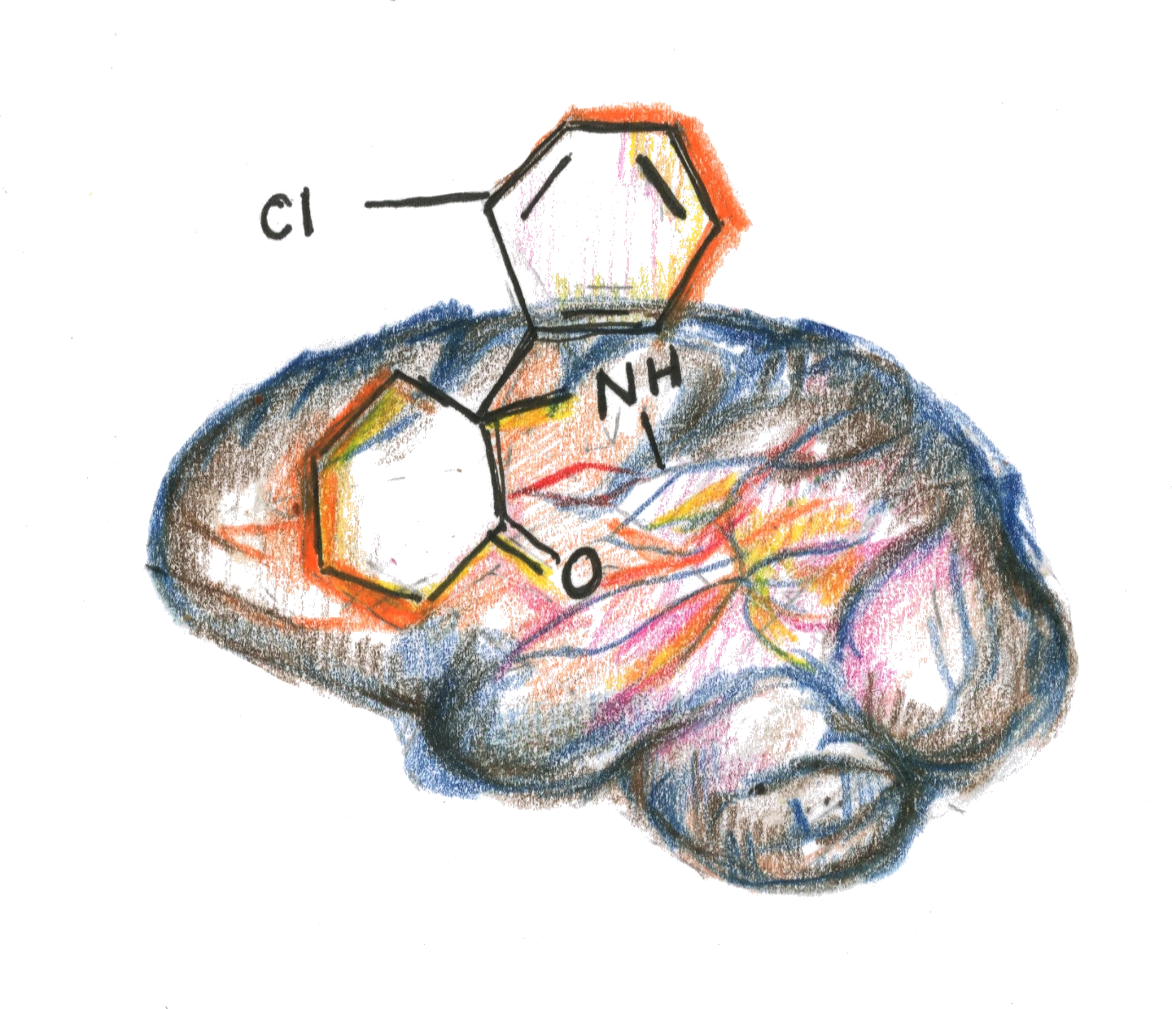
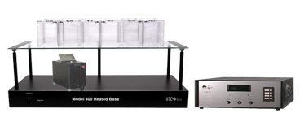
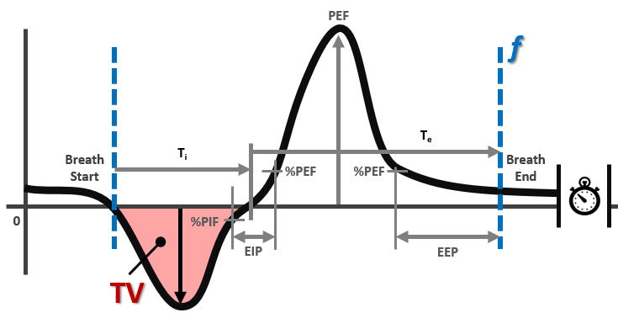

Evaluating Ketamine and Naloxone for Casualties Exposed to Opioid Agents as an Analgesic Strategy for the Modern Battlefield
Michelle C Racine, Justin Tressler, Katie Beam, Annie Wang, Ava M Zapf-Rickards, PhD, Kelsey Evans, Kailen Watson, Seung Ho Choi, PhD, Bryan John McCranor, PhD
US Army Medical Research Institute of Chemical Defense Aberdeen Proving Ground- Edgewood, MD 21010
Introduction
Results
Synthetic opioids pose a dual threat; not only have their high potency and rapid action complicated the ongoing opioid crisis (69.3% of all overdose deaths (OD) involved fentanyl in 2023), but they have demonstrated potential for use as chemical weapons, as seen in the 2002 Moscow theater hostage crisis. Naloxone (NX) is an FDA approved drug for the rapid reversal of opioid overdose such as carfentanil (CRF). In an opioid contaminated environment NX would negate analgesic effects of traditional battlefield treatments in the context of poly-trauma. Fentanyl and ketamine (KET) are the two fielded analgesics for casualties in moderate to severe pain. This research aims to determine dosing and efficacy of co-administered NX and KET for casualties who have both injuries exposure to opioid chemical warfare agents.
Carfentanil
Ultra-potent synthetic opioid,
100 times stronger than fentanyl.
Legally approved exclusively for veterinary use as a large-animal tranquilizer (e.g., for elephants)
Naloxone (Narcan)
Capable of reversing respiratory depression induced by morphine & fentanyl
Short duration of action resulting in possible renarcotization
Ketamine
Cardiac function is stimulated rather than depressed
At lower doses, potent analgesic and mild sedation, At higher doses, dissociative anesthesia and moderate to deep sedation
Various references in Battlefield analgesia and sedation
Opioid Induced Respiratory Depression Frequency
CRF exposure causes a significant decrease in f from baseline (p < 0.01, 2-way ANOVA). Following exposure, treatment with NX (IM) caused a rapid return to near baseline levels. Additional treatments with both IV and IM KET had no significant change in f when compared to NX treatment alone.
Opioid Induced Respiratory Depression Tidal Volume
We observed no significant changes following exposure in any treatment cohort. We observed incidents of nausea (vomiting and/or diarrhea) in most cohorts with IM KET having higher instances. CRF exposure did cause lethality but there was no correlation to any treatment cohort.
Pain Response (Single Naloxone Dose)
Pain Response (Double Naloxone Dose)
Methods
Male ferrets were exposed to aerosolized or subcutaneous (SQ) CRF. Treatments were administered post exposure; NX via intramuscular (IM) injection at a human equivalent dose (HED) of 10mg, and KET as a single or double intravenous injection (IV) of 20mg or 50mg HED via IM. Pain response was determined at baseline, 30, 60 and 90 minutes post NX treatment using the Hargraves Plantar Test. Respiratory parameters such as frequency (f), tidal volume (TV) and minute volume (MV) were recorded via whole body plethysmography.
Hargreaves Analgesia measurements
Pain nociception was assessed utilizing a Hargreaves apparatus. We observed indications of renarcotization, especially in the animals treated with a single dose of naloxone. Indication of renarcotization is less in animals treated with a double dose of naloxone. Surprisingly, ketamine does not appear to provide pain relief after reversing the effects of a carfentanil overdose, particularly when administered as a double dose via IV injection.
Conclusions
Exposure to SQ CRF rendered all animals unresponsive to thermal stimuli in the Plantar Test. KET treated ferrets experienced delayed pain response and IM KET combined with NX appears to delay response time more than IV treatments. Double IM to double IV treatments were statistically significant by one way ANOVA (P<0.0001). However, a similar trend is noted with NX only treated animals indicating possible renarcotization.
This cohort, which received ketamine after either a single or double dose of naloxone, shows latency times near baseline at all measured timepoints, including those where we observe renarcotization in other treatment groups. Ketamine not providing pain relief after reversal could be attributed to NMDA Receptor Over Activation. Opioids may overstimulate the glutaminergic system, leading to the over activation of NMDA (N-methyl-D-aspartate) receptors. Future studies will continue to investigate dosages of KET and NX treatment in CRF exposed casualties and determine the effects on pain management in this poly-pharmacology scenario.
Hargreaves Analgesia Apparatus
This unit is designed for testing narcotics and strong non-narcotic drugs. In plantar mode, the visible light/heat source is directed at the paw on top of a transparent, elevated glass platform. A focused beam of infrared (IR) or visible radiant heat beneath the glass, targeting the plantar (bottom) surface of the animal’s front paw. Once the animal feels the thermal discomfort, they instinctively withdraw the paw, and the sudden movement causes a drop in reflected light. This automatically shuts off the heat source and stops a built-in timer. The time elapsed until withdrawal is recorded as the "paw withdrawal latency". The time it takes for the animal to remove its paw is recorded and averaged over three separate trials. The baseline response for all animals is recorded prior to exposure and treatment.
Visual of frequency, Tidal Volume (TV)
Breathing frequency, also known as respiratory rate, is the number of breaths someone takes every minute. Tidal volume (TV) represents the amount of air that is inhaled or exhaled during a typical breathing cycle and is measured in milliliters (mL).
This research was supported in part by an appointment to the Department of War (DoW) Research Participation Program administered by the Oak Ridge Institute for Science and Education (ORISE) through an interagency agreement between the U.S. Department of Energy (DoE) and the DoW. ORISE is managed by ORAU under DoE contract number DE-SC0014664. All opinions expressed in this paper are the author's and do not necessarily reflect the policies and views of DoW, DoE, or ORAU/ORISE.
This work was supported by the Office of the Assistant Secretary of Defense for Health Affairs, Defense Health Agency, and the US Army Medical Research & Development Command Combat Casualty Care Research Program under Award No. CO240043. Opinions, interpretations, conclusions and recommendations are those of the author and are not necessarily endorsed by the Department of War.
The experimental protocol was approved by the Animal Care and Use Committee at the United States Army Medical Research Institute of Chemical Defense, and all procedures were conducted in accordance with the principles stated in the Guide for the Care and Use of Laboratory Animals and the Animal Welfare Act of 1966 (P.L. 89-544), as amended.
The views, opinions and/or findings contained in this poster are those of the author and do not necessarily reflect the views of the Department of War (DoW) and should not be construed as an official DoW position, policy or decision unless so designated by other documentation. No official endorsement should be made. Reference herein to any specific commercial products, process, or service by trade name, trademark, manufacturer, or otherwise, does not necessarily constitute or imply its endorsement, recommendation, or favoring by the U.S. Government.

