Slide 1

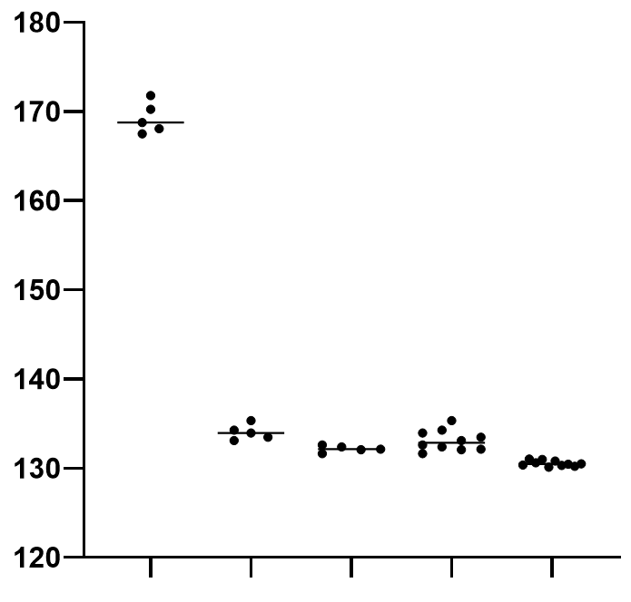
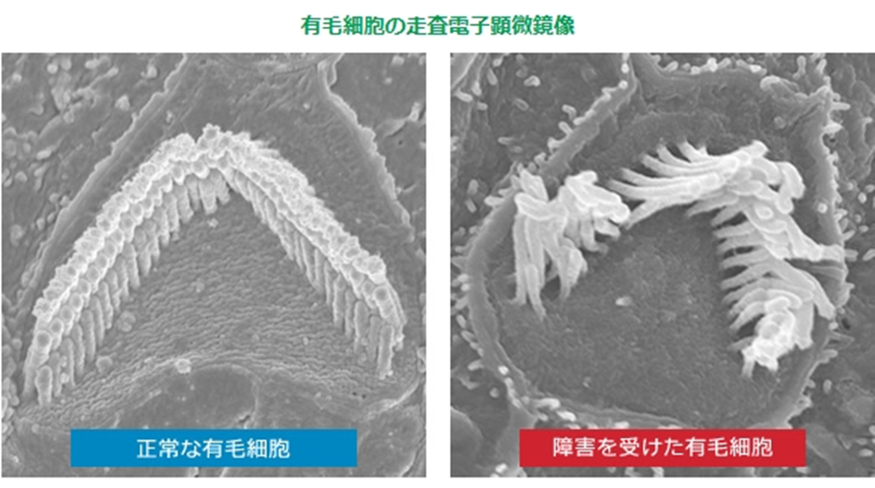
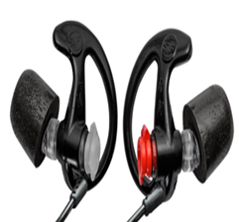
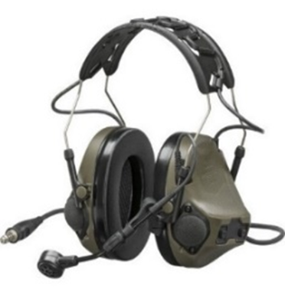
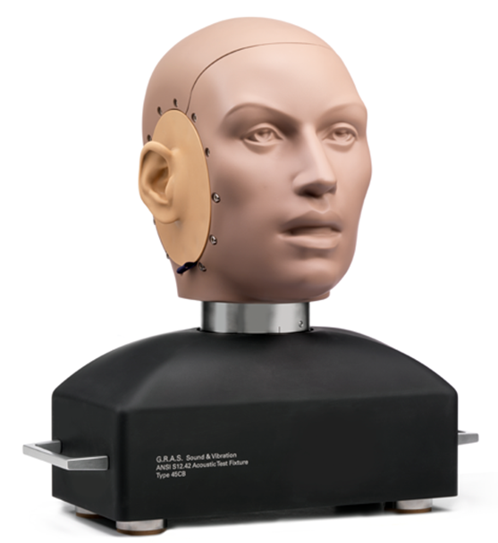
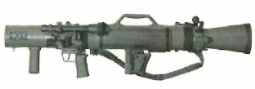
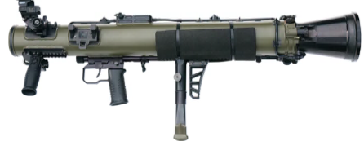

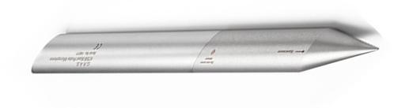
Noise Exposure Assessment and Evaluation of Hearing Protection Effectiveness during
84mm Recoilless Rifle Firing
N. Ogata, S. Yamada, K. Ito, K. Kaminishi, W. Nagata, T. Nara, T. Nihongi, S. Kurihara,
M. Kawasaki
Military Medicine Research Unit, Test & Evaluation Command, Japan Ground Self-Defense Force
Results and Discussions
1. Evaluation of Noise Attenuation: Comparison of Hearing Protection Devices
＊
＊
ａ： Pencil type sensor ： Raw noise
ｂ～ｄ：single protection
ｂ：Earplug ( Right )
ｃ：Earplug ( Left )
ｄ：Earplugs
ｅ：Double protections
＊ Earplugs and Earmuffs
Mounted on the head model sensor under conditions b to e.
Objective
＊
Noise-induced hearing loss (NIHL) is a major health concern among military personnel. To assess the current situation, we measured and analyzed acoustic noise generated during the use of military equipment.
firearm：84RR ( B )
Ammunition：TP
Measurement point：10 m
Background
dB
a b c d e
NIHL is a common occupational disorder caused by prolonged exposure to high-intensity noise. In military personnel, exposure to blast noise during training and operations can result in irreversible cochlear hair cell damages and permanent hearing impairment. Because effective treatment is limited, prevention is essential. This study evaluated noise exposure during 84mm recoilless rifle firing.
Cochlear Hair Cell
Double protection provided significantly greater attenuation than earplugs alone.
2. Noise Attenuation with Distance: Comparison Between Weapon Systems
Normal
Abnormal
＊
＊
Figure1. Changes in Cochlear Hair Cells
Caused by Noise Exposure
http://www.doyukai.com/medical/128.html
Double protections on the head model sensor.
Equipment and Materials
firearm：84RR ( B )
84RR ( C )
Ammunition：HE
Measurement point：0 m、5 m
Weapon Systems: 84mm Recoilless Rifle (84RR), Models B and C
Ammunition: Training Projective (TP), High-Explosive (HE) Round,
Hearing Protection Devices: Earplugs(SUREFIRE®), Earmuffs(OPS-CORE®)
Measurement Instruments: Head Simulator sensor system, Pencil-type sound sensor(GRAS®)
Hearing Protection Devices
Head-model sensor
Table 1. Comparison of Weapons
Item | 84RR(B) | 84RR(C)
Image
Weight | 10.4 kg | 7.0 kg
Continuous firing capacity |  | Automatic trajectory calculation / Automatic aiming adjustment
dB
0 m 5 m 0 m 5 m
Peak noise levels were similar between the B and C models.
Increasing distance reduced exposure.
Earplug
Earmuff
Conclusions
5 m
Assistant
Gunner
Hearing protection and increased distance effectively reduced sound pressure exposure.
Noise levels may differ by ammunition type, highlighting the need for measurements across multiple ammunition types.
Further studies are needed to optimize hearing protection, establish limits on the number of shots fired, and define safe exposure durations and cumulative exposure.
Shooter
0 m
reference point
Pencil-type sound sensor
(used as a monitor）
Statistic Analysis
Two-group comparison: Mann-Whitney U test
Three-group comparison: Tukey’s multiple comparison test
Moise Exposure Evaluation Criteria
152 dB ( Japanese Occupational Health Society guideline)
Figure 2. Measurement Setup

