Slide 1
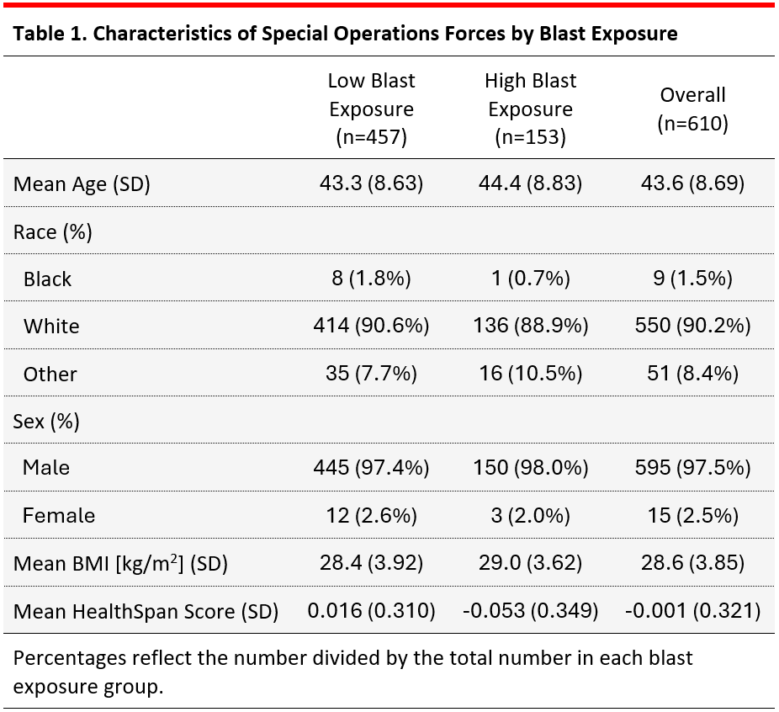

HealthSpan and Chronic Disease Burden Among Special Operations Forces
Charlotte B. Luster, B.A. (cluster@mgh.harvard.edu);¹ Evan D. Feigel, Ph.D.;¹ Brenna Finegan, M.P.H;¹ Michael J. Mastrodicasa, B.S.;¹ Maya Zegel, Ph.D.;² Sofia E. Matta, M.D.;² Brian L. Edlow, M.D.;^{3,4,5} Scott Sorg, Ph.D.;² Joseph L. Bonvie, Psy.D.;² Alan Berkeley, M.B.A.;² Kaloyan S. Tanev, M.D.;² Robert C. Cantu, FACSM, M.D.;^{6,7,8} Daniel H. Daneshvar; M.D., Ph.D.^{1,9,10}
1. Department of Physical Medicine and Rehabilitation, Spaulding Rehabilitation Hospital, Boston, MA; 2. Home Base: Red Sox Foundation and Massachusetts General Hospital Program, Boston, MA, USA; 3. Center for Neurotechnology and Neurorecovery, Massachusetts General Hospital and Harvard Medical School, Boston, MA; 4. Department of Neurology, Massachusetts General Hospital and Harvard Medical School, Boston, MA; 5. Athinoula A. Martinos Center for Biomedical Imaging, Massachusetts General Hospital and Harvard Medical School, Charlestown, MA; 6. Boston University Alzheimer’s Disease and CTE Centers, Boston University Chobanian & Avedisian School of Medicine, Boston, MA; 7. Department of Neurosurgery, Boston University Chobanian & Avedisian School of Medicine, Boston, MA; 8. Department of Neurosurgery, Emerson Hospital, Concord, MA; 9. Department of Physical Medicine and Rehabilitation, Harvard Medical School; Boston, MA; 10. Department of Physical Medicine and Rehabilitation, Massachusetts General Hospital, Boston, MA
BACKGROUND
RESULTS
Remarkable strides in extending lifespan have not been matched by comparable improvements in HealthSpan, the period of life spent in good health.
Growing attention has focused on the long-term health of military personnel, including Special Operations Forces (SOF).
The occupational demands of SOF may accelerate physiological strain and multimorbidity risk.
Objective: determine the factors associated with multimorbidity and reduced HealthSpan.
Figure 1. (A) Distribution of HealthSpan score (B) mean HealthSpan score by cumulative blast exposure quartile among Special Operations Forces
High cumulative blast (β=−0.244; 95%CI:−0.443,−0.055), shoulder-fired weapon (β=−0.269; 95%CI:−0.461,−0.077), and vehicle-mounted heavy weapon (β=−0.199; 95%CI:−0.394,−0.005) exposure were associated with lower HealthSpan score.
Years of service and number of deployments were not associated with HealthSpan.
METHODS
610 SOF personnel who completed the Comprehensive Brain Health and Trauma Program, a multidisciplinary clinical program provided by Home Base, were included.
Cumulative blast exposure calculated from Blast Exposure Threshold Survey. Total deployments and years of service were self-reported.
An age-residualized HealthSpan score was derived by regressing endocrine (testosterone, IGF-1, TSH), metabolic (LDL, HDL, HbA1c), cardiovascular (systolic BP), sleep (insomnia, OSA), and psychiatric (PTSD, MDD, GAD) variables on age; standardized residuals were inverted, z-scored, and summed.
Inverse probability weights using age, sex, race, and SOF branch as covariates were computed. Weighted logistic regression evaluated associations between military exposures (≥75% vs. <75%) and HealthSpan score (α=0.05).
Figure 2. Association of (A) cumulative exposure and (B) weapon-specific blast exposures with HealthSpan score among Special Operations Forces. Inverse probability weighted logistic regressions adjusted for age, sex, race, and SOF branch.
CONCLUSIONS
ACKNOWLEDGEMENTS
Repetitive blast exposure was associated with multimorbidity burden and reduced HealthSpan, representing a critical area for future research and targeted interventions to reduce chronic disease risk.
This work was supported by the Maloney/Carpenter Trauma-Related Neurodegenerative Disease Research Fund, Navy Seal Foundation, Wounded Warrior Project, and the United States Special Operations Command.

