Slide 1
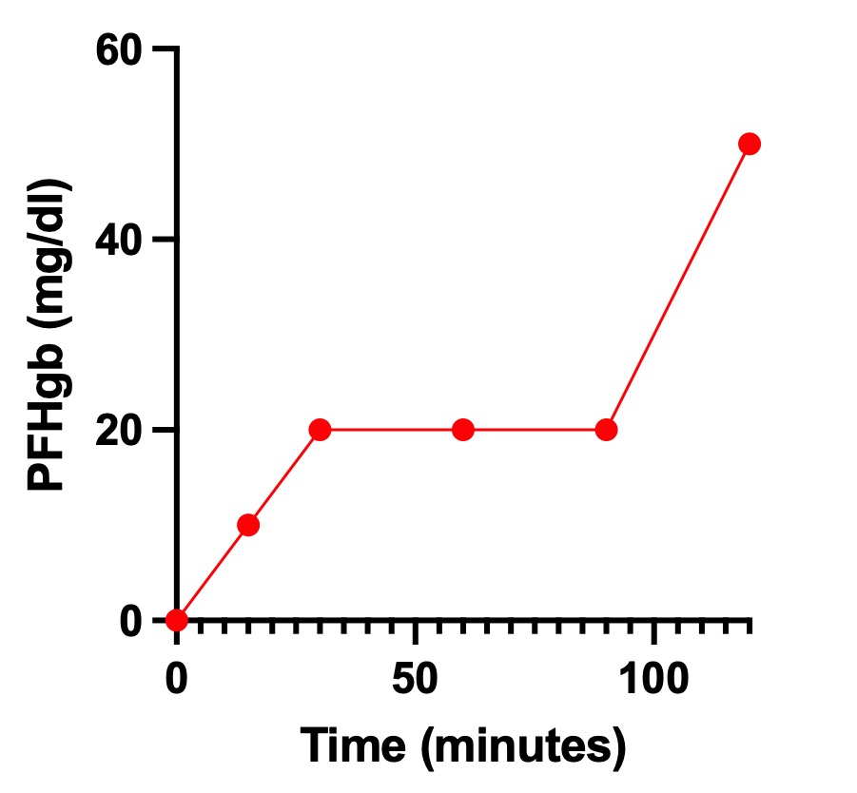
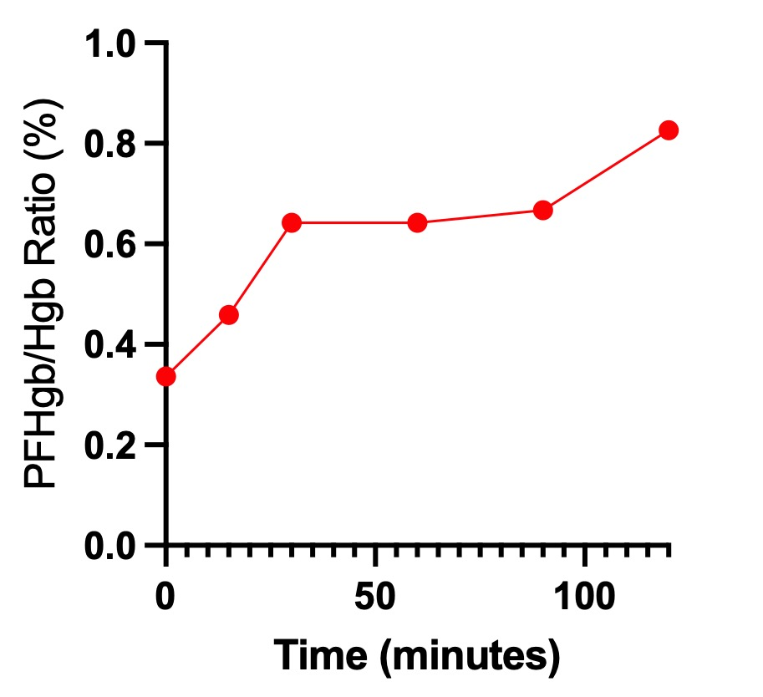
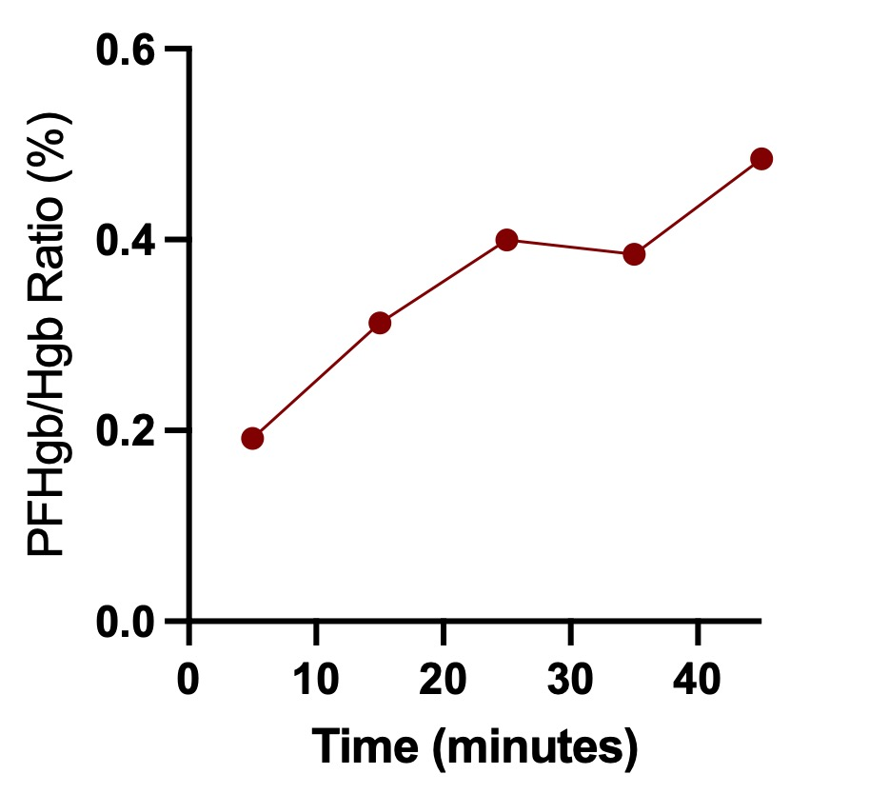
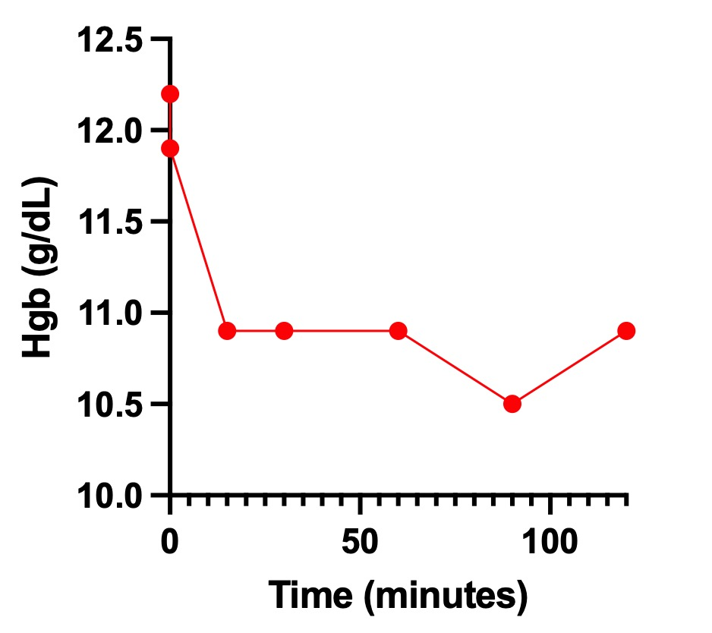
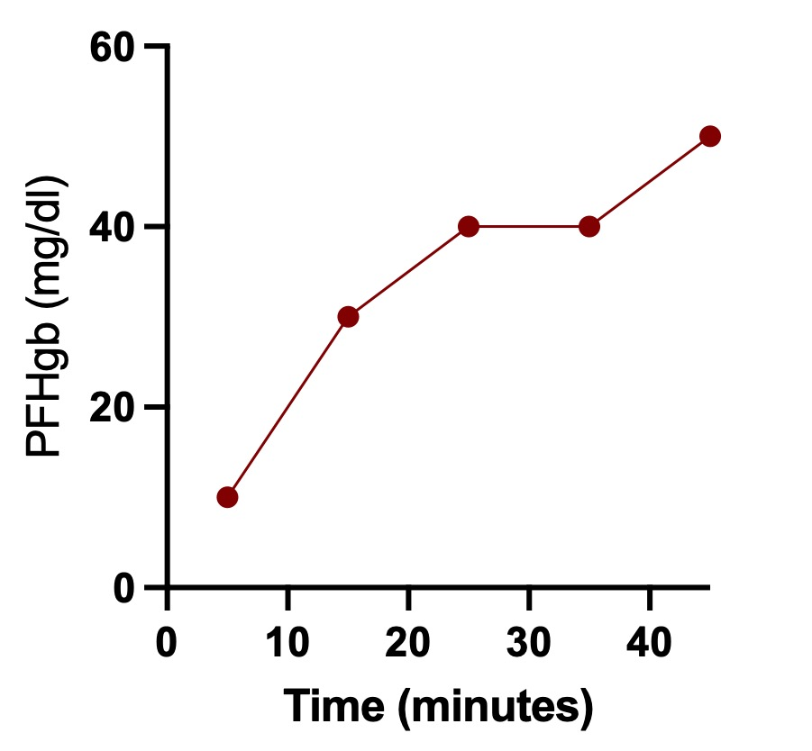
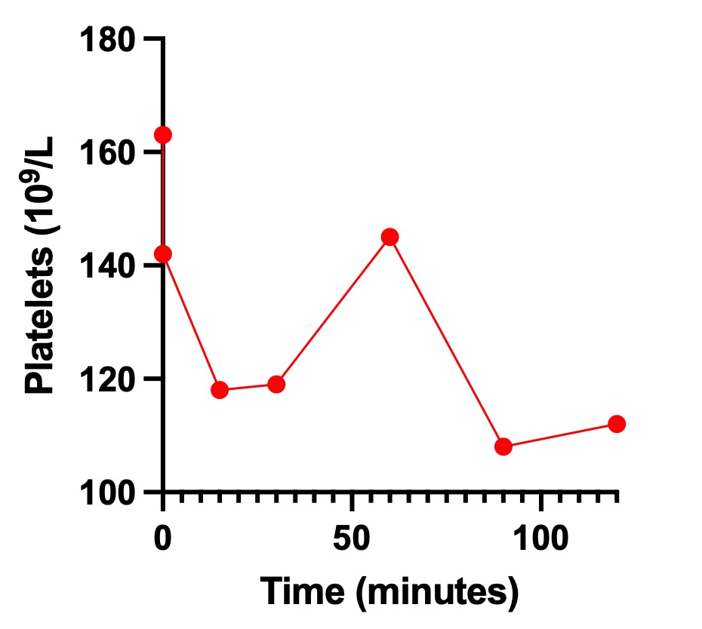
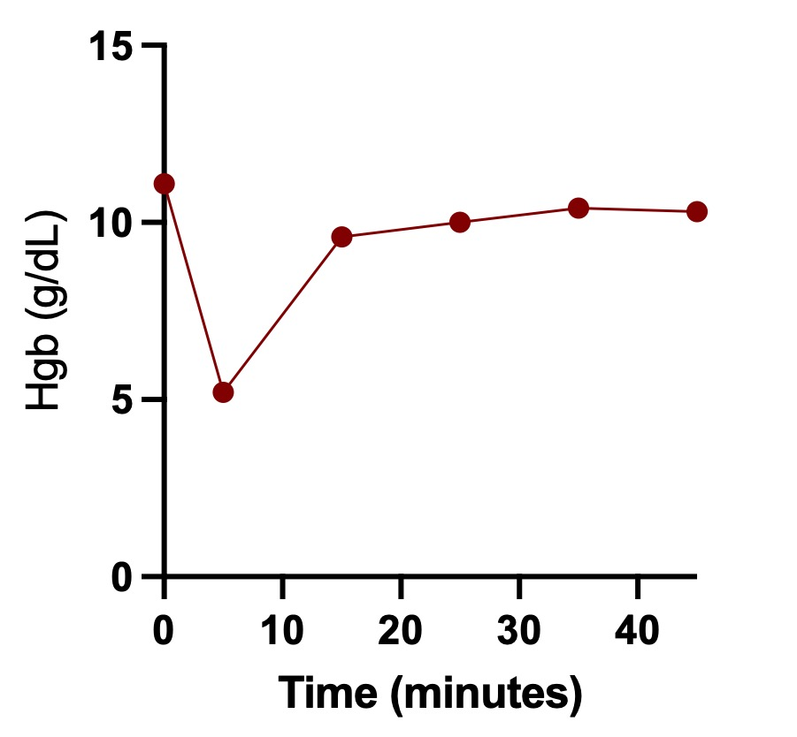
Initial Safety Profile of a Novel Cell Salvage and Autologous Transfusion Prototype
Collin Santos¹, Peter Voland¹, Rose Joynt¹, Piersson Hoenisch², Richard Betzold³, Jody Cantu², Nathan Stover¹, Elizabeth K. Powell⁴
¹ AFRL 711 HPW, AFMC, Rapid Prototyping Cell ² AFRL 711 HPW, AFMC ³ University of Arkansas for Medical Sciences, Little Rock, AR ⁴ University of Maryland School of Medicine, R Adams Cowley Shock Trauma Center, Baltimore, MD
ABSTRACT:
Introduction: Hemorrhage is the leading cause of preventable trauma death. A prototype autologous blood collection and reinfusion system was evaluated to determine whether blood could be safely collected and returned without significant hemolysis.
Methods: Human whole blood was tested in vitro using recirculation and air–blood/collection interface models. Plasma free hemoglobin (PFHgb), hemoglobin (Hgb), platelet count, and thromboelastography (TEG) were measured. Safety limits were PFHgb ≤50 mg/dL and PFHgb/hemoglobin ratio <1%.
Results: PFHgb remained within safety limits in all experiments. Hemoglobin and platelet counts showed expected dilutional decreases followed by stabilization. TEG values remained within normal ranges, with no evidence of clinically significant hemolysis.
Conclusion: The prototype demonstrated a favorable initial safety profile for blood collection and reinfusion. Further in vivo studies are needed to evaluate clinical safety and effectiveness.
Figure 1. Plasma Free Hemoglobin (PFHgb) levels over time with prototype suction fully submerged in a pan containing 1400ml of human whole blood with a large surface area and no air/blood mixture during collection and recirculated for a total of 120 minutes. Blood was warmed during collection to 37C.
Figure 4. PFHgb/Hgb ratios over time with prototype suction fully submerged in a pan containing 1400ml of human whole blood with a large surface area and no air/blood mixture during collection and recirculated for a total of 120 minutes. Blood was warmed during collection to 37C.
Figure 7. PFHgb/Hgb ratios were assessed with 3600 mL of whole blood collected with a large surface area air interface in a stainless-steel pan. Blood was sequentially collected and immediately circulated through the system and discarded. Blood was warmed to 37C and the experiment lasted 45 minutes.
INTRODUCTION:
RESULTS:
Hemorrhage is the leading cause of preventable death on the battlefield and in the civilian trauma population. The administration of early, warm, whole blood has demonstrated improved survival in bleeding patients. Cell salvage or the collection of shed blood and autologous transfusion are techniques used in other fields of medicine, but much less commonly used in trauma. It is hypothesized that in an in vitro study simulating hemorrhage conditions, blood can be collected and returned without elevated markers of hemolysis.
During the 2-hour recirculation without an air/blood interface, PFHgb demonstrated a minimal increase of 10 mg/dL to 20 mg/dL until the 2-hour mark where PFHgb reached 50 mg/dL with a PFHgb/hemoglobin ratio < 1% throughout the experiment. Hemoglobin and platelet counts demonstrated an expected early decrease consistent with crystalloid dilution, followed by stabilization.
TEG values remained within normal reference ranges throughout both experiments. In both the submerged and air/blood interface experiments there was no evidence of significant hemolysis by PFHgb and ratio values.
The change in PFHgb remained at or below the 50 mg/dL safety threshold and the PFHgb/hemoglobin ratio remained <1%. Hemoglobin and platelet trends again showed an initial dilutional decrease followed by stabilization and partial recovery.
METHODS:
A series of controlled in vitro experiments using human whole blood stored in CPDA-1 were performed to evaluate the hematologic safety of the prototype. Laboratory assessment included measurements of PFHgb, Hgb, platelet count, and TEG. For the first experiment, 1400 mL of whole blood warmed to 37C was collected from a stainless-steel pan with a standard suction catheter fully submerged without an air/blood interface and circulated through the primed (400ml crystalloid) prototype for 2 hours. In a separate experiment, 3600ml of whole blood was exposed to a large surface area with an air/blood interface (mimicking collection in a surgical field) in a stainless-steel pan. Blood was sequentially collected and immediately returned. A PFHgb ≤ 50 mg/dL and a PFHgb/hemoglobin ratio of < 1% was used as a conservative threshold for safe reinfusion.
For the recirculation 2-hour experiment, following a saline prime, approximately 1400ml of blood was circulated through the prototype for 2 hours. Flow rates remained stable between 630–690 mL/min, with outlet and minimal pressure variation throughout testing.
For the air/blood mixture experiment with 3600ml of blood lasting 45 minutes, blood was continually collected with minimal recirculation through the device and then discarded. Blood was collected at approximately 100ml/min.
Laboratory values were collected periodically to assess hemolysis and various plasma levels over time.
Figure 2. Hemoglobin (Hgb) levels over time with prototype suction fully submerged in a pan containing 1400ml of human whole blood with a large surface area and no air/blood mixture during collection and recirculated for a total of 120 minutes. Blood was warmed during collection to 37C. Time point zero values are hemoglobin levels in the pan. Levels were exposed to 400ml of crystalloid.
Figure 5. Plasma Free Hemoglobin (PFHgb) levels were assessed with 3600 mL of whole blood collected with a large surface area air interface in a stainless-steel pan. Blood was sequentially collected and immediately circulated through the system and discarded. Blood was warmed to 37C and the experiment lasted 45 minutes.
CONCLUSIONS:
These in vitro experiments demonstrate a favorable initial safety profile of the prototype during blood collection and return.
PFHgb and PFHgb/hemoglobin ratios remained within conservative reinfusion thresholds for submerged and air/blood mixture experiments.
Further safety and in vivo efficacy testing are required to inform development.
Cell salvage and autologous transfusions may be a safe option in austere environments with delayed and contested resupply, lack of cold chain logistics, and limited walking blood banks.
Figure 3. Platelet levels over time with prototype suction fully submerged in a pan containing 1400ml of human whole blood with a large surface area and no air/blood mixture during collection and recirculated for a total of 120 minutes. Blood was warmed during collection to 37C. Time point zero values are platelet levels in the pan. Levels were exposed to 400ml of crystalloid.
Figure 6. Hemoglobin (Hgb) levels were assessed with 3600 mL of whole blood collected with a large surface area air interface in a stainless-steel pan. Blood was sequentially collected and immediately circulated through the system and discarded. Blood was warmed to 37C and the experiment lasted 45 minutes.
References:
Disclosure:
Cell Salvage in Trauma. Current Opinion in Anaesthesiology. 2021. Waters JH.
Cost-Effectiveness of Cell Salvage in Trauma Blood Transfusions. The American Surgeon. 2023. Beeton G, Zagales I, Ngatuvai M, et al.
Cell Salvage in Emergency Trauma Surgery. The Cochrane Database of Systematic Reviews. 2015. Li J, Sun SL, Tian JH, et al.
Early Autologous Fresh Whole Blood Transfusion Leads to Less Allogeneic Transfusions and Is Safe. The Journal of Trauma and Acute Care Surgery. 2015. Rhee P, Inaba K, Pandit V, et al.
Autologous Blood Transfusion During Emergency Trauma Operations. Archives of Surgery. 2010. Brown CV, Foulkrod KH, Sadler HT, et al.
The views expressed are those of the authors and do not reflect the official guidance or position of the United States Government, the Department of War or of the United States Air Force.

