Slide 1
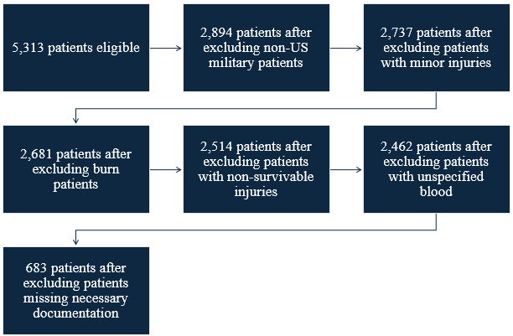
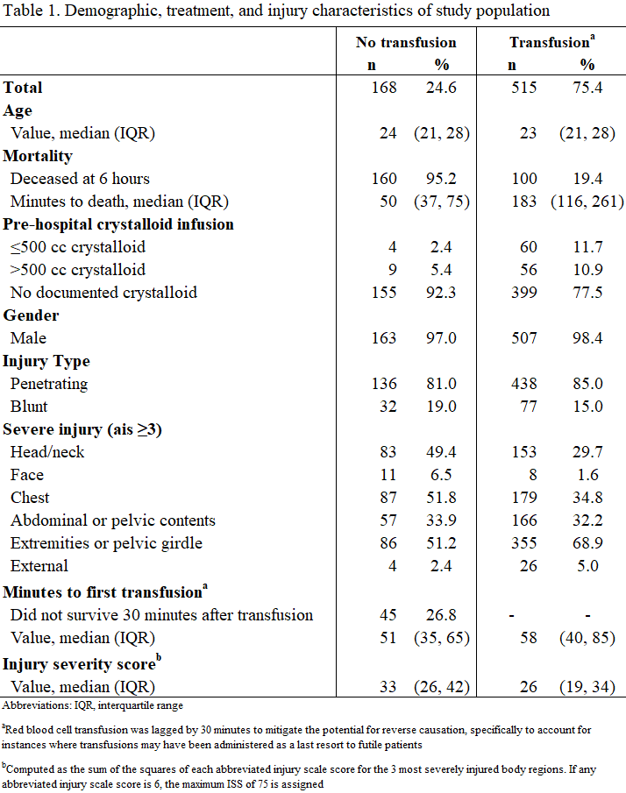


Association of Pre-Hospital Crystalloid Use with Survival in
Combat Casualties Receiving Transfusion
Jennifer M. Gurney, MD, FACS¹, Amanda M. Staudt, PhD, MPH², Deborah del Junco, PhD², Jennifer D. Trevino, MBA², Michael A. Broussard, DMS, PA-C¹
¹Joint Trauma System, DoD Center of Excellence for Trauma, ²The Geneva Foundation at U.S. Army Institute of Surgical Research
Introduction
Excessive crystalloid use has been linked to coagulopathy and mortality Modern damage control resuscitation emphasizes early blood products
Results
Objective
Determine whether pre-hospital crystalloid >500 cc independently predicts 6-hour mortality and modifies transfusion effects
Methods
Retrospective, observational study Setting: Deployed medical facilities in CENTCOM from 2003-2020 Data collection: Patient charts or records collected during treatment or autopsy Data Sources: DODTR TMDS and WISPR ASBP AFMES Cox proportional hazards modeling Exposure: Red blood cell transfusion lagged by 30 minutes Modifier: >500 cc vs ≤500 cc crystalloid Outcome: 6-hour mortality
Figure 1. Flow Diagram
Results
Pre-hospital crystalloid use (>500 cc) was identified as a statistically significant independent risk factor for mortality Adding pre-hospital crystalloid use as a covariate changed the hazard ratio for transfusion by <15%, indicating it was not a confounder in the relationship between initial transfusion and mortality No significant interaction between initial transfusion and pre-hospital crystalloid use detected
Conclusions
The study may be underpowered to detect interaction effects Pre-hospital crystalloid >500 cc independently increased mortality risks Findings support minimizing crystalloid administration in hemorrhagic combat trauma.
Acknowledgements
The authors acknowledge DoDTR for providing data for this study. This work was supported by the Assistant Secretary of Defense for Health Affairs through the Defense Medical Research and Development Program under Award No. W81XWH2020045. This study was conducted under a protocol (USAISR Protocol H-19-035) reviewed and approved by the US Army Medical Research and Development Command Institutional Review Board and in accordance with the approved protocol.
Use of the Joint Trauma System's Department of Defense Trauma Registry (DoDTR) data from this presentation without expressed acknowledgment is prohibited.
Notes:
Instructions for Use:
NOTE: If a template is required to meet foreign specifications such as different proportions of height to width, contact the Media Informatics Branch BEFORE making the poster. A specialized template will be developed for your use.
Title: Use Title Case. (Every Major Word Capitalized)
Authors: Cite by First Name, Middle Initial, Last Name, Title. (John P. Smith, MD, PhD) 1 Include rank for posters being presented to a DoD audience. (LTC John P. Smith, MD, PhD) Accreditations (FACS, etc) are optional, dependent on the meeting.
Other Affiliations: List additional activities beneath USAISR and include reference numbers by the name(1) and corresponding number by the activity. (1 Texas University of Health Sciences)
Logos from collaborators: To be placed to the right of the round USAISR Logo on the top right. This will require moving the MRMC and USAISR logo to the left. Additional logos are to be no larger than the USAISR Logo height of two inches.
Bullets: Short statements are better than lengthy paragraphs of descriptions. Avoid too much text or too much detail.
Acronyms: Spell out acronyms such as Joint Trauma System (JTS).
Other Instructions:
Tables, charts and pictures should include a reference number, a title and should be cited within the writing.
Pictures should have a caption.

