Slide 1


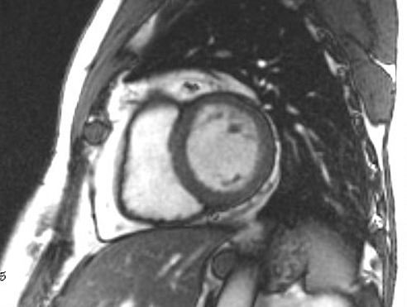
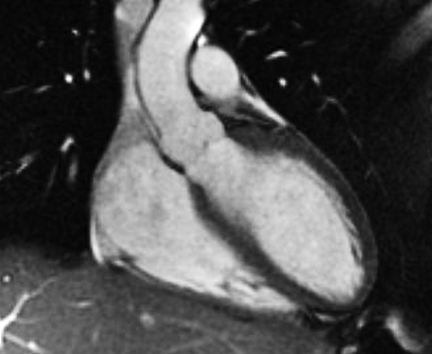
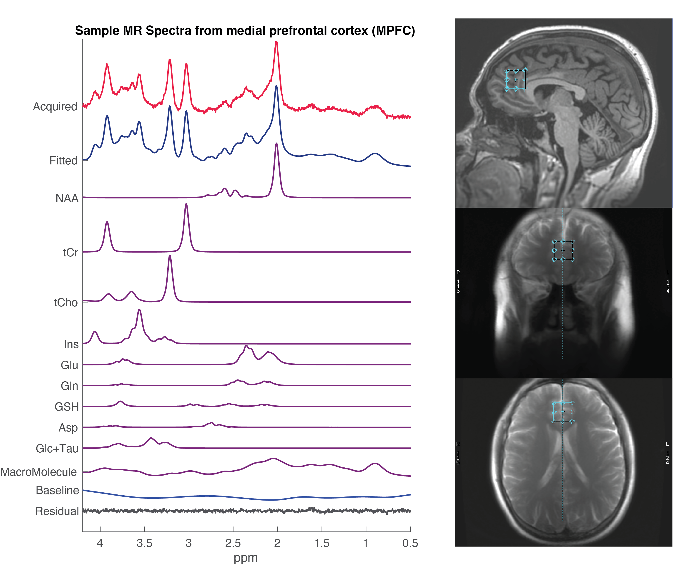
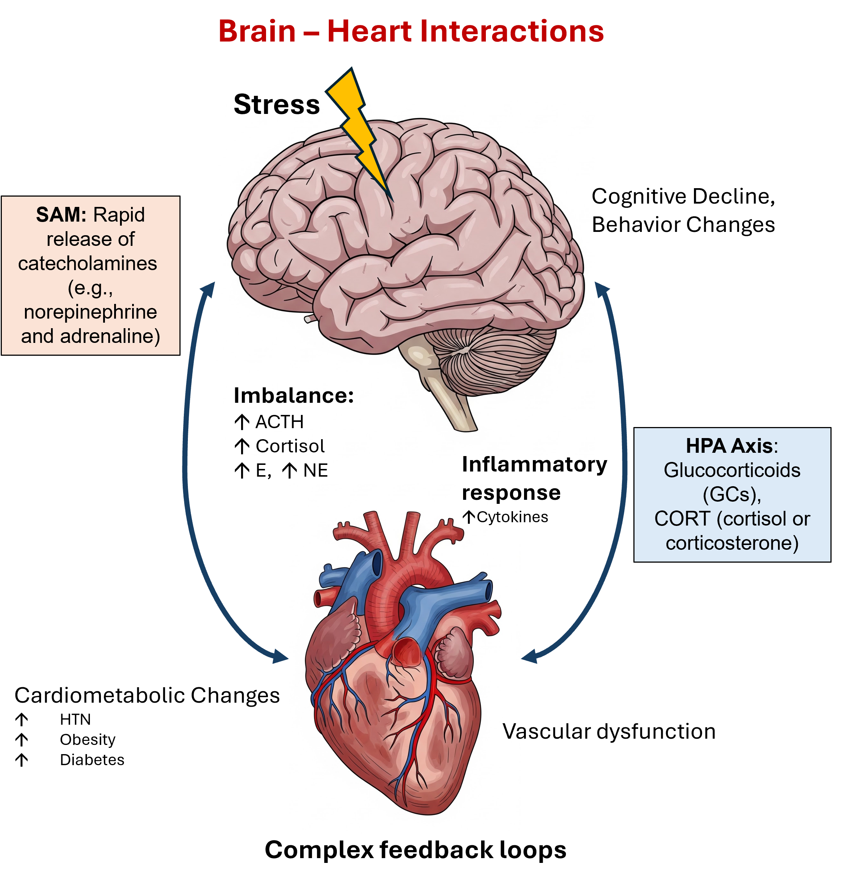
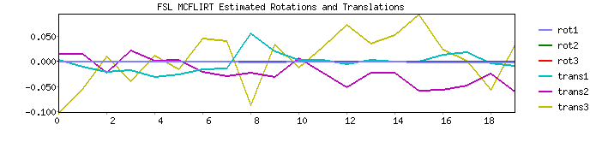
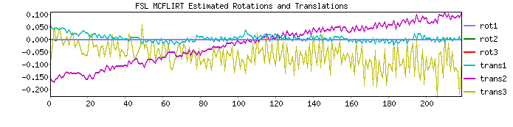
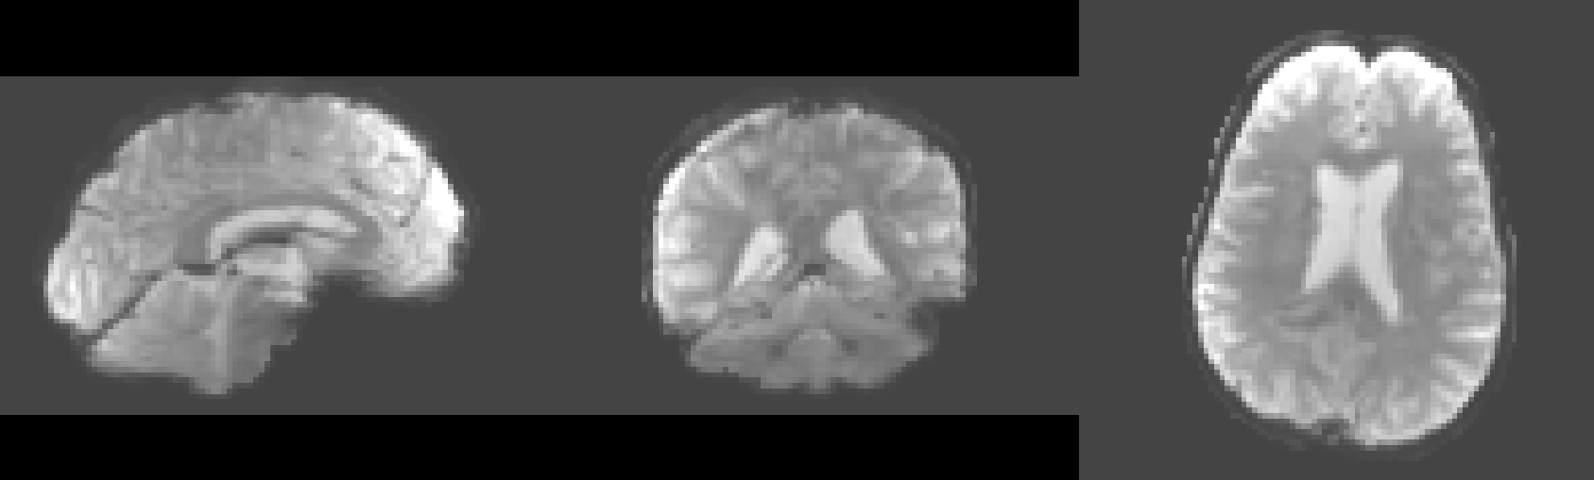

Measuring the Impact of Traumatic Stress on Brain and Cardiovascular Health
Maureen N. Hood, PhD, RN¹; Patricia Spangler, PhD^{2,3}; Catherine Dempsey, PhD^{2,3}; H. Doug Morris, PhD¹; Mark C. Haigney, MD⁴; M. Alaric Franzos, MD, MPH⁴; Soroosh Solhjoo, PhD^{4,5}; Gail Kohls, RT^{1,6}; Haymanot Yalewaker, MS^{1,6}, Samrawit Yalewaker, BS^{1,6}, LT Keen Seong Liew, PhD⁷, Estefania Baez- Calvillo, MS^{1,2}; David Benedek, MD³.
.
1. Uniformed Services University, Department of Radiology & Bioengineering, Bethesda, MD, USA; 2. The Henry M. Jackson Foundation for the Advancement of Military Medicine, Inc., Bethesda, MD, USA; 3. Uniformed Services University, Department of Psychiatry, Bethesda, MD, USA; 4. Uniformed Services University, Department of Medicine, Bethesda, MD, USA; 5. Uniformed Services University, The Metis Foundation, San Antonio, TX, USA; 6. Uniformed Services University, The Geneva Foundation, Bethesda, MD, USA; 7. US Navy.
INTRODUCTION
US service members have been deployed to combat operations and humanitarian efforts around the world. Post Traumatic Stress Disorder (PTSD) and mild TBI (mTBI) has been found to be a frequent sequelae of combat or military operational exposures. Prior studies suggest traumatic experience during military operations may lead to the increased incidence for cardiovascular disease (CVD), but specific biomarkers predicting development of CVD in these military members have not been identified. It would be helpful to find biomarkers that not only can identify persons who are adversely adjusting but also the biomarker changes that are connected to resiliency¹.
We hypothesize that PTSD-related changes in the brain lead to inflammation and dysfunction of the sympathetic adrenal medullary system (SAM) and hypothalamic-pituitary-adrenal (HPA) axis systems with negative impact to the cardiovascular system.
RESULTS
Our group previously assessed the military health records for mTBI and its link to secondary injuries, such as PTSD, sleep disturbances, depression and CVD². We found evidence that a wide range of cardiovascular risk factors, such as sleep disorders, hypertension, obesity, anxiety, and depression, were found to be increased (all p<0.001) in service members with mild TBI. Our current study is underway. We expect to demonstrate clinical changes in the brain health to align with imaging, cardiac rhythms, and blood biomarkers as we progress with data collection and analysis.
Figure 2 A, B. Cardiac MRI are shown using steady state free precession to cur through the heart at various angles in a cine fashion so that structure and function can be calculated. Other techniques help to further characterize the myocardium and vasculature.
A
B
DISCUSSION
Early identification may lead to interventions to reduce inflammation, reduce risk of CVD, and optimize the readiness of our service members.
Our prior study validated a significant link between mTBI, PTSD, HTN, diabetes, and other cardiovascular risk factors².
  mTBI did not predict a diagnosis of CVD; however, the average age of the subjects in this study was approximately 28 years
Increased risk factors at an early age have prompted our team to now prospectively assess service members
  subclinical signs of cardiovascular disease
  military occupations stressors.
We hypothesize in our new study that we will find biomarkers that predict which service members are more likely to recover as well as those who are progressing toward cardiovascular and cognitive decline.
METHODS
Prior work: Consort diagram for the sampling and matching process for the large data record search.
B
A
Excluded (n=351,339)
Duplicated records (n= 127,151)
Did not meet data selection criteria (n= 214,734)
Met exclusion criteria (n= 9,454)
mTBI records (eligibility)
(n= 436,228)
Records (control group) (n=1,631,998)
Figure 3 A-D. Brain MRI (including structural, functional and neurovascular angiography imaging) and MR spectroscopy (MRS) data are acquired using the GE MAGNUS 3T head-only ultra-high-gradient MRI scanner at Walter Reed National Military Medical Center (WRNMMC). MRS (C-F) measures neurochemical levels within a 20x20x20 mm³ voxel in both posterior cingulate and medial prefrontal cortices using a vendor-harmonized semi-LASER pulse sequence (TR=3000ms / TE=30ms)⁸.
In 3A, the molecular markers of interest are labeled with their peaks.
Excluded duplicates
(n = 681)
Initial mTBI cases
(n=84889)
Initial control cases
(n=1,631,317)
C
Excluded Incomplete cases (n=289,965)
Initial sample (n=1,716,206)
Matched sample (n=254,532)
D
Excluded outliers, discrepancies, anomalies (n=57,575)
Final sample (n=196,957)
Current study - Prospectively recruiting service members diagnosed with PTSD to comprehensively assess for biomarkers of inflammation, SAM, and HPA dysregulation (Figure 1). Blood biomarkers, psychological assessments, brain functional MRI, cardiac MRI, electrocardiography, and endothelial function will be measured to identify subclinical inflammatory conditions in our service members to define and compare operational stressors and trauma exposure in individuals with and without TBI and/or PTSD.
A
Figure 4. Resting-state fMRI (rsfMRI). rsfMRI sequence images were acquired at 3 Tesla MAGNUS GE scanner. The representative refMRI images shown here are the brain extracted, slice timing corrected and motion corrected⁹. The motion plot show good image quality with rotations and translations below acquisition voxel size for both phase acquisitions. rs-fMRI is a technique that measures spontaneous brain activity and functional connectivity when a person is not performing any specific task.
Table 1. Example key biomarkers in our prospective study.
B
Candidate Biomarker | Significance
High-sensitivity C-Reactive Protein (hsCRP) | Inflammation, atherosclerosis risk, highly validated
Low Density Lipoprotein (LDL) | “Bad” Cholesterol – the primary driver of plaque formation
Lipoprotein(a) | Inherited genetic variant strongly linked to premature atherosclerosis, clotting, and plaque formation
Triglycerides | Insulin resistance, metabolic risk
HbA1c | Reflects long-term glucose control; chronic hyperglycemia accelerates atherosclerosis and endothelial damage
Homocysteine | Vascular damage risk
Endothelial Function | Earliest measurable change in the development of cardiovascular disease
Cardiac MR | Microvascular disease which is more common in women
Cardiac CT | Large vessel disease which is more common in men
Advanced MAGNUS 3T Brain MRI | Functional MRI, diffusion MRI, MR spectroscopy and MR Angiography can show early changes in brain structure, function and metabolism
C
CONCLUSIONS
This study seeks to combine biomarkers of inflammation, SAM activation, and HPA dysregulation with state-of-the-art brain and cardiac imaging to elucidate the most salient mechanisms driving the negative impact of PTSD on heart health to better inform future interventions to optimize resiliency and readiness.
Figure 1. Stress triggers a response that is initially fast-acting (the sympathetic adrenal medullary system—SAM) by catecholamines (epinephrine and norepinephrine) to initiate the so called “flight-or fight” response^{3,4}. Then the neurohormonal hypothalamic-pituitary-adrenal (HPA) axis is activated with the pituitary secreting corticotropin-releasing hormone (CRH), along with arginine vasopressin (AVP) into the system and regulates the release of adrenocorticotropin (ACTH). These hormones travel through the blood system where synthesis and release of glucocorticoids is stimulated^{5,6}. These two systems also are associated with an increase in pro inflammatory cytokines⁷. The body has a complex feedback loop to regulate these processes and bring the body back to hemostasis. Chronic stress and certain conditions such as traumatic brain injury (TBI) can alter these metabolic processes that can lead to changes in tissues and organs throughout the body that can result in adverse metabolic, behavioral, and cognitive function responses⁶. Images partially generated by Gemini AI.
DISCLAIMERS
The opinions or assertions contained herein are the private views of the authors and are not to be construed as official or reflecting the views of the Uniformed Services University of the Health Sciences or the Department of War of the United States of America.
The authors have no financial connections with any companies pertaining to this research.
References
ACKNOWLEDGEMENTS
The authors would like to acknowledge the assistance of Jesus Caban, PhD and his team from the Informatics Core at Walter Reed National Military Medical Center and the Department of Preventive Medicine & Biostatistics at Uniformed Services University of the Health Sciences.

