Slide 1


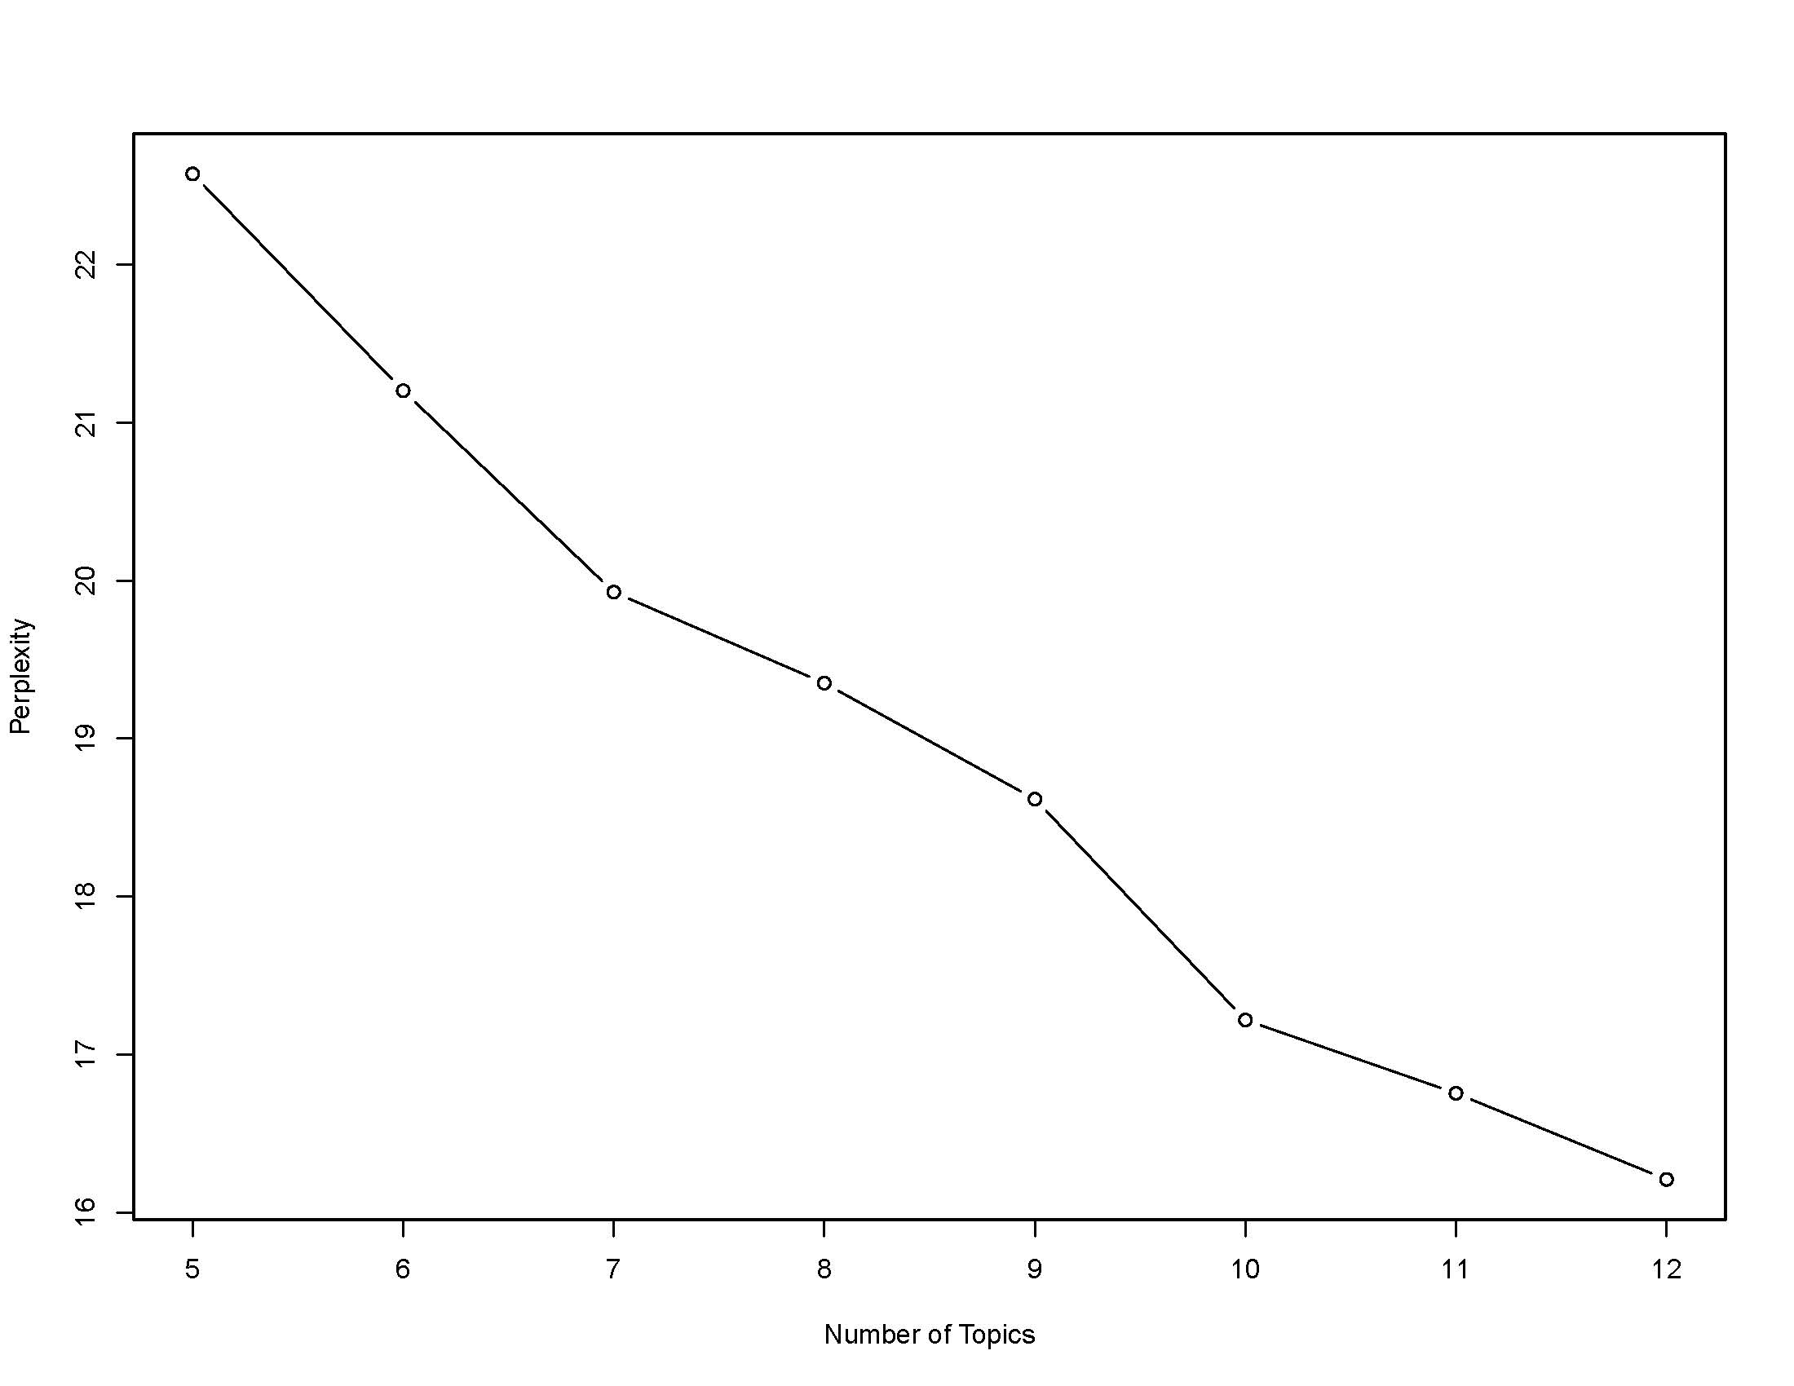
DISEASE AND INJURY ASSOCIATIONS AMONG COMBAT-INJURED VETERANS USING DIAGNOSIS GROUPS AND TOPIC MODELING
James Zouris, MS¹; Andrew J. MacGregor, PhD¹; Dustin French, PhD²; Ted Melcer, PhD¹
¹Naval Health Research Center, San Diego, CA; ²VA Health Systems Research, Hines, IL
Background
Topic Descriptions and Utilization Metrics
Combat-injured veterans often present with complex health care needs including physical injuries, mental health disorders, and comorbidities that require multidisciplinary care. Years 3 to 5 post-combat injury represent a critical transition from acute surgical trauma care to long-term chronic disease management. Traditional clinical grouping methods look at isolated diagnoses and often fail to capture how physical trauma and psychological conditions intertwine over time. Applying Latent Dirichlet Allocation (LDA) treats each veteran as a "document" and their Clinical Classifications Software (CCS) categories as "words" to uncover latent clinical phenotypes (comorbidity profiles). ¹⁻⁴
Table 2. Mean Injury Severity Score and Average Number and Total Counts of CCS
Topic | Topics | Count | % | Mean ISS | AVG Number of CCS | AVG Counts of CCS
T1 | Spondylosis & Metabolic Conditions | 2528 | 13.48% | 5.76 | 13.71 | 7.55
T2 | Insomnia | 970 | 5.17% | 8.45 | 11.17 | 7.52
T3 | Late Effects/ Adjustment disorders | 591 | 3.15% | 7.11 | 11.47 | 6.52
T4 | Post Traumatic Stress Disorder (PTSD) | 4722 | 25.18% | 5.07 | 14.06 | 11.19
T5 | Alcohol-related disorders / Substance Abuse | 666 | 3.55% | 5.46 | 16.60 | 24.13
T6 | Traumatic Brain Injury (TBI) sequalae | 2238 | 11.93% | 7.40 | 16.23 | 12.94
T7 | Musculoskeletal | 1472 | 7.85% | 4.83 | 10.80 | 5.62
T8 | Depression | 331 | 1.76% | 4.48 | 10.79 | 9.30
T9 | Lower Extremity injuries | 1720 | 9.17% | 6.93 | 12.86 | 6.68
T10 | Administrative /Social admission | 3517 | 18.75% | 8.64 | 11.93 | 8.43
Learning Objectives
To identify and characterize distinct multi-system comorbidity clusters among combat-injured veterans during the late chronic phase (3–5 years post-injury) using machine learning.
Describe the top diagnosis categories associated with specific topics, such as injuries and mental health disorders
Compare characteristics across topics to identify differences in patient demographics, injuries, and health care needs
Figure 3. Topic distribution frequency plots.
Material and Methods
Data Source: Electronic Health Records (EHR) of combat-injured casualties were identified from the Expeditionary Medical Encounter Database (EMED) and matched to the Veterans medical health records.
Time Window: Filtered to healthcare encounters occurring strictly between ≥ 3 and ≤ 5 years post-injury date.
Temporal downsampling applied by capping duplicate ICD codes at a maximum of one instance per distinct six-month post-injury window. This eliminates confounding inflation caused by routine clinic check-ins while preserving the clinical granularity of co-occurring, non-identical CCS codes.
Feature Extraction: International Classification of Diseases (ICD) codes collapsed into single-level CCS Categories to reduce high-dimensionality. Matrix Construction: Built a patient-by-CCS document-term matrix (DTM).
Hyperparameter Tuning: Evaluated optimal topic count (k) using perplexity scoring
Model Fitting: Executed final LDA model using Gibbs sampling in R (topicmodels package) R Studio 2024.04.2
Topic Demographics
Table 3. Distribution of Demographic Characteristics by Topics
Demographic characteristics | T1 % | T2 % | T3 % | T4 % | T5 % | T6 % | T7 % | T8 % | T9 % | T10 % | P-value
Sex |  |  |  |  |  |  |  |  |  |  | <0.01
Female | 4 | 2.99 | 10 | 3.9 | 1.05 | 2.91 | 2.18 | 7.85 | 4.77 | 3.53
Male | 96 | 97.01 | 90 | 96.1 | 98.95 | 97.09 | 97.83 | 92.15 | 95.23 | 96.47
Service |  |  |  |  |  |  |  |  |  |  | <0.01
Air Force | 1.66 | 2.06 | 1.35 | 1.31 | 0.45 | 1.25 | 0.75 | 0.6 | 1.4 | 0.88
Army | 75 | 69.18 | 70.22 | 69.8 | 70.42 | 66.89 | 65.63 | 73.41 | 68.14 | 69.69
Marine | 21.08 | 26.6 | 27.24 | 26.64 | 28.38 | 29.27 | 31.39 | 23.56 | 28.08 | 27.55
Navy | 2.25 | 2.16 | 1.18 | 2.24 | 0.75 | 2.59 | 2.24 | 2.42 | 2.38 | 1.88
Mission |  |  |  |  |  |  |  |  |  |  | <0.01
Operation Enduring Freedom | 41.72 | 56.16 | 33.29 | 42.3 | 46.91 | 32.3 | 34.03 | 44.98 | 39.44 | 39.37
Operation Freedom Sentinel | 4.01 | 5.27 | 2.04 | 2.04 | 1.52 | 2.38 | 1.64 | 4.26 | 2.34 | 1.03
Operation Iraqi Freedom | 52.08 | 35.06 | 62.62 | 55 | 51.41 | 63.83 | 62.97 | 47.42 | 56.58 | 58.64
Operation Inherit Resolve | 1.79 | 2.9 | 1.53 | 1.02 | 0.76 | 1.08 | 0.82 | 3.04 | 0.99 | 0.51
Operation New Dawn | 0.4 | 0.52 | 0.51 | 0.45 | 0.3 | 0.4 | 0.55 | 0.3 | 0.64 | 0.46
Year group |  |  |  |  |  |  |  |  |  |  | <0.01
yr_2009_2012 | 72.73 | 71.91 | 77.06 | 78.85 | 81.46 | 75.97 | 81.05 | 65.52 | 80.57 | 82.47
yr_2013_2015 | 16.96 | 15.57 | 13.76 | 14.83 | 14.59 | 14.93 | 12.57 | 22.41 | 12.45 | 14.22
yr_2016_2020 | 10.31 | 12.52 | 9.17 | 6.32 | 3.95 | 9.1 | 6.38 | 12.07 | 6.98 | 3.31
Mechanism of Injury |  |  |  |  |  |  |  |  |  |  | <0.01
Blast | 85.4 | 85.62 | 83.91 | 84.87 | 86.6 | 88.22 | 84.37 | 81.85 | 82.88 | 85.63
Gunshot wound | 10.95 | 9.86 | 14.01 | 11.62 | 9.81 | 8.68 | 12.11 | 7.69 | 14.27 | 11.87
Other | 3.65 | 4.51 | 2.08 | 3.51 | 3.58 | 3.09 | 3.52 | 10.46 | 2.85 | 2.51
TBI Severity |  |  |  |  |  |  |  |  |  |  | <0.01
None | 57.24 | 56.80 | 67.68 | 56.04 | 53.45 | 52.10 | 63.93 | 58.01 | 64.53 | 61.36
Mild | 41.73 | 42.47 | 32.15 | 42.99 | 45.50 | 46.43 | 35.19 | 41.39 | 34.83 | 37.65
Moderate | 1.03 | 0.62 | 0.17 | 0.95 | 1.05 | 1.30 | 0.88 | 0.60 | 0.64 | 0.97
Severe | 0.00 | 0.10 | 0.00 | 0.02 | 0.00 | 0.18 | 0.00 | 0.00 | 0.00 | 0.03
Injury severity group |  |  |  |  |  |  |  |  |  |  | <0.01
Minor | 80.46 | 65.98 | 68.87 | 81.49 | 79.73 | 72.97 | 80.5 | 84.89 | 69.71 | 62.47
Moderate | 10.56 | 16.8 | 18.61 | 12.66 | 12.76 | 12.47 | 14.81 | 9.37 | 16.92 | 18.65
Serious | 4.75 | 8.14 | 7.95 | 4.09 | 4.8 | 7.46 | 3.6 | 4.23 | 8.78 | 11.8
Critical | 4.23 | 9.07 | 4.57 | 1.76 | 2.7 | 7.1 | 1.09 | 1.51 | 4.59 | 7.08
Rank |  |  |  |  |  |  |  |  |  |  | <0.01
Enlisted | 94.78 | 95.06 | 95.93 | 97.25 | 99.37 | 96.24 | 96.1 | 96.12 | 94.12 | 96.02
Officer | 5.22 | 4.94 | 4.07 | 2.75 | 0.63 | 3.76 | 3.9 | 3.88 | 5.88 | 3.98
Results
Figure 4. Topic probability plot for each CCS category.
Summary
LDA identified 10 distinct topics among BI veterans using perplexity score
The Alcohol/Substance Abuse topic had the highest average number of unique CCS categories (16.60) and the highest average CCS count (24.13), suggesting greater comorbidity burden and more frequent health care utilization compared to other topics
Differences in age, injury type, and comorbidity profiles observed across topics
The largest clinical topic is PTSD, followed by administrative/social admissions and back/endocrine disorders.
Topics differ in injury severity, comorbidity burden, and health care utilization.
Mean Injury Severity Score (ISS) is highest in Administrative/Social Admission (8.64) and Insomnia (8.45), lowest in Depression (4.48) and MSKI (4.83).
Topic groupings may reflect shared risk factors or comorbidity patterns rather than direct clinical relationships.
Future research should explore predictive models using early post-injury data to identify veterans at risk for complex health trajectories before chronic conditions develop
Figure 1. Perplexity plot displaying the optimal number of topics. The big dip from 9 to 10 suggests that 10 is the ideal number of Topics
Top CCS Categories for each of the 10 Topics
References
Table 1. Top Clinical Classification Categories Proportions by Topic
Topics | CCS | CCS descriptions | % | Topics | CCS | CCS descriptions | %
1 | CCS205 | Spondylosis intervertebral disc disorders | 40% | 7 | CCS232 | Sprains and strains | 14.5%
1 | CCS53 | Disorders of lipid metabolism | 10% | 7 | CCS225 | Joint disorders and dislocations trauma | 4.5%
2 | CCS259 | Sleep Related Disorders/Insomnia/Sleep Apnea | 49% | 7 | CCS203 | Osteoarthritis | 3.4%
2 | CCS258 | Other screening for suspected conditions | 23% | 8 | CCS657 | Mood disorders | 92.8%
3 | CCS244 | Other injuries and conditions due to external causes | 25.6% | 8 | CCS651 | Anxiety disorders | 2.6%
3 | CCS650 | Adjustment disorders | 23.9% | 8 | CCS662 | Suicide and intentional self-inflicted injury | 0.9%
3 | CCS2618 | External cause codes | 6.2% | 9 | CCS211 | Other connective tissue disease | 23.4%
4 | CCS651 | Anxiety disorders | 98% | 9 | CCS10 | Immunizations and screening for infectious disease | 9.0%
5 | CCS660 | Alcohol-related disorders | 46.1% | 9 | CCS200 | Other skin disorders | 8.6%
5 | CCS661 | Substance-related disorders | 40.0% | 9 | CCS134 | Other upper respiratory disease | 6.1%
6 | CCS233 | Intracranial injury | 30% | 9 | CCS126 | Other upper respiratory infections | 4.8%
6 | CCS84 | Headache including migraine | 19% | 9 | CCS133 | Other lower respiratory disease | 3.9%
6 | CCS95 | Other nervous system disorders | 15% | 10 | CCS255 | Administrative/social admission | 86.2%
6 | CCS254 | Rehabilitation care | 14% | 10 | CCS136 | Disorders of teeth and jaw | 13.2%
7 | CCS204 | Other non-traumatic joint disorders | 39.7%
Healthcare Cost and Utilization Project (HCUP). Clinical Classifications Software (CCS) for ICD-9-CM and ICD-10-CM/PCS. Agency for Healthcare Research and Quality (AHRQ). https://www.hcup-us.ahrq.gov/toolssoftware/ccs/ccs.jsp
Li, Y., Nair, P., Lu, X.H. et al. Inferring multimodal latent topics from electronic health records. Nat Commun 11, 2536 (2020). https://doi.org/10.1038/s41467-020-16378-3
Quan H, Sundararajan V, Halfon P, et al. Coding algorithms for defining comorbidities in ICD-9-CM and ICD-10 administrative data. Medical Care. 2005;43(11):1130-1139. https://pubmed.ncbi.nlm.nih.gov/16224307/
Mehmood I, Zahra Z, Iqbal S, Qahmash A, Hussain I. A Systematic Review of Topic Modeling Techniques for Electronic Health Records. Healthcare (Basel). 2026 Jan 22;14(2):282. doi: 10.3390/healthcare14020282. PMID: 41595418; PMCID: PMC12840768.
Partners/Collaborators
Highlighted cells represent the highest percentage within each demographic characteristic across topics.
VA collaboration included the US Department of Veterans Affairs and the Edward Hines Junior Hospital.
Disclaimer: I am a military service member or employee of the U.S. Government. This work was prepared as part of my official duties. Title 17, U.S.C. §105 provides that copyright protection under this title is not available for any work of the U.S. Government. Title 17, U.S.C. §101 defines a U.S. Government work as work prepared by a military service member or employee of the U.S. Government as part of that person’s official duties. This work was supported by the U.S. Navy Bureau of Medicine and Surgery under work unit no. 62475. The views expressed in this work are those of the authors and do not necessarily reflect the official policy or position of the Department of the Navy, Department of Defense, nor the U.S. Government. The study protocol was approved by the Naval Health Research Center Institutional Review Board in compliance with all applicable federal regulations governing the protection of human subjects. Research data were derived from approved Naval Health Research Center Institutional Review Board protocol number NHRC.2007.0016

