Slide 1


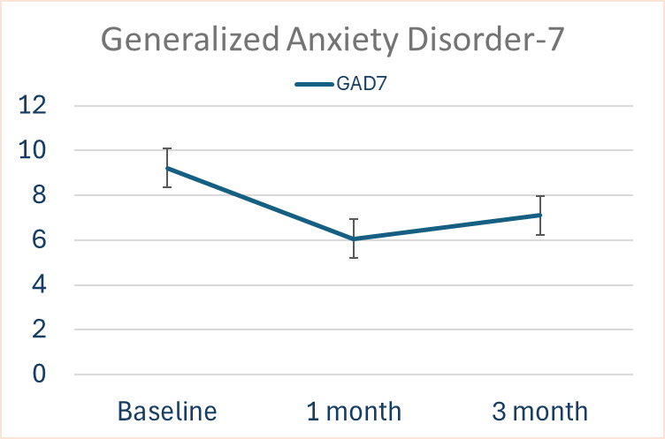
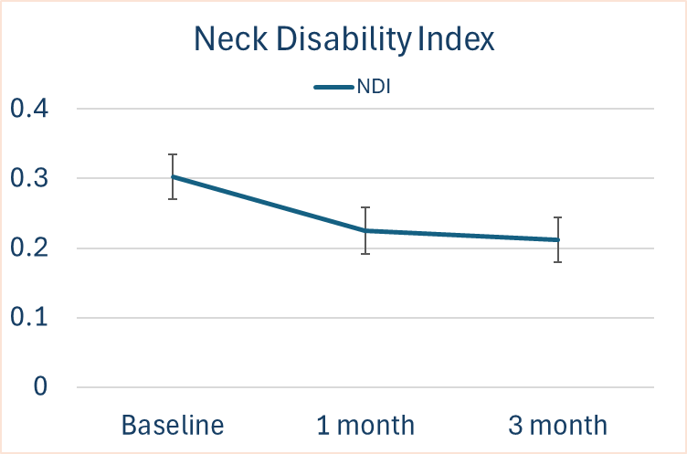
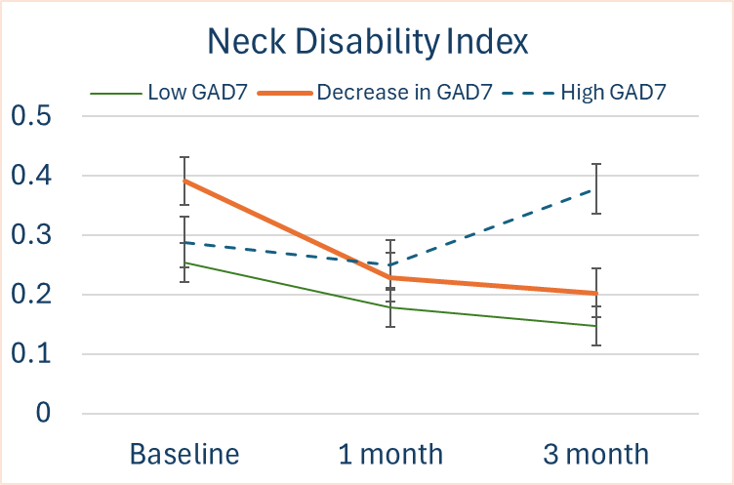
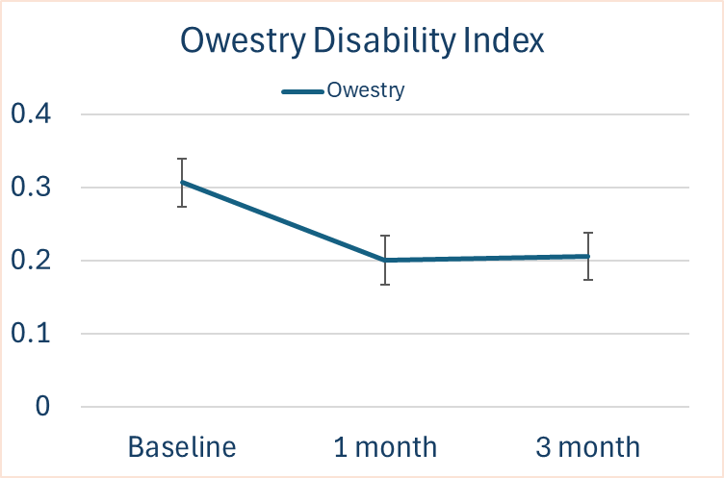
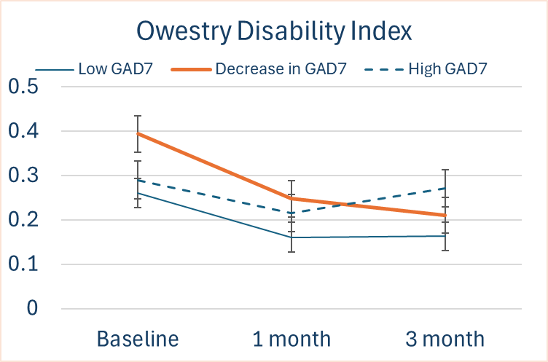
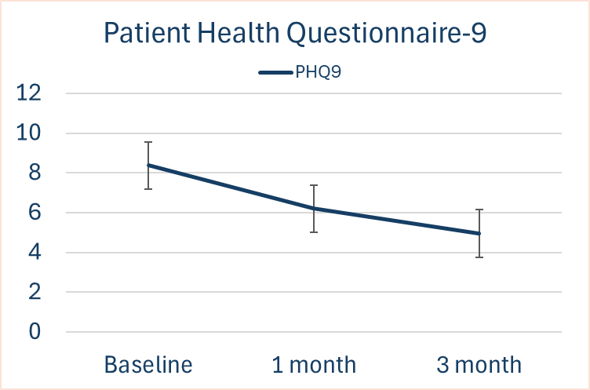
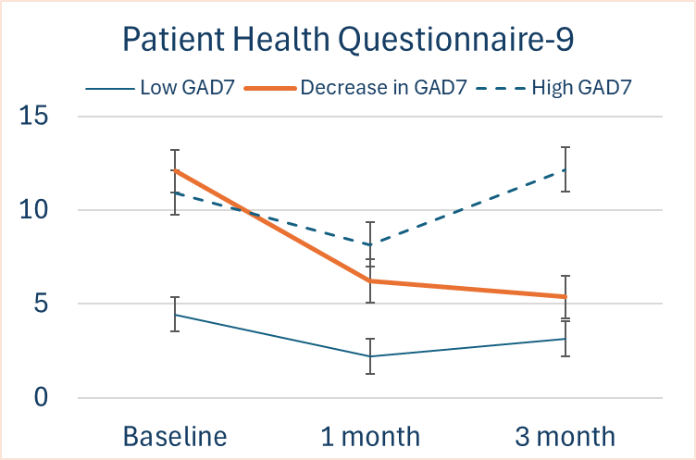
A Holistic FRP Approach Improves Chronic Pain, Anxiety, and Depression:
3 Month Outcome
James K. Aden, PhD¹, Nicholas A. Levine Ph.D², Zachary E. Lopez, M.S.³, Michelle D. Lockwood, Ph.D^{2,3}
1. San Antonio Uniformed Services Health Education Graduate Medical Education, 2. Center for the Intrepid, Brooke Army Medical Center, JBSA Ft. Sam Houston, TX; 3. Extremity Trauma and Amputation Center of Excellence, Defense Health Agency, Falls Church, VA
Background
1
Results
Chronic neck and back pain with comorbid anxiety and depression impairs active-duty Service members’ readiness and quality of life^{1,2}. Traditional rehabilitation treats these separately, delaying recovery.
The Center for the Intrepid’ s (CFI) 30-day Functional Restoration Program (FRP)³—integrates physical therapy, behavioral medicine, and wellness—it aims to restore function and resilience.
This study evaluates the FRP’s effects on both physical and psychological outcomes and explores the associations between them.
Reductions in anxiety (GAD-7) was significantly correlated with reductions in depression (PHQ-9, r = 0.625) (Fig. 4B), neck pain (NDI, r = 0.568) (Fig. 2B), and back pain (Oswestry, r = 0.533) (Fig. 3B)
Patients in the top quartile for GAD-7 improvement had larger reductions in NDI and ODI scores than others. NDI decreased by 48% versus a 31% increase in the comparison group (p<0.001), and ODI decreased by 45% versus 6% (p=0.003). (Figures 2B, 3B, and 4B).
2A
2B
Discussion
Hypothesis
The FRP was associated with 26–49% reductions in pain, disability, anxiety, and depression, with improvements in psychological outcomes predicting greater physical recovery
This 30-day model accelerates recovery, function, resilience, and return-to-duty in service members.
The CFI’s holistic FRP approach improves chronic pain, anxiety, and depression at 1 and 3 months.
3A
3B
Methods
In this retrospective review, 45 active-duty Service members participating in the FRP (Jan 2024–Jan 2026) completed surveys at program initiation, 1 month, and 3 months. Surveys included: Neck Disability Index (NDI; chronic neck pain), Oswestry Disability Index (ODI; chronic low back pain), Patient Health Questionnaire-9 (PHQ-9; depression severity), and Generalized Anxiety Disorder-7 (GAD-7; anxiety severity)
Patients missing 3-month data were excluded. 1-way Repeated Measures ANOVA with Bonferroni adjustments was utilized (α = 0.05). Patients whose anxiety remained low, remained high, or changed from high to low were grouped together and compared in a 2-way RM-ANOVA for NDI, ODI, and PHQ-9.
CFI’s holistic approach to patient care shows a significant benefit for patients suffering from anxiety, depression, as well as chronic neck and back pain
4A
4B
Sources and Supplemental Data
Campello M. et al.. Mil Med. 2024 Aug 19;189(Suppl 3):624-627. doi: 10.1093/milmed/usae203. PMID: 39160865.
Mullins PM. et al. Pain Pract. 2023 Jul;23(6):589-594. doi: 10.1111/papr.13220. Epub 2023 Mar 14. PMID: 36881021.
https://bamc.tricare.mil/Clinics/Center-for-the-Intrepid
Figure Legend: Figures show average scores with standard error for the RM-ANOVA model looking at change in designated survey scores over the course of the CFI program
Low GAD7 - the survey score < 10 at Baseline and 3-month follow-up.
High GAD7 - the survey score ≥ 10 at Baseline and 3-month follow-up.
Decrease in GAD7 – the survey score went from ≥10 at Baseline to < 10 at 3-month follow-up.
Results
Patients enrolled had a mean age of 38.6 ± 8.7 years, 42% were female, and 38% were non-White.
NDI decreased 26% (p<0.001), ODI 35% (p<0.001), PHQ-9 26% (p<0.001), and GAD-7 34% (p<0.001) at 1 month, with gains maintained at 3 months (Figs. 1, 2A, 3A, and 4A).
Disclaimer
The views expressed in this presentation reflect the results of research conducted by the author(s) and do not necessarily reflect the official policy or position of the Defense Health Agency, Department of War, nor the U.S. Government.

