Slide 1
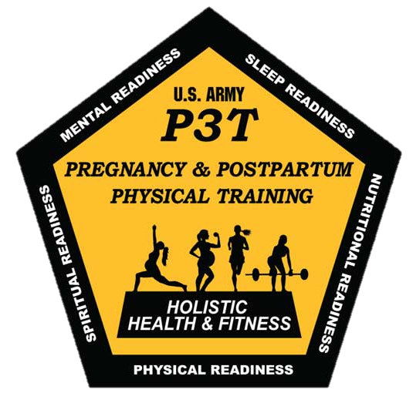
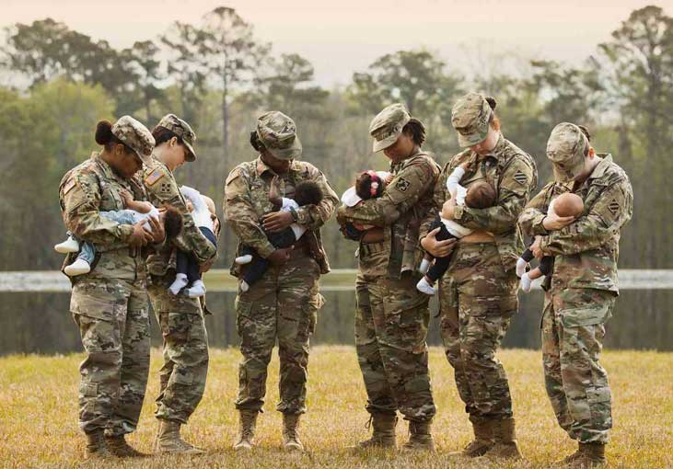
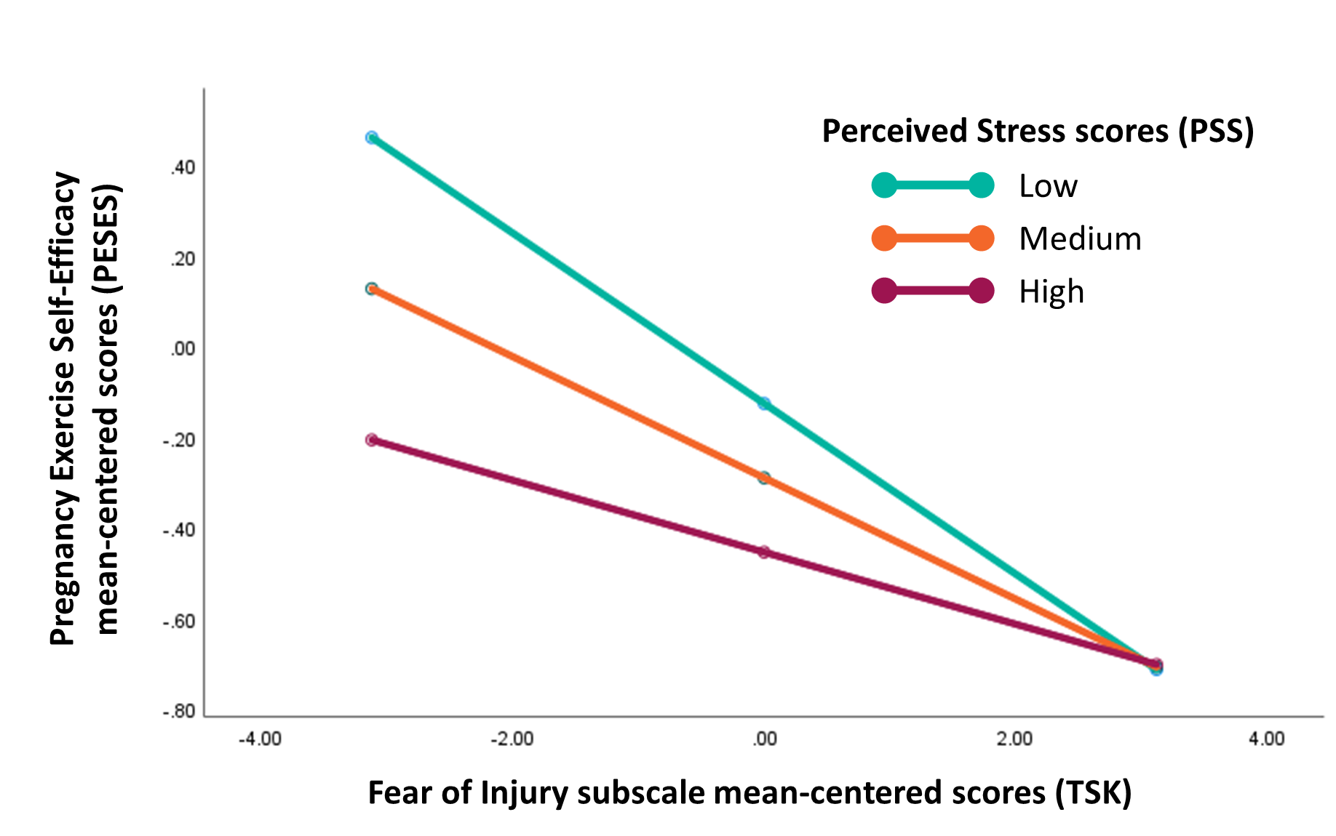
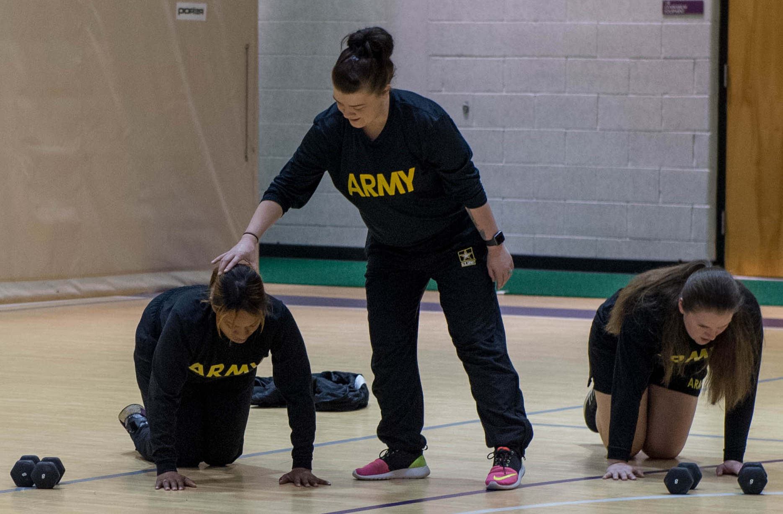
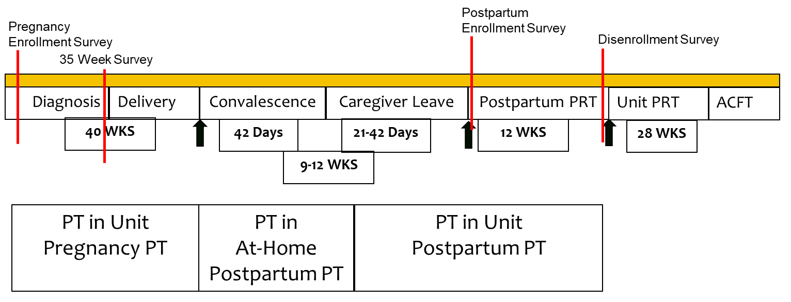
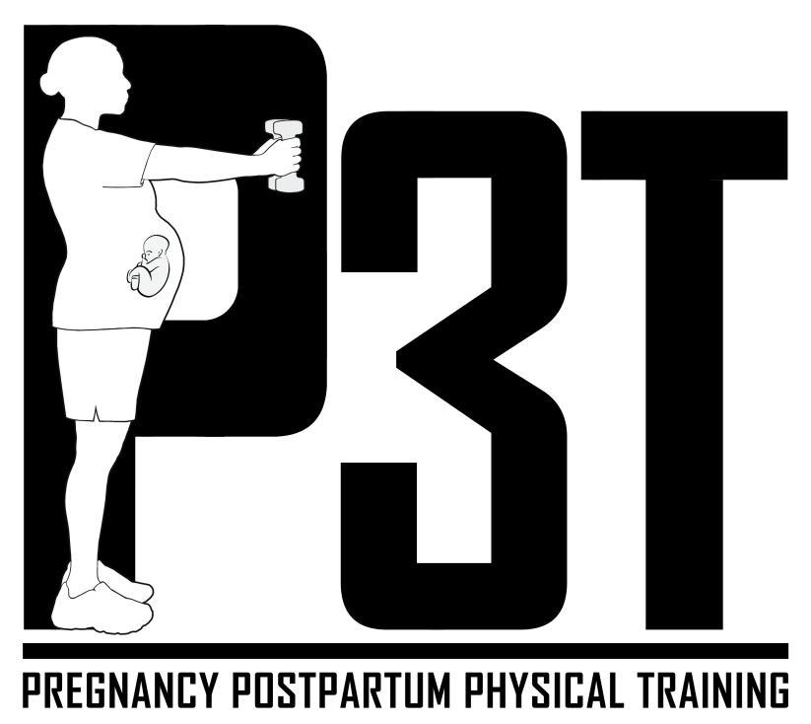

Perceived stress moderates the effect of injury-related anxiety on exercise confidence among pregnant Service members
¹ Bradley Fawver, ¹ Phillip J. Mastrosimone, ¹ Megan E. Douglas, ² Jeffrey M. Osgood
¹ Walter Reed Army Institute of Research (WRAIR) – West, Joint Base Lewis-McChord, WA, USA; ² Uniformed Services University of the Health Sciences, Bethesda, MD, USA
Introduction
Methods
Results
Background & Rationale
Pregnant Service members often report experiencing increased pain, fear of injury, and life stress during pregnancy, postpartum, and return to full duty.^{1,2}
The Army’s Pregnancy and Postpartum Physical Training (P3T) program utilizes standardized training and educational curricula to enhance exercise self-efficacy,
mitigate exercise-related apprehensions,
and promote Soldier health and fitness
during and following pregnancy, thereby
promoting return to pre-pregnancy levels
of performance.³
Purpose and Hypotheses
The purpose of this program evaluation was to explore the relationship between fear of injury and exercise self-efficacy among active-duty Soldiers participating in the P3T Program. Furthermore, we examined whether perceived competency, relatedness, and stress moderated this association.
We expected to observe a negative relationship between fear of injury and exercise self-efficacy, which would be exacerbated by higher levels of life stress and mitigated by increased autonomy and relatedness.
Measures
Soldiers completed online questionnaires using Qualtrics, assessing: pregnancy-specific health items, psychological needs (PNSE), perceived stress (PSS), mood (PANAS, EPDS), exercise-related anxiety and confidence (PESES), fear of pain (TSK), exercise barriers (OSTRC, PBE), physical activity (GLTEQ), and perceptions of the program.
Analyses
Data were first mean-centered to aid in interpretation of results. A series of correlations were then conducted to establish associations between key factors of interest.
Regressions were utilized to determine whether fear of injury was negatively associated with exercise self-efficacy after controlling for age and weeks pregnant.
Following establishment of a significant regression, we examined whether autonomy, relatedness, and stress moderated the aforementioned relationship.
Regressions revealed that fear of injury had a negative effect on pregnant Soldiers’ perceived exercise self-efficacy, R² = .297, β = -.540, SE = .103, p < .001.
Only stress significantly moderated this relationship, ΔR² = .038, β = .188, SE = .092, p = .044, with injury-related anxiety predictive of exercise self-efficacy at low to moderate levels of life stress (p’s < .001), while higher levels of injury anxiety were associated with low self-efficacy, regardless of stress.
Discussion
Results suggest that life stress may interfere with perceptions of exercise self-efficacy and Soldiers’ return to pre-pregnancy levels of fitness and occupational health, even amongst those that do not endorse anxieties about training.
Findings further highlight the important role of health and exercise-related education to allay Service members’ fears about physical activity and injury risk
during pregnancy, postpartum, and
return to full duty and fitness testing.
Limitations
One notable limitation in this program evaluation (i.e., pilot project) was the lack of control over when assessments were conducted, which necessitated subsampling and a cross-sectional approach rather than the intended longitudinal design.
This evaluation was conducted before the full decentralization of the P3T program, so some Soldiers represented in the sample may have had a different experience in the program and connection with other Soldiers and trainers in the program.
Results
Correlations revealed a negative association between injury-related fears and exercise self-efficacy (r = -.308, p < .001), which was still evident after controlling for age and weeks pregnant in this sample.
Self-efficacy was negatively correlated with stress (r = -.267, p < .001) but positively correlated with exercise-related autonomy and relatedness (r’s > .328, p’s < .001).
Methods
Participants
A cohort of junior enlisted military personnel (E1-E4) and non-commissioned officers (E5-E6) engaged in the Army’s P3T program (N = 81, Mean age = 25.36 + 4.69 years,
Mean time pregnant = 13.94 + 8.86 weeks) participated in the program evaluation. This sample, of the larger P3T evaluation, reported bodily pain in the past four weeks.
The authors declare no personal or financial conflicts of interest
References are available upon request – Contact: Brad Fawver, PhD, bradley.j.fawver.civ@health.mil.
We acknowledge and thank the I Corps Command Team, support staff, and P3T teams at Joint Base Lewis-McChord, WA for their assistance with conducting this evaluation.

