Slide 1
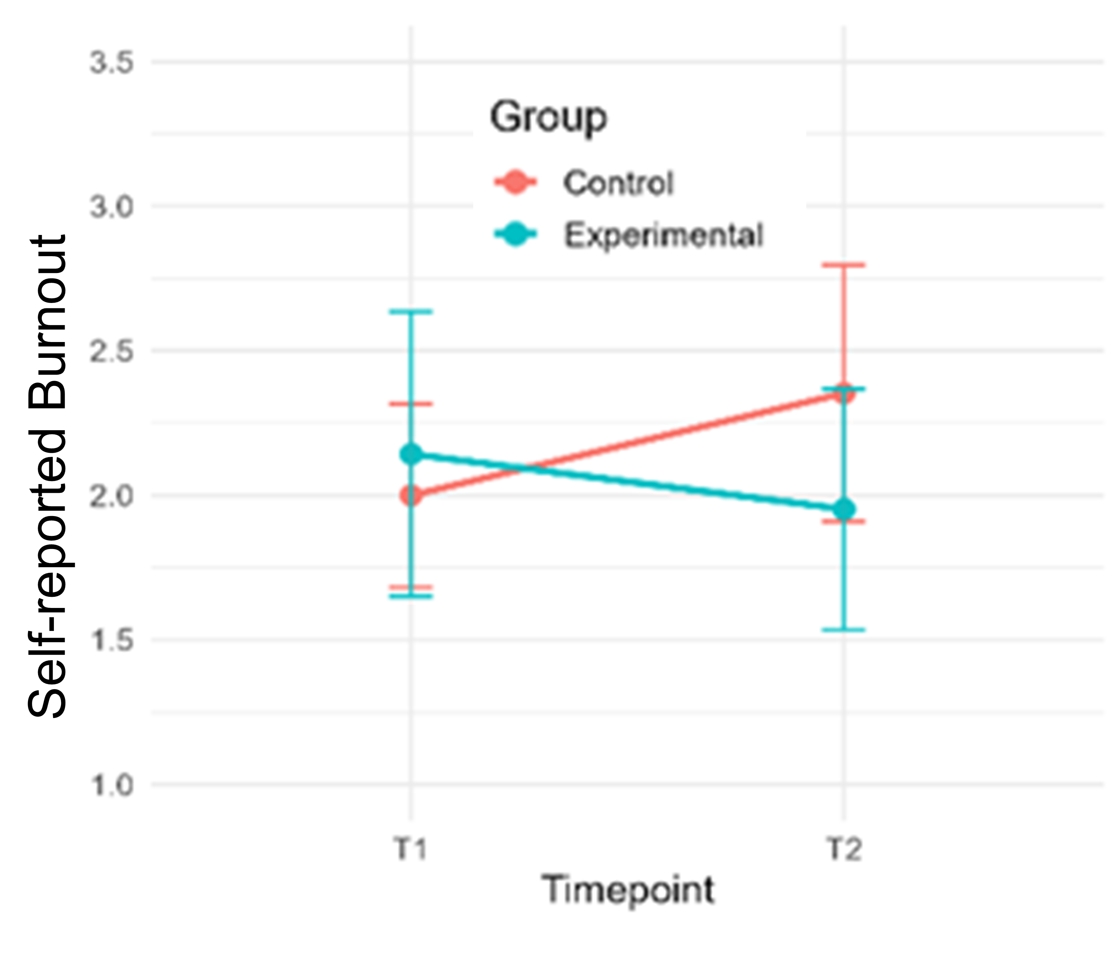

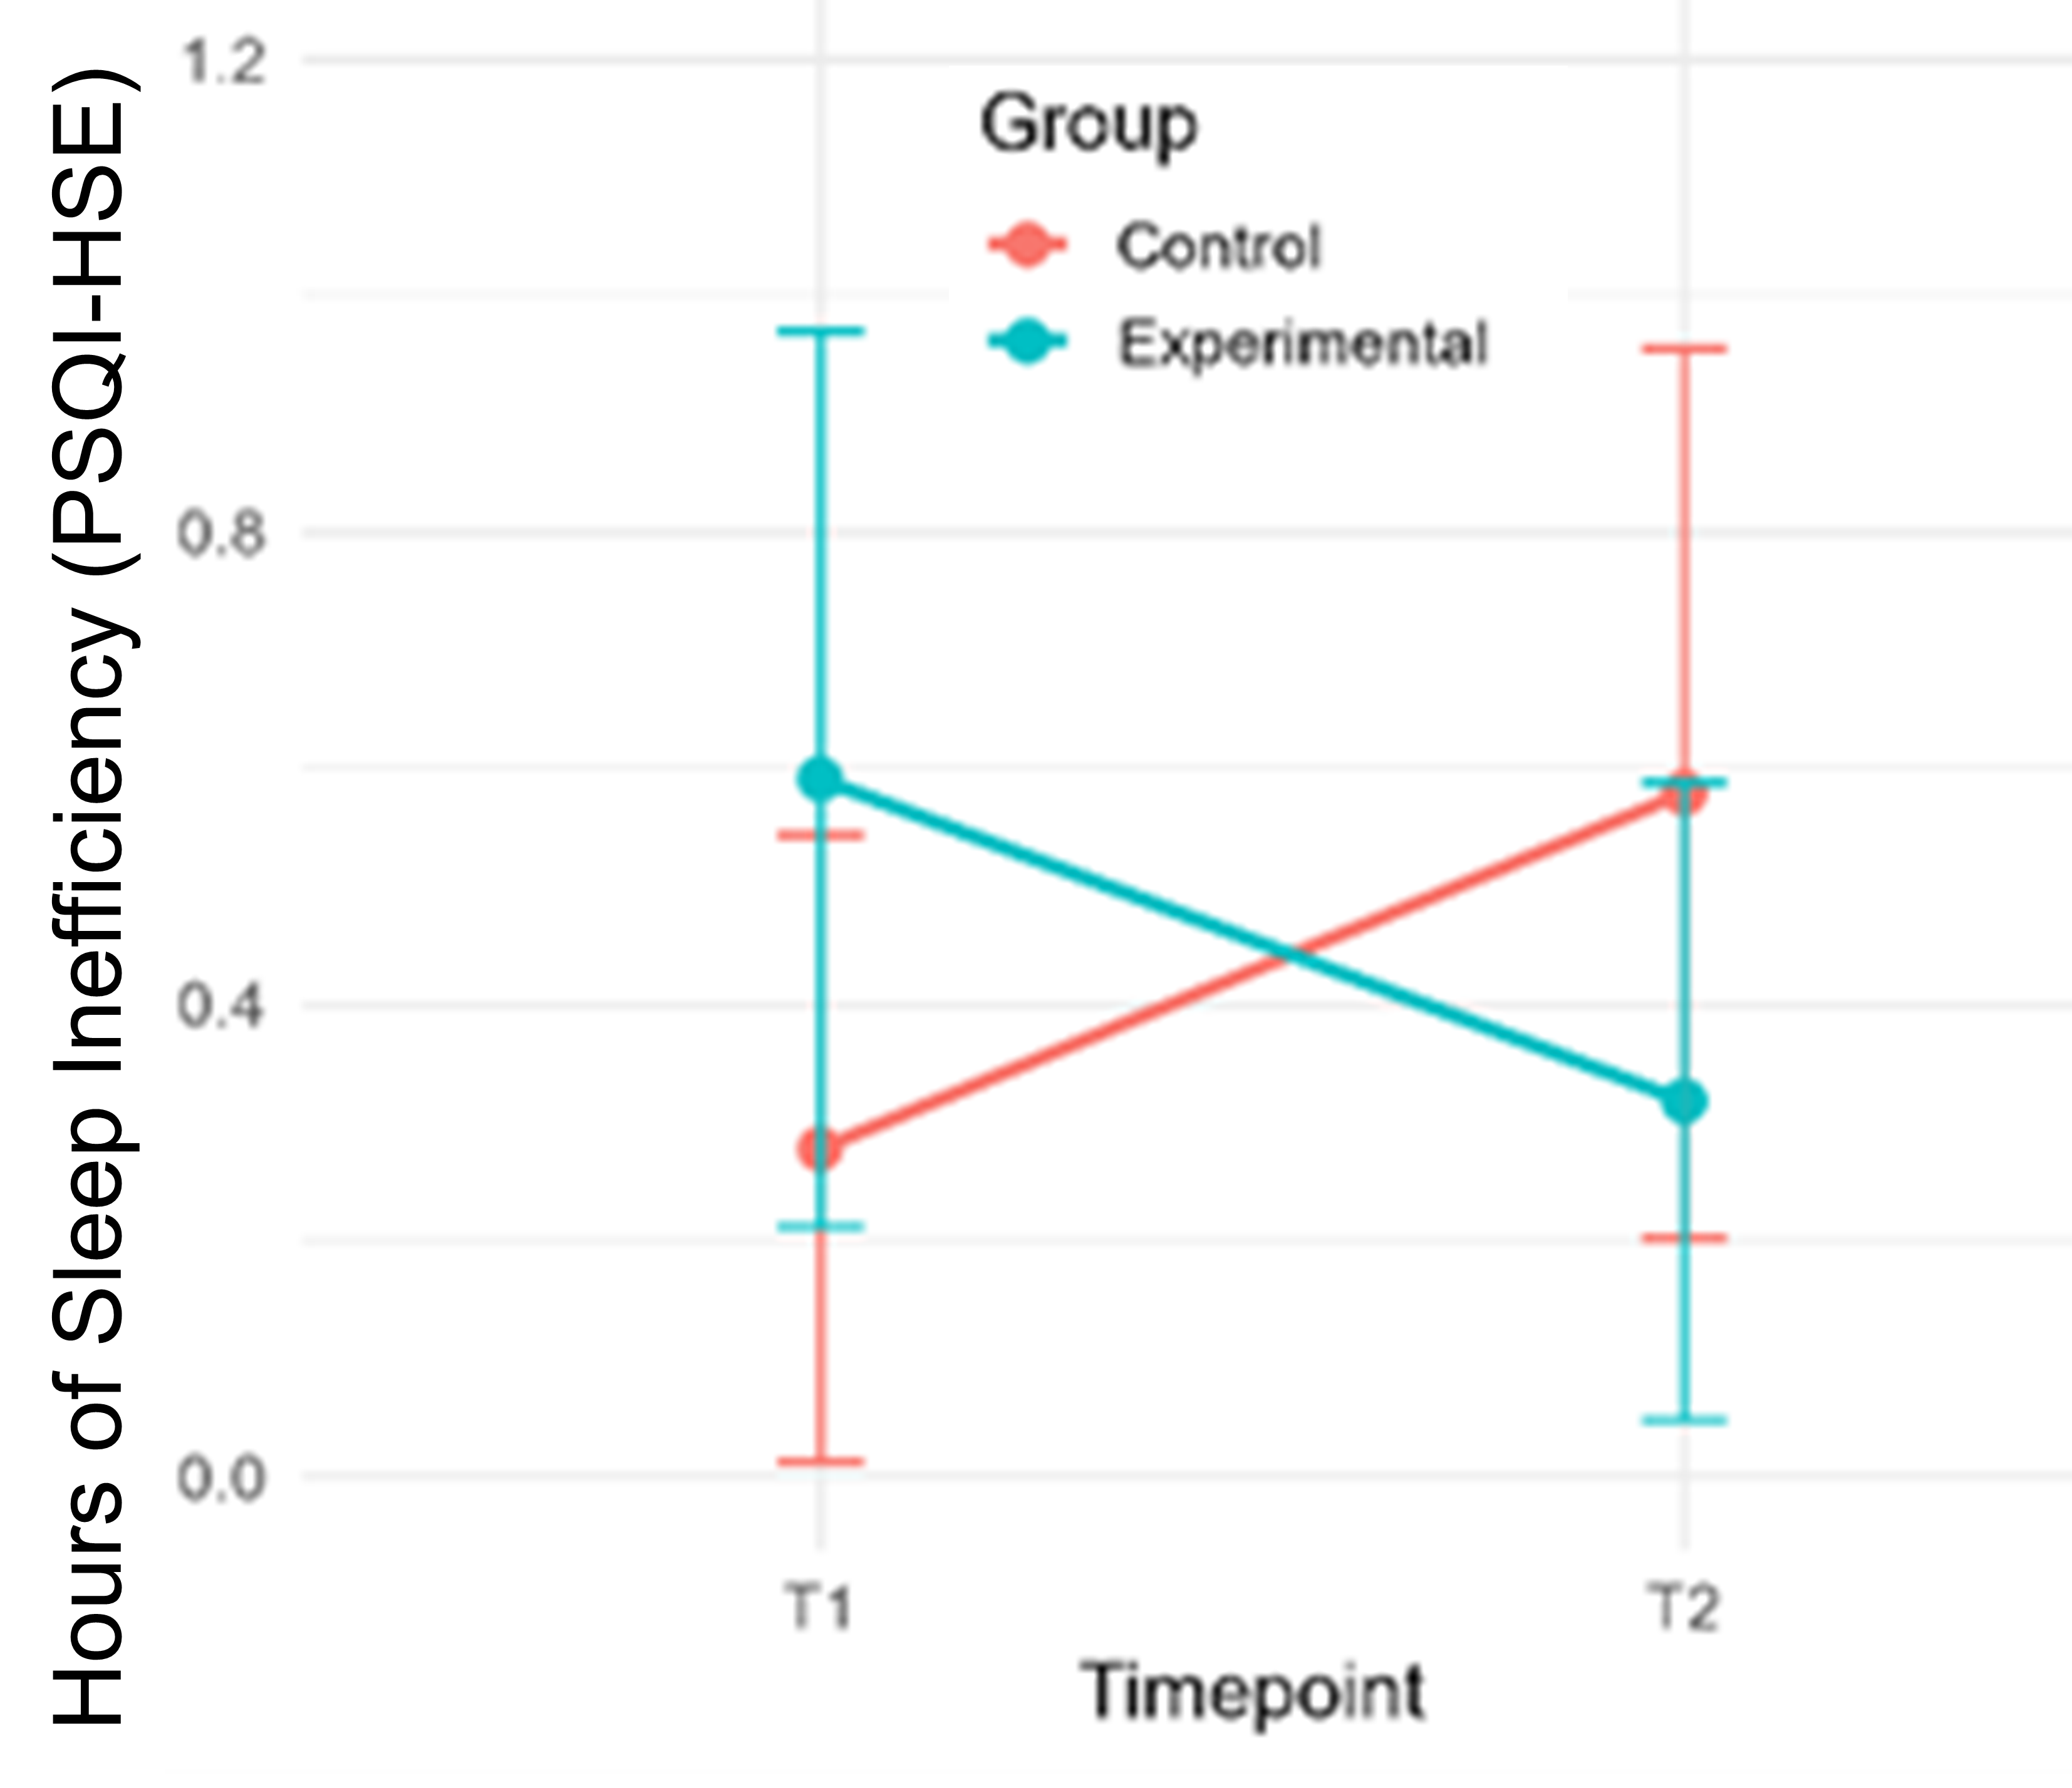
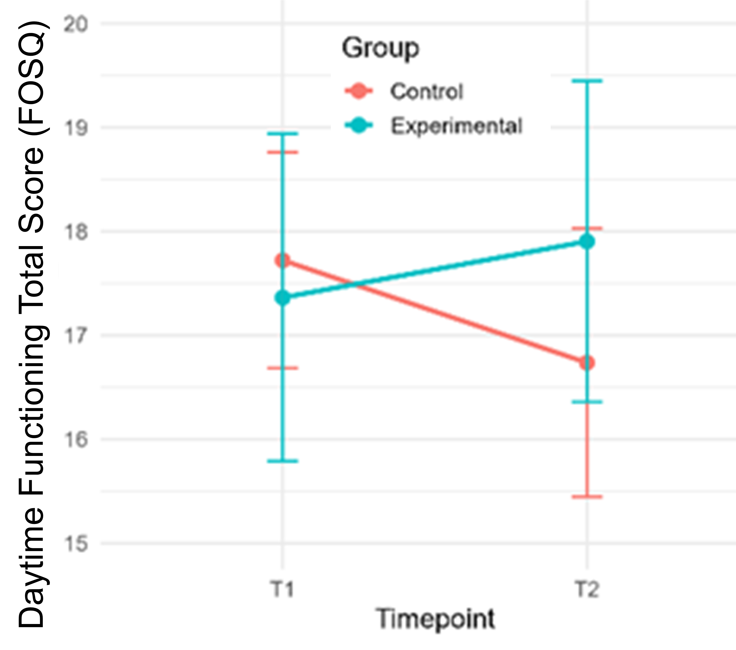
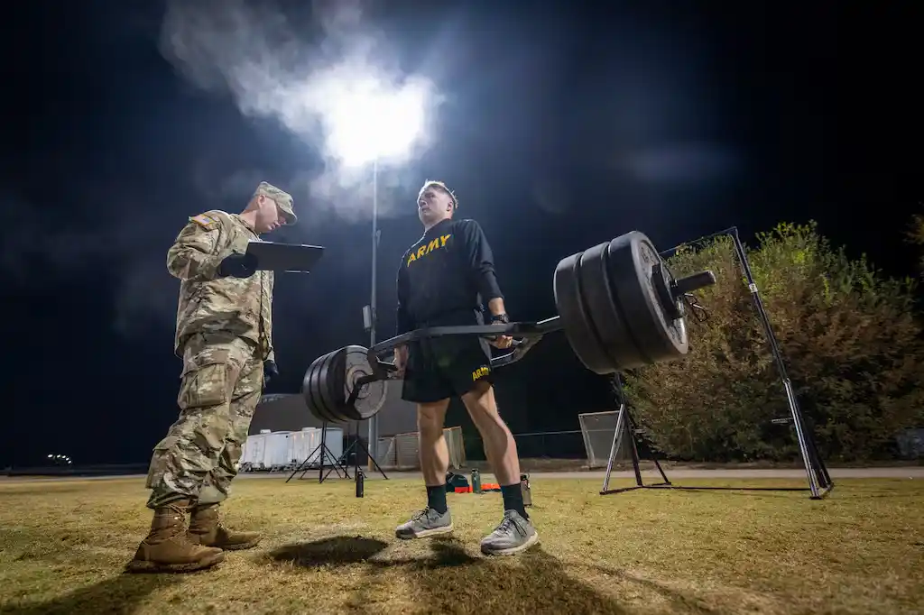
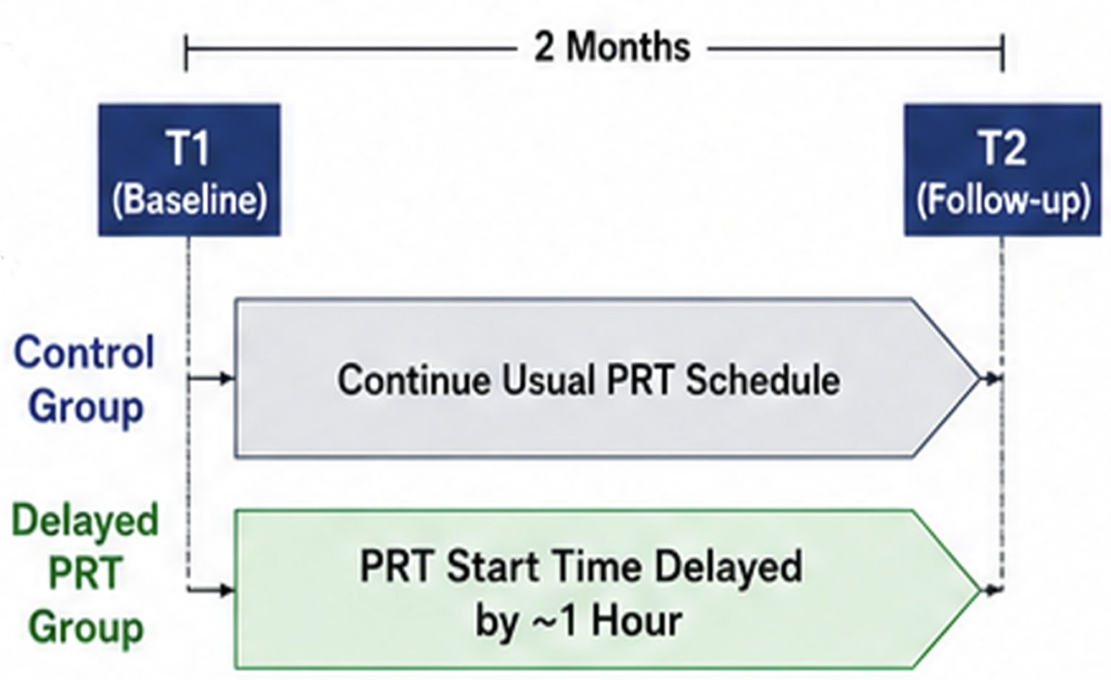
Delaying morning physical readiness training enhances self-reported sleep behavior, promotes external exercise engagement, and reduces caffeine use in active-duty Soldiers
¹ Jeffrey T. Cooke, ² John D. Snyder, ³ Stephen A. Krauss, ² Brian R. Johnson, & ² Bradley Fawver
¹ Madigan Army Medical Center, Clinical Psychology Resident Program, Joint Base Lewis-McChord, WA, USA; ² Walter Reed Army Institute of Research (WRAIR) – West, Joint Base Lewis-McChord, WA, USA; ³ Center for Military Psychiatry and Neuroscience, Walter Reed Army Institute of Research (WRAIR), Silver Spring, MD, USA
Introduction
Methods
Results
Background & Rationale
Physical readiness training (PRT) typically occurs at the start of the duty day (e.g., 0600); however, exercising early in the morning may impact on energy availability,¹ performance capabilities,² daytime functioning,³ and work-family stress.⁴
Empirical studies on training time and circadian rhythm have been conducted in various civilian populations,⁵ but similar research in military settings is lacking.
Purpose and Hypotheses
The purpose of this command-directed evaluation was to explore the effects of delaying PRT by ~1-2 hours on Soldiers’ sleep behavior, health, stress, morale, and body composition across a 6-week period.
We generally expected that delaying PRT would yield improvements to sleep outcomes, perceived performance during training, health, work-life balance, and caffeine use.
Measures
Demographics, body composition, and fitness test (AFT) scores were collected at baseline.
Primary outcomes included sleep latency and efficiency (PSQI), daytime dysfunction (FOSQ-10), training workload (NASA-TLX), work-family conflict (WFCS), stress (PSS), career intention, and burnout.
Secondary outcomes included body composition (e.g., BMI, body fat percent, fat-free mass), physical activity behavior (GLTEQ), intrinsic motivation (AIMI), productivity, and mindfulness.
Analyses
Data were analyzed primarily using linear mixed-effects models with fixed effects for Group and Time and random effects for Participant, or through t-tests. Age-adjusted models were applied as appropriate. Correlations were used to explore relationships between constructs.
Reduced use of sleep medications, work-family strain, burnout, and energy-dense/sugary beverage consumption were also notable trends in the dataset.
Unit staff confirmed the Delayed PRT schedule did not interfere with accountability or other duty requirements.
Discussion
Delaying morning PRT by 1-2 hours was suggestive of positive improvements in sleep quality, efficiency, and daytime function, with no observed decrements in body composition, health, or perceived performance during training.
Participants reported similar wake time (Control = 0522, Delayed = 0509), suggesting that Soldiers in the Delayed group were not necessarily using the additional time before PRT to sleep but rather to prepare for the duty day and spend time with family.
Limitations and Future Directions
As a Command-directed program evaluation (i.e., pilot study), several limitations are worth noting, such as the sample size, between-subjects design, reduced ability to monitor participants, lack of post-study fitness testing, and the use of a single unit as a single military installation.
Future work should aim to include additional measures and more tightly controlled conditions when evaluating the influence of different PRT schedules on Service members’ health, wellness, and performance capabilities.
Methods
Results
Active-duty Soldiers (N = 62) were split into two groups: Standard PRT at 0600 (n = 31, M_{age} = 27.07 + 5.69 yrs) or Delayed PRT at 0800 (n = 31, M_{age} = 26.67 + 5.43 yrs).
Soldiers completed an initial body composition assessment (InBody770) and electronic questionnaires (Qualtrics).
Data from previous unit assessments (e.g., fitness tests) were provided by the unit in a coded format.
Each group trained at their designated start time for 6 weeks, after which Soldiers completed a post-evaluation questionnaire and body composition assessment.
Compared to Standard PRT (0600), the Delayed PRT (0800) group reported improved sleep efficiency (β = -0.563,
p = .026), daytime functioning (β = 1.314, p = .022) and general productivity (β = 0.251, p = .030).
These effects were robust to age as a covariate in the models.
Although not statistically significant (e.g., p < .10), secondary outcomes showed a consistent directional pattern favoring delayed PRT, including greater lean body mass, more exertion during training, and greater off-duty exercise.
References are available upon request – Contact: Brad Fawver, PhD, bradley.j.fawver.civ@health.mil.
We acknowledge and thank the Command Team and support staff (i.e., Holistic Health and Fitnesss Program) at 555th Engineering Brigade for their support of this program evaluation.

