Slide 1

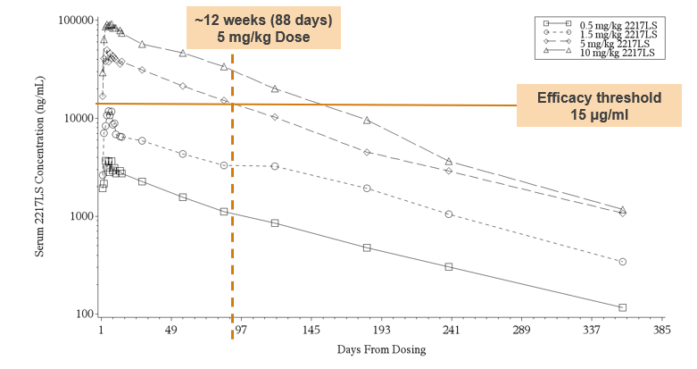
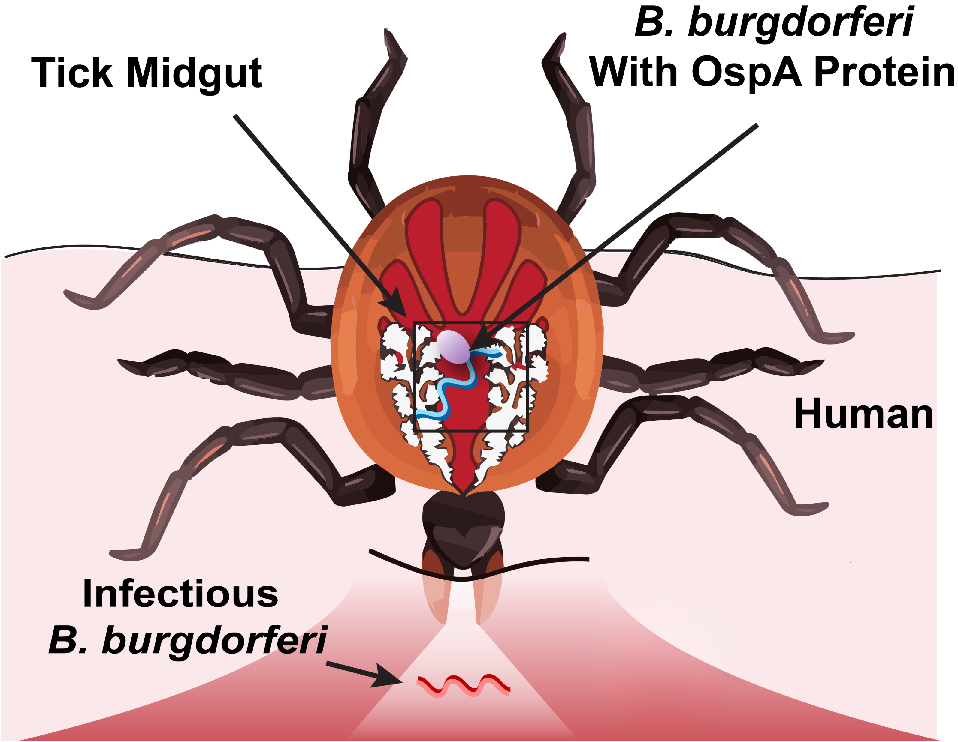
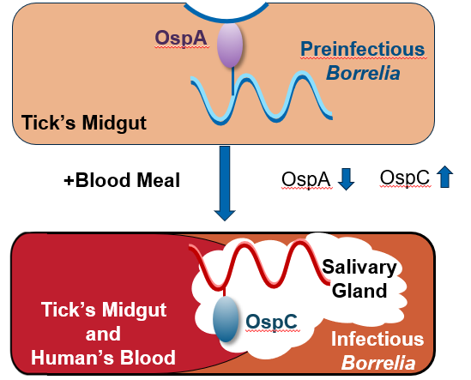
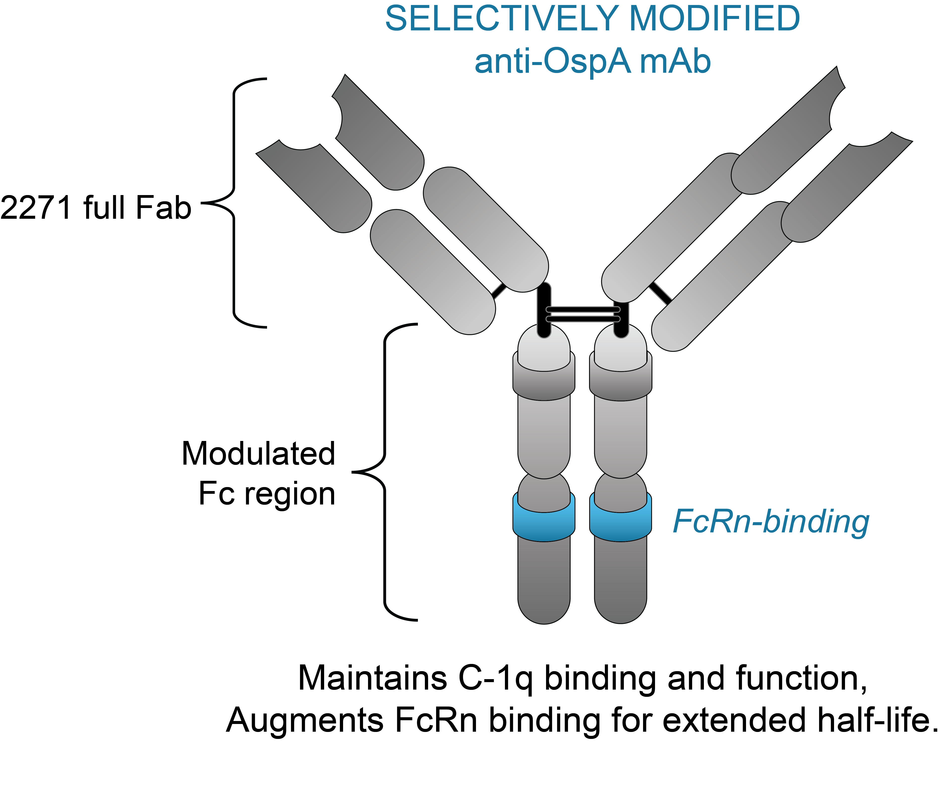



TNX-4800: A Monoclonal Antibody (mAb) to Protect the Warfighter Against Lyme Disease
Z. Rosenberg MD; G. Sullivan, MD; Evia Bavari; S. Lederman, MD
Tonix Pharmaceuticals Inc., Berkeley Heights, NJ
Abstract
Impact on Warfighters
Results
Lyme Disease, including Post-Treatment Lyme Disease syndrome (PTLDS) often reduces the warfighter’s readiness and career. A new rapid-acting preventive monoclonal antibody against Lyme has shown promise in a Phase 1 clinical study, and a Phase 2 field study is planned for 2027.
Borrelia burgdorferi is the cause of 99% of all reported Lyme disease cases in the U.S. Currently, there are no U.S. Food and Drug Administration approved vaccines or on-label prophylactics to protect against seasonal Lyme disease.
TNX 4800 is a long-acting borreliacidal human monoclonal antibody that targets protein A (OspA) of Borrelia burgdorferi and contains an engineered domain for an extended half-life and avoiding binding epitopes once considered arthritogenic in the past. TNX-4800 is being developed as a prophylactic to be administered subcutaneously (SC) in the spring season. Based on Phase 1 data, it is expected to provide protection within 2 days after administration and last for 24 weeks*
TNX-4800 acts inside the tick midgut both to kill Borrelia and block Borrelia transmission.
Fig. 4 Observed Phase 1 Pharmacodynamics ⁹
Approximately 75% of U.S. military bases are located in states that account for 99% of CDC-reported tickborne illnesses in the US ^{7,8}
Symptoms such as severe cognitive dysfunction, short-term memory loss, and temporary paralysis have impaired elite personnel—including active combat fighter pilots— in their ability to safely perform mission-critical duties safely ⁷
Up to 20% of infected individuals develop Post-Treatment Lyme Disease Syndrome (PTLDS), resulting in debilitating chronic joint pain and cognitive fatigue that can be impact long-term health for warfighters ⁷
Standard field prevention protocols, such as permethrin-treated uniforms, frequently fail or wear out during prolonged field training and deployment operations
Doxycycline is not recommended by the CDC for prevention and, while effective for treatment, may cause side effects such as photosensitivity in chronic use
Introduction
Monoclonal Antibodies May Offer Advantages Over a Vaccination
for Lyme Disease Prevention
Fig. 1 OspA is an Outer Membrane Protein on Borrelia That Facilitates Bacterial Adherence to the Tick Midgut¹⁻³
Table 1 | Monoclonal Antibody | Vaccine
Immunity | Passive | Active
Dose Number | 2 doses | 3 doses + 1 booster
Start Date | 2 days before tick season | 1 year before tick season
Protection | Immediate | Delayed
Drug exposure increased by approximately 25 times for a 20-times increase in dose.
Serum TNX-4800 was measurable at the earliest sampling time of two days, indicating rapid systemic absorption.
TNX-4800 concentrations remained quantifiable for >200 days in 80% of volunteers at the lowest dose and up to 350 days in the majority of volunteers at higher doses (i.e., ≥ 1.5 mg/kg).
Mean half-life ranged from 62-69 days across groups. Serum concentrations remained quantifiable for up to 12 months in most volunteers. Mean exposure for the 10 mg/kg cohort was less than 17% of the highest exposures in a rat toxicology study.
Transient low levels of anti-drug antibodies were detected in <10% of treated volunteers.
Treatment related adverse events were graded mild or moderate (eg headache, fatigue).
Injection site reactions were mild to moderate and occurred in 6 of 34 participants receiving TNX-4800
Final dosing schedule to include a second dose on Day 85 and blood levels above the 15 ug/ml threshold to keep blood levels above the 15 ug/ml concentration threshold from day 85 to well past Day 168
Blood Induces Metamorphosis of Borrelia from the Pre-infectious to Infectious Stage^{4,5}
Methodology
Fig. 3 TNX-4800 Long-acting anti-OspA Monoclonal Antibody Design
TNX-4800 (2217LS) is a long-acting borreliacidal, human monoclonal antibody (mAb), with an engineered crystallizable fragment (Fc) domain for an extended half-life, that targets protein A (OspA) of Borrelia burgdorferi
Fig. 2 Anti-OspA Monoclonal Antibody TNX-4800 Blocks Differentiation of Borrelia from the Pre-infectious to Infectious Stage, Migration to Salivary Glands, and Transmission⁶
Developmental findings and status
TNX-4800 is ready to advance into Phase 2 clinical trials. The initial Phase 1 study—which evaluated safety, tolerability, pharmacokinetics, and immunogenicity across subcutaneous doses of 0.5, 1.5, 5, and 10 mg/kg—yielded a generally favorable safety profile, with mild to moderate drug-related adverse findings across clinical laboratory assessments, vital signs, ECGs, or physical examinations
Notably, the drug demonstrated rapid systemic absorption paired with exceptional long-acting durability. Based on these insights, development is transitioning to an optimized, two dose regimen *. The primary endpoint will be 6 months protection with a secondary endpoint of 3 months protection.
The company is actively seeking strategic partners to support the upcoming Phase 2 field trial in 2027.
OspA
Midgut
Adherence
Blood Meal
No TNX-4800 mAb
Blood Meal
With TNX-4800 mAb
Phase 1 Study Design
TNX-4800 was studied in a Phase 1 randomized, double-blind, sequential dose-escalation study (NCT04863287) that evaluated safety, tolerability, pharmacokinetics (PK), and immunogenicity of TNX-4800 in healthy adults.
Migration
Migration
Table 2
Cohort | No. of Participants | TNX-4800 Dose (mg/kg)
1 | 10 TNX-4800 2 placebo | 0.5
2 | 8 TNX-4800 2 placebo | 1.5
3 | 8 TNX-4800 2 placebo | 5
4 | 8 TNX-4800 2 placebo | 10
Blood meal
Iron-dependent OspA downregulation
Blood meal
mAb binds OspA, no downregulation
Primary Objective:
Evaluate safety and tolerability of a SC injection of TNX-4800 (2217LS) when administered to healthy volunteers
Secondary Objective:
Evaluate pharmacokinetics (PK) of a SC dose of TNX-4800 (2217LS) when administered to healthy volunteers
Study Population:
Healthy male and female subjects, age 19 to 65 years, inclusive. 44 volunteers enrolled, 41 completed
Salivary glands
OspC
Salivary glands
References
Migration
OspC upregulation
Some Borrelia killed
No Migration
No metamorphosis
Some Borrelia killed
*Primary efficacy endpoint proposed is 6 mo., with secondary at 3 mo., following two doses of TNX-4800
1. de Silva AM, et al. J Exp Med. 1996;183(1):271-275. 2. Radolf JD, et al. Nat Rev Microbiol. 2012;10(2):87-99. 3. Anderson C, et al. Pathogens. 2021;10(3):281. 4. Dattwyler R, et al. NPJ Vaccines. 2022;7(1):10. 5. de Silva AM, et al. Infect Immun. 1999;67(1):30-35. 6. Woodman ME, et al. FEMS Immunol Med Microbiol. 2008;54(2):277-282.7 McFaight,M. 16th Air Force (2021, Feb 17). 8 Lederman S. Infection tody. Ay 6,2026.) 9. KlepnerM. World Vaccine Congress 2026.
Tick to Human Transmission
Participants received either placebo or TNX-4800 (2217LS) by subcutaneous (SC) injection
Mouthpiece
Transmission
Mouthpiece
No Transmission

