Slide 1



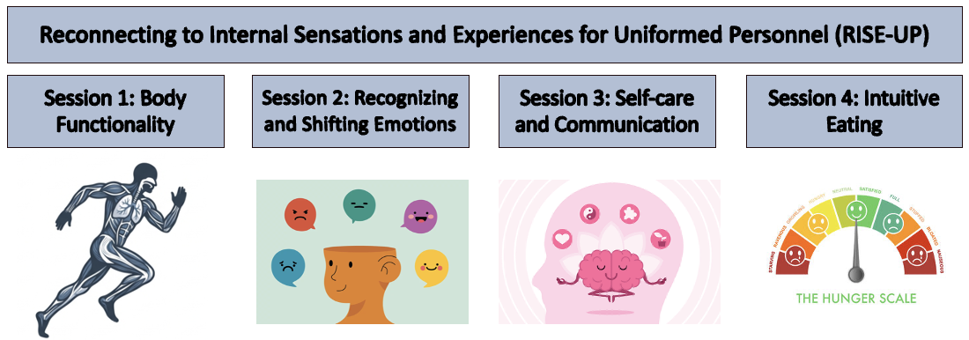
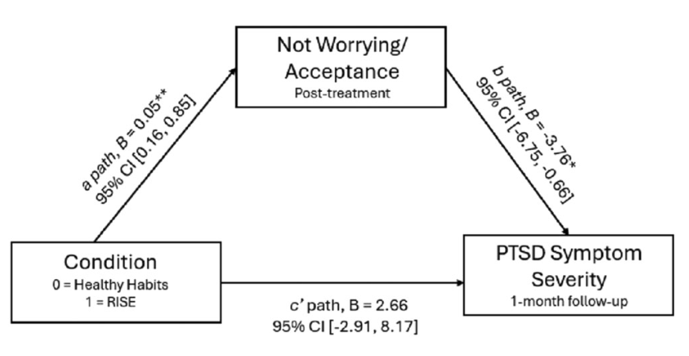


A Scalable Interoceptive Intervention for Suicide Prevention: Development and Military Adaptation of RISE
April R. Smith, Ph.D.¹, Jillian A. Carter, B.S.¹, Andrew P. Weinstein, Ph.D.², Cristian M. Curran, M.A.¹, Dana R. Henry, B.A.², &
Nathan T. Kearns, Ph.D. ²
¹ Department of Psychological Sciences, Auburn University, Auburn, AL, USA
² Walter Reed Army Institute of Research (WRAIR)-West, Joint Base Lewis-McChord, WA, USA
Background
Interoceptive dysfunction is a transdiagnostic risk factor for suicidal ideation and psychopathology across military and civilian populations.
Interoception refers to the ability to recognize, interpret, and respond to internal body sensations (e.g., emotions, pain, hunger, thirst, and physiological arousal).
To target this mechanism, we developed Reconnecting to Internal Sensations and Experiences (RISE), a brief, self-guided intervention designed to improve interoceptive awareness while addressing stigma and access barriers common in military settings.
Results
Across studies, RISE demonstrated high feasibility, acceptability, and strong completion rates.
The initial RCT showed significant and sustained improvements in multiple domains of interoceptive sensibility relative to the control condition.
Secondary analyses indicated that increased acceptance of uncomfortable internal sensations mediated reductions in PTSD symptoms.
Adapted versions for youth, eating disorder, veterinary student, and military populations demonstrated feasibility, acceptability, and preliminary evidence of target engagement.
Two additional RCTs are currently underway: one evaluating RISE as a universal prevention and resilience-building intervention for healthy Service Members and another evaluating the military-adapted RISE-UP intervention.
Ongoing RCTs will evaluate the effectiveness of RISE for prevention, resilience enhancement, and military-specific adaptation outcomes.
Figure 2: RISE-UP adaptation overview
Implications
Findings support interoception as a modifiable mechanism relevant to suicide risk, PTSD symptoms, and broader psychological functioning.
The successful adaptation of RISE across multiple populations highlights the flexibility and scalability of an interoception-focused approach while preserving core intervention principles.
Objectives
This poster describes the iterative development and evolution of RISE, from initial randomized controlled trials (RCTs) to population-specific adaptations and ongoing studies evaluating prevention, resilience, and military readiness outcomes.
We illustrate how a mechanism-focused intervention can be adapted across diverse high-risk populations while maintaining fidelity to its core theoretical framework.
Conclusion
RISE represents a scalable, transdiagnostic, and adaptable intervention targeting a core mechanism implicated in suicide risk and mental health outcomes.
Its iterative development across diverse high-risk populations supports its potential utility as both a prevention and intervention tool within the Military Health System. Future research will clarify its effectiveness for enhancing resilience, reducing risk, and promoting readiness among Service Members.
Methods
RISE was evaluated in a preregistered RCT among active-duty Service Members and veterans (N = 195), comparing RISE to an active control matched for time and attention. Subsequent analyses examined mechanisms of change in a subsample with probable PTSD (N = 100), see Fig. 1.
Guided by these findings, RISE was adapted using stakeholder input and feasibility testing for high-risk populations, including high school students receiving care in school-based health centers, individuals in intensive eating disorder treatment (RISE-ED), veterinary students, and uniformed personnel (RISE-UP), see Fig. 2.
Adaptations retained core interoceptive components while modifying language, examples, and delivery context.
References
Smith, A. R., Witte, T. K., Troop‐Gordon, W., Grunewald, W., Crosby, E., Hill, K., ... & Dretsch, L. M. (2023). Reconnecting to Internal Sensations and Experiences (RISE): An online, multi‐session intervention improves interoceptive sensibility for military personnel. Suicide and Life‐Threatening Behavior, 53(6), 940-957.
Kearns, Nathan T., Benjamin Trachik, and April R. Smith. "Impact of an interoception intervention on posttraumatic stress disorder in military service members: The role of the acceptance of internal sensations." Journal of Traumatic Stress 38.6 (2025): 1094-1104.
Figure 1: Mediating effect of not worrying/acceptance on the association between intervention and post-traumatic stress disorder (PTSD) symptom severity.
Note: The model controlled for baseline not worrying/acceptance and PTSD symptom severity scores (not depicted). RISE = Reconnecting to Internal Sensations and Experiences; CI = confidence interval.
Contact
Dr. April R. Smith, PhD: ars0152@auburn.edu
Dr. Nathan T. Kearns, PhD: nathan.t.kearns.civ@health.mil
Disclaimer: Material has been reviewed by the Walter Reed Army Institute of Research. There is no objection to its presentation and/or publication. The data presented derive from protocols approved by the Walter Reed Army Institute of Research Institutional Review Board. The opinions or assertions contained herein are the private views of the presenter and are not to be construed as official or as reflecting the position of the Department of the Army or the Department of Defense. The investigators have adhered to the policies for protection of human subjects as prescribed in AR 70–25.
Scan for more information about WRAIR
Notes:
4 feet high and 6 feet wide.

