Slide 1


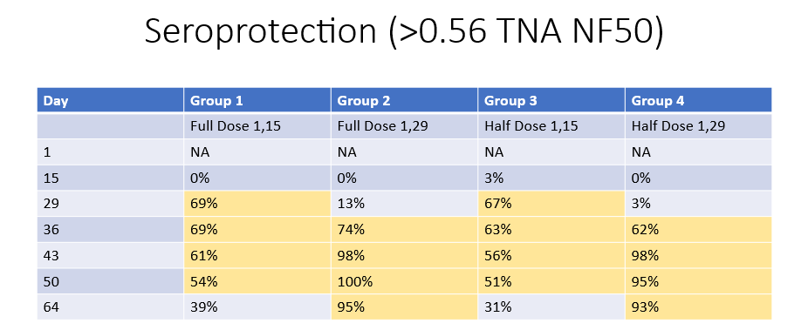
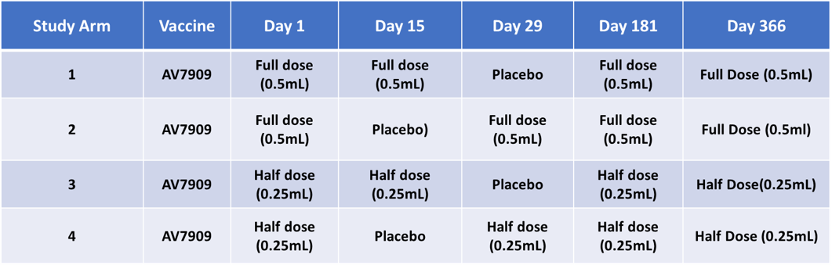
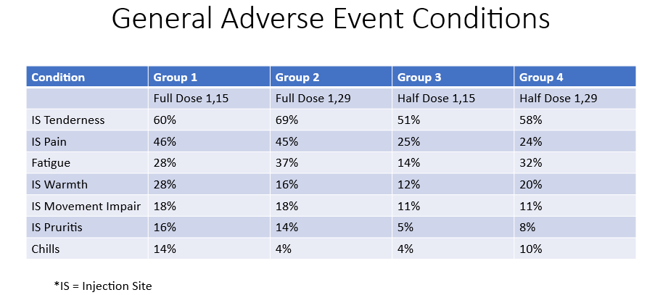
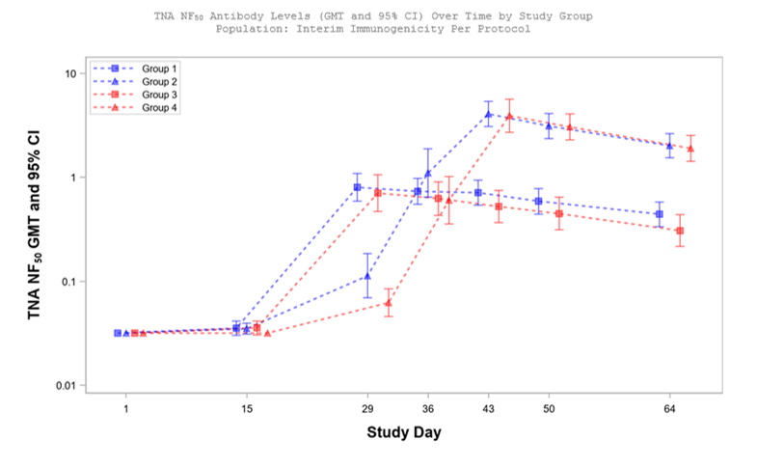
Clinical Evaluation of Dose Response Kinetics of an Adjuvanted Anthrax Vaccine
U.S. Department of Health & Human Services
Biomedical Advanced Research and Development Authority (BARDA)
Adam Clark, Ph.D.¹ Lindsay Parish, Ph.D.¹ Derek Eisnor, MD¹ Gary Horwith, MD^{1,2} Lynn Khosrowshahi, MPH^{1,3} Matthew Steele, Ph.D., RAC¹ Kimberly Hofmeyer, Ph.D.¹
¹Biomedical Advanced Research and Development Authority (BARDA), Administration for Strategic Preparedness and Response (ASPR), U.S. Department of Health and Human Services (HHS). Washington, DC, USA., ²Tunnell Federal Government Services (contractor supporting BARDA). Bethesda, MD,
³Booz Allen Hamilton (contractor supporting BARDA). McLean, VA
Abstract
Results
The Vaccine Program within BARDA’s Chemical, Biological, Radiological, and Nuclear (CBRN) Countermeasures Division supports the development, licensure, and procurement of vaccines against biological threats such as anthrax. In 2023, the BARDA-funded anthrax vaccine CYFENDUS was licensed by the FDA for post-exposure prophylaxis (PEP) of disease following exposure to Bacillus anthracis when administered in conjunction with recommended antibiotics. CYFENDUS reduced the vaccine PEP regimen to two doses from the three doses required by BIOTHRAX.
BARDA is interested in logistical and operational improvements to optimize vaccine deployment in public health emergencies. For CYFENDUS, BARDA is investigating two key questions: (1) whether a half-dose can maintain effectiveness, and (2) whether the 2-dose primary series can be successfully boosted. If effective, use of half-dose has the potential to extend the number of procured doses if a shortage occurs during an incident response.
To address these questions, BARDA is conducting the Anthrax AV7909 Boost Evaluation Study (ABESt), a randomized, Phase 2, double-blinded study to assess the safety and immune response kinetics of the CYFENDUS (AV7909) anthrax vaccine administered on two primary series vaccination schedules followed by 6- and 12-month boosters (NCT05997264). Healthy adults were included in the study to evaluate immune responses as measured by Toxin Neutralizing Assay (TNA) and safety. Here we present an interim analysis of the primary series vaccinations. Subjects were randomized 1:1:1:1 across 4 treatment groups of half- and full-doses and schedules of 1,15 and 0, 29 days. The data demonstrate that half-doses are equally effective as full doses at eliciting immune responses on both schedules but the magnitude of the response of both doses was substantially greater with the 1, 29 schedule. For both schedules, the half-dose may decrease the incidence of adverse events. These data suggest that the vaccine could be further optimized for clinical utility in both PEP and pre-exposure prophylaxis (PrEP) settings.
BIOTHRAX is still the only available PrEP to prevent anthrax disease; however, the regimen is extensive, requiring a 3-dose primary series with 6- and 12-month boosters and annual boosting thereafter. The data from the CYFENDUS ABESt trial have the potential to enable a shorter primary series and improved logistics for PrEP, benefiting preparedness in terms of protection and medical planning where anthrax may be a threat.
The results presented here include only an interim analysis (IA) of the study data of the primary series of vaccinations through day 64 post-initial vaccination. No booster data has been included.
The results demonstrate that both full- and half-doses of the vaccine are effective in eliciting an immune response (Figure 1). As expected, neither full- or half-doses of a single vaccine dose appeared to generate a robust immune response. By day 15, all four cohorts had only a single dose, yet none of the groups demonstrated much change in TNA values above baseline. By day 29 in the two cohorts that only received the single dose there appeared to be marginal increases in TNA levels of single full- and half-doses but neither approaching the 0.56 TNA threshold.
In the two cohorts receiving the doses on the labeled schedule of 1,15 days (Groups 1 and 3), both were able to surpass the 0.56 TNA threshold by Day 29 with no statistical difference being observed between the full- or half-dose groups. These groups also demonstrated a high percentage of seroprotection (defined as the percentage of individuals surpassing the 0.56 TNA threshold) with well over half of the group demonstrating seroprotection by Day 29 and maintaining it through day 50 (Table 2).
Background
Anthrax is an acute infectious disease caused by the Gram-positive, spore-forming bacterium Bacillus anthracis. Anthrax can be found naturally or weaponized as inhalation anthrax, with a mortality rate of around 90% when left untreated by antibiotics or prevented through vaccination raising concern for its use as a bioweapon against civilians or the warfighter [2].
Currently there are two anthrax vaccines licensed for use in adult populations ages 18-65: Biothrax which is licensed for both pre-exposure prophylaxis (as a 3-dose primary series with 6- and 12-month boosters and annual boosting) and post-exposure prophylaxis (as a three-dose series 1,15, 29 days) and CYFENDUS (AV7909) which currently only is licensed for post-exposure prophylaxis (as a two-dose 1,15 days).
Both vaccines are manufactured as a cell-free filtrate of an avirulent, non-encapsulated strain of B. anthracis containing proteins from the bacteria to illicit the immune response. CYFENDUS was designed as a next-generation vaccine that included the addition of the CpG 7909 adjuvant to the filtrate to stimulate a more rapid and robust immune response. CpG 7909 acts as a Toll-like receptor 9 (TLR9) agonist and was shown to reduce the time to onset of immune protection and the number of doses needed for a protective immune response [3,4].
The FDA allowed use of the “Animal Rule” for justification of the effectiveness of anthrax vaccines as a correlate on human protection. Under this model, the FDA accepted a Toxin Neutralizing Assay (TNA) value of 0.56 or greater as an acceptable threshold as a correlate for human protection after studies showed a 70% probability of survival associated with a TNA NF50 (50% neutralization factor) level of 0.56 in rabbits and 0.29 in NHPs. [6,7].
While CYFENDUS was licensed as a vaccine that demonstrated effectiveness through animal models and non-inferiority against Biothrax in clinical studies [5] little is known about the immune kinetics for the vaccine in humans in terms of lower doses or booster doses. Such data could be valuable in evaluating use of the vaccine in the event of vaccine shortages, use of the vaccine in special populations like pediatrics or pregnant women, or application of the vaccine for a pre-exposure prophylaxis indication for the warfighter that requires lower of fewer doses.
In order to better understand the immune kinetics of the vaccine, BARDA conducted the Anthrax AV7909 Boost Evaluation Study (ABESt) to understand how changes in both vaccine dose and schedule may affect the immune response and adverse events of the vaccine following administration.
Conclusion
CYFENDUS is currently only licensed for post-exposure prophylaxis. Previous supporting studies demonstrated a strong immune response that was effective as a two-dose regimen compared to the three-dose Biothrax vaccine. This study demonstrated that half-doses of CYFENDUS administered according to the labeled schedule of 1,15 days and a revised schedule of 1,29 days were both able to meet the TNA protective threshold of 0.56. This suggests that dose-sparing in an emergency would be a viable option for post-exposure prophylaxis in the event of a vaccine shortage.
Interestingly, the revised schedule of 1,29 days demonstrated a markedly greater immune response than the 1,15 day schedule with seroprotection lasting throughout the length of the evaluation for the interim analysis of the study. Given that the immunogenicity results were nearly identical in these groups regardless of the full- or half-dose vaccination, the results also suggest that the effective administrative dose may be saturated and that lower doses may be sufficiently effective.
While CYFENDUS is not yet licensed as a pre-exposure prophylaxis vaccine, these data strongly suggest consideration for a licensed indication. They data also support that it may confer protection at lower doses and a revised vaccine schedule of fewer doses (and potentially fewer adverse events) compared to the licensed Biothrax. Here, we only present the interim analysis data. Longer term immunogenicity data has not yet been evaluated. Booster data results from the clinical trial are pending and will provide additional data on immunological response.
Methods & Materials
This trial was a randomized, double-blinded, multicenter study evaluating immune response kinetics of full and half doses of CYFENDUS (AV7909) with different primary series vaccination schedules followed by 6- and 12-month boosters. Healthy adult male and female subjects aged 18 through 65 years were included in the study. Subjects were randomized 1:1:1:1 across 4 treatment groups (approximately 50 subjects per group) and received a total of 5 intramuscular (IM) injections. Primary series were administered on Days 1, 15, and 29, and booster IP doses were administered on Days 181 and 366. On each administration day, subjects received an IM injection of full-dose CYFENDUS (0.5 mL), half-dose CYFENDUS (0.25 mL), or placebo (0.5 mL or 0.25 mL sodium chloride for injection), based on their assigned treatment group. (TABLE 1)
Safety assessments were based on solicited adverse events; unsolicited treatment-emergent adverse events (TEAEs); treatment-emergent serious adverse events (SAEs), potentially immune-mediated medical conditions (PIMMCs), and medically attended adverse events (MAAEs). Immunological assessments included toxin-neutralizing antibody (TNA) 50% neutralization factor (NF50) and the seroprotection rate as defined by the percentage of subjects surpassing the TNA threshold of 0.56.
Interestingly, the two cohorts receiving the doses on the alternate schedule of 1,29 days (Groups 2 and 4) also were able to demonstrate protections as measured by TNA by day 36 but had levels that were orders of magnitude greater than their 1,15 day counterparts. They also were not statistically different in the response and peaked with TNA levels of approximately 4 by day 43 and maintaining high levels through day 64. These groups also demonstrated upwards of 90% seroprotection throughout this timeframe.
Among the adverse events measured the study did demonstrate that half-doses may also elicit fewer events than full-doses. Subjects in the half-dose cohorts reported reductions in injection site tenderness, pain, and movement impairment compared to their full-dose counterparts.
References
Kamal, S.; Rashid, A.K.M.M.; Bakar, M.A.; Ahad, M.A. Anthrax: An Update. Asian Pac. J. Trop. Biomed. 2011, 1, 496–501.
Goel, A. Anthrax: A disease of biowarfare and public health importance. World J. Clin. Cases 2015, 3, 20–33.
CpG 7909: PF 3512676, PF-3512676. Drugs R D. 2006;7(5):312-6. doi: 10.2165/00126839-200607050-00004. PMID: 16922592.
Drobic B, Akintunde G, Kim J, Mirceta M, Beach M, Komlenovic V. Immunogenicity, safety, and lot consistency of the anthrax vaccine adsorbed, adjuvanted for post-exposure prophylaxis of anthrax in healthy adults: A phase 3, randomized, double-blind trial. Vaccine. 2026 Feb 6;72:128068
FDA Package Insert. CYFENDUS™ (Anthrax Vaccine Adsorbed, Adjuvanted) Suspension for Intramuscular Injection Initial U.S. Approval. Available at fda.gov
Hopkins et al. Phase 3 trial evaluating the immunogenicity and safety of a three-dose BioThrax® regimen for post-exposure prophylaxis in healthy adults. Vaccine. 2014. 32(19), 2217-2224.
FDA Package Insert. BIOTHRAX® (Anthrax Vaccine Adsorbed) injectable suspension, for intramuscular or subcutaneous use Initial U.S. Approval: 1970. Available at fda.gov
Notes:
Poster Presentation Template Instructions
Due to size limitations within PowerPoint, this poster presentation template is pre-formatted for a 36” x 24” (horizontal) poster. All poster sizes are dictated by the meeting organizer. Please reach out to the meeting planner to confirm a size before designing the poster. The poster size also may be available on the meeting’s website or in the confirmation email you received when your poster was accepted.
The most common poster size is 6’ x 4’ (72” x 48”). For posters this size, use this template to input your content then save as either a TIFF file or PDF file. When submitting the poster for print, please indicate that it should be printed at 200%.
If a different sized poster is needed, please contact ASPR Comms at ASPRComms@hhs.gov or click on “Slide Size” under the “Design” tab. From here you can resize the poster using the “Custom Slide Size” feature. Note that the maximum size of a PowerPoint slide is 56” x 56”. Please do not distort the graphic elements already on the template when using the Custom Slide Size feature.

