Slide 1
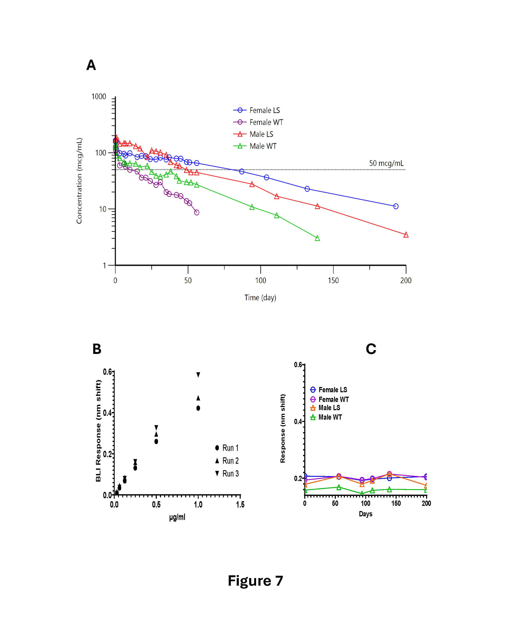
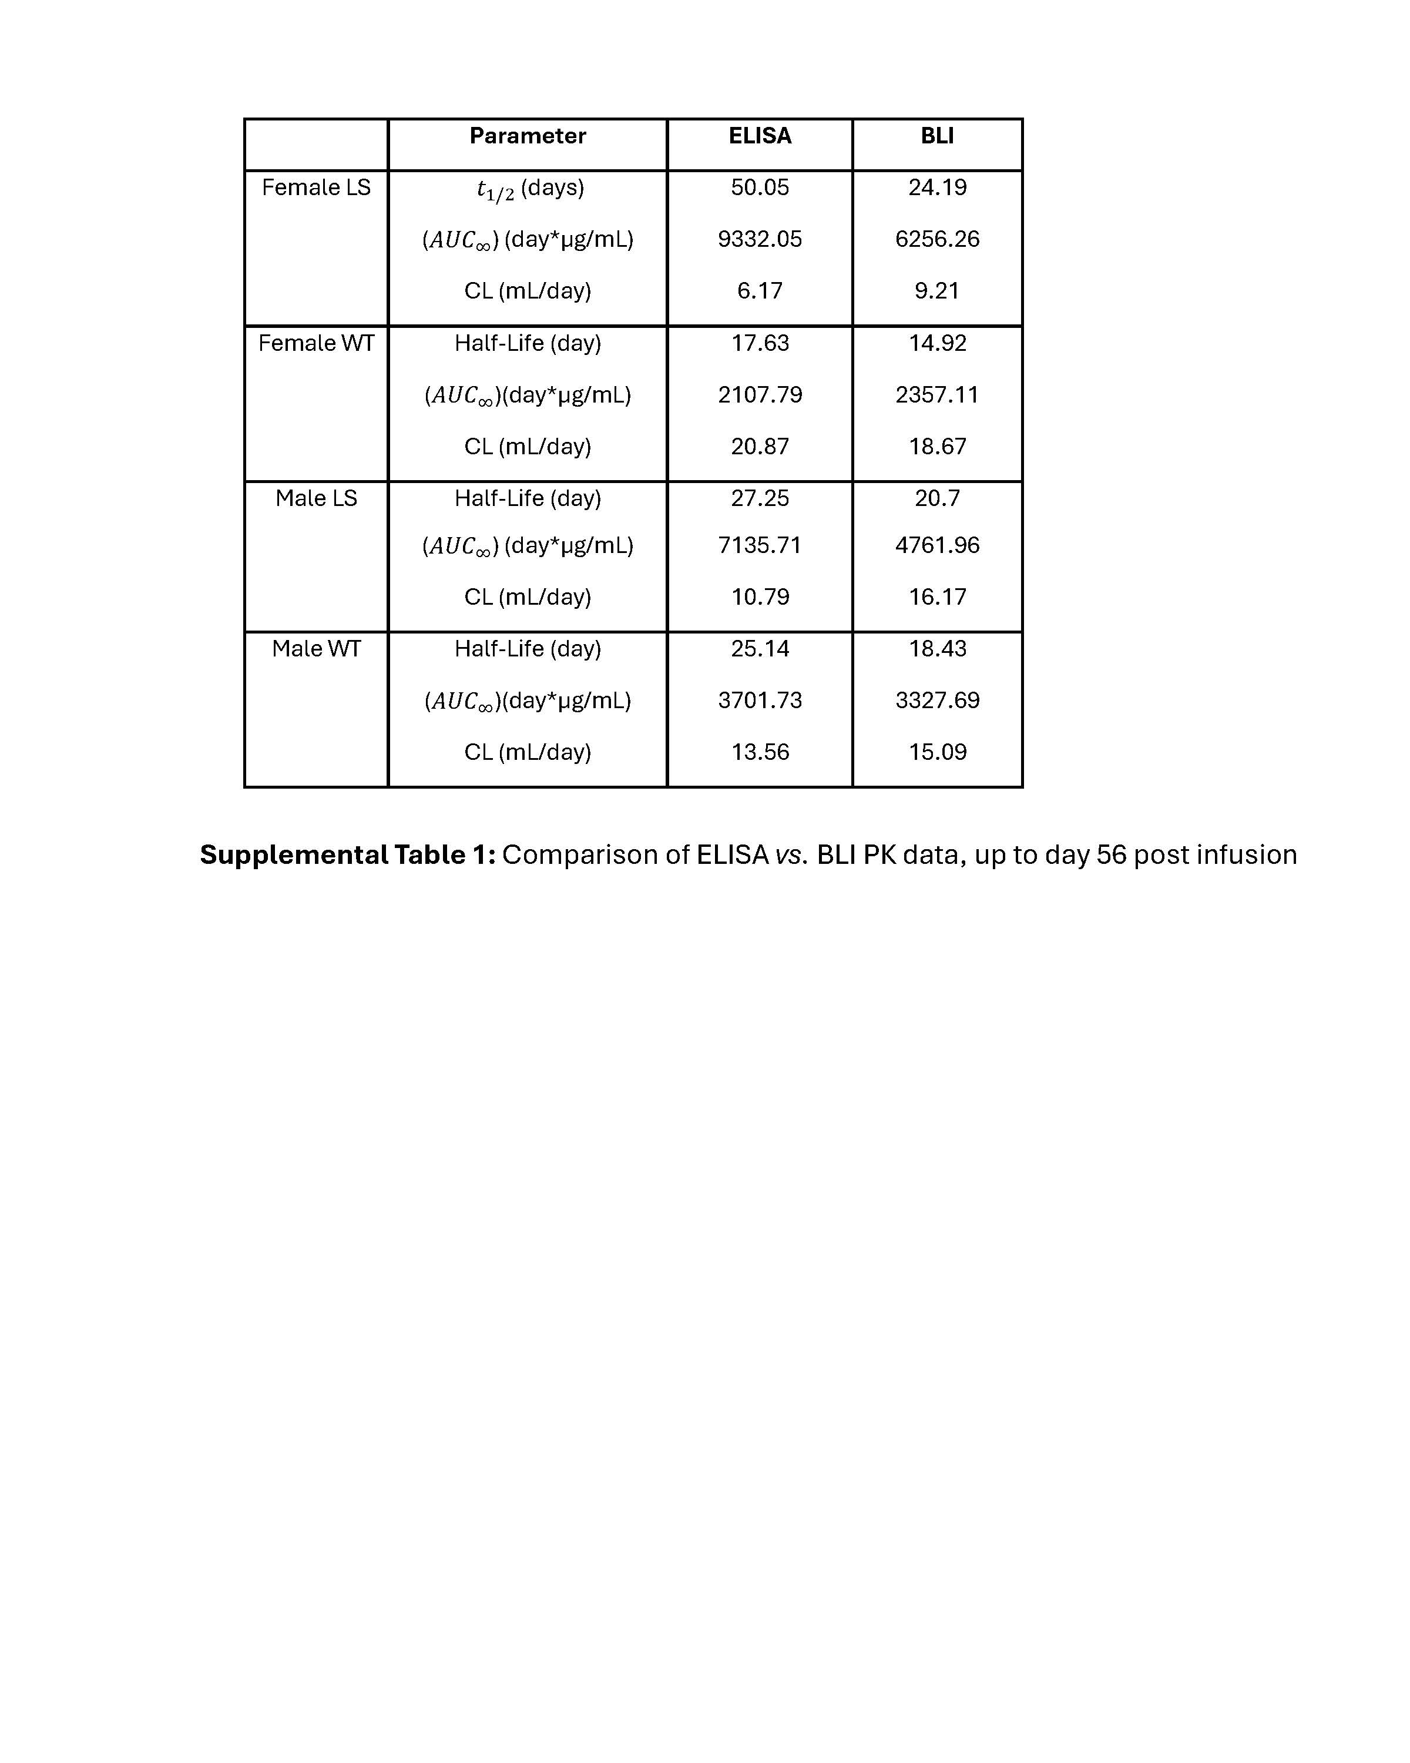
Comparative Pharmacokinetic Assessment of Two Malaria Monoclonal Antibodies
William R. Fugina¹, Dallas R. Brown², Dawn Wolf¹, Renita Brown¹, Jesse P. Deluca³, Geoffrey C. Chin³ and Sheetij Dutta^{2*}
¹ In vivo Services Branch, Center for Enabling Capabilities, Walter Reed Army Institute of Research, Silver Spring, MD 20910
² Structural Vaccinology Laboratory, Biologics Research and Development Branch, Center for Infectious Disease Research, Walter Reed Army Institute of Research, Silver Spring, MD 20910
³ Experimental Therapeutics Branch, Center for Infectious Disease Research, Walter Reed Army Institute of Research, Silver Spring, MD 20901
Abstract
Results
Monoclonal antibodies (mAbs) may serve as a valuable tool for the prevention of malaria in travelers, military personnel, and pregnant women. MAb candidates targeting the Plasmodium falciparum circumsporozoite protein (CSP) have emerged as leading clinical candidates. Pharmacokinetics are important considerations for down-selecting mAbs during hit-to-lead optimization. As part of a programmatic pivot towards developing malaria mAb candidates, a half-life extension (HLE) study was performed at WRAIR using prototype P. falciparum mAb 311. We evaluated a Fc modification HLE strategy where a LS mutation was introduced to mAb 311 Fc to improve the half-life. The resulting mAb 311-LS and its wild-type version (311-WT) were evaluated in the rhesus pharmacokinetics (PK) model. Both MAb 311-LS and 311-WT given to Rhesus at 10 mg/kg intravenously showed no adverse reaction. There was a ~2-fold improvement in pharmacokinetic half-life (T_{1/2}) of 311-LS compared to the wild-type mAb 311. The PK assessment of malaria mAb 311 described here will be critical for translation of future novel anti-malarial mAbs.
ELISA Vs. BLI Assay Comparison
ELISA Pharmacokinetics Graph
Introduction
Despite current countermeasures, Plasmodium falciparum malaria remains a significant global threat, with 30 cases reported among US service members in 2024 (1). While vaccines exist, military personnel lack approved and viable vaccine options for protection against malaria. Monoclonal antibodies (mAbs) targeting the P. falciparum circumsporozoite protein (CSP) offer a promising prophylactic solution, with clinical candidates demonstrating sterilizing protection (2). However, establishing reliable, long lasting mAbs is still a challenge. This includes extending the standard 20-day IgG half-life through Fc-region engineering. The LS mutation in the Fc domain (leucine [L] and serine [S] amino acids) significantly enhances monoclonal antibody binding to the neonatal Fc receptor (FcRn), resulting in reduced degradation and extended half-life. In rhesus studies, CIS43LS showed a 9–13-fold increase in FcRn affinity and doubled the half-life from 22 to 39 days compared to wildtype CIS43 (6). Specifically, utilizing LS mutations increase endosomal FcRn-Fc binding affinity by 2- to 40-fold, which rescues the antibody from degradation within the lysosome enhancing serum half-life (3-6). This study evaluates prototype CSP mAb 311 and compares pharmacokinetics of mAb 311-WT vs 311-LS. These data establish essential preclinical benchmarks for a deployable malaria prophylactic.
ELISA Pharmacokinetics Table
Rhesus monkeys received 10 mg/kg IV infusions of 311-LS or 311-WT, showing no adverse reactions during the 28 weeks of monitoring. Serial blood samples were collected, and both ELISA and BLI assays showed strong correlation in quantifying mAb concentrations for the first 56 days. ELISA indicated higher serum half-life and longer time above the therapeutic threshold (50 µg/mL) than BLI and was thus used to analyze the remaining 150 days. Overall, 311-LS demonstrated higher peak concentration, slower clearance, and greater overall exposure (AUC) compared to 311-WT, with differences more pronounced in females. No anti-drug antibody response was detected up to 200 days post-infusion. Overall, 311-LS exhibited superior pharmacokinetic properties compared to 311-WT.
Conclusion
References:
ELISA and BLI assays showed good concordance for mAb quantification, with ELISA offering higher sensitivity and BLI providing robust, reproducible data. Both 311-LS and 311-WT were well tolerated in rhesus monkeys at 10 mg/kg, with no adverse effects. The study was limited by single-dose, single-route administration, and small group size. Females exhibited greater increases in 311-LS half-life, warranting further study. The LS variant demonstrated a ~10-fold improvement in FcRn binding and ~2-fold increase in half-life and therapeutic time. These findings align with previous reports and support the use of extended half-life mAbs for malaria prophylaxis.
Malaria among members of the U.S. Armed Forces, 2024. Msmr. 2025;32(4):22-8.
Birkett AJ, Ansah E, Gordon S, Gyapong M, Hall S, Kelly SL, et al. Value profile for Malaria vaccines and monoclonal antibodies. Vaccine. 2025:127971.
Brennan FR, Polli JR, Sathish J, Ramones M, Wolf B, Schlothauer T, et al. Impact of antibody Fc engineering on translational pharmacology, and safety: insights from industry case studies. MAbs. 2025;17(1):2505092.
Dall'Acqua WF, Kiener PA, Wu H. Properties of human IgG1s engineered for enhanced binding to the neonatal Fc receptor (FcRn). J Biol Chem. 2006;281(33):23514-24.
Borrok MJ, Wu Y, Beyaz N, Yu XQ, Oganesyan V, Dall'Acqua WF, et al. pH-dependent binding engineering reveals an FcRn affinity threshold that governs IgG recycling. J Biol Chem. 2015;290(7):4282-90.
Kisalu, N.K., et al., Enhancing durability of CIS43 monoclonal antibody by Fc mutation or AAV delivery of malaria prevention. JCI insight, 6(3).
Methods
Four rhesus monkeys received intravenous mAb 311-LS or 311-WT infusions under sedation. Safety was monitored via vital signs and injection site checks, with blood collected at multiple timepoints up to 28 weeks. mAb concentrations were quantified by ELISA and Bio-layer Interferometry (BLI) and pharmacokinetic parameters were analyzed. BLI was also used for anti-drug antibody detection.
Acknowledgments: We thank Congressionally Directed Medical Programs for funding this work under the project PR211833.
The experiments reported herein were conducted in compliance with the Animal Welfare Act and per the principles set forth in the “Guide for Care and Use of Laboratory Animals,” Institute of Laboratory Animals Resources, National Research Council, National Academy Press 2011

