Slide 1

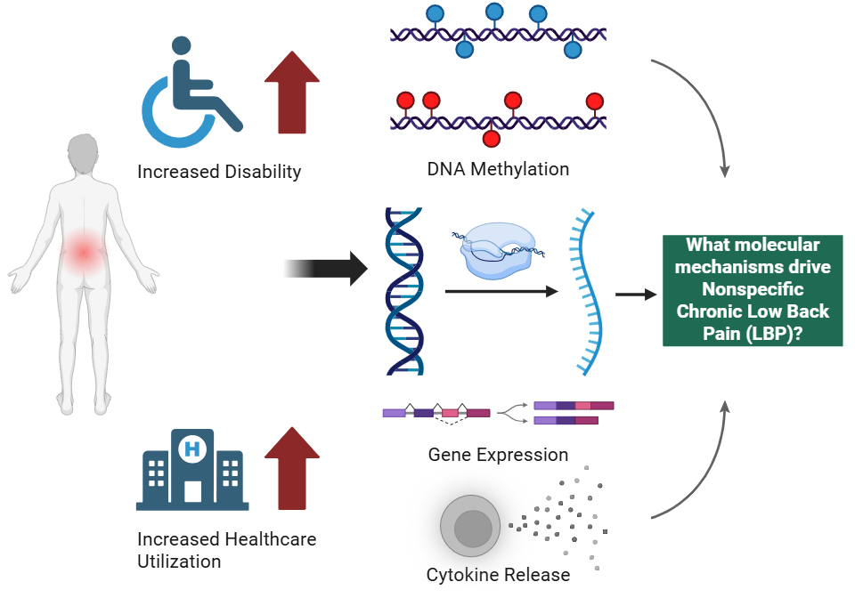
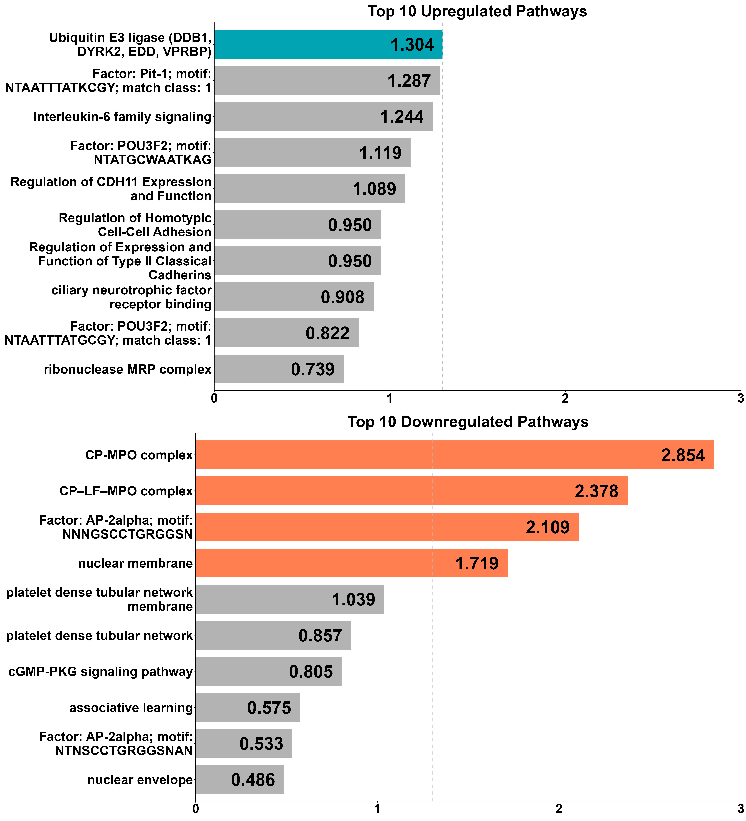
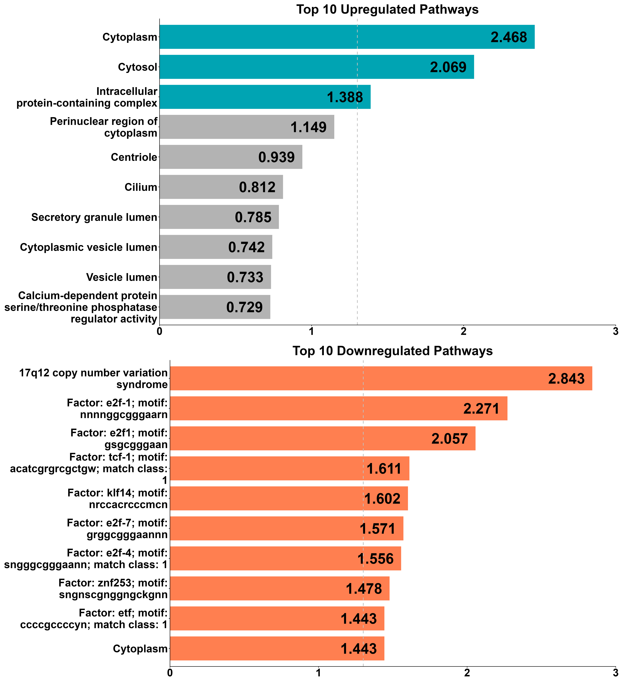
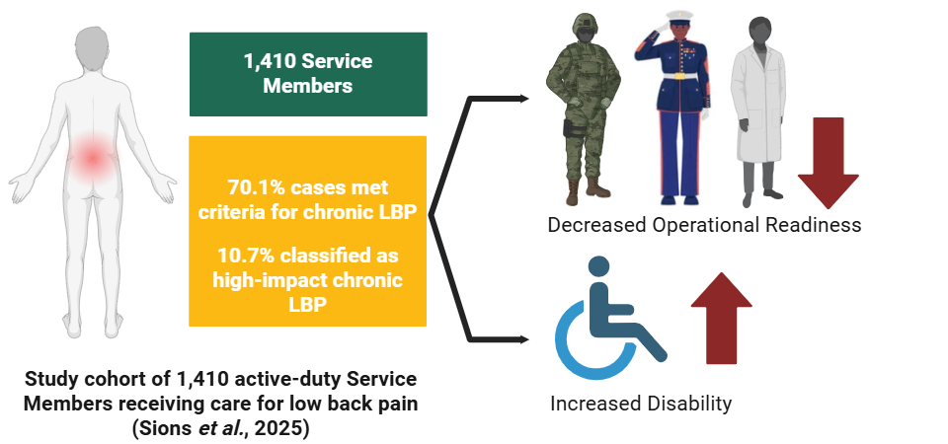



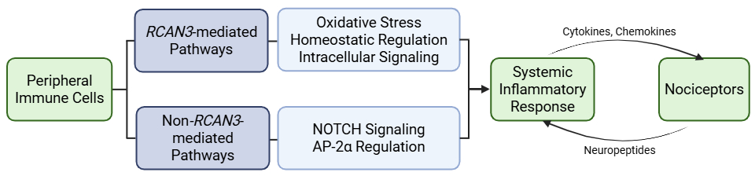








Insert
QR code here
Peripheral Blood Multi-omic Signatures of Nonspecific Chronic Low Back Pain: Biomarker Implications for Military Readiness
Khalid W. Freij, PhD, Edwin N. Aroke, PhD, CRNA
KEY TAKEAWAY: Chronic low back pain remains difficult to treat because its underlying biology is incompletely understood. Multi-omic profiling in a civilian population identified convergent alterations pathways related to cellular stress response, transcriptional regulation, and homeostatic maintenance, providing new insight into biological mechanisms that may contribute to persistent pain.
Chronic Low Back Pain
Results
Differential Methylation
Differential Expression
Military Relevance
Objective
To characterize epigenetic and transcriptomic alterations associated with CLBP and identify biological pathways implicated through multi-omics integration.
Oxidative stress, NOTCH signaling, and AP-2α-associated regulatory pathways were enriched in CLBP.
E2F-regulated transcriptional programs and intracellular signaling pathways were altered in CLBP.
Methods
Independent epigenomic and transcriptomic analyses converged on stress-response, regulatory, and homeostatic pathways, with RCAN3 emerging as a shared molecular signal in CLBP.
Integration
Khalid Freij, PhD
Bioinformatician
Gene Expression
RNA-Seq (N=132)
DNA Methylation
MethylEPIC (N=132)
Differential Expression
Differential Methylation
kfreij95@uab.edu
346 DEGs
69 DMRs
Funding
Integration & Pathway Enrichment
Overview of methylome-transcriptome integration analysis

