Slide 1


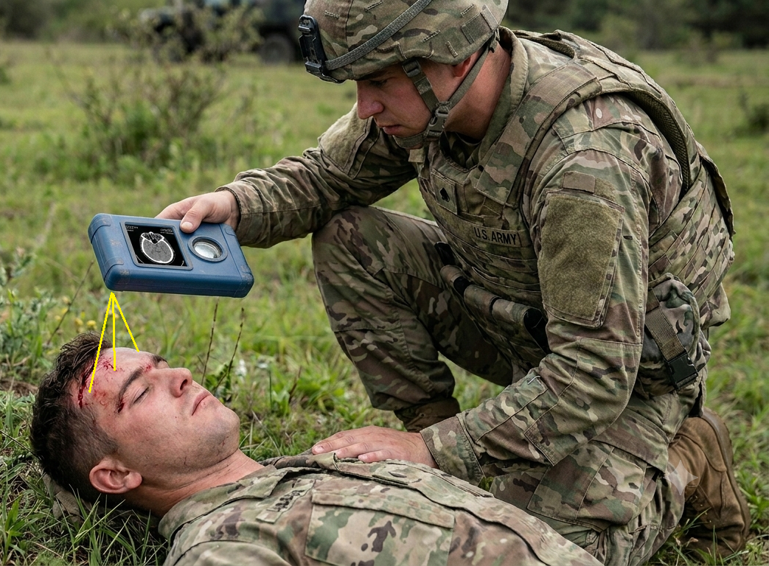
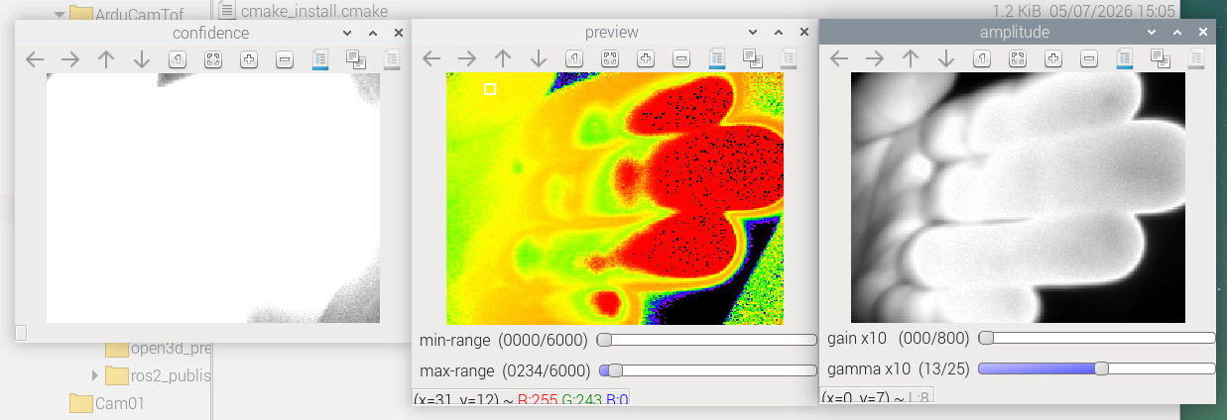
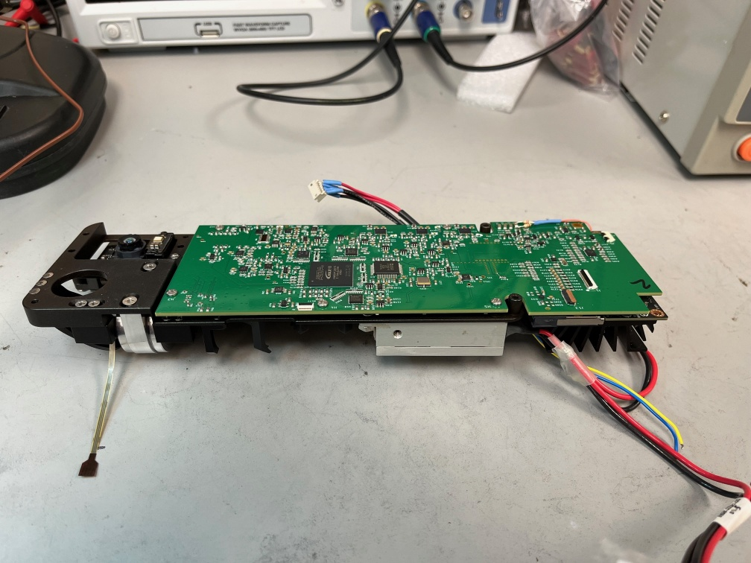
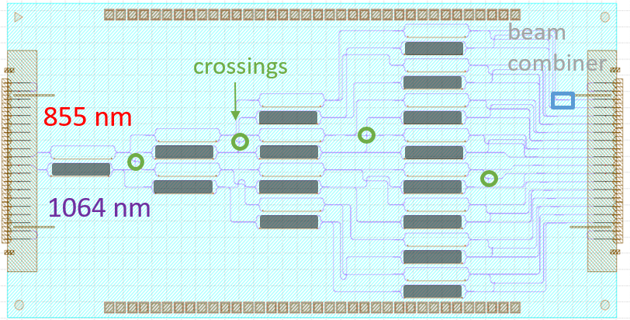
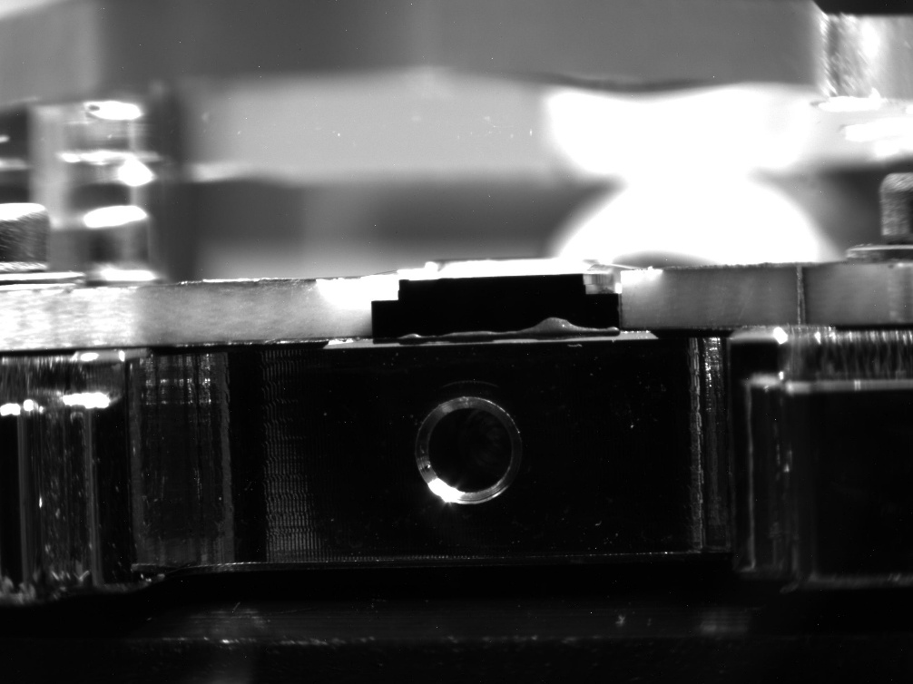
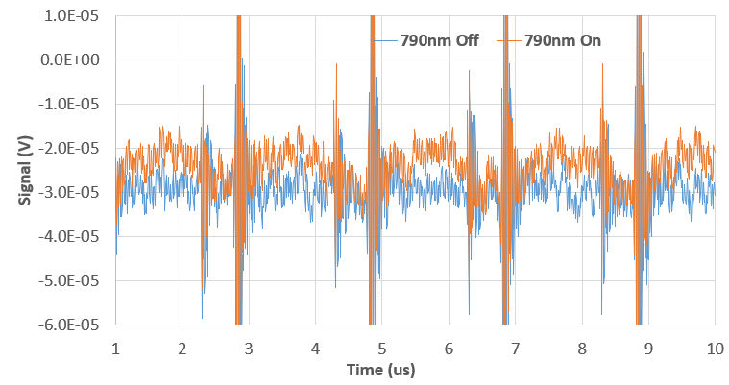
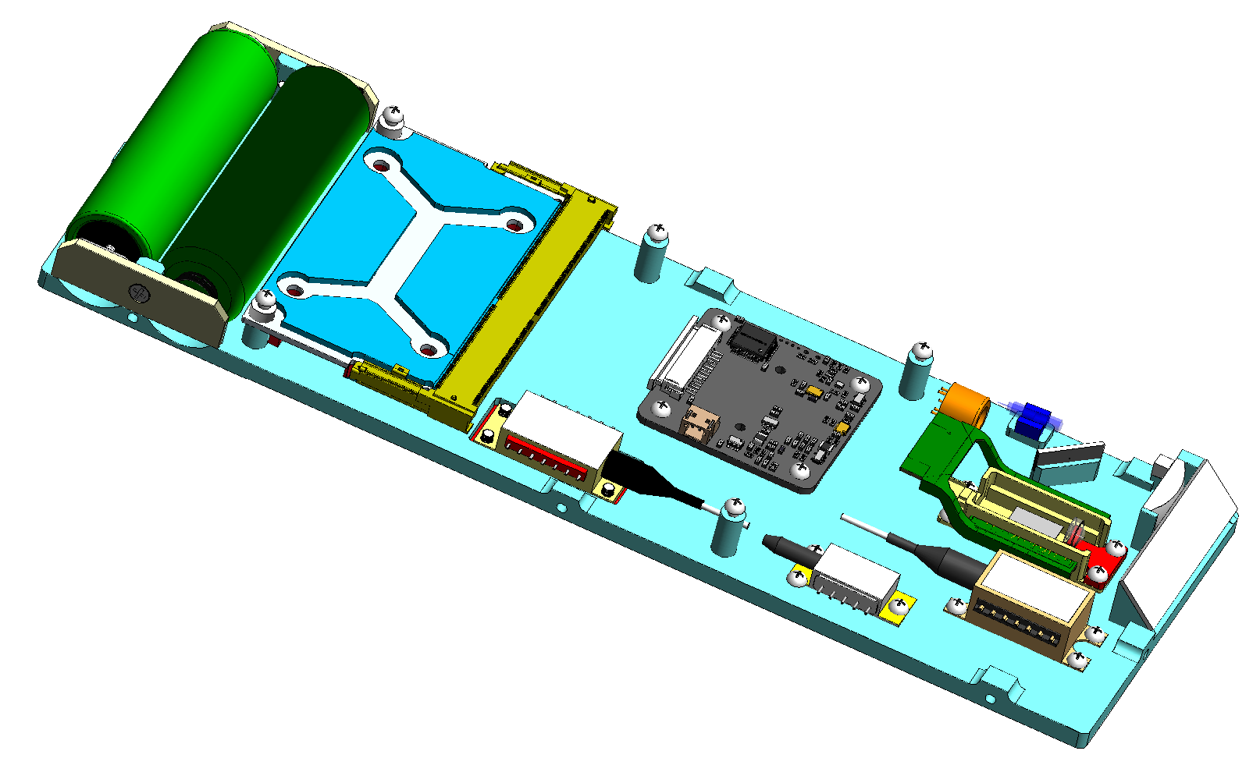
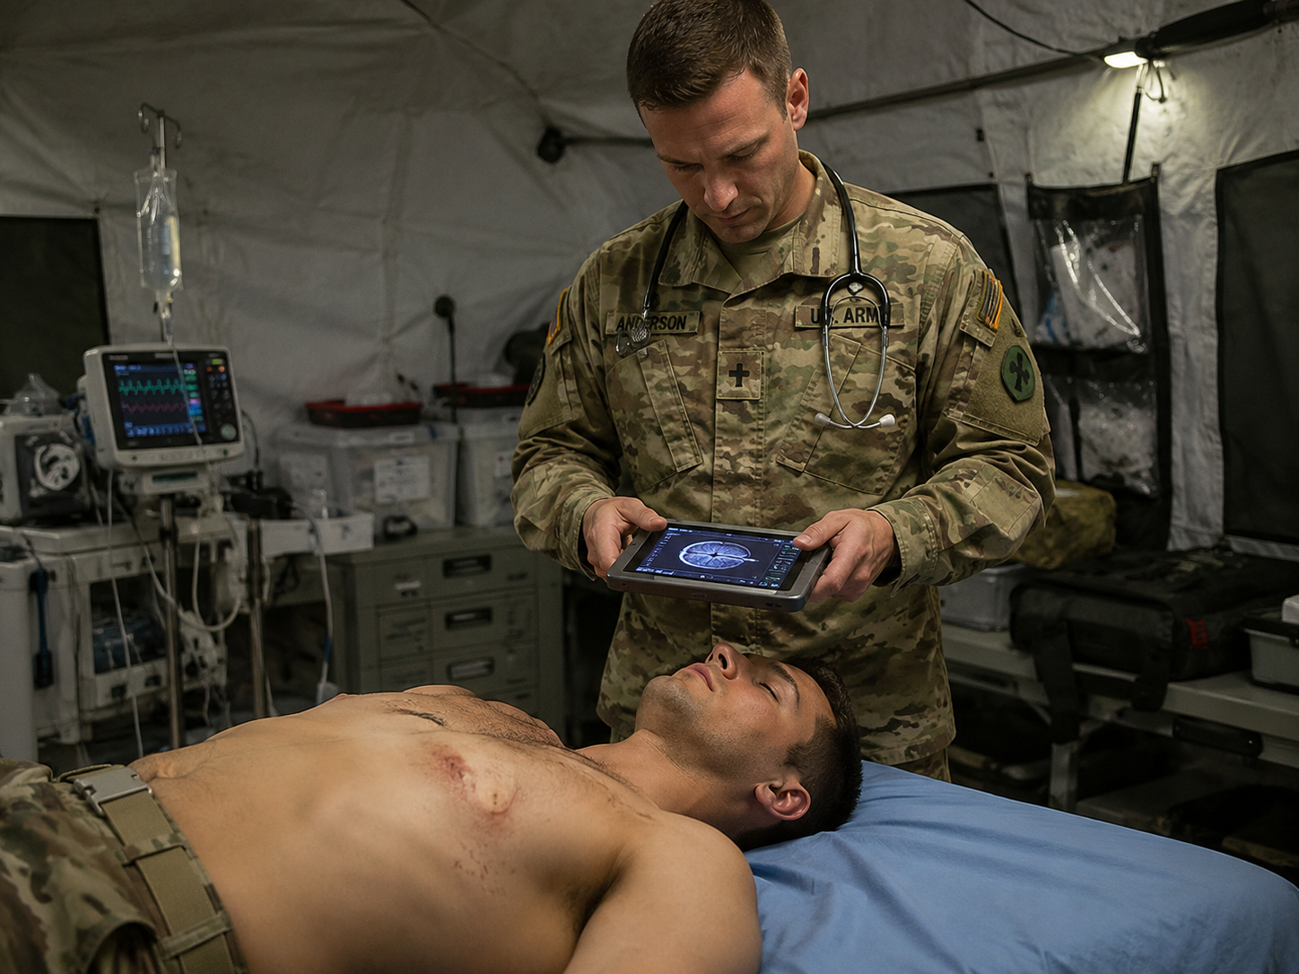
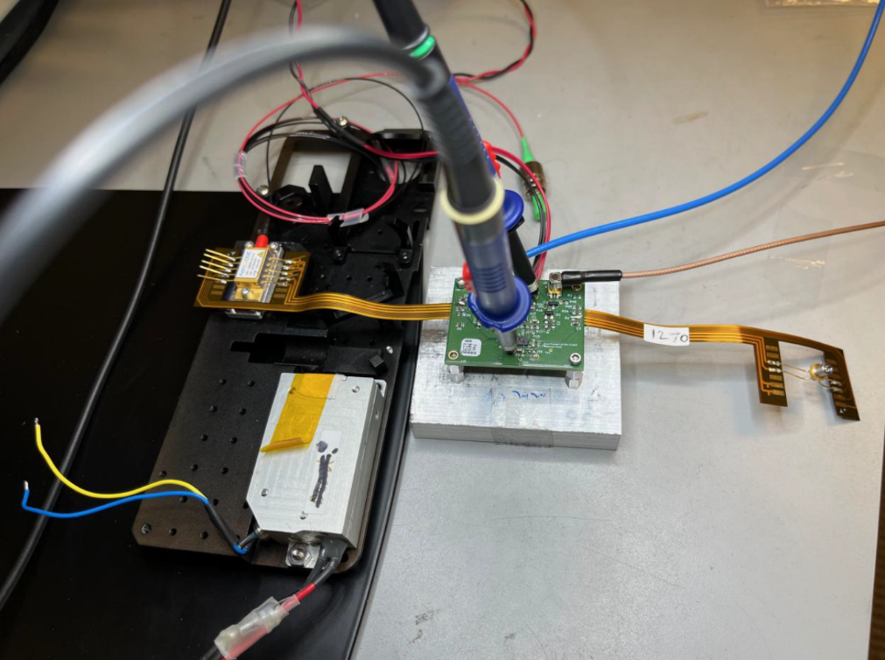
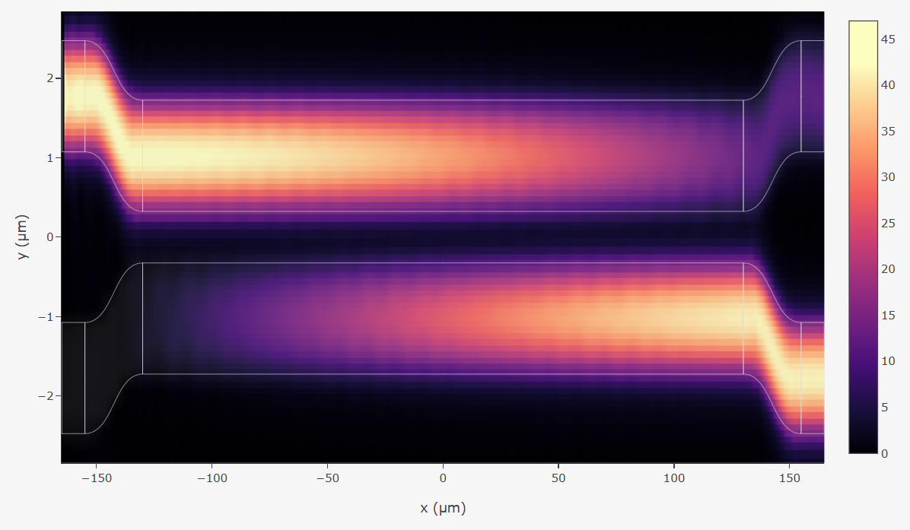
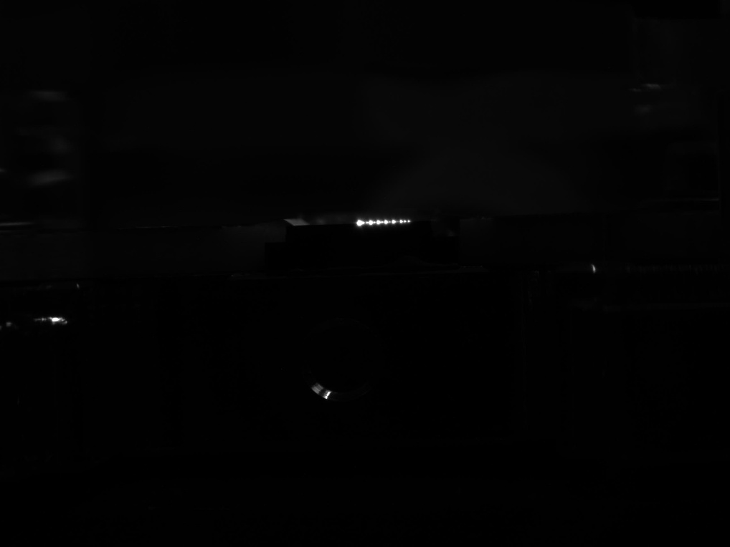
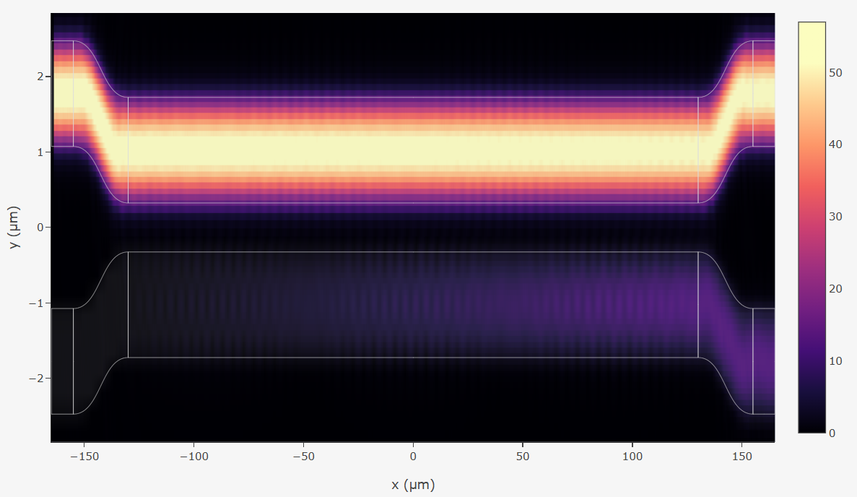
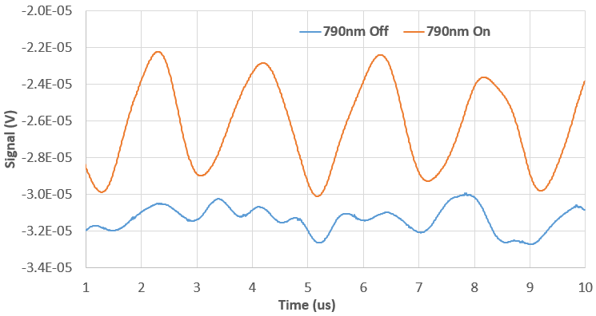
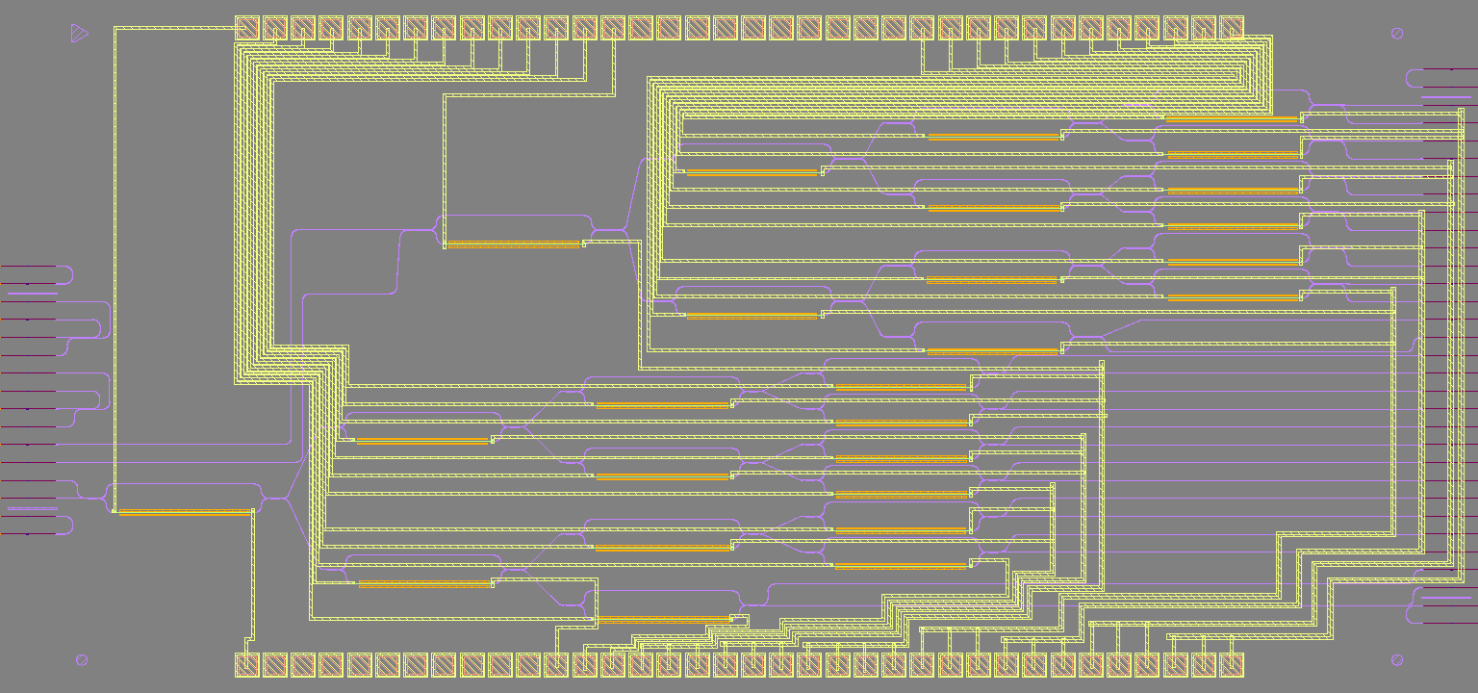

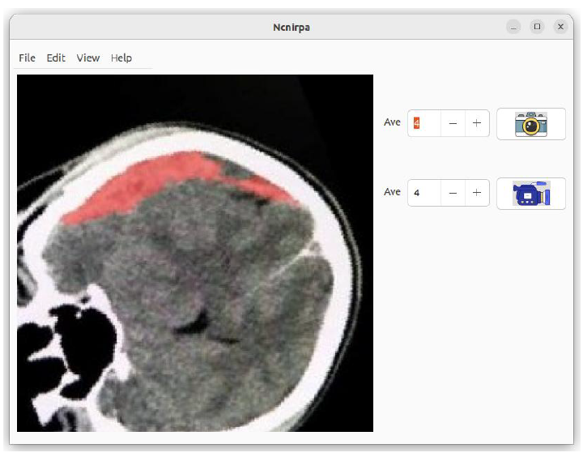
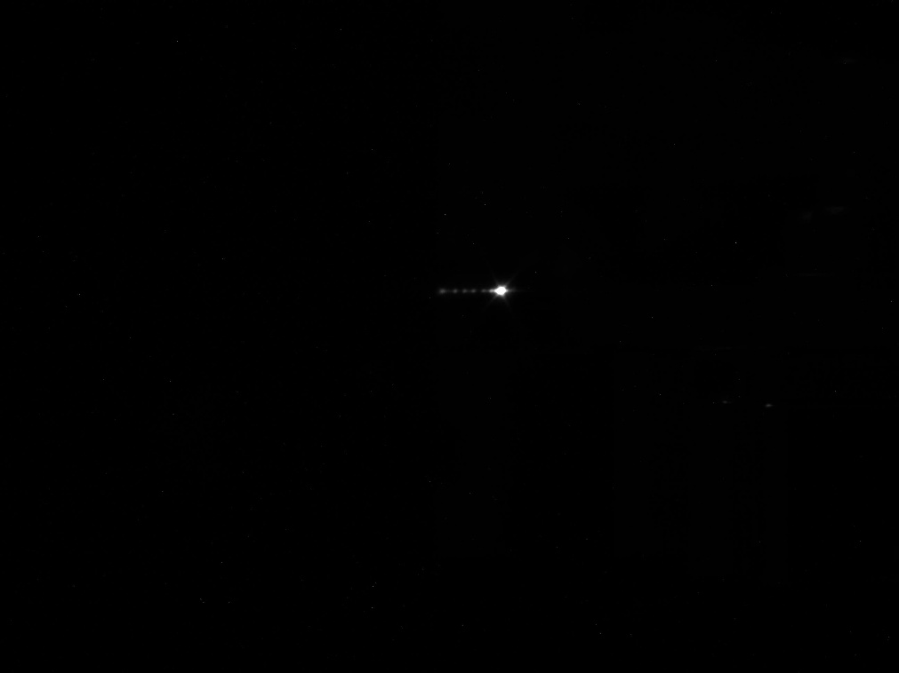
Non-contact near-infrared imaging to reveal internal trauma
ChenChia Wang¹, Feng Jin¹, Sudhir Trivedi¹, Mark Goncharovsky¹, Deepak Patel¹, Hayden Diener¹, Gary P. Zientara², Jacob B. Khurgin³, Xue Bai⁴, Benjamin Punshon-Smith⁴, and Fow-Sen Choa⁴
¹Brimrose Corp., Baltimore, MD 21152 ²US Army Research Institute of Environmental Medicine, Natick, MA 01760
³Dept. of Electrical and Computer Engineering, The Johns Hopkins University, Baltimore, MD 21218 ⁴University of Maryland, Baltimore County, Baltimore, MD 21250
DHA SBIR Phase II Program #HT9425-24-C-0071
Introduction
Method
Excessive hemoglobin suggests hematoma.
Twin-color light (790/915 nm) interrogates Hb and HbO₂ via All-Optical Photoacoustic (PA) imaging
Speckle-tolerant Laser sensing (1064 nm) of PA pressure waves
Autonomous Laser Scanning forms hematoma map with onboard GPU
Handheld by Combat Medic for Role 1 care
Manual placement over ROI, Autonomous Laser Line Scan over field of view
Electronic controlled laser beam projection over ROI via Photonic IC (PIC), NO moving parts
Time-of-Flight (ToF) camera for standoff distance measurement, aiding hematoma image registration and map forming
Optical Speckle-tolerant Laser sensing of PA signals
Onboard GPU for image processing, forming, and reconstruction and characterization of hematoma map
Photonic IC for device compactness
Results
Development, validation of hardware components,
Photonics IC design, simulation, validation, and characterizations
Human hemoglobin signatures at 790/915 nm
3D Rendering of Prototype
Role 2 and Role 3 Applications
Laser ON
filtering
Laser OFF
Conclusion
Operational Efficiency : non-contact handheld for Role 1 care
Autonomous laser interrogation with minimal manual intervention
Aids rapid POC assessments on invisible hematoma/internal injuries
Wireless communications enable Role 2/3 studies
Light beam switching/routing by PIC
Graphic User Interface
This project is supported by DHA SBIR Phase II Program under the guidance of Dr. Gary P. Zientara of US Army Research Institute of Environmental Medicine

