Slide 1


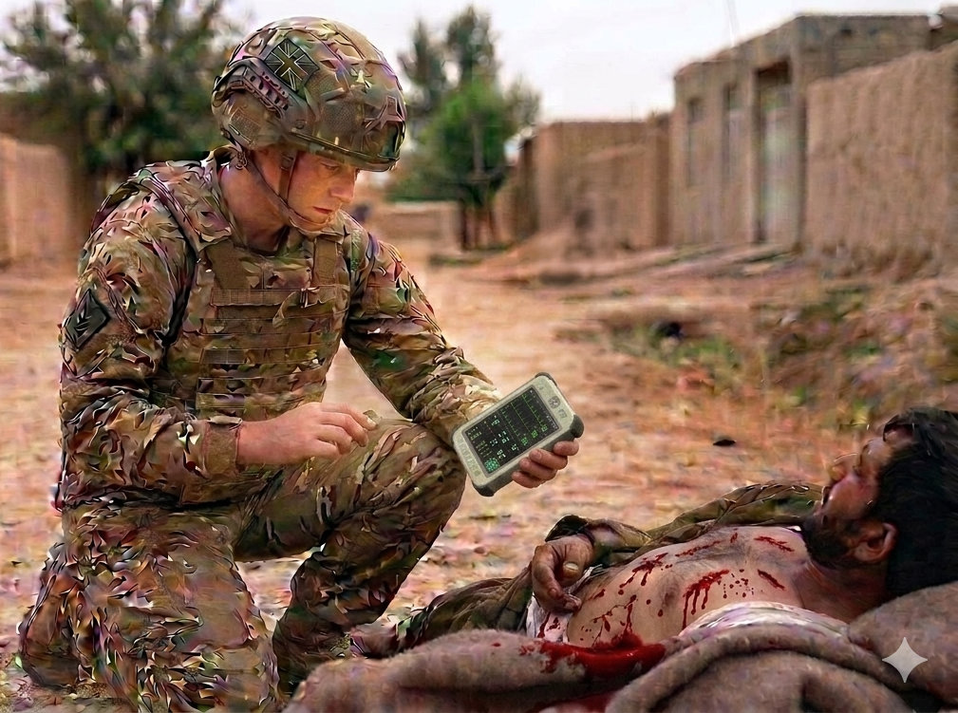
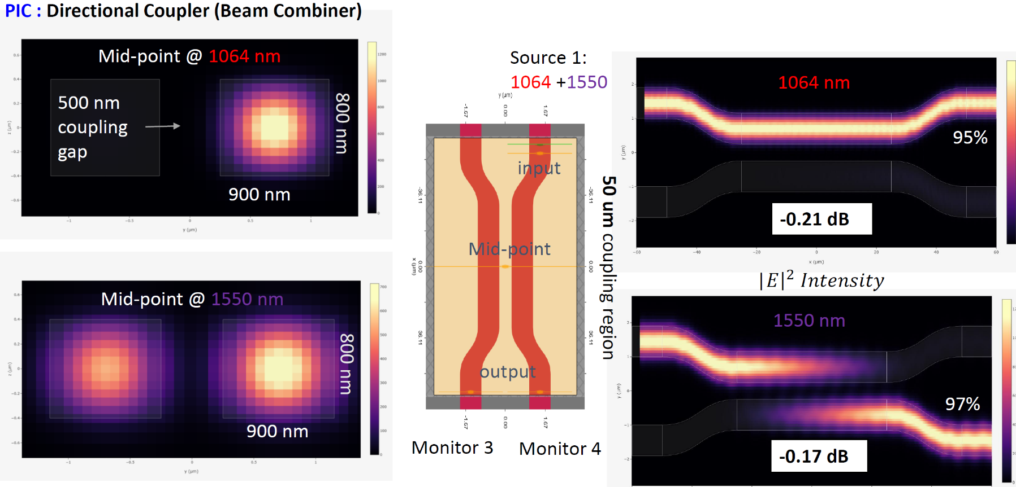

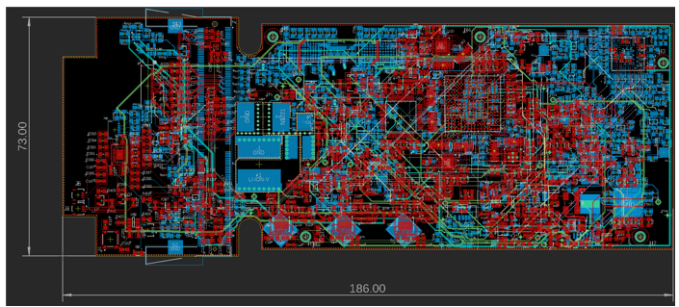
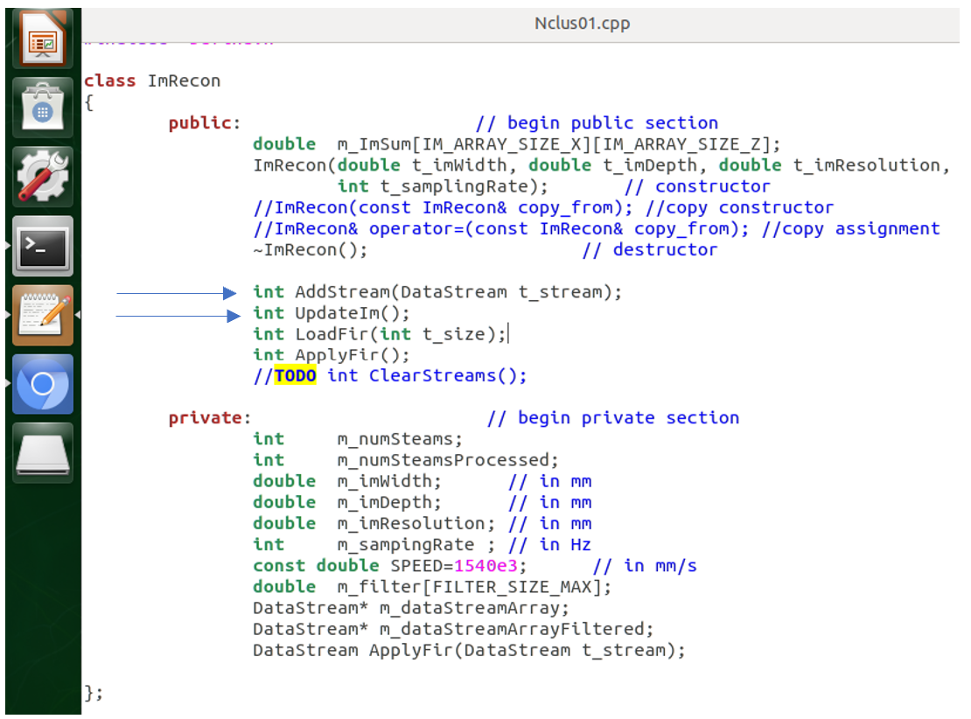
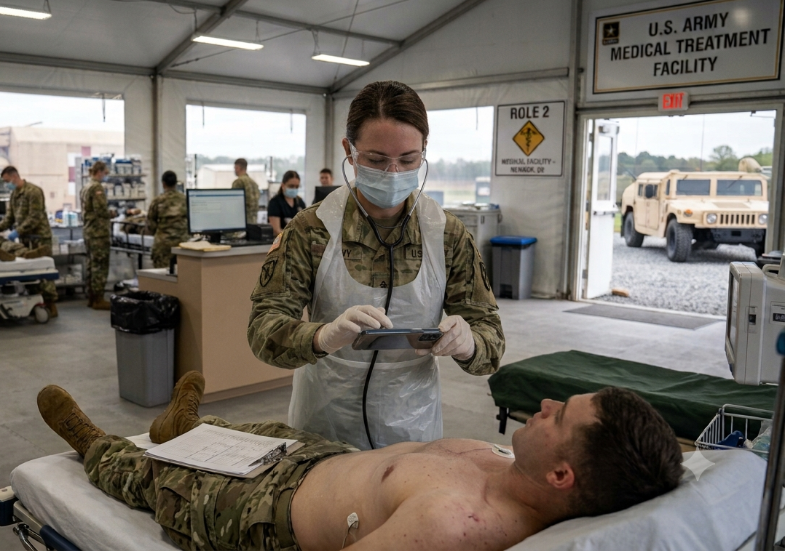

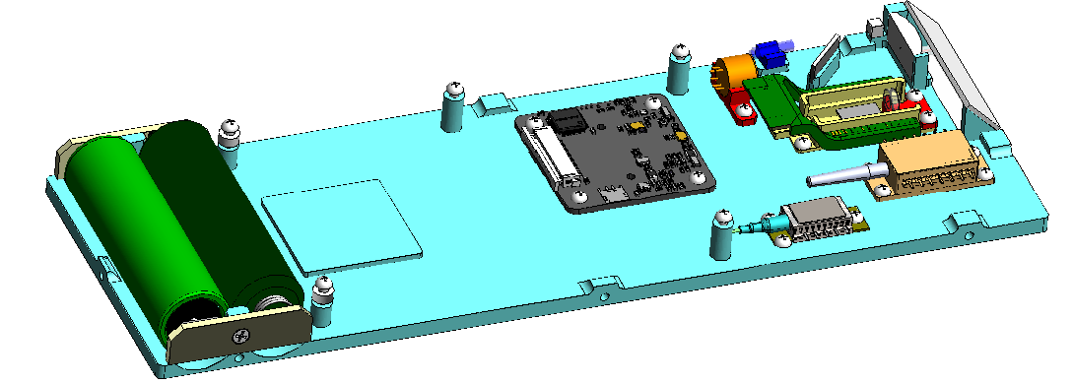
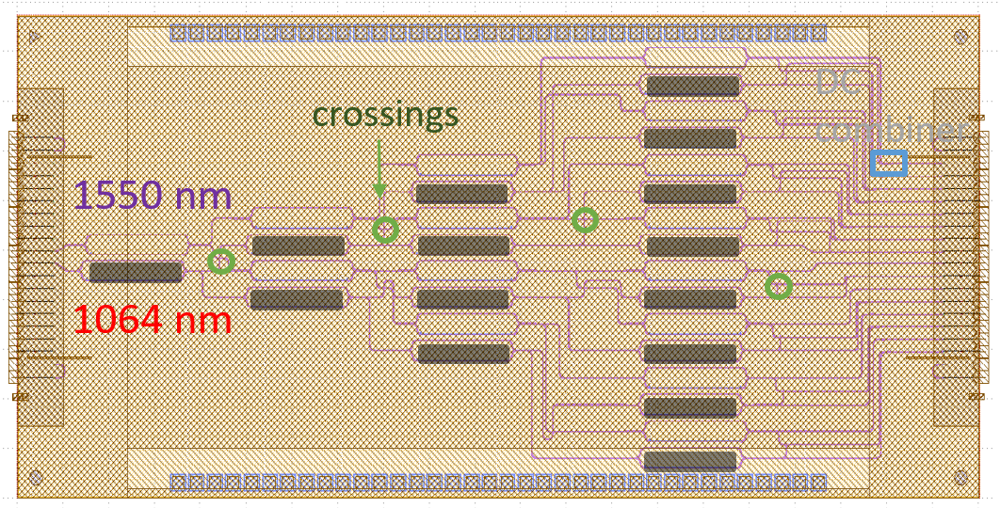
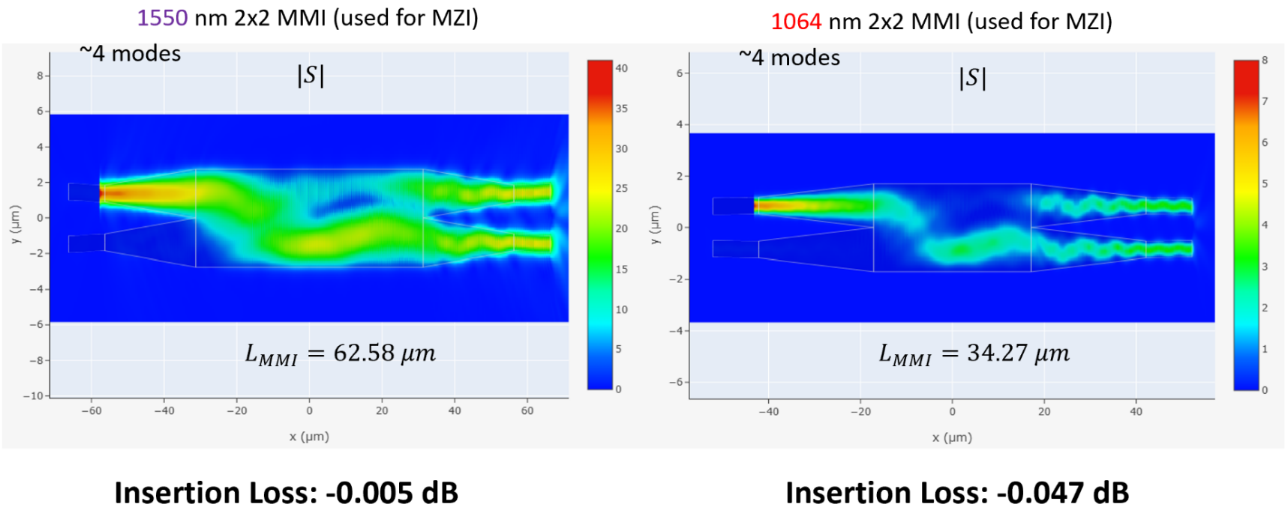
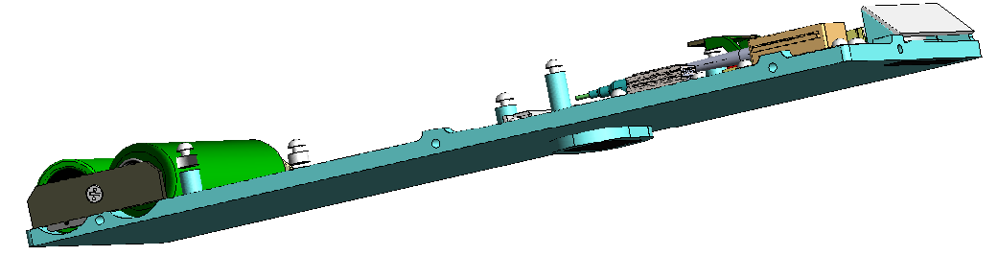
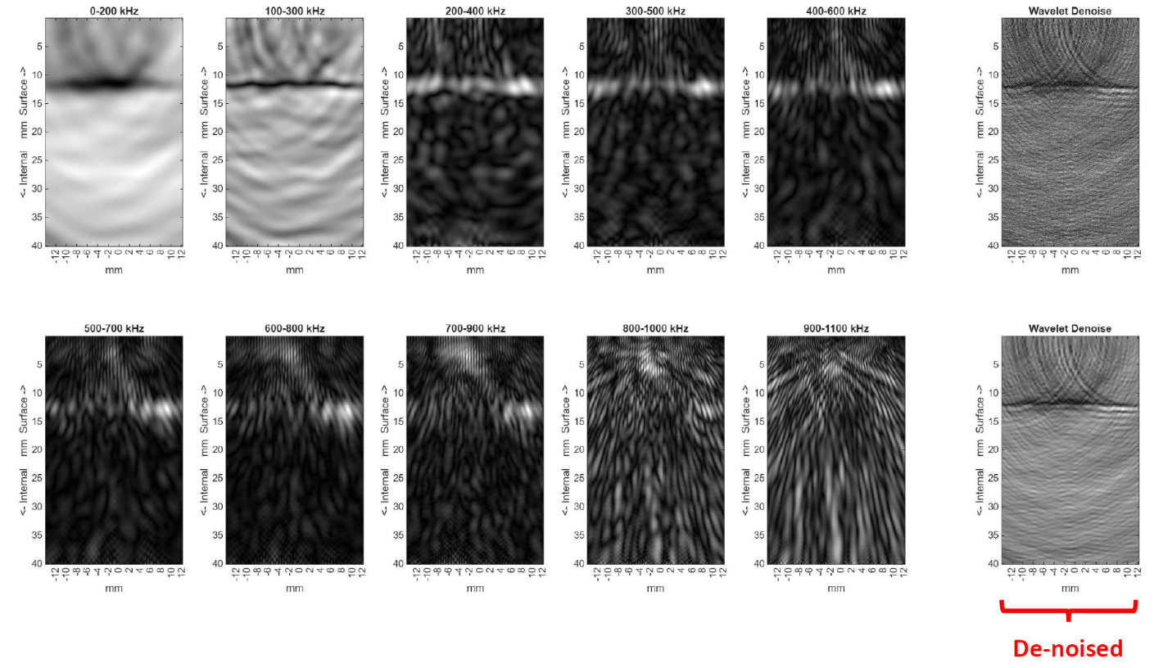
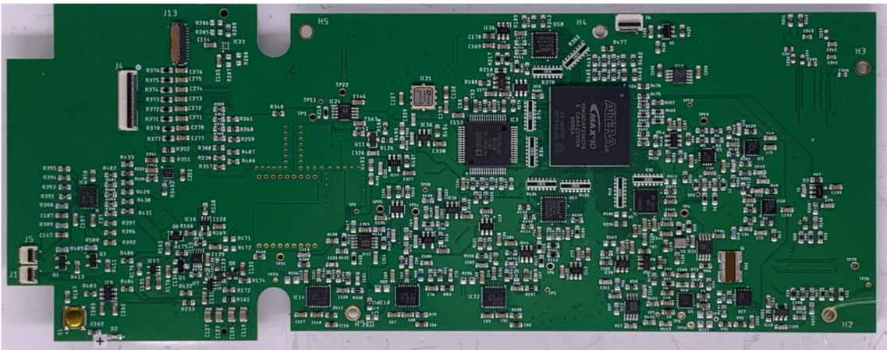
Handheld non-contact laser ultrasound design and implementation
ChenChia Wang¹, Feng Jin¹, Sudhir Trivedi¹, Mark Goncharovsky¹, Deepak Patel¹, Hayden Diener¹, Gary P. Zientara², Jacob B. Khurgin³, Xue Bai⁴, Benjamin Punshon-Smith⁴, and Fow-Sen Choa⁴
¹Brimrose Corp., Baltimore, MD 21152 ²US Army Research Institute of Environmental Medicine, Natick, MA 01760
³Dept. of Electrical and Computer Engineering, The Johns Hopkins University, Baltimore, MD 21218 ⁴University of Maryland, Baltimore County, Baltimore, MD 21250
DHA SBIR Sequential Phase II Program #HT942525CE016
Introduction
Method
NonContact Ultrasound (US) Imaging provides operational efficiency, ease of transport, acoustic gel free, and operator skill level independent
Autonomous scanning aids triage efficiency
Applies for injured Warfighters with open wounds and/or CBRN contaminations
Device miniaturization by Photonic IC deployment. NO moving parts
Handheld by Combat Medic for Role 1 care
Autonomous image scanning, no manual intervention
Photoacoustic (PA) pressure wave generation and Laser signal detection, all-optical, non contact PAI
Visible/ToF cameras for image registration and body contour calibration
Autonomous laser beam scanning over ROI via Photonic IC: NO moving parts
Optical Speckle-tolerant Laser retrieval of PA signatures
Deep learning for US image de-noising
Onboard GPU US image processing, reconstruction
Photonic IC for device compactness
Results
Development of US image reconstruction algorithms
3D Rendering of Prototype
PIC layout design and simulations
Electronic controlled light beam routing and pointing
Role 2 and Role 3 Applications
De-noise algorithm improves US image quality
Conclusion
Development, bui;ld, and validation of tailored electronics
Operational Applicability : Handheld for Role 1, 2 care,
Wireless communications for waveform sharing and off-line studies
Autonomous operations minimizes human intervention
Alleviates operator skill level requirements
This project is supported by DHA SBIR Sequential Phase II Program under the guidance of Dr. Gary P. Zientara of US Army Research Institute of Environmental Medicine

