Slide 1

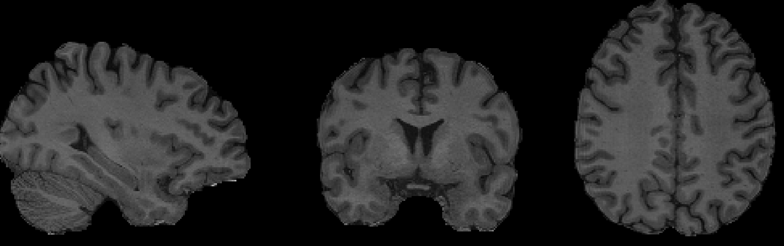
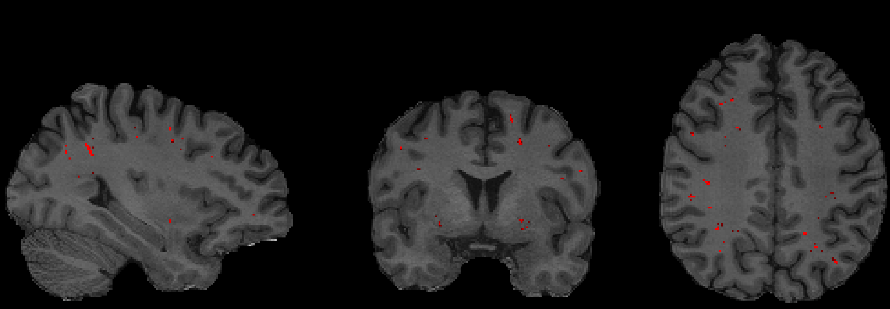
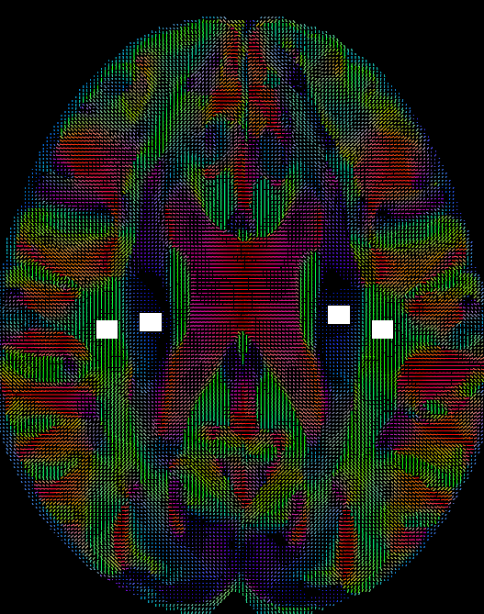
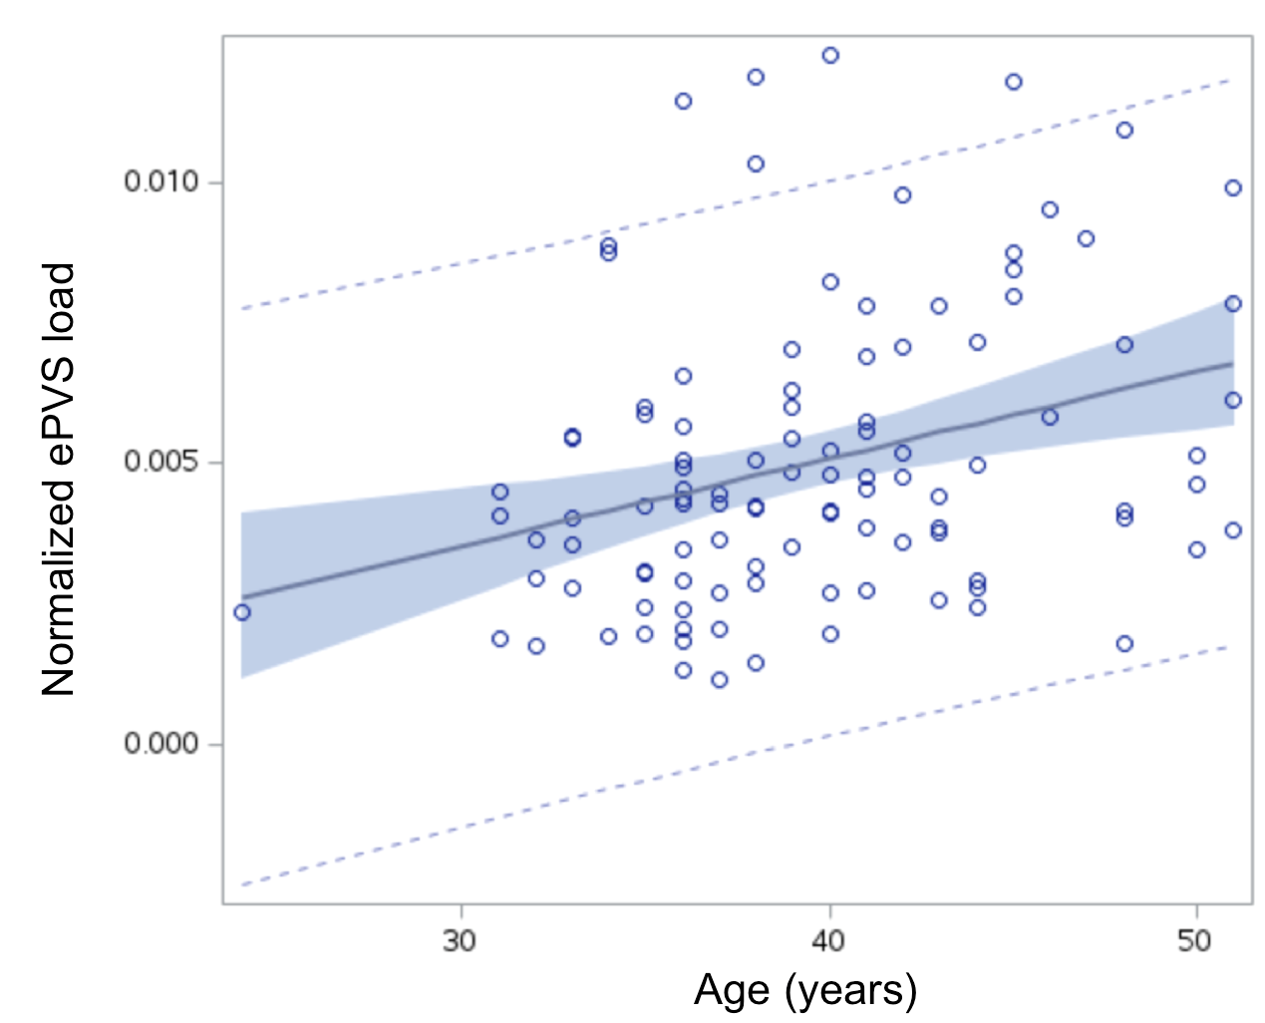
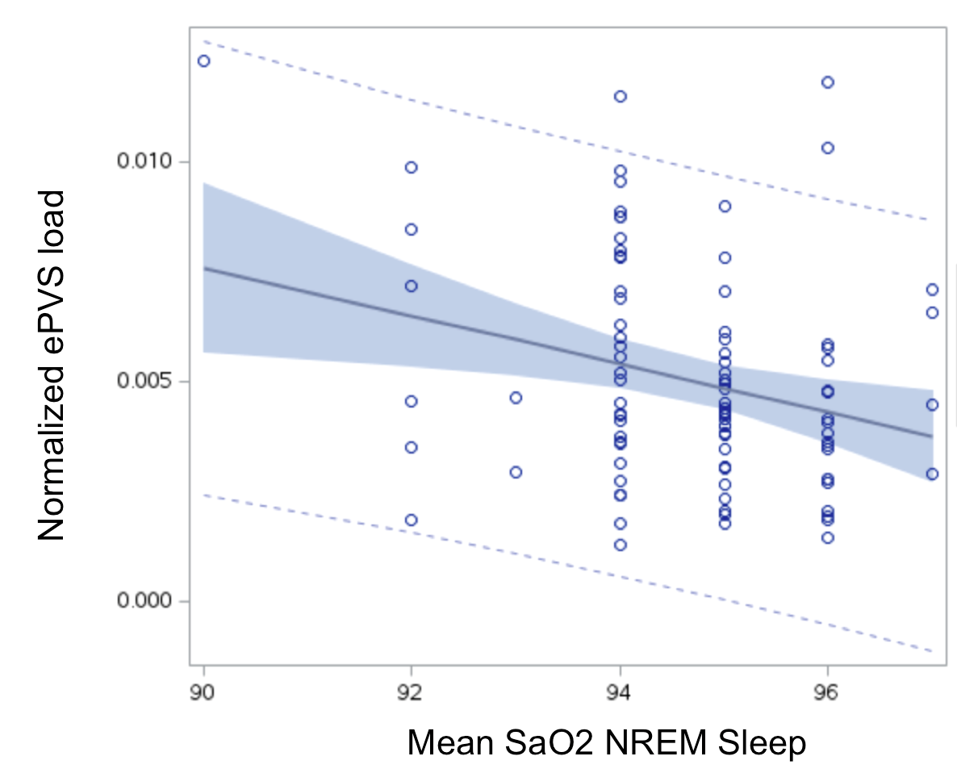
MRI-visible perivascular spaces associated with objective sleep measures in military service members with chronic mild traumatic brain injury
Ping-Hong Yeh¹, J. Kent Werner, Jr² , Chihwa Song¹, Wei Liu¹, Rujirutana Srikanchana¹, John Ollinger¹
BACKGROUND
Sleep is essential for metabolic waste clearance via the glymphatic system, and enlarged perivascular spaces (ePVS) on MRI may reflect impaired clearance.
Sleep–wake disturbances, among the most prevalent and persistent sequelae of traumatic brain injury (TBI), affect 50–80% of individuals with mild traumatic brain injury (mTBI) ¹.
Perivascular spaces (PVS) are fluid-filled spaces around cerebral arterioles in the brain parenchyma. They play an important role in the exchange and drainage of interstitial fluid through mechanisms such as the intramural periarterial drainage pathway and the glymphatic system.
Enlarged perivascular spaces (ePVS) could represent a marker for reduced clearance of the glymphatic system ².
DTI analysis along the perivascular space (DTI-ALPS) analysis, evaluating the movement of water molecules in the space around blood vessels by measuring the diffusion coefficient, has been shown to be associated with objective sleep measures ³.
Hypothesis: Brain macro- and micro-structural changes are associated with objective sleep measures.
Aim: To promote identification of objective imaging markers for sleep disorders after TBI by investigating the association between brain structural changes and sleep measures in service members (SMs) after TBI.
¹National Intrepid Center of Excellence, Walter Reed National Military Medical Center, Bethesda, MD, ²Uniformed Services University of the Health Sciences, Bethesda, MD
RESULTS
Fig. 1. Examples of T1w and segmented MRI visible PVS
Variable | Mean ± Std
Age (years old) | 39.65 ± 5.3
Time since injury (years) | 19.14 ± 9.53
PSQI total score | 11.53 ± 3.53
Sleep REM (%) | 17.29 ± 6.00
Sleep Latency (%) | 13.61 ± 24.62
Slow wave Sleep (%) | 15.87 ± 9.52
‍N1 (%) | 7.63 ± 5.50
N2 (%) | 59.21 ± 9.19
Mean SaO2 NREM (%) | 94.68 ± 1.24
Nadir SaO2 REM | 90.52 ± 4.08
Fig. 2. ROIs for calculating DTI ALPS index
METHOD
Participants were drawn from a cohort at the National Intrepid Center of Excellence. Lifetime TBI history was obtained using a modified Ohio State University TBI Identification instrument ⁴. Clinical diagnose of mTBI was as previously described ⁵. We included 106 active service members (SMs) (103/4 M/F; age 39.7 ± 5.4 years; time since injury 19.1 ± 9.5 years).
ePVS ⁶ were segmented on T1w mages by applying deep learning algorithms with a convolutional auto-encoder and a U-shaped neural network for the 3-dimensional segmentation of lesions. The DTI-ALPS index was calculated from diffusion and non-diffusion–weighted images (b=1000 s/mm²), where higher values indicate better glymphatic function. DTI–ALPS index = mean (Dxproj, Dxassoc) / mean (Dyproj, Dzassoc), where Dxproj, Dxassoc, Dyproj, Dzassoc are for x, y, z axis diffusivity in projection fiber and association fiber on the bilateral hemispheres.
Polysomnography (PSG) data was acquired during their overnight sleep. Calculated polysomnographic indices included the apnea-hypopnea index (AHI; the number of apnea and hypopnea events per hour of sleep), arousal index (the number of arousals per hour of sleep), and periodic limb movement (PLM) in sleep index (the number of periodic limb movement events per hour of sleep).
General linear mixed modeling was applied to evaluate the difference of macro- and micro-structural metrics and and fixed effect of group difference between controls and mTBI subjects by modeling age as a covariate.
Partial Pearson correlation was used to assess association between neuroimaging measures, self-report symptomatic scores, PSG data in TBI participants by using age as a covariate. Significance was set at p <= 0.005 to correct for multiple comparisons.
Table 1. Summary statistics of demographics and PSG data of mTBI participants.
Fig. 3. ePVS load was positively correlated with age (p=0.0009, r=0.32, Adj R2=0.092)
Fig 4. The whole brain ePVS load was inversely associated with the mean oxygen saturation (SaO2) during NREM sleep (p=0.008, r=-0.27, Adj R2=0.063) in mTBI participants.
There is no significant correlation between DTI-ALPS index and any PSG measure.
DISCUSSION / CONCLUSIONS
The findings of association of higher burden ePVS and objective PSG measures in mTBI suggest neuroimaging measures can be beneficial in predicting the sleep disorders in mTBI after a remote brain injury and their long-term outcomes caused by heterogeneous injury mechanisms.
References
Duclos C, Dumont M, Wiseman-Hakes C, Arbour C, Mongrain V, Gaudreault PO, Khoury S, Lavigne G, Desautels A, Gosselin N. Sleep and wake disturbances following traumatic brain injury. Pathol Biol (Paris). 2014 Oct;62(5):252-61.
Eugene AR, Jolanta Masiak. The Neuroprotective Aspects of Sleep. MEDtube Sci. 2015.
Tiing Yee Siow et.al. Association of Sleep, Neuropsychological Performance, and Gray Matter Volume With Glymphatic Function in Community-Dwelling Older Adults. Neurology 2022;98:e829-e838.
Walker WC, Carne W, Franke LM, et al. The Chronic Effects of Neurotrauma Consortium (CENC) multi-centre observational study: Description of study and characteristics of early participants. Brain Inj. 2016;30(12):1469-1480.
Kay T, Harrington DE, Adams R, et al. Definition of mild traumatic brain injury. J Head Trauma Rehabil. 1993;8(3):86-87.
Philippe Boutinaud et. al. 3D Segmentation of Perivascular Spaces on T1-Weighted 3 Tesla MR Images With a Convolutional Autoencoder and a U-Shaped Neural Network. Front Neuroinform. 2021 Jun 18;15:641600.
Disclaimer: The views expressed are those of the authors and do not reflect the official policy of the Uniformed Services University, Department of Army/Navy/Air Force, Department of Defense, or U.S. Government. The identification of specific products, scientific instrumentation, or organizations is considered an integral part of the scientific endeavor and does not constitute endorsement or implied endorsement on the part of the authors, DoD, or any component agency. Additionally, the authors have no conflicts of interest to report.

