Slide 1

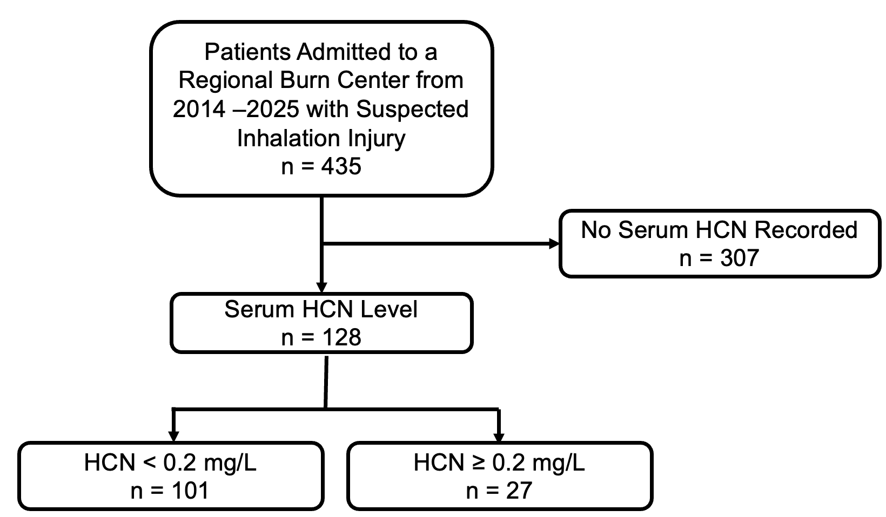
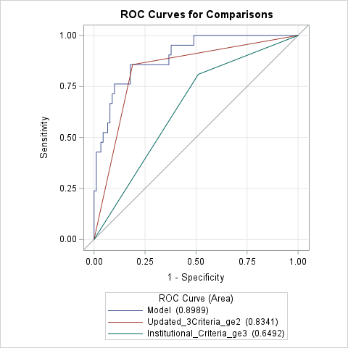


An Institutional Review of Cyanide Levels and Surrogate Markers of Toxicity After Reported Inhalation Injury
Tharun Potluri, BS¹; Tuan Le, MD, DrPH¹; Christina Qian, BS¹; Anoushka Kathiravan, BS, BA¹; Melissa M. McLawhorn, RN, BSN¹; Lauren T. Moffatt, PhD^{1,2,3}; Jeffrey W. Shupp, MD¹⁻⁵; Shawn Tejiram, MD^{1-3,5}
¹ Firefighters’ Burn and Surgical Research Laboratory, MedStar Health Research Institute, Washington, DC ²Department of Surgery, Georgetown University School of Medicine, Washington, DC, ³Department of Biochemistry and Molecular & Cellular Biology, Georgetown University School of Medicine, Washington, DC, ⁴The Burn Center, Department of Surgery, MedStar Washington Hospital Center, Washington, DC, ⁵Department of Plastic and Reconstructive Surgery, Georgetown University School of Medicine, Washington, DC
Introduction
Variable | All Patients | No HCN Toxicity | Yes HCN Toxicity | p-value
Patients, n (%) | 128 (100.0) | 101 (78.9) | 27 (21.1) | −
Age in Years, median (IQR) | 59 (43–72) | 59 (44–71) | 61 (39–74) | 0.496
Male, n (%) | 78 (60.9) | 60 (59.4) | 18 (66.7) | 0.492
Cutaneous Burn & IHI, n (%) | 107 (83.6) | 84 (83.2) | 23 (85.2) | 0.9999
% TBSA | 7.3 (1.0-22.0) | 8.8 (1.0-22.0) | 6.0 (1.0-24.0) | 0.9347
Closed-Space Fire, n (%) | 124 (96.9) | 97 (96.0) | 27 (100.0) | 0.5782
Hydroxocobalamin Given, n (%) | 53 (41.4) | 34 (33.7) | 19 (70.4) | 0.0006
GCS < 8, n (%) | 50 (39.1) | 38 (37.6) | 12 (44.4) | 0.5188
HCO₃⁻ (mEq/L), median (IQR) | 21.6 (18.5–25.1) | 22.7 (19.2–25.5) | 18.7 (14.4–21.5) | <0.0001
pCO₂ (mmHg), median (IQR) | 42.5 (38.0–50.0) | 44.0 (39.0–51.5) | 39.0 (36.0–42.0) | 0.0099
COHb (%), median (IQR) | 5.7 (2.6–16.7) | 4.4 (2.2–8.8) | 26.4 (27.2–31.1) | <0.0001
Acidemia, n (%) | 62 (48.4) | 44 (43.6) | 18 (66.7) | 0.0329
Evidence of IHI, n (%) | 98 (76.6) | 72 (71.3) | 26 (96.3) | 0.0064
≥ 3 Institutional Criteria, n (%) | 69 (53.9) | 48 (47.5) | 21 (77.8) | 0.0051
Mortality, n (%) | 33 (25.8) | 24 (23.8) | 9 (33.3) | 0.313
Predictor | OR (95% CI) | p-value
COHb > 15.2% | 28.7 (9.10–90.47) | <0.0001
Evidence of IHI | 10.47 (1.36–80.80) | 0.0243
HCO₃⁻ < 20.45 mEq/L | 4.72 (1.85–12.03) | 0.0012
IHI grade ≥ 2 | 4.02 (1.65–9.80) | 0.0022
BD < -6.1 | 3.70 (1.50-9.11) | 0.0045
pCO₂ < 39.5 mmHg | 3.31 (1.36–8.10) | 0.0086
Acidemia | 2.59 (1.06–6.32) | 0.0364
Updated three-criterion model ≥ 2 | 25.8 (6.80–97.53) | <0.0001
Institutional criteria ≥ 3 | 3.86 (1.44–10.38) | 0.0073
Adjusted Model
Updated three-criterion model ≥ 2* | 35.7 (8.24–154.53) | <0.0001
Hydrogen cyanide (HCN) toxicity following inhalation injury (IHI) is associated with significant morbidity and mortality, yet its incidence remains poorly characterized due to limited point-of-care testing, short serum half-life, and delayed laboratory results. This study aims to determine the incidence of HCN toxicity in patients with suspected inhalation injury and compare surrogate markers predictive of cyanide toxicity.
Methods
Patients admitted to a regional, American Burn Association-verified burn center from 2014 to 2025 with suspected inhalation injury and measured serum HCN levels were retrospectively reviewed (Figure 1). HCN toxicity was defined as serum level ≥ 0.2 mg/L. Demographics, injury characteristics, and clinical outcomes were abstracted from the electronic health record. Patients were grouped by toxic versus non-toxic serum HCN level for comparison using the Mann-Whitney U test and chi-square or Fisher's exact test, as appropriate. Receiver-operating characteristic curve analysis with the Youden index was used to identify optimal predictive cutoffs, which were combined into an updated three-criterion model incorporating carboxyhemoglobin (COHb), pCO₂, and bronchoscopy-determined IHI grade. This criteria was compared to historical institutional criteria (closed-space fire, bronchoscopy-determined IHI, GCS <8, or acidemia) to determine predictive performance.
Table 2. Univariate and multivariable-adjusted odds ratios (OR) for HCN toxicity (≥ 0.2 mg/L). *Adjusted for age, sex, % TBSA and closed-space exposure.
Table 1. Selected patient demographic, physiologic, and injury characteristics by HCN toxicity status (serum level ≥ 0.2 mg/L vs. < 0.2 mg/L). Values are median (IQR) or n (%).
Results
Conclusion
Of 128 patients included, 27 (21.1%) had toxic serum HCN levels. Patients with toxic HCN levels had greater physiologic derangement (Table 1). On univariate analysis, COHb > 15.2% was the strongest individual predictor of HCN toxicity (OR=28.7, 95% CI: 9.10-90.47; p<0.0001), followed by evidence of IHI, HCO₃⁻, IHI grade, base deficit (BD), pCO₂, and acidemia. (Table 2). The presence of ≥ 2 criteria in the updated three-criterion model increased the odds of HCN toxicity by 25.8-fold on univariate analysis (95% CI: 6.80-97.53; p<0.0001) and 35.7-fold after adjusting for age, sex, burn TBSA, and closed-space exposure (95% CI: 8.24-154.53, p<0.0001). The presence of ≥ 3 historical institutional criteria was only associated with a 3.9-fold increase in HCN toxicity (95% CI: 1.44-10.38; p=0.0073) and demonstrated weaker predictive ability with lower discrimination (AUC: 95% CI: 0.65 (0.55-0.75) vs. 0.83 (0.75-0.92); p=0.0103) (Figure 2).
Of 435 patients screened, 128 had serum HCN measured and 27 (21.1%) had toxic HCN levels.
The updated three-criterion model increased the adjusted odds of toxicity 35.7-fold (95% CI: 8.24-154.53; p<0.0001).
The updated three-criterion model (≥2 of: COHb > 15.2%, pCO₂ < 39.5 mmHg, or IHI grade ≥ 2) outperformed historical institutional criteria (≥3 of: closed-space fire, IHI grade ≥ 2, GCS <8, or acidemia) in predicting HCN toxicity risk.
Applicability to Practice
Among patients with suspected inhalation injury and cyanide toxicity, the updated three-criterion model significantly outperformed historical institutional criteria in predicting HCN toxicity risk. Bronchoscopy-determined inhalation injury grade and arterial blood gas analysis may effectively stratify cyanide toxicity risk, and when two or more criteria are present, empiric hydroxocobalamin treatment should be strongly considered.
Figure 1. Patient selection flow diagram. Of 435 patients admitted with suspected inhalation injury (2014-2025), 128 had a serum HCN level recorded. 27 (21.1%) met the threshold for HCN toxicity (≥ 0.2 mg/L).
Figure 2. Receiver operating characteristic (ROC) curves comparing the full multivariable model (AUC 0.90), the updated three-criterion model (AUC 0.83), and the historical institutional criteria (AUC 0.65) for predicting HCN toxicity.

