Slide 1
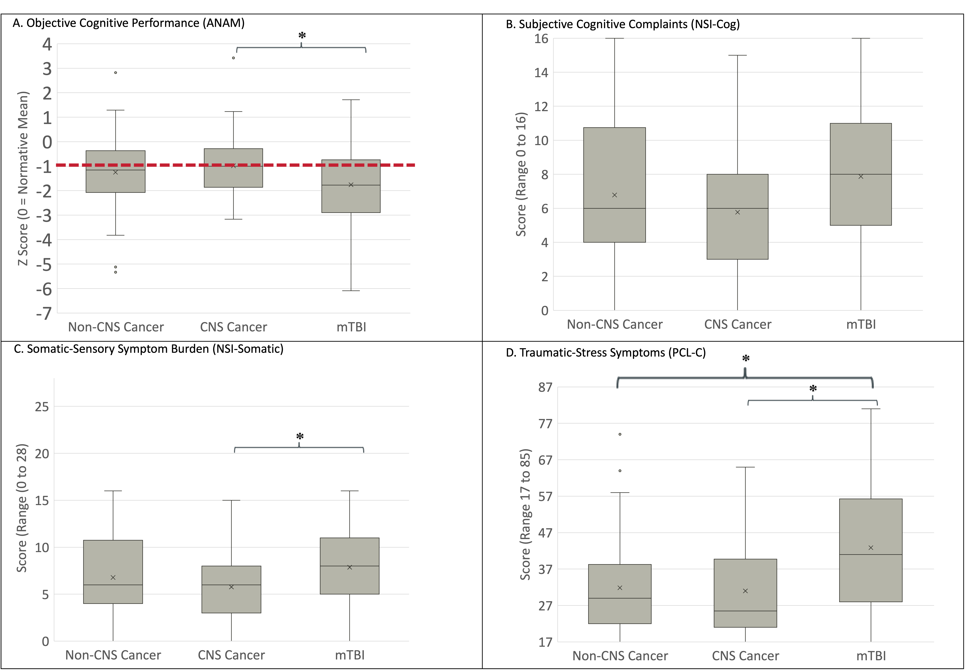
Cancer's Impact on Readiness: Cognitive Profiles, Performance, and Policy Implications
Katherine W. Sullivan, PhD^{1,2}, Brett Theeler, MD^{1,3}, Louis M. French, PsyD^{1,2,3}
¹ Walter Reed National Military Medical Center, Bethesda, MD; ² National Intrepid Center of Excellence, Bethesda, MD; ³ Uniformed Services University of the Health Sciences, Bethesda, MD
Introduction
Results
Results
BACKGROUND
The Challenge: Rising cancer survivorship in the Military Health System (MHS) requires managing long-term consequences, notably cancer-related cognitive impairment (CRCI).
Impact on Readiness: CRCI ("cognitive fog") impairs operational readiness and diminishes quality of life for active-duty members and dependents.
The Clinical Gap: While the MHS utilizes interdisciplinary protocols for mTBI, extending these strategies to oncology depends on whether these distinct clinical populations share overlapping symptom presentations. ¹
STUDY OBJECTIVES
Compare Clinical Profiles: Contrast objective and subjective cognitive dysfunction across distinct clinical populations seeking rehabilitation.
Identify Transdiagnostic Drivers: Determine the contributions of somatic and traumatic-stress symptoms to cognitive dysfunction across these groups.
STUDY OBJECTIVE 1: COMPARE CLINICAL PRESENTATIONS
STUDY OBJECTIVE 2: IDENTIFY TRANSDIAGNOSTIC DRIVERS
Figure 1. Clinical Presentations Across Cohorts: Objective Performance and Subjective Symptom Burden
Figure 2. Transdiagnostic Predictors of Subjective and Objective Cognitive Outcomes.
PREDICTORS
COGNITIVE OUTCOMES
Somatic Sensory Symptoms
(NSI factor)
Subjective Cognitive Complaints
(NSI factor)
n.s.
Traumatic Stress Symptoms
(PCL-C Total)
n.s.
Objective Cognitive Performance
(ANAM)
Note: Solid lines = significant predictive pathways (p < .01); dashed lines = non-significant (n.s.). All regression models controlled for age, sex, and TPO. Abbreviations: ANAM, Automated Neuropsychological Assessment Metrics; NSI, Neurobehavioral Symptom Inventory; PCL-C, PTSD Checklist-Civilian Version; TPO, time post-onset.
Subjective Complaints: Self-reported cognitive complaints were significantly predicted by both somatic-sensory and traumatic-stress symptoms (p < .01).
Objective Performance: Objective cognitive processing efficiency was predicted only by somatic-sensory symptom severity (p < .05). Traumatic-stress and cognitive complaints did not predict objective test performance.
Methods
DESIGN: Retrospective, cross-sectional database analysis
PARTICIPANTS (N = 270): Patients referred to an outpatient military cognitive rehabilitation clinic, group by diagnoses (see Table 1):
Non-CNS Cancer: No overt structural brain damage.
CNS Cancer: Known structural brain damage (structural comparison group).
mTBI: No overt structural brain damage.
Conclusions
CRCI is a Measurable Readiness Concern
Beneficiaries with non-CNS cancers exhibited objective cognitive impairment equal to those with structural brain tumors.
Implication: Cancer-related cognitive impairment is a tangible deficit that may require intervention to optimize operational readiness and quality of life.
Transdiagnostic Drivers Require Interdisciplinary Care
Across all cohorts, including those with brain lesions, cognitive dysfunction was driven primarily by physical and emotional distress.
Implication: These findings highlight an opportunity to leverage existing mTBI care models to treat modifiable drivers in the oncology population, consistent with transdiagnostic research.²
Targeted Rehabilitation
Subjective complaints and objective performance are driven by different symptom clusters.
Implication: Protocols may benefit from distinct goals: direct training for objective deficits, and interdisciplinary management (somatic, stress) for subjective complaints, supporting known psychopathological boundaries.³
Note. Box plots display median (horizontal line), mean (x), and interquartile range. Brackets with an asterisk (*) indicate significant post hoc pairwise differences (p < .01). Unbracketed comparisons are not statistically significant. The dashed line in Panel A represents the clinical deficit threshold (1.0 SD below the normative mean).
PRIMARY MEASURES:
Objective Cognition: ANAM Composite Score.
Subjective Cognition & Somatic Burden: NSI factors.
Traumatic Stress: PTSD Checklist-Civilian Version (PCL-C) Total.
Objective Performance & Physical Burden
Clinically Significant Impairment:
Objective Performance: Across all cohorts, objective cognitive performance fell 1.0 to 1.75 SDs below normative expectations (Panel A).
Structural Comparison: CNS cancer performed significantly better than mTBI (Panel A, p < .005) on ANAM, suggesting a structural brain lesion does not dictate cognitive performance.
Somatic Burden: The mTBI cohort reported a significantly higher somatic symptom burden than the CNS cancer group (Panel C).
Subjective Complaints & Emotional Distress:
Subjective Cognitive Complaints: Severity of subjective cognitive complaints did not significantly differ across cohorts (Panel B).
Clinically Elevated Distress: Both cancer groups reported traumatic-stress scores meeting positive PTSD screening thresholds (Panel D).
mTBI Trauma Stress: The mTBI cohort reported significantly higher traumatic-stress symptoms than both oncology groups (Panel D) (p < .001).
STATISTICAL ANALYSIS:
1. Predictors: Multiple linear regression models.
2. Group Comparisons: ANCOVA and MANCOVA, controlling for covariates.
Table 1. Demographic and Military Characteristics by Group
Characteristic | Non-CNS Cancer (n=48) | CNS Cancer (n=52) | mTBI (n=170)
Age (years), Mean (SD) | 49.40 (14.86) | 44.46 (11.43) | 35.18 (10.28)
Female sex, n (%) | 37 (77.1) | 16 (30.8) | 33 (19.4)
TPO (mos), Mean (SD) | 40.25 (48.39) | 24.72 (45.03) | 34.28 (38.87)
Active Duty, n (%) | 14 (29.2) | 29 (55.8) | 143 (84.1)
Limitations: This retrospective convenience sample of treatment-seeking patients may restrict the generalizability of these findings. Additionally, the dataset did not allow us to control for military deployment history, chronic pain, or sleep disturbances.
Disclaimer: The views expressed in this presentation are those of the authors and do not necessarily reflect the official policy of the Defense Health Agency, Department of War, or the U.S. Government.
Abbreviations: ACS, Automated Neuropsychological Assessment Metrics Composite Score; ANAM, Automated Neuropsychological Assessment Metrics; ANCOVA, analysis of covariance; CNS, central nervous system; CRCI, cancer-related cognitive impairment; DoD, Department of Defense; MANCOVA, multivariate analysis of covariance; MHS, Military Health System; mTBI, mild traumatic brain injury; NSI, Neurobehavioral Symptom Inventory; PCL-C, PTSD Checklist-Civilian Version; SD, standard deviation; TPO, time post-onset.
References:
Cicerone KD, et al. Evidence-based cognitive rehabilitation: Systematic review of the literature from 2009 through 2014. Arch Phys Med Rehabil. 2019;100(8):1515-1533
Denno S, et al. Defining brain fog across medical conditions: A transdiagnostic review. Trends Cogn Sci. 2025;29(2):120-135
Van Stan JH, et al. The Rehabilitation Treatment Specification System: implications for improvements in research design, reporting, replication, and synthesis. Arch Phys Med Rehabil. 2019;100(1):146-155.

